Slide 1
Storms

Slide 2
Air Masses
Large areas (blobs) of air that have the same weather, temperatures and humidity
Air Mass Types - Named for where they come FROM
Weather changes occur with changes in air masses

Slide 3
TYPES of Air Masses
maritime Tropical (mT)- warm & humid air
continental Tropical (cT)- hot & dry air
maritime Polar (mP)- cold & humid air
continental Polar (cP)- cold & dry air

Slide 4
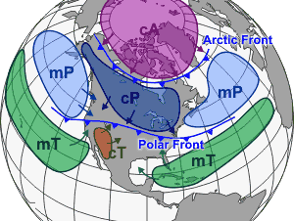

Slide 5
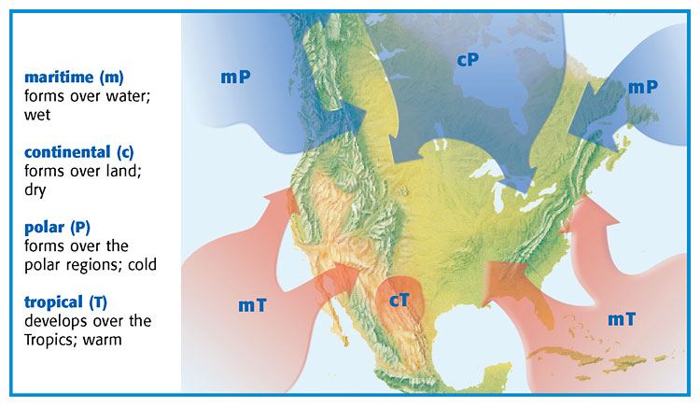

Slide 6
Notes:
Air masses
large blobs of air that are similar throughout
Named for where they come from
maritime Tropical (mT) wet – warm
continental Tropical (cT) dry – warm
maritime Polar (mP) – wet – cold
continental Polar – dry – cold

Slide 7
Fronts
boundary between two air masses
bring changes in the weather (from west to east)
Fronts are named for the air that is behind them

Slide 8
Notes:
Fronts – storms form only on the line between two air masses
All the fighting (storms) happen on the boundary line (the front) behind the boundary weather is calm

Slide 9
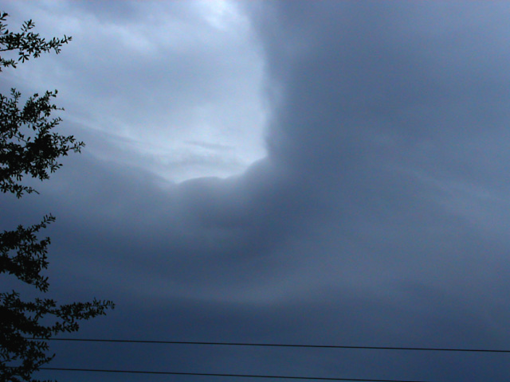

Slide 10
Air Mass Army Analogy
Think of air masses as an army front (the army is BEHIND the frontline)
At the Front there is FIGHTING and lots of VIOLENCE (stormy weather)
Behind the front (inside the air mass) the general sits on his butt and watches the goings-on while enjoying the nice weather!

Slide 11
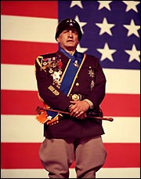
NICE WEATHER
FIGHTING - STORMS

Slide 12
Cold Front
Cold dense air pushes warm air out of the way
Cold fronts move very quickly and bring short periods of rain/thunderstorms
Lower temperatures are behind the front
SYMBOL – the direction of the “arrows” points towards the direction the front is MOVING

Slide 13
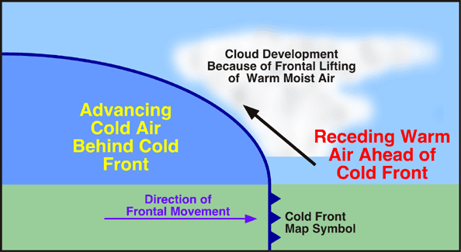

Slide 14
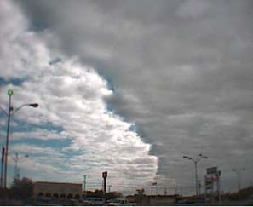

Slide 15
Notes:
Cold Front pushes warm air out – strong quick storms (thunderstorms) pointy arrows

Slide 16
Warm Front
Warm air moves up the cold front as it slowly displaces the cold air
Warm fronts move slowly, and bring many days of steady precipitation
Higher temperatures are behind the front
SYMBOL – direction of “half-moons” is the direction the front is moving

Slide 17
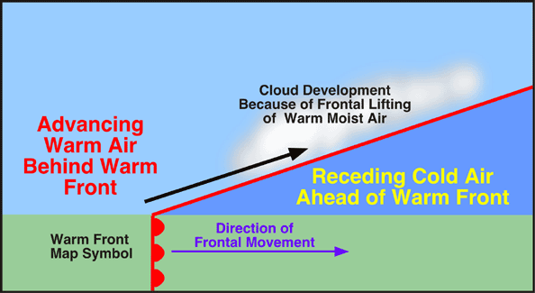

Slide 18
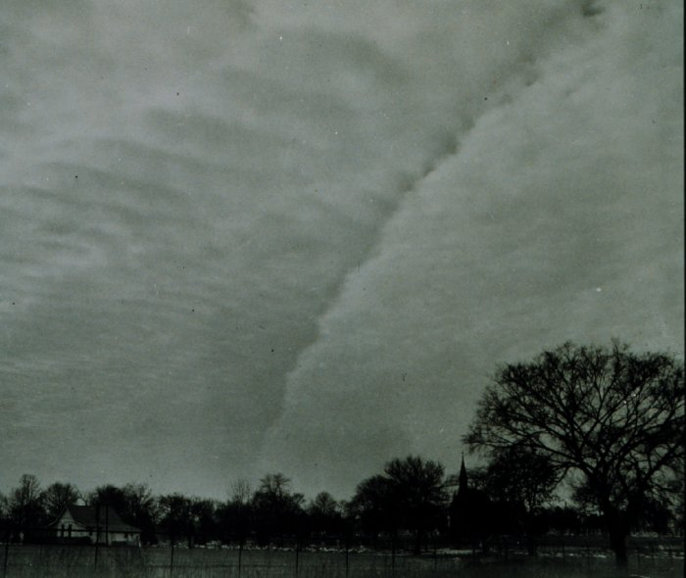

Slide 19
Notes:
Warm Front – warm air rises as it pushes cold out – brings warm weather and days of precipitation – rounded arrows

Slide 20
Stationary Front
The air from the warm front and cold front meet, but do not move
These fronts have the same weather as warm fronts
SYMBOL – warm and cold fronts are moving in opposite directions, thus making a stationary condition

Slide 21
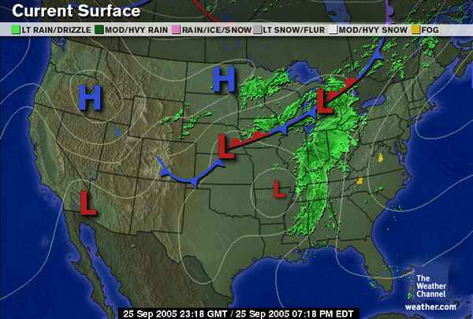

Slide 22
Notes:
Stationary Front – warm and cold front collide – but neither strong enough to push the other out – days of precipitation – both pointy and rounded arrows

Slide 23
The Cyclone
A Cyclone is any low pressure system that has a counterclockwise rotation
(In the Northern Hemisphere)

Slide 24
End of Section 2.2

Slide 25
Notes:
Cyclone –low pressure system - rotates counter clockwise

Slide 27
Thunderstorms
small area storms formed by the strong upward movement of warm, moist air
usually occurs ahead of a cold front as the colder, denser air shoves the warmer air upward
This forms the cumulonimbus clouds that produce thunderstorms
These storms are accompanied by heavy rain, thunder, lightning, sometimes hail, and can also produce tornadoes

Slide 28
Notes:
Thunderstorms
small storms caused by very hot land and a cooler atmosphere
arrives ahead of a cold front with cumulonimbus clouds
Heavy rain – lightning and maybe hail or tornadoes

Slide 29
All thunderstorms produce lightning
Lightning is the discharge of huge amounts of static electricity (think of walking across a carpet in your socks and then touching something-ZAP)
Lightning can travel from the cloud to the ground, cloud to cloud, or even from the ground to a cloud!
Thunder is the result of the air quickly expanding from the heat of the lightning bolt (causes a sound wave)
You cannot have lightning without thunder!!

Slide 30
Notes:
Thunderstorms
Lightning – warm air rubs cooler air as it rises – causes static
Thunder – sonic boom as air moves faster than the speed of sound

Slide 31
+
+
+
+
+
+
+
-
-
-
-
-
-
-
+
+
+
+
+
+

Slide 32
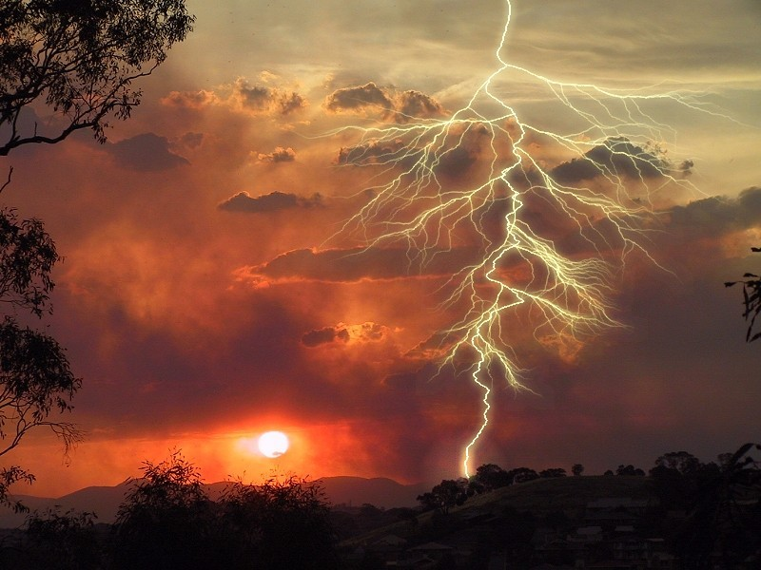

Slide 33
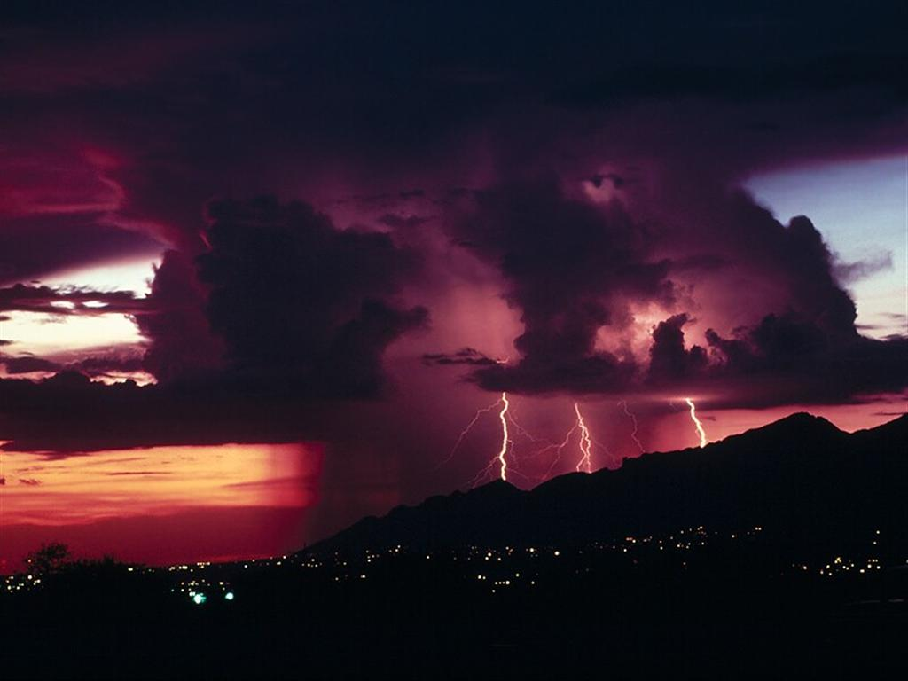

Slide 34
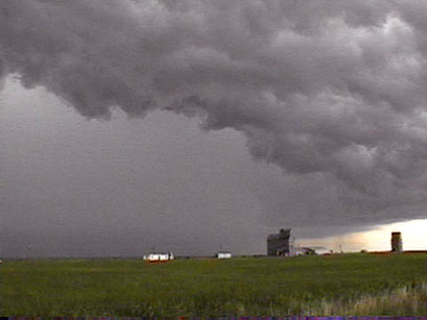
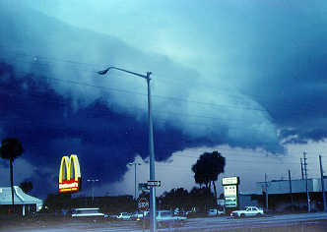
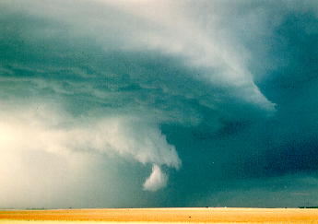
Supercell Thunderstorm formations – will form SEVERE storms and tornadoes! THIS IS ONE BIG STORM SYSTEM!

Slide 35
Notes:
Thunderstorms
Supercell thunderstorm – major storm

Slide 36
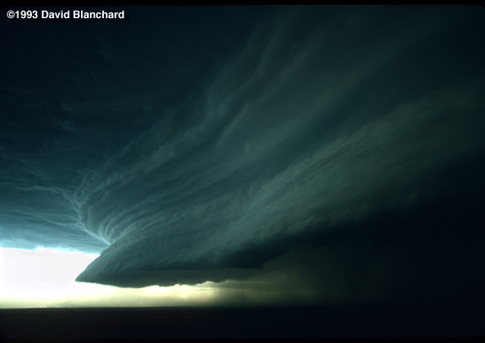

Slide 37
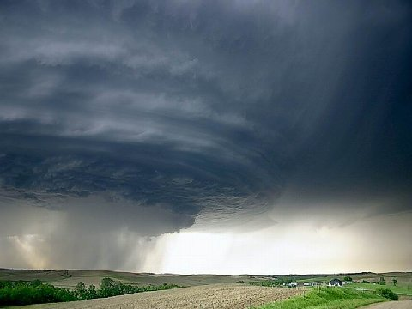

Slide 38
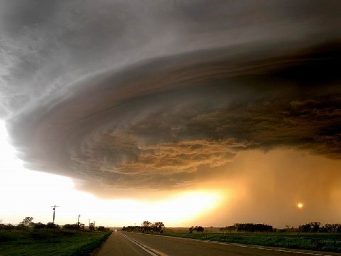

Slide 39
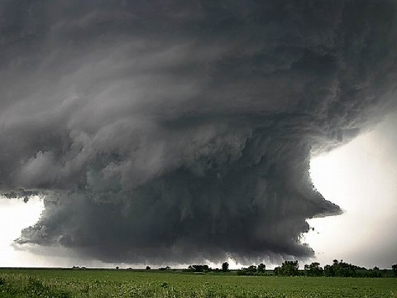

Slide 41
Types of Cyclones:
Tornado- a small, compact storm with strong winds
AKA:
Twister
Willy-Willy (Australia)

Slide 42
Tornadoes
form from very powerful thunderstorms (cumulonimbus clouds)
These are funnel shaped columns of spiraling winds that extend down to the ground from the base of a cloud
The winds move into a tornado (low pressure), and can reach a maximum of 318 mph!

Slide 43
Notes:
Cyclones (tornadoes)
Almost all tornadoes occur in the US or Australia
Caused by powerful thunderstorms with cumulonimbus clouds

Slide 44
Tornadoes
Spin COUNTER CLOCKWISE (like a hurricane)
The actual funnel is made by water droplets (clouds) and dust

Slide 45
Tornadoes are especially dangerous because it is so difficult to predict where they will form
Damage is usually along a narrow path where the tornado traveled
They usually last less then one hour

Slide 46
Notes:
Cyclones (tornadoes)
Begin when funnel touches the ground
Impossible to predict
Very small path

Slide 47
Most fatalities are caused by flying debris
Tornadoes are rated on the Fujita scale (F0 – F6)
An F6 tornado has never been achieved. It would have wind speeds above 318 mph

Slide 48
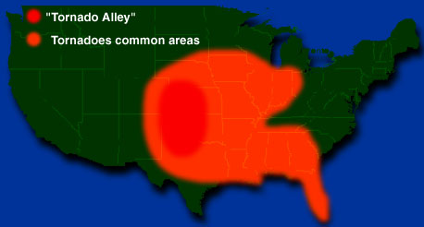
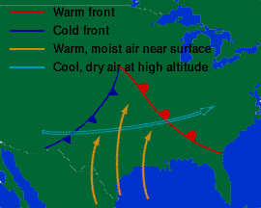

Slide 49
Notes:
Cyclones (tornadoes)
Occur most in Tornado alley because of dry polar air meeting wet tropical air

Slide 50
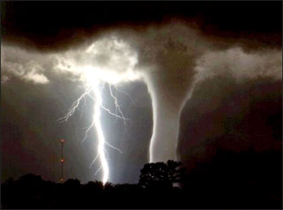

Slide 51
Notes:
Cyclones (tornadoes)
Rated on the Fujita Scale – F0 to F6
F1 – small – roof damage – trees down
F2 – roofs removed – trees pulled out of ground
F3 – trains knocked over – cars lifted houses badly damaged

Slide 52
Notes:
F4 – serious – houses blown into tiny pieces
F5 – houses gone cars picked up and carried for miles
F6 – has never occurred

Slide 53
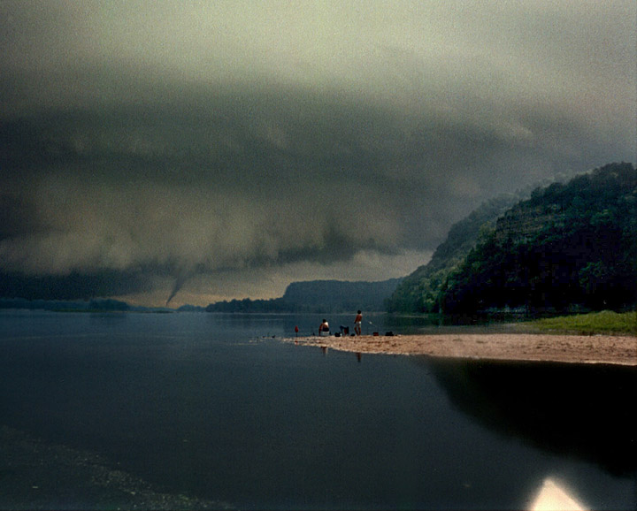

Slide 54
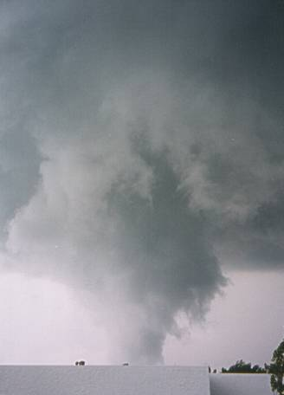
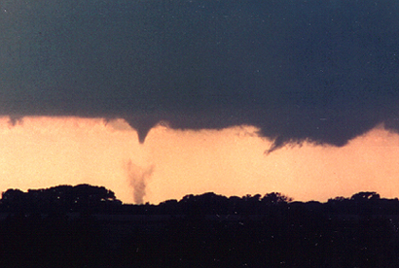
TORNADOES!

Slide 55
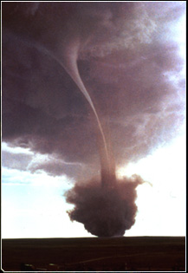
Tornadoes will pick up dust and debris from the ground when they “touch down” – this creates a wider swirl at the bottom of the tornado

Slide 56
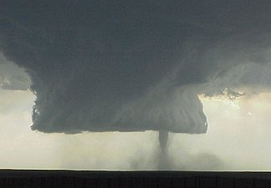

Slide 57
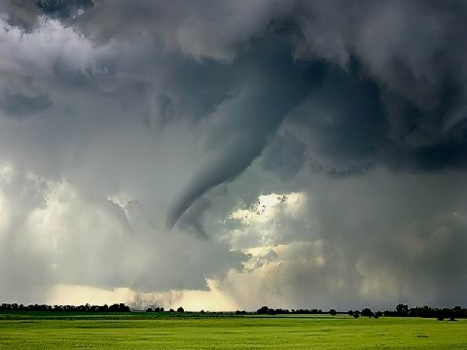

Slide 58
For those of you who aren't familiar with tornadoes, here is a short glossary to help you understand. Fujita Scale: Scale used to measure wind speeds of a tornado and their severity.
F1: Laughable little string of wind unless it comes through your house, then enough to make your insurance company drop you like a brick. People enjoy standing on their porches to watch this kind.
F2: Strong enough to blow your car into your house, unless of course you drive an Expedition and live in a mobile home, then strong enough to blow your house into your car.

Slide 59
F3: Will pick your house and your Expedition up and move you to the other side of town.
F4: Usually ranging from 1/2 to a full mile wide, this tornado can turn an Expedition into a Smart Car, then gift wrap it in a semi truck.
F5: The Mother of all Tornadoes, you might as well stand on your front porch and watch it, it’ll be quite a sight and it's probably going to be the last sight you’ll ever see.

Slide 60
Meteorologist: A rather soft-spoken, mild-mannered type person until severe weather strikes, and they start yelling at you through the TV: "GET TO YOUR BATHROOM OR YOU'RE GOING TO DIE!“
Storm Chaser: Meteorologist-rejects who are pretty much insane but get us really cool pictures of tornadoes. We release them from the mental institution every time it starts thundering, just to see what they'll do.

Slide 61
Types of Cyclones
Hurricane- A large, organized storm with strong winds and heavy rain
AKA
Typhoon- in the Pacific

Slide 62
Hurricanes
Massive storms with a size that can be more than 300 miles in diameter.
Feed on warm water
Biggest danger is the storm surge in coastal areas

Slide 63
Notes:
Hurricanes
the most powerful storms on earth
Massive
Begin as thunderstorms over the ocean

Slide 64
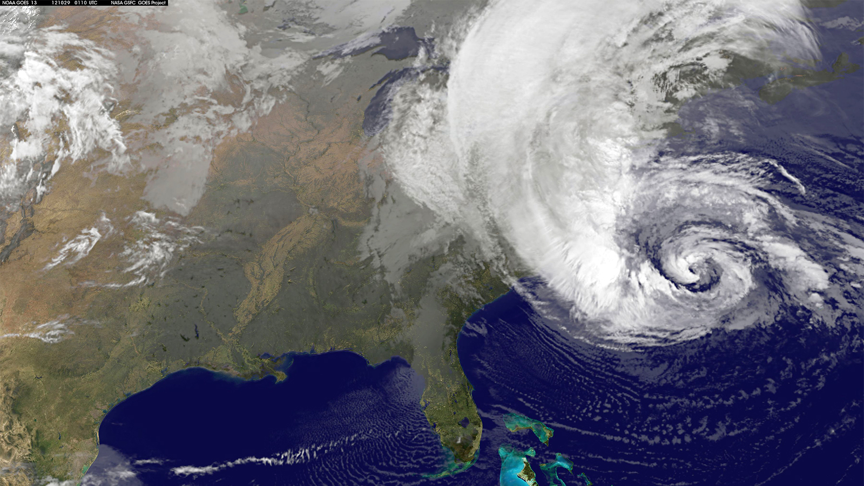
Hurricane Sandy

Slide 65
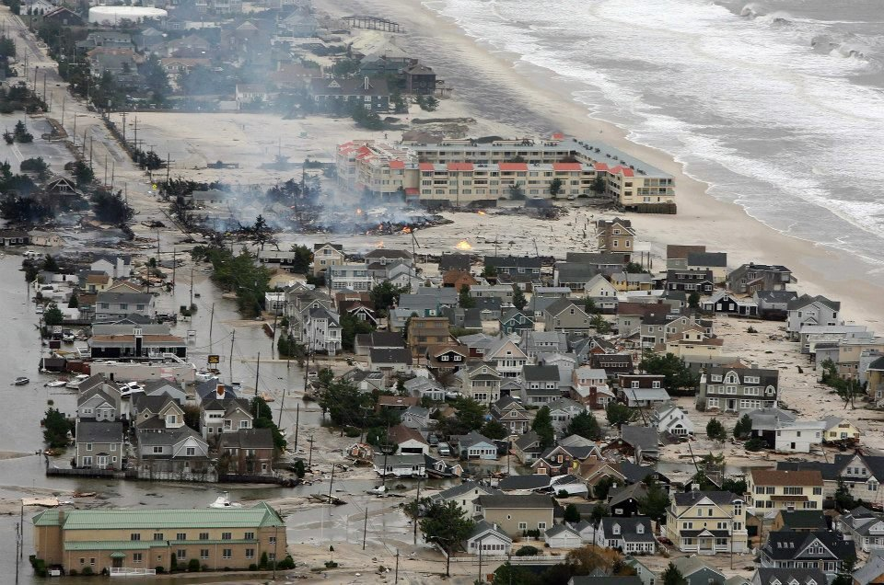
Hurricane Sandy

Slide 66
Notes:
Get energy from the water – once they move over land they fizzle out
Storm surge causes massive flooding
Also called Typhoon

Slide 67
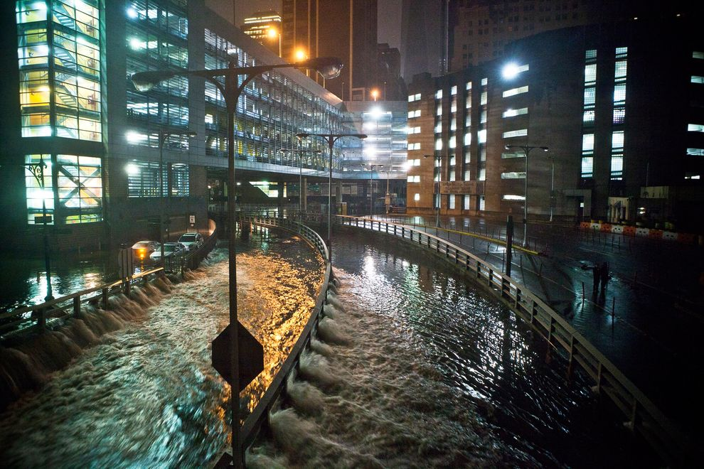
Hurricane Sandy

Slide 68
Hurricane far off shore
Rough surf
hundreds of
miles away.
Storm Surge

Slide 69
Hey! Let’s check out the storm!

Slide 71
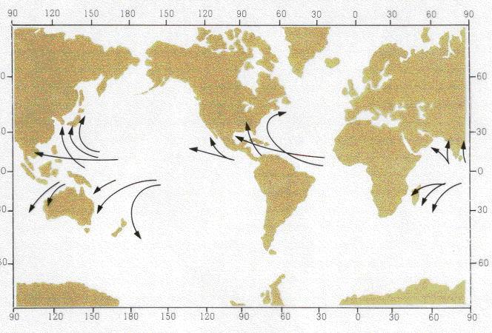
Hurricane Tracks

Slide 72
The BIG STORM TIP of the day:
When your electricity goes out, and you go to bed at night, be sure to turn off everything that was on before it went out, or when it is unexpectedly restored in the middle of the night, every light, every computer, your dishwasher, your blow dryer, your washing machine, your microwave and your fans will all come on all at once. 1) You'll just about have a heart attack when they all come on at the same time, waking you from a dead sleep. And 2) Your circuit breakers will blow, leaving you in the dark once again.

