Slide 1
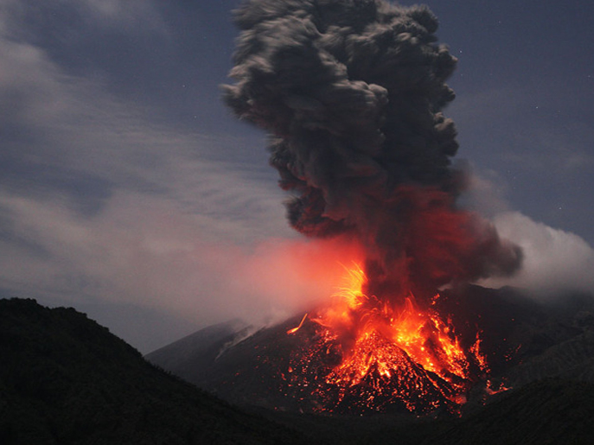
What is a volcano?

Slide 2
A volcano is a fault in earth’s crust that allows magma to escape.

Slide 3
We call the release of magma an eruption.

Slide 4
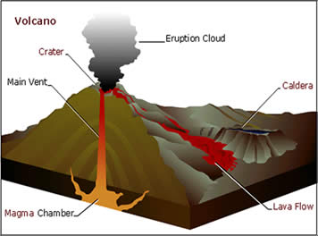
How does that work?
Magma is the layer of melted rock that lies just below earth’s crust.

Slide 5
How does that work?
This melted rock is very hot and it expands as it melts putting pressure on the rock above.

Slide 6
How does that work?
As the magma gets hotter it gets bigger. It burns holes through the rock above it . That’s the main vent.

Slide 7
How does that work?
But at the top of the main vent is rock that acts like a lid until the pressure gets too strong and it explodes.

Slide 8
How does that work?
Lava spills out and gases escape as an eruption cloud.

Slide 9
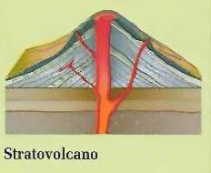
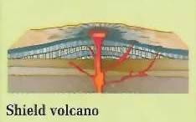
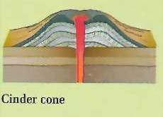
Composite
There are three main types of
volcanoes
Shield
Cinder Cone

Slide 10
Shield volcanoes don’t explode – they ooze.
They form from eruptions of flowing lava.
The lava spreads out and builds up volcanoes with broad, gently sloping sides. The shape resembles a warrior's shield.
Hawaii is built from shield volcanoes.
Shield

Slide 11
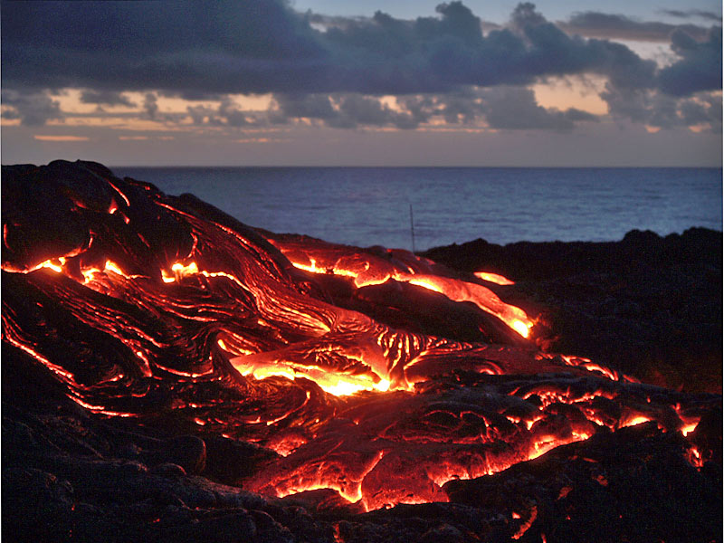
Shield volcanoes ooze lava over huge areas and can create islands like Hawaii

Slide 12
Cinder cones are the smallest volcanoes. They are made of small bits of lava that erupt into the air and harden before they hit the ground. The whole volcano is like a large gravel pile.
Cinder Cone

Slide 13
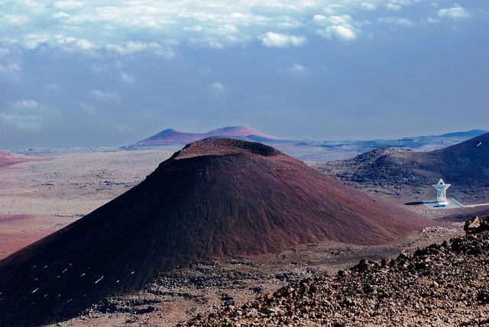
Cinder cone volcanoes are small and made of gravel.

Slide 14
Composite volcanoes are what you think of when you think of a volcano.
They are made from two different types of eruptions.
Sometimes they ooze like shield volcanoes. - that leaves layers of hard rock.
Sometimes they explode like cinder cone volcanoes – that leaves layers of gravel.
Composite Volcanoes

Slide 15
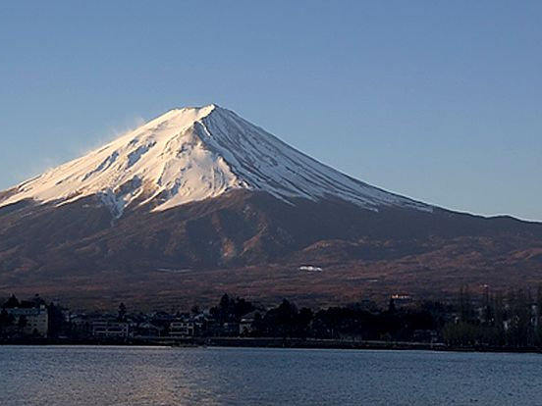
Mount Fuji in Japan is a composite volcano

Slide 16
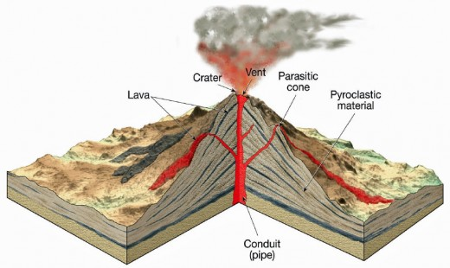
Let’s look at the inside of a volcano.

Slide 17
Main Vent
The magma travels through the inside of the mountain through the main vent.

Slide 18
Side Vent
Sometimes the main vent gets clogged and a new – side vent forms.

Slide 19
Crater
At the top of a volcano is the crater – this is where the volcano has exploded and left a hole.

Slide 20
Ash (pyroclastic material)
Lava (pyroclastic material)
Pyroclastic material is the “stuff” that comes out of a volcano as either ash or lava

Slide 21
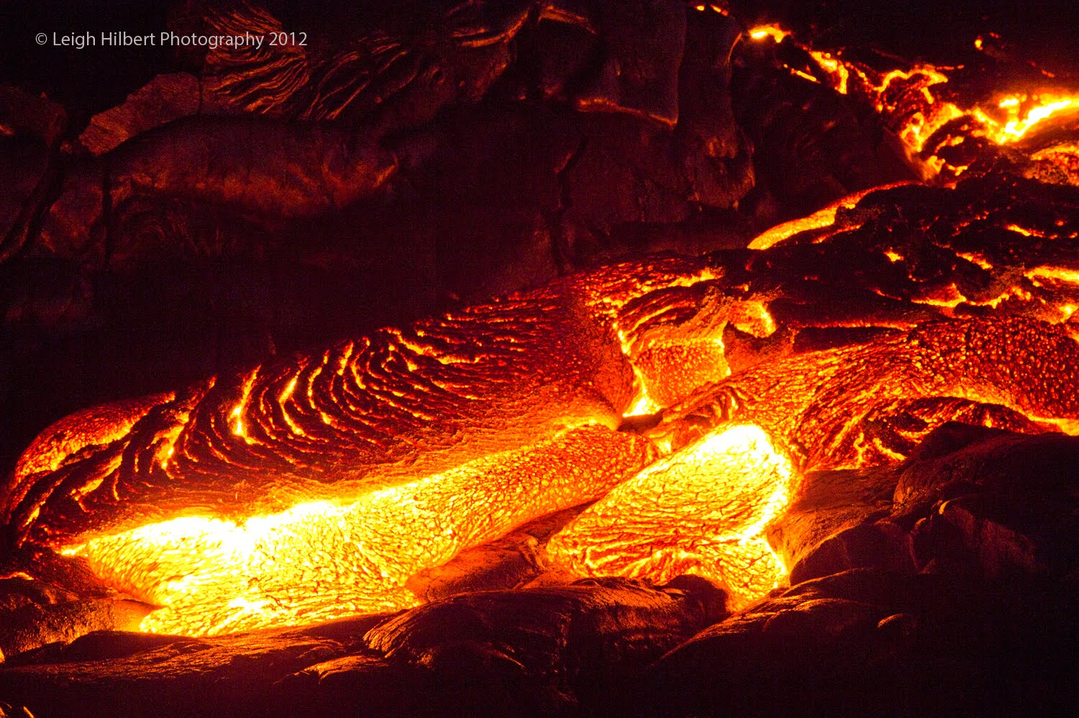
We tend to think of the lava as the scariest stuff

Slide 22
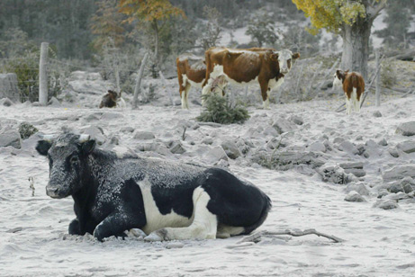
But the ash is even scarier!

Slide 23
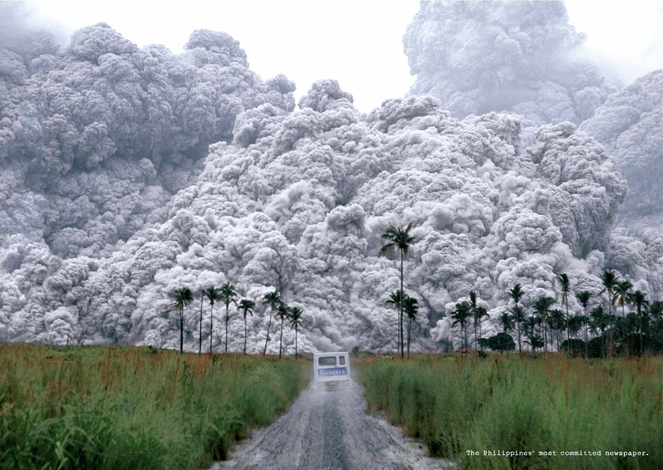
The ash flow (called a pyroclastic flow) is up to 1000 degrees!

Slide 24
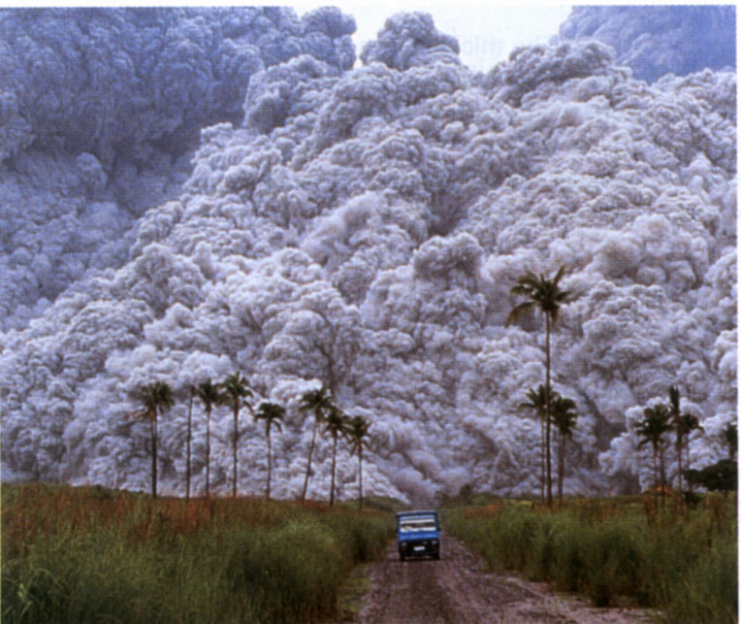
It races down the mountain at 700 miles per hour

Slide 25
And if you breathe it in your lungs will instantly burn to ash

Slide 26
And even if you are not anywhere near the explosion – the ash can be deadly

Slide 27
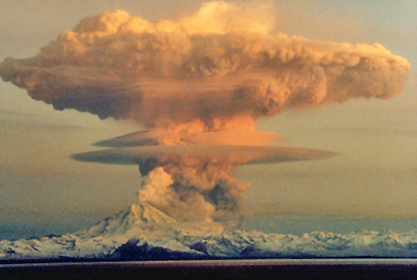
In 1990 Alaska’s Mount Redoubt exploded
You can clearly see the ash that filled the sky

Slide 28
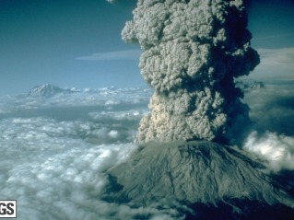
Mt. Pinatubo
In 1991 Mount Pinatubo in the Philippines blew its top.
The ash cloud reached almost to the top of the stratosphere!
The ash cloud shadowed earth for several years and dropped temperatures by .75 to 1 degree!
Doesn’t sound like much huh?

Slide 29
Volcanic winter temperature drops of 1-2 degrees are only a global average temperature drop. All that ash swirls around in the atmosphere and causes disturbed weather in all sorts of places.

Slide 30
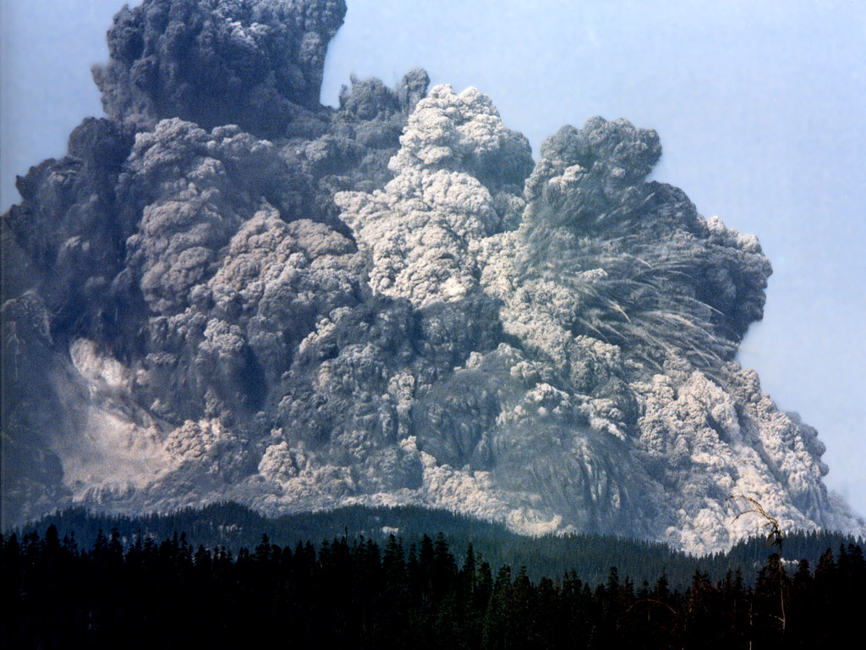
In 1815 Mount Tambora erupted – causing global cooling.

Slide 31
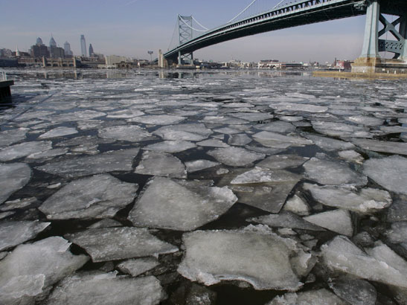
There were ice floats in the Delaware River at Philadelphia in July!

Slide 32
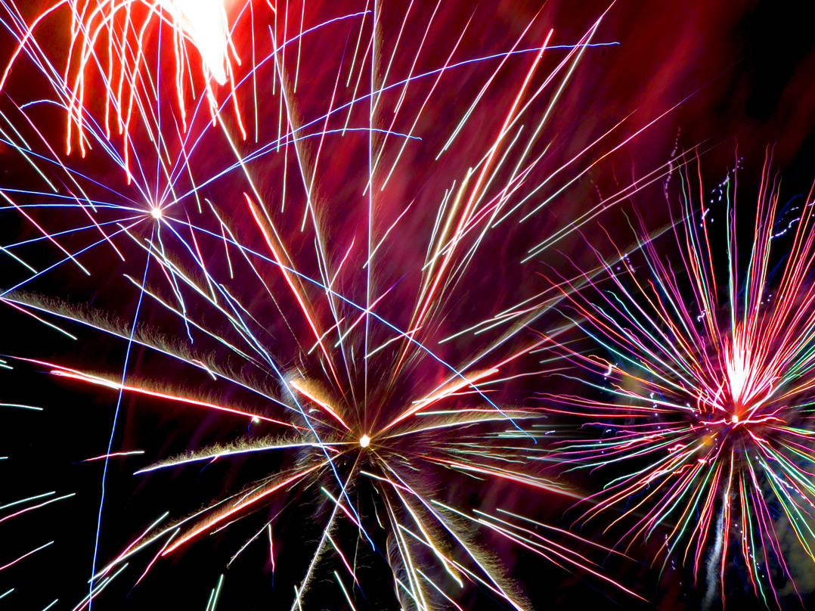
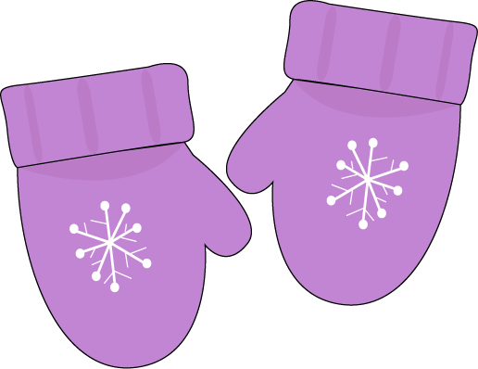
Happy Fourth of July
Don’t forget your mittens

Slide 33
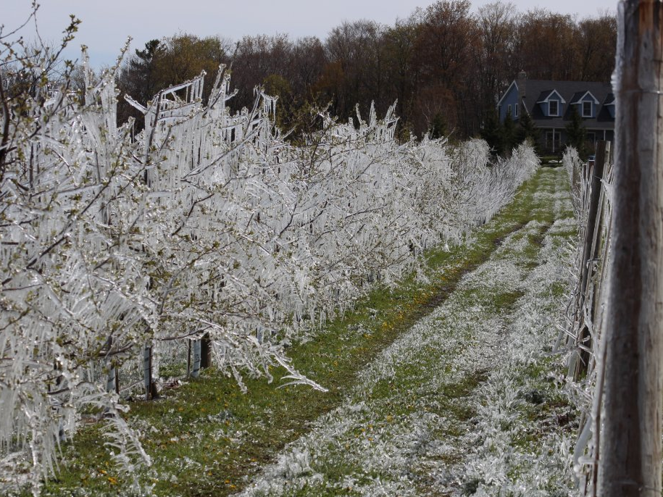
The cold froze crops
And people starved

Slide 34
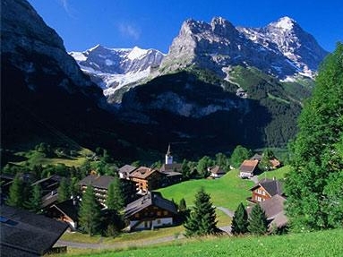
It was cold and rainy in the Swiss Alps that year and vacationers couldn’t hike and swim.

Slide 35
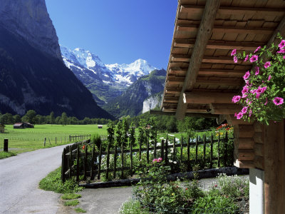
So one group of people began to write horror stories to keep themselves amused.

Slide 36
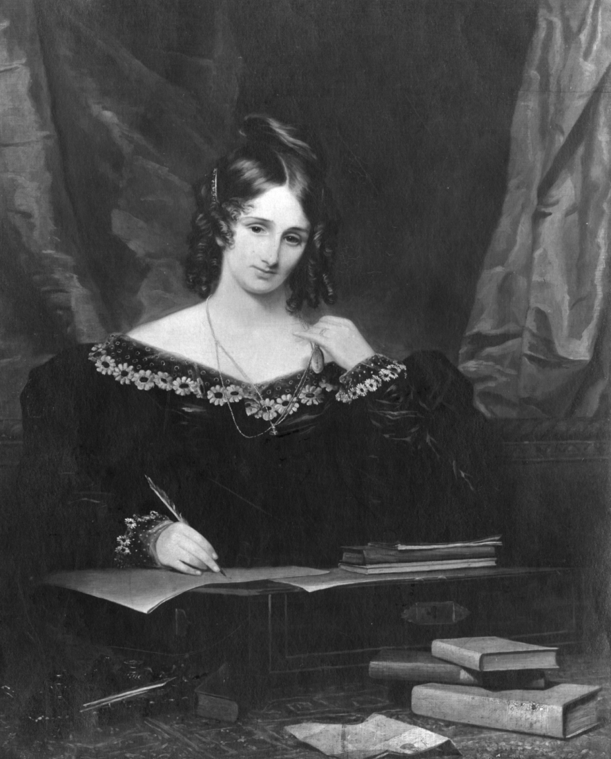
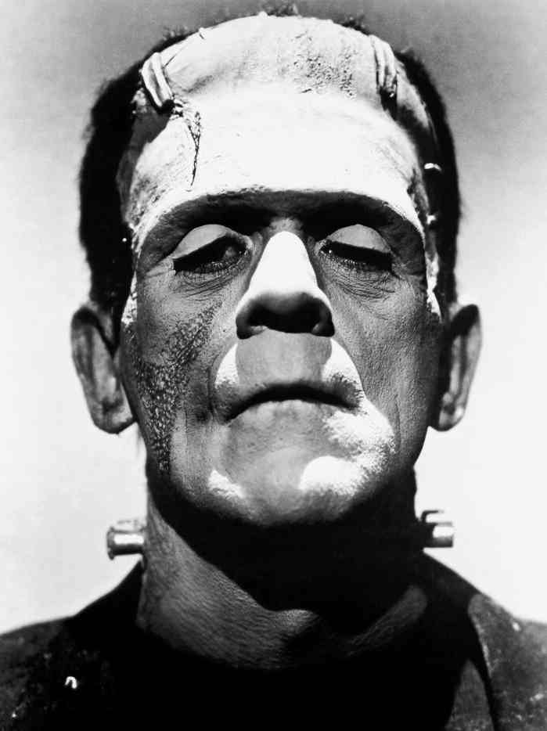
And Mary Shelley wrote Frankenstein

Slide 37
