Slide 1
What do living things need to survive?
ESSENTIAL QUESTION
UNIT 2 Life Cycles

Slide 2
How does grass like this…
think about this…
UNIT 2 Life Cycles

Slide 3
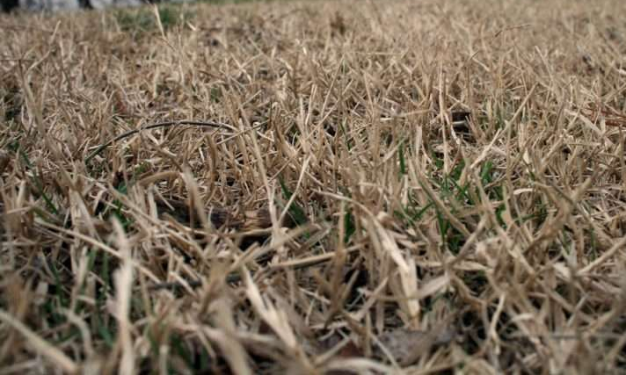
End up like this?
think about this…
UNIT 2 Life Cycles

Slide 4
The living organism
did not have what it needed.
(could be too little water, or too much heat, or even chemicals)
think about this…
UNIT 2 Life Cycles

Slide 5
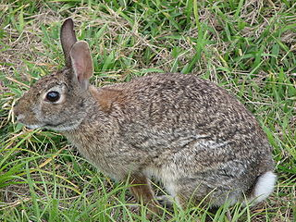
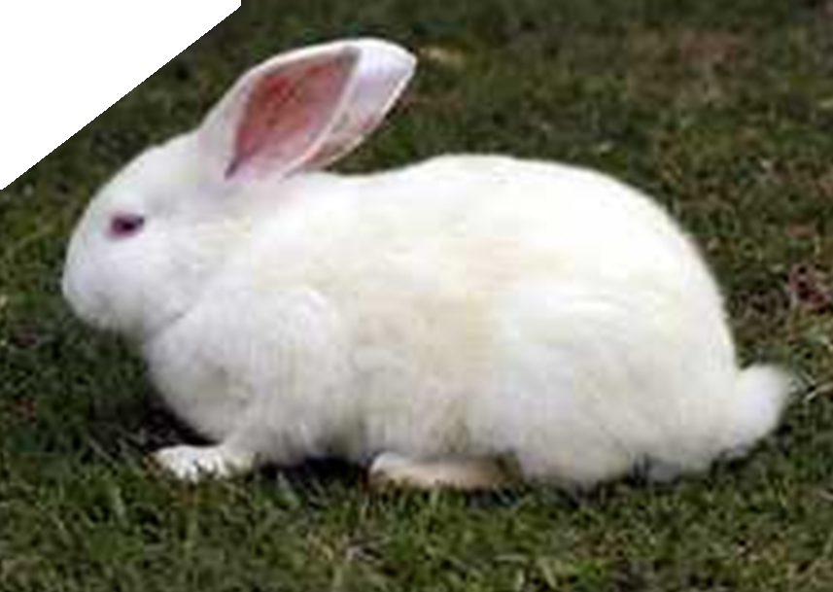
Rabbits need grass, and they need to camouflage against predators.
Every living thing needs specific things in order to survive.
think about this…
If they can’t camouflage they wont live very long.
UNIT 2 Life Cycles

Slide 6
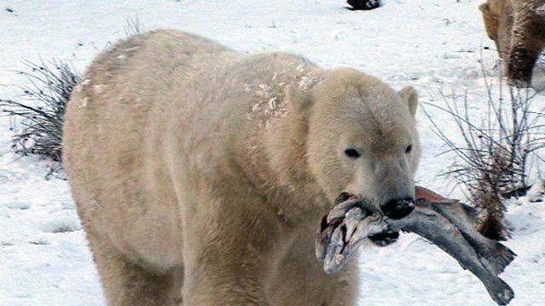
What does a
polar bear need in it’s habitat?
What do polar bears need?
UNIT 2 Life Cycles

Slide 7
Cold weather, snow for camouflage, fish to eat, icebergs
(that’s where they stand to look for fish)
think about this…
UNIT 2 Life Cycles

Slide 8
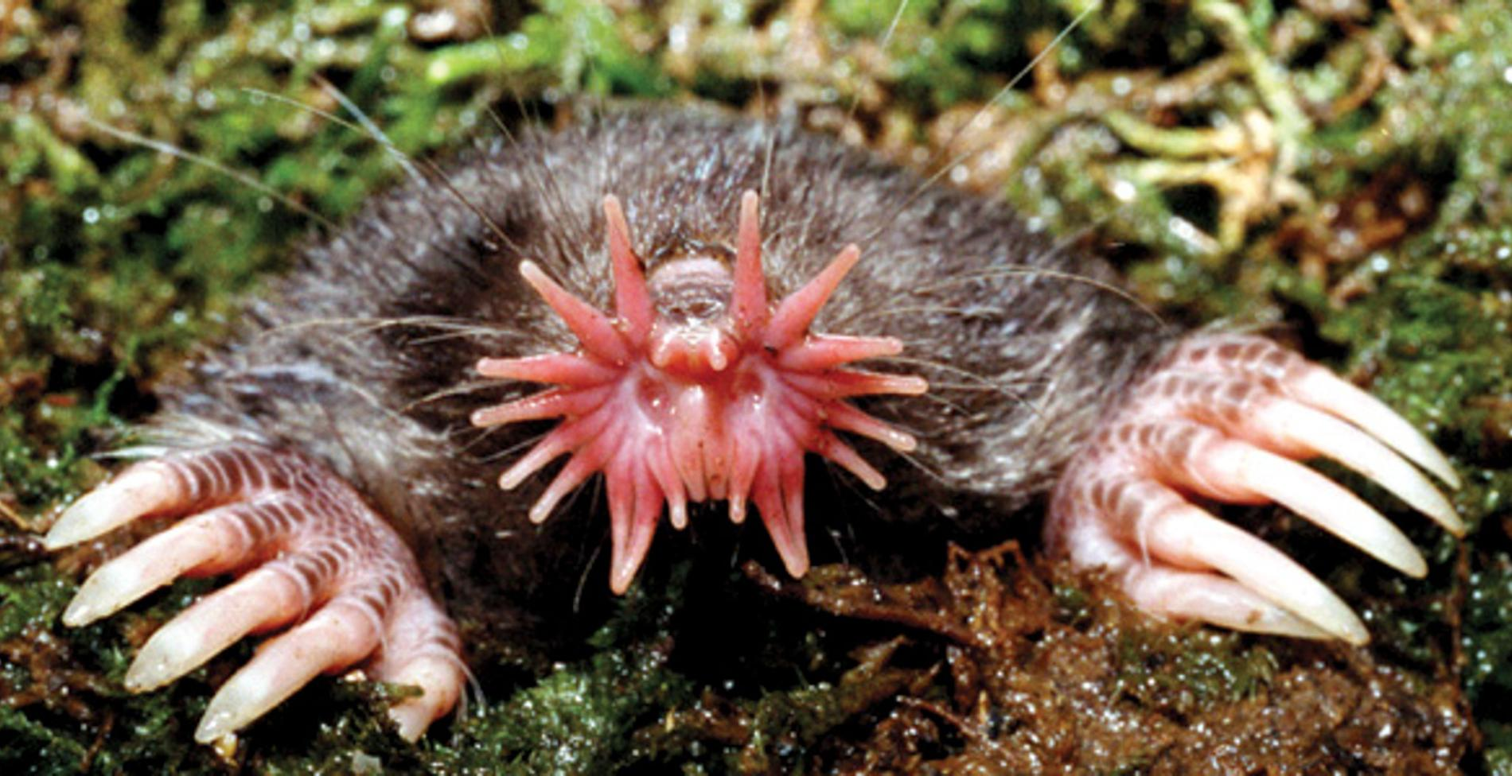
What does a
star nosed mole need in it’s habitat?
Watch this video
https://video.nationalgeographic.com/video/worlds-deadliest-ngs/deadliest-star-nosed-mole
What do star nosed moles need?
UNIT 2 Life Cycles

Slide 9
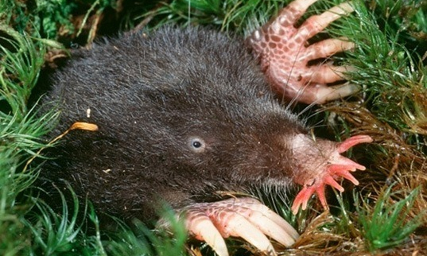
Darkness. Warm wet dirt to borrow in. A nearby pond or stream. Insects and worms to eat.
What do star nosed moles need?
UNIT 2 Life Cycles

Slide 10
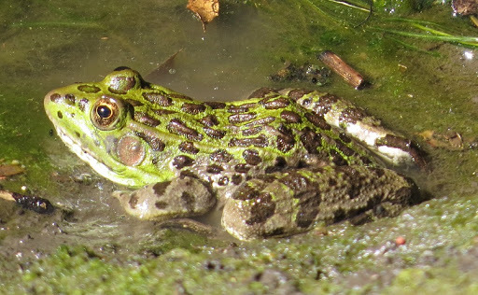
What does a
Leopard frog need in it’s habitat?
Watch this video
https://www.youtube.com/watch?v=X6ELF3LHueU
What do leopard frogs need?
UNIT 2 Life Cycles

Slide 11
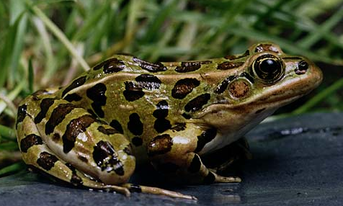
https://www.youtube.com/watch?v=X6ELF3LHueU
Wet areas like ponds, marshes and steams to raise their young. Fields to hunt for flies, ants, beetles, worms and smaller frogs. Warm temperatures.
What do leopard frogs need?
UNIT 2 Life Cycles

