Slide 1
What is a life cycle?
ESSENTIAL QUESTION
UNIT 2 Life Cycles

Slide 2
We start as babies.
Then learn to walk.
We go to school.
We begin to work.
We begin to grow old.
All living things have life cycles
UNIT 2 Life Cycles

Slide 3
Vocabulary
Life Cycle
The way living things grow from birth to maturity to reproduction and finally to death
UNIT 2 Life Cycles

Slide 4
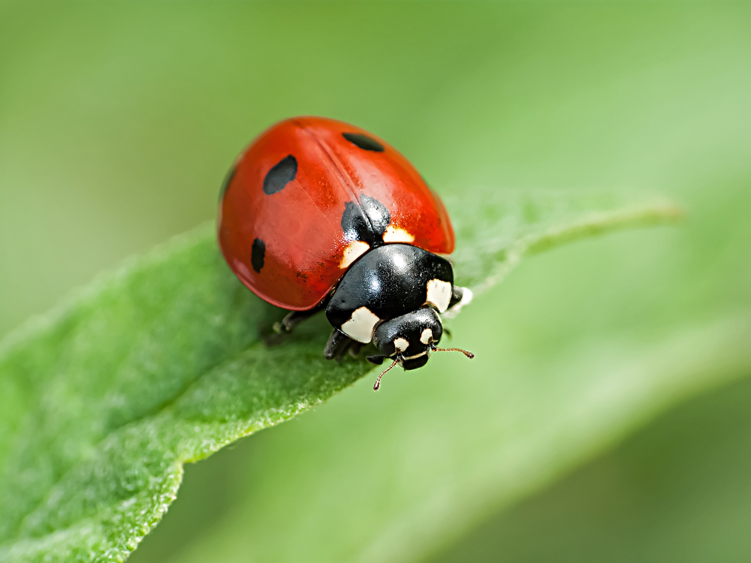
The life cycle of a ladybug
Read Page 88 - 89
UNIT 2 Life Cycles

Slide 5
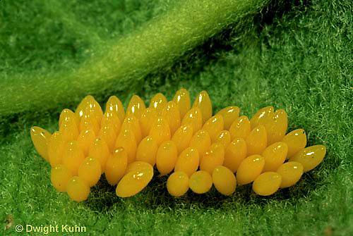
A ladybug lays eggs on the bottom of a leaf
Life Cycle of a Ladybug
UNIT 2 Life Cycles

Slide 6
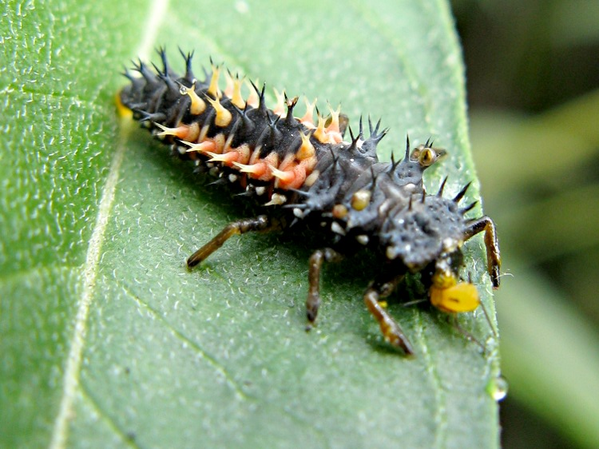
The baby ladybugs DO NOT look at all like the parents!!
(they are called larva)
Life Cycle of a Ladybug
UNIT 2 Life Cycles

Slide 7
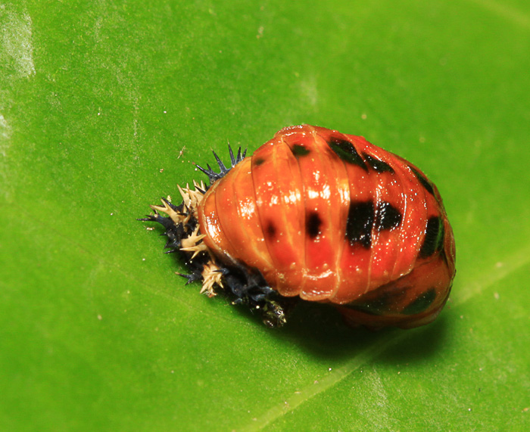
Once the larva grows big enough it attaches to a leaf.
(this is the pupa stage)
Life Cycle of a Ladybug
UNIT 2 Life Cycles

Slide 8
When the ladybug emerges from the pupa stage it is finally a full grown ladybug!
Life Cycle of a Ladybug
UNIT 2 Life Cycles

Slide 9
Once the ladybug
reaches adulthood it can reproduce.
Life Cycle of a Ladybug
UNIT 2 Life Cycles

Slide 10
Reproduction is when an adult has a child.
Life Cycle of a Ladybug
UNIT 2 Life Cycles

Slide 11
adult
egg
The life cycle of a ladybug has 4 stages
Life Cycle of a Ladybug
pupa
larva
UNIT 5 WEATHER
UNIT 2 Life Cycles

Slide 12
Vocabulary
Life Cycle
The way living things grow from birth to maturity to reproduction and finally to death
Life Cycle of a ladybug
egg → larva → pupa → adult
UNIT 2 Life Cycles

Slide 13
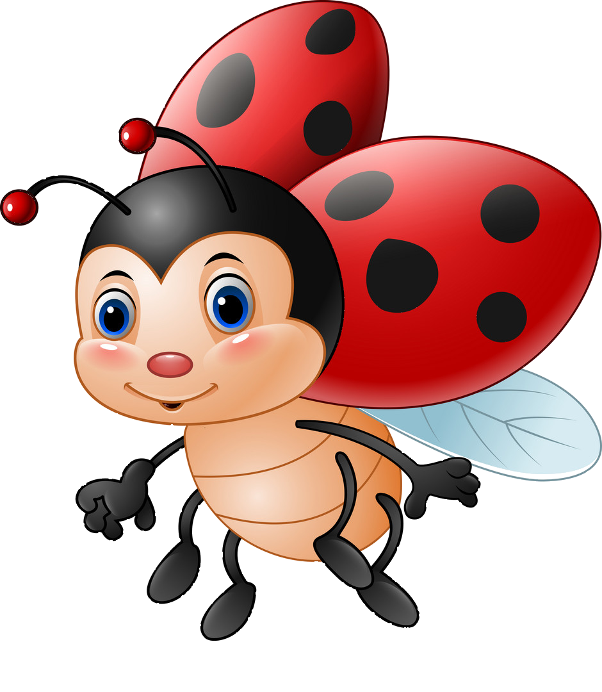
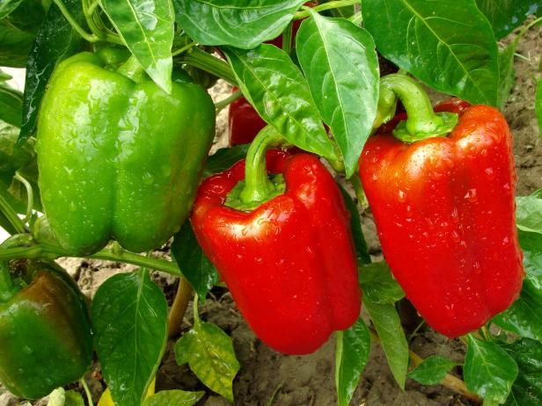
How is the life cycle of a ladybug the same as the life cycle of a pepper plant?
Essential Question
UNIT 2 Life Cycles

Slide 14
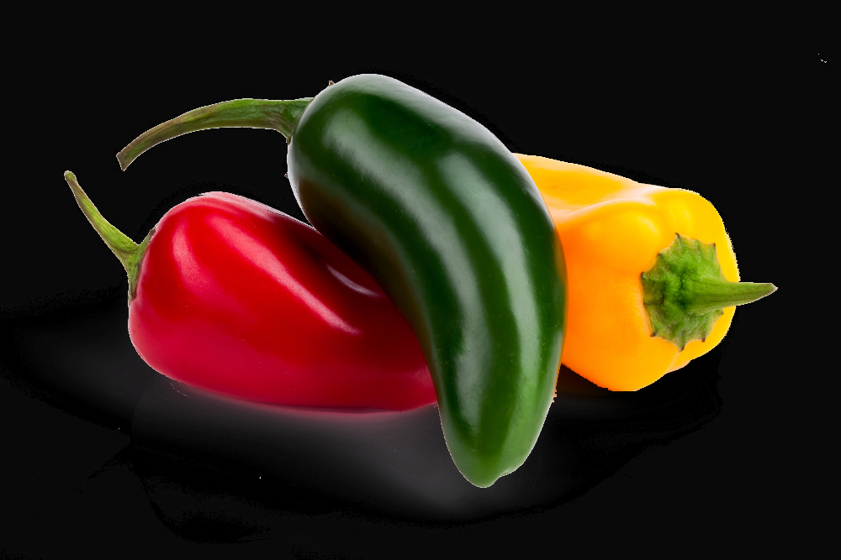
A jalapeno pepper comes in different colors (color is a trait that is inherited from it’s parent)
Life Cycle of a Jalapeno Pepper
UNIT 2 Life Cycles

Slide 15
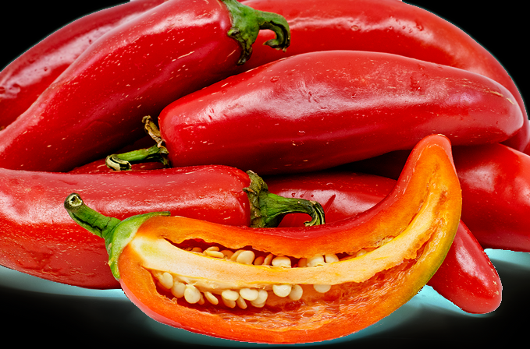
Jalapeno’s grow from the seeds that are inside the grown plant.
Life Cycle of a Jalapeno Pepper
UNIT 2 Life Cycles

Slide 16
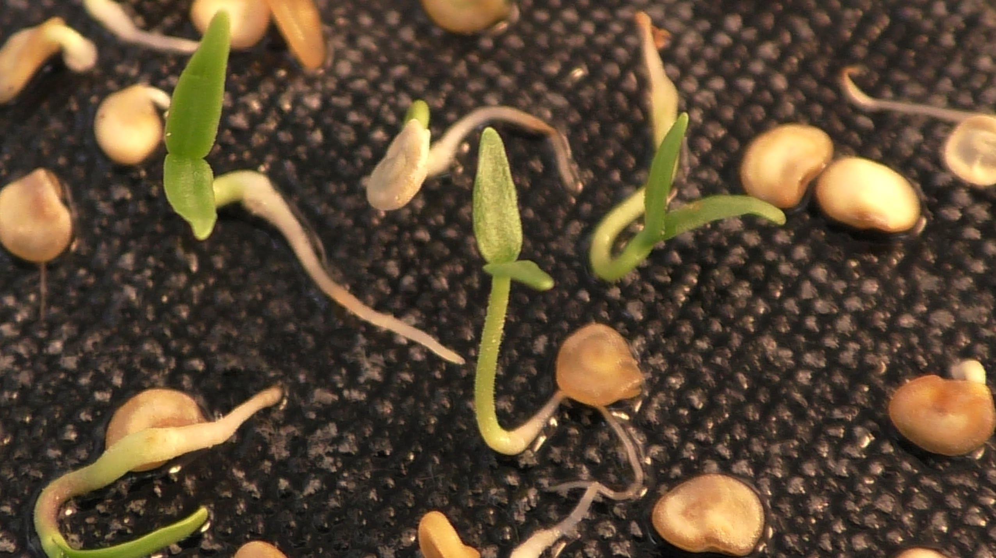
If the seeds from a pepper have enough water and soil, they will begin to grow.
This is a seedling.
Life Cycle of a Jalapeno Pepper
UNIT 2 Life Cycles

Slide 17
From seedling they grow into young plants
Life Cycle of a Jalapeno Pepper
UNIT 2 Life Cycles

Slide 18
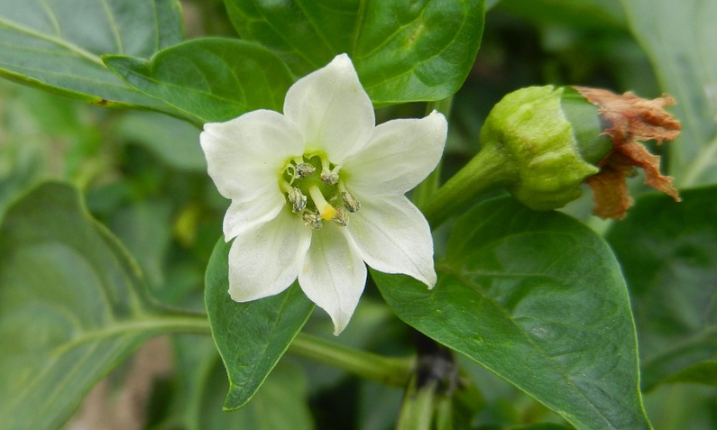
When they finally become an adult plant they flower and the flowers grow into new peppers.
Life Cycle of a Jalapeno Pepper
UNIT 2 Life Cycles

Slide 19
Can you see the new green jalapeno pepper?
(the green color is an inherited trait)
Life Cycle of a Jalapeno Pepper
UNIT 2 Life Cycles

Slide 20
adult
seed
The life cycle of a jalapeno has 4 stages.
Life Cycle of a Jalapeno Pepper
young plant
seedling
UNIT 2 Life Cycles

Slide 21
adult
egg
The life cycle of a ladybug has 4 stages
Life Cycle of a Ladybug
pupa
larva
UNIT 5 WEATHER
UNIT 2 Life Cycles

Slide 22
adult
adult
seed
How is the life cycle of a ladybug the same as the life cycle of a pepper plant?
Essential Question
young plant
seedling
adult
adult
egg
pupa
larva

Slide 23
Vocabulary
Life Cycle
birth to maturity to reproduction and finally to death
Life Cycle of a ladybug
egg → larva → pupa → adult
Inherited Trait
Passed on from parent to child (hair color & curl, eye color, height, intelligence)
Life Cycle of a pepper plant
seed → seedling → young plant → adult
UNIT 2 Life Cycles

