Slide 1
Magnets
ESSENTIAL QUESTION
UNIT 6 PHYSICS

Slide 2
Read Pages 20-21
ESSENTIAL QUESTION
UNIT 6 PHYSICS

Slide 3
Vocabulary
Attract A force the pulls objects together
Repel a force that pushes objects apart
UNIT 6 PHYSICS

Slide 4
Vocabulary
Attract A force the pulls objects together
Repel a force that pushes objects apart
UNIT 6 PHYSICS

Slide 5
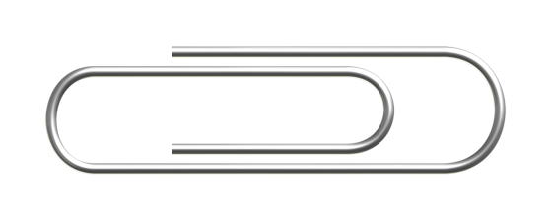
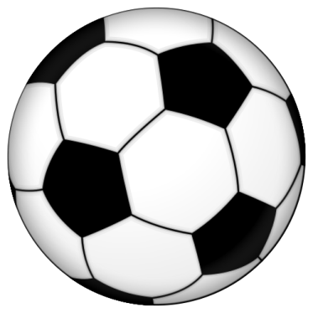
How is the force applied when you kick a soccer ball different than the force a magnet applies to a paper clip?
Think about it…
Correct!
You push against a soccer ball but a magnet pulls!
UNIT 6 PHYSICS

Slide 6
The place where a magnet pulls the strongest are called poles.
did you know?
S N
The South Pole
The North Pole
UNIT 6 PHYSICS

Slide 7
The North attracts to the South and The South attracts to the North
did you know?
S N
S N
S N
S N
UNIT 6 PHYSICS

Slide 8
But the same poles repel each other (so the each pole repels itself and attracts the other)
did you know?
S N
S N
S N
S N
UNIT 6 PHYSICS

Slide 9
Try the experiment on Pages 22 - 23
Try it!
UNIT 6 PHYSICS

Slide 10
Try the experiment on Pages 24 - 25
Try it!
UNIT 6 PHYSICS

