Slide 1
What is weather?
ESSENTIAL QUESTION
UNIT 5 WEATHER

Slide 2
Read Pages 118-119
Read
UNIT 5 WEATHER

Slide 3
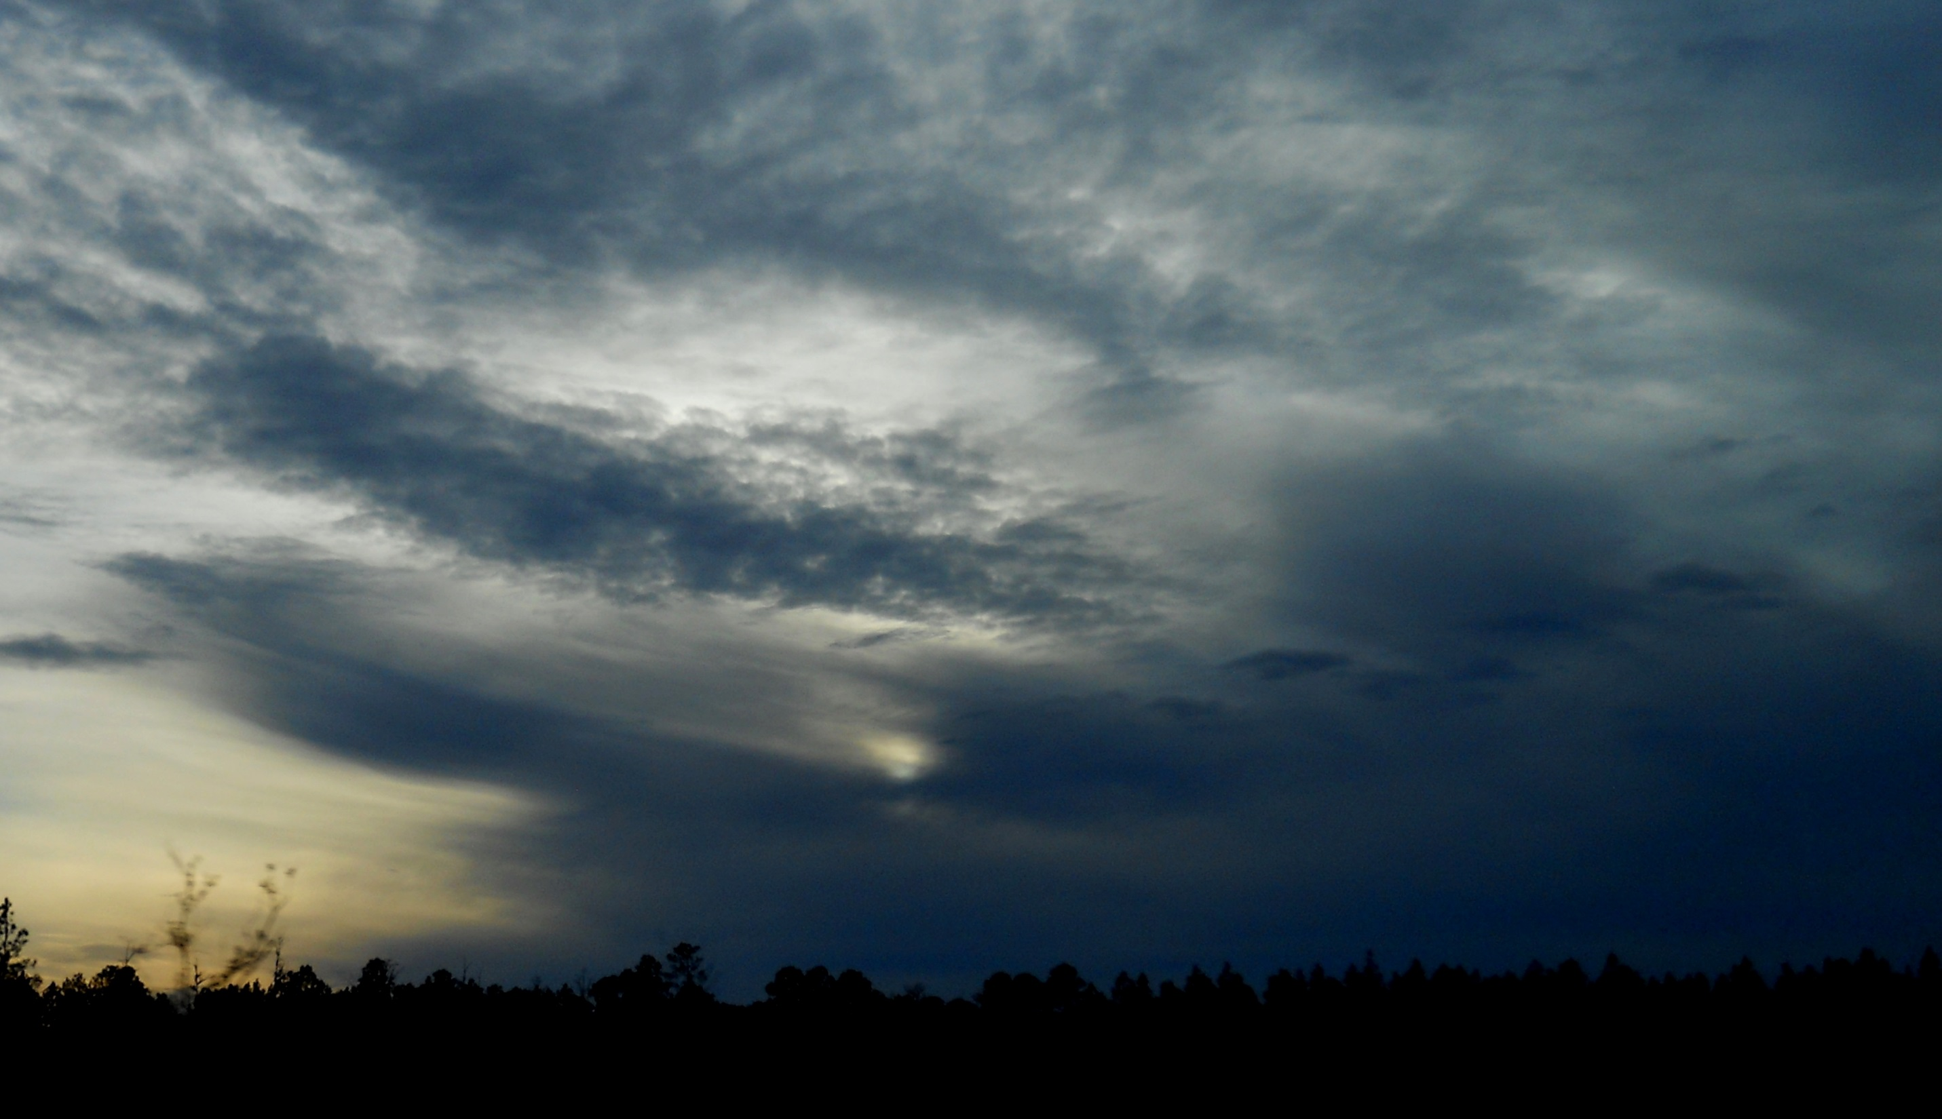
Tell 3 ways that weather can change.
Read
day to day hour to hour season to season
UNIT 5 WEATHER

Slide 4
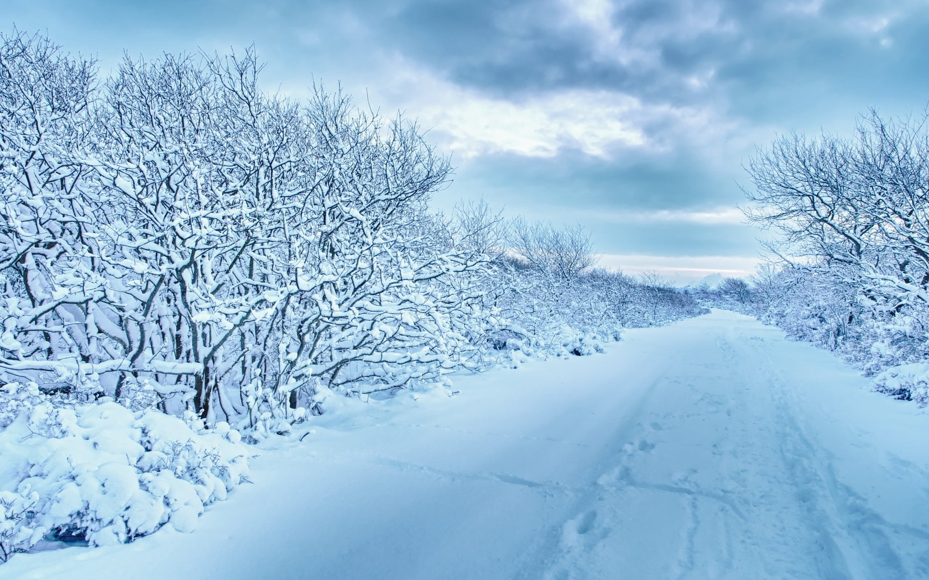
Weather describes the conditions of the atmosphere (air) at a specific time and place.
Vocabulary
UNIT 5 WEATHER

Slide 5
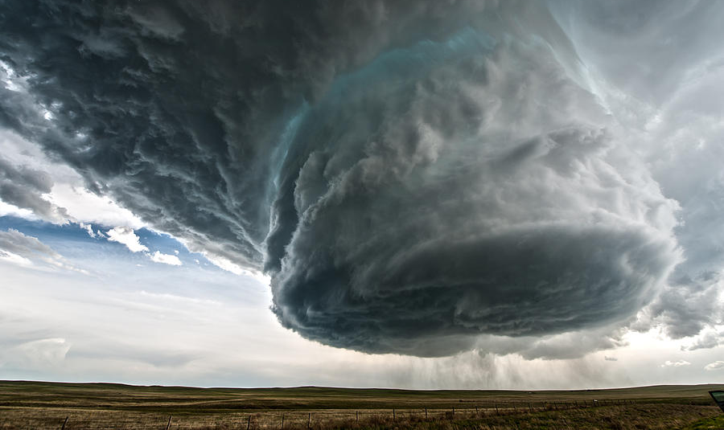
Think of the craziest weather you have ever seen. What words can you use to describe it?
What is Weather?
UNIT 5 WEATHER

Slide 6
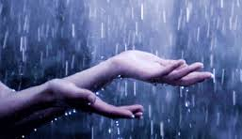
Weather is described by temperature, cloud cover, wind, precipitation and humidity.
Technical words…
UNIT 5 WEATHER

Slide 7
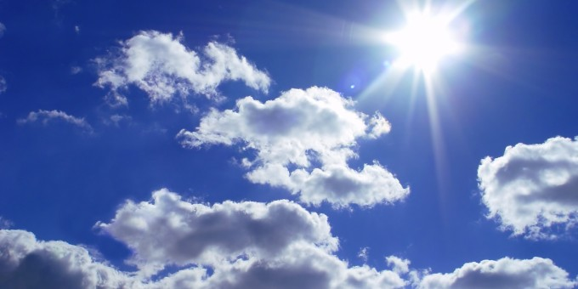
Think of that crazy weather day…
How would you describe the weather?
Temperature | Cloud Cover | Wind | Precipitation
UNIT 5 WEATHER

Slide 8
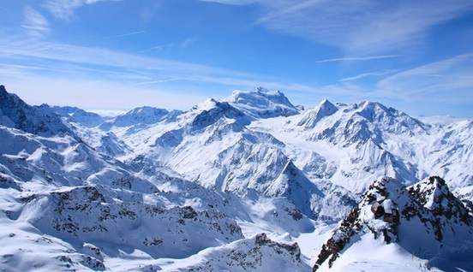
Read Pages 120-121
Read
UNIT 5 WEATHER

Slide 9
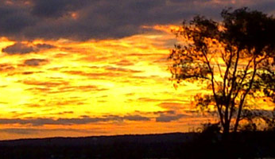
How do we measure weather?
Thermometers
measure temperature
Wind Vanes
measure wind direction
Anemometers
measure wind speed
Barometer
measure air pressure
Rain Gauges
measure rain amount
UNIT 5 WEATHER

Slide 10
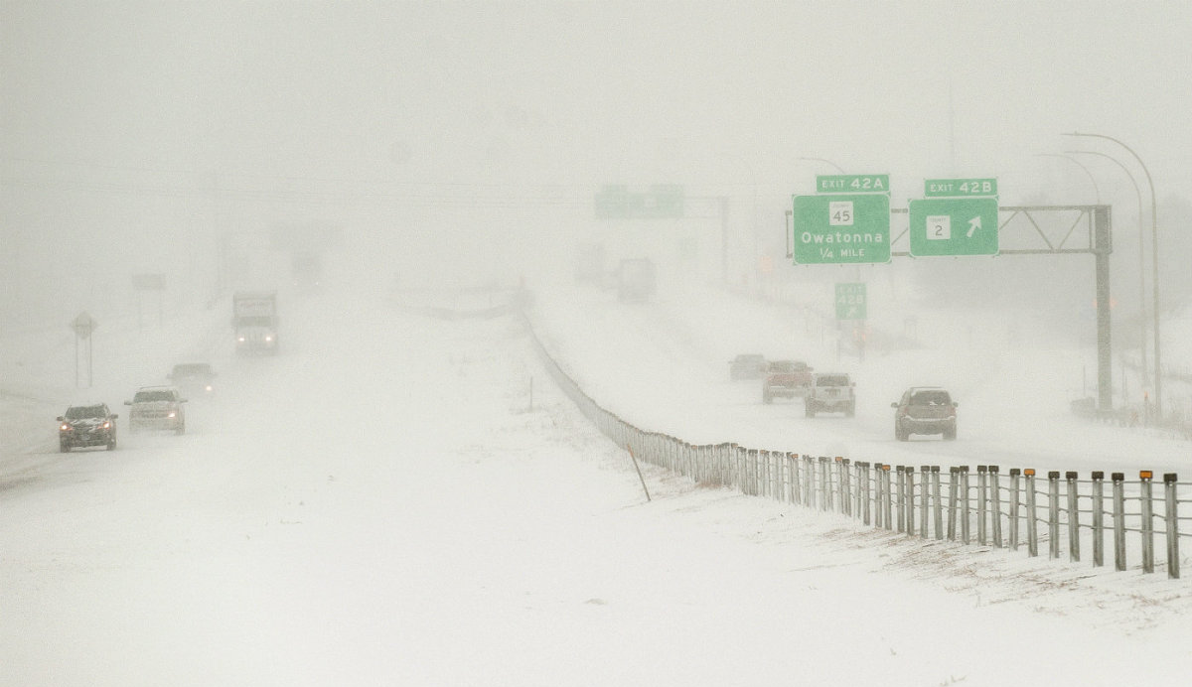
The Elements of Weather
https://www.youtube.com/watch?v=3pPcVxmdC3I
How do we measure weather?
UNIT 5 WEATHER

Slide 11
End of Day One
UNIT 5 WEATHER

Slide 12
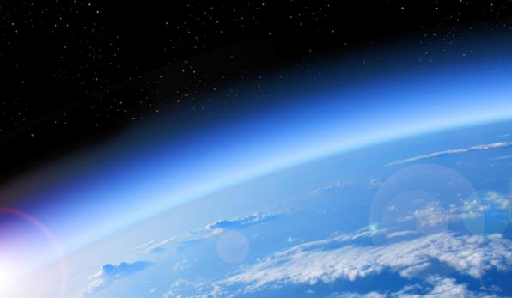
Can you see it? The atmosphere is the fuzzy line around our planet. This is a picture taken from space.
Our earth is a great big sphere floating around in space. It has a large layer of “air” around it that we call our atmosphere.
But what is weather?
All weather happens inside the atmosphere.
UNIT 5 WEATHER

Slide 13
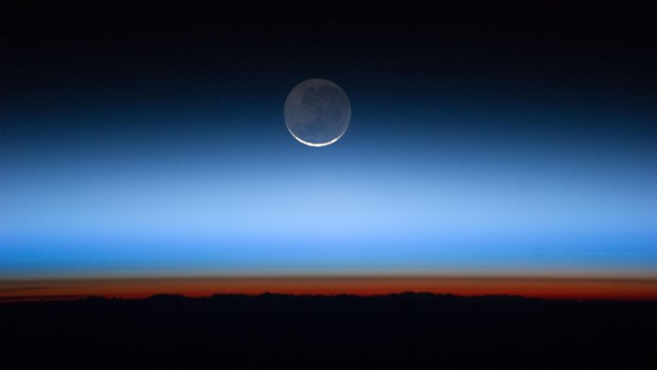
So…if we are surrounded by a large layer of atmosphere (air), why does weather happen? Shouldn’t it stay the same all the time?
Hmmm….
UNIT 5 WEATHER

Slide 14
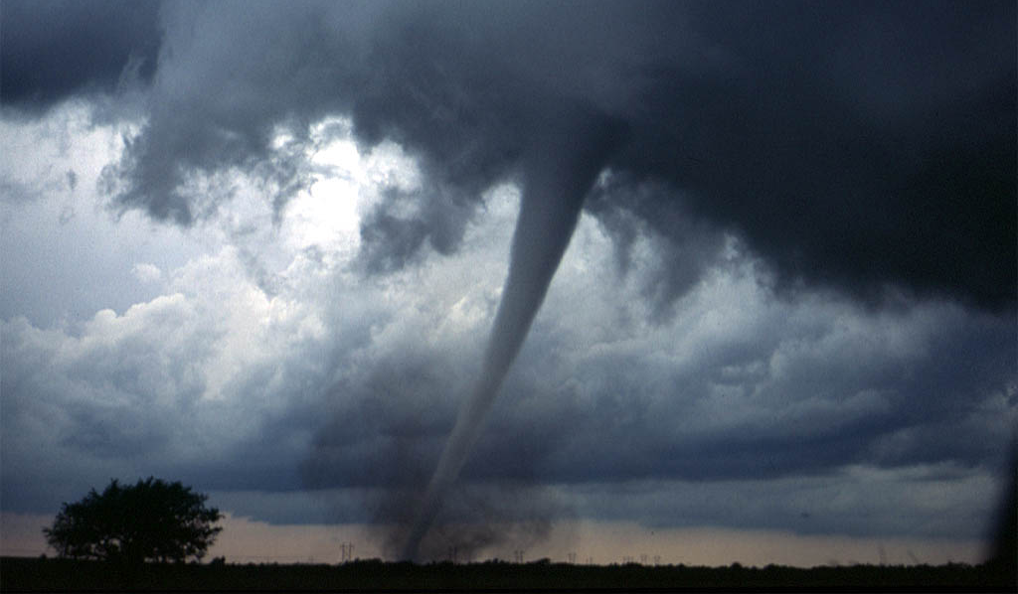
Why do we have weather?
UNIT 5 WEATHER

Slide 15
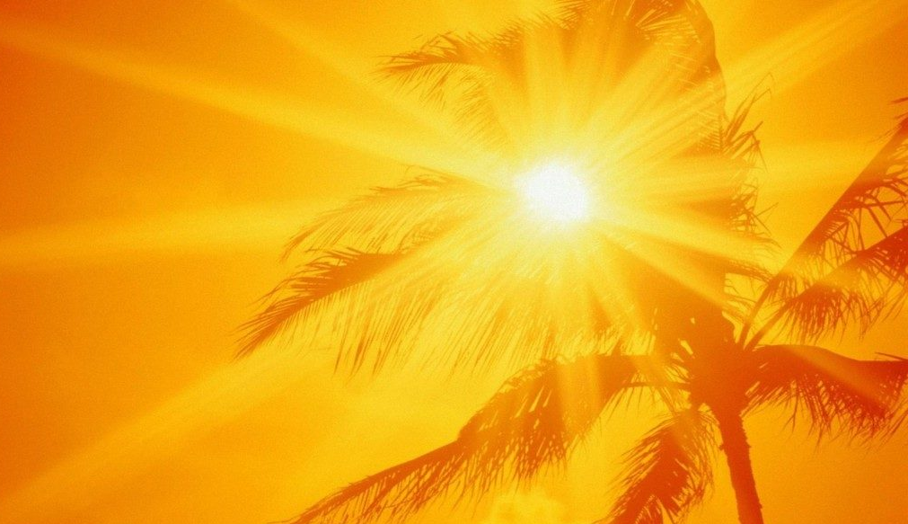
The easy answer is…
Heat!
Huh?
UNIT 5 WEATHER

Slide 16
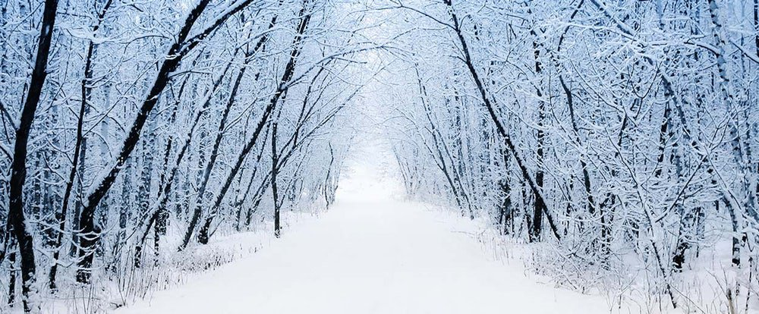
What is the weather like at the North Pole?
What is it like at the equator?
Think about it
UNIT 5 WEATHER

Slide 17
Do you think the air above the hot land at the equator gets hot?
Think about it
Of course it does!
The air over the North Pole gets cold too.
UNIT 5 WEATHER

Slide 18
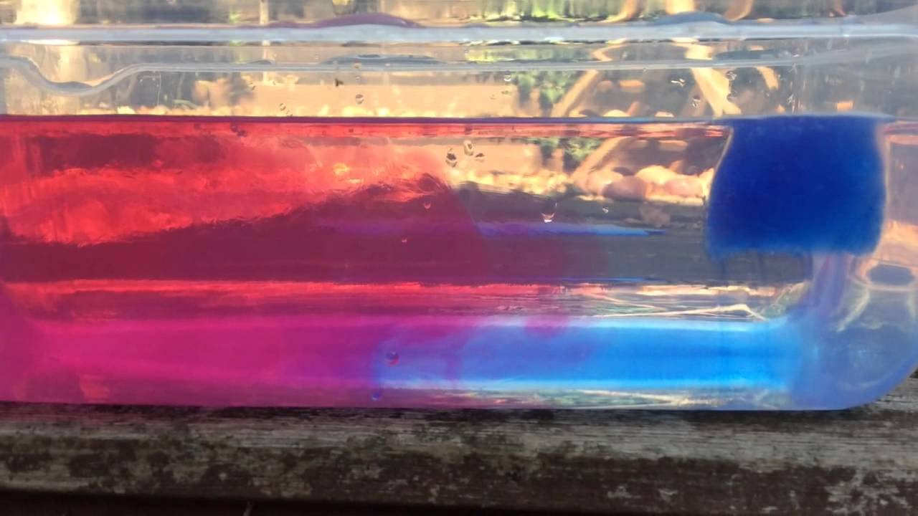
Each group has a bowl of water on their tables. I am going to give you ice cubes that I have dyed blue so we can see what happens when we put the ice cubes in the water.
Lets do a quick experiment.

Slide 19
https://www.youtube.com/watch?v=1LMjscj17pc
https://www.youtube.com/watch?v=yBBVSTBLRNk
Watch it again!

Slide 20
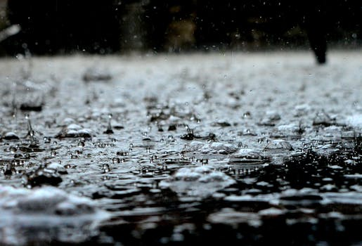
A blob of cold air is called a cold air mass.
A blob of warm air is called a warm air mass.
One rises – the other falls
So What?
UNIT 5 WEATHER

Slide 21
Air behaves just like water.
When cold arctic air bumps into warm air the warm air rises and the cold air sinks.
So What?
UNIT 5 WEATHER

Slide 22
Air in our atmosphere “stirs”
just like the water did.
This air “stirring” is wind!
So What?
UNIT 5 WEATHER

Slide 23
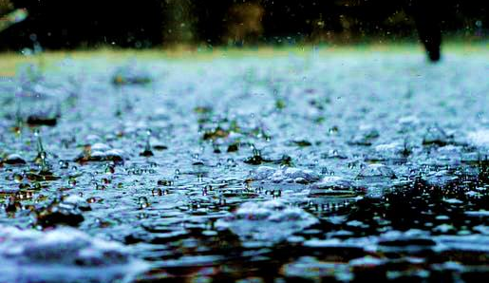
Hot air holds a lot of water.
When hot air bumps against cold air it gets colder and the water “falls” out.
That’s how you get rain!
(or snow sleet or hail)
One more thing…
UNIT 5 WEATHER

Slide 24
Cold – dry air mass
(formed over the North Pole)
↓
↑
Hot – wet air mass
(formed over the equator)
The cold air sinks – the hot air rises .
When they rub together they form static electricity (lightning) and the water “falls” out of the hot cloud.
↑
Because the air masses are moving, they create wind
UNIT 5 WEATHER

Slide 25
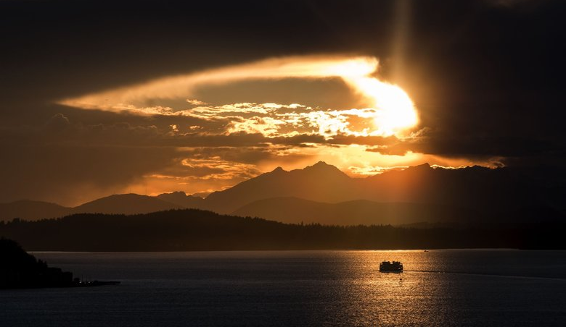
Cold dry air sinks
Hot wet air rises
Precipitation is when the water in the hot air
falls out of the sky!
That’s all there is to it!
UNIT 5 WEATHER

Slide 26
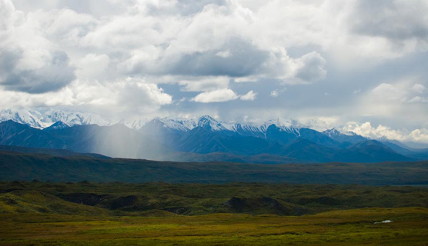
Vocabulary
Atmosphere a thick “blanket” of “air” that surrounds our planet. Precipitation – water that “falls” out of warm air - rain, snow, sleet or hail. Air mass – a blob of air that is hot or cold depending on where it formed
UNIT 5 WEATHER

Slide 27
End of Day Two and Three
UNIT 5 WEATHER

Slide 28
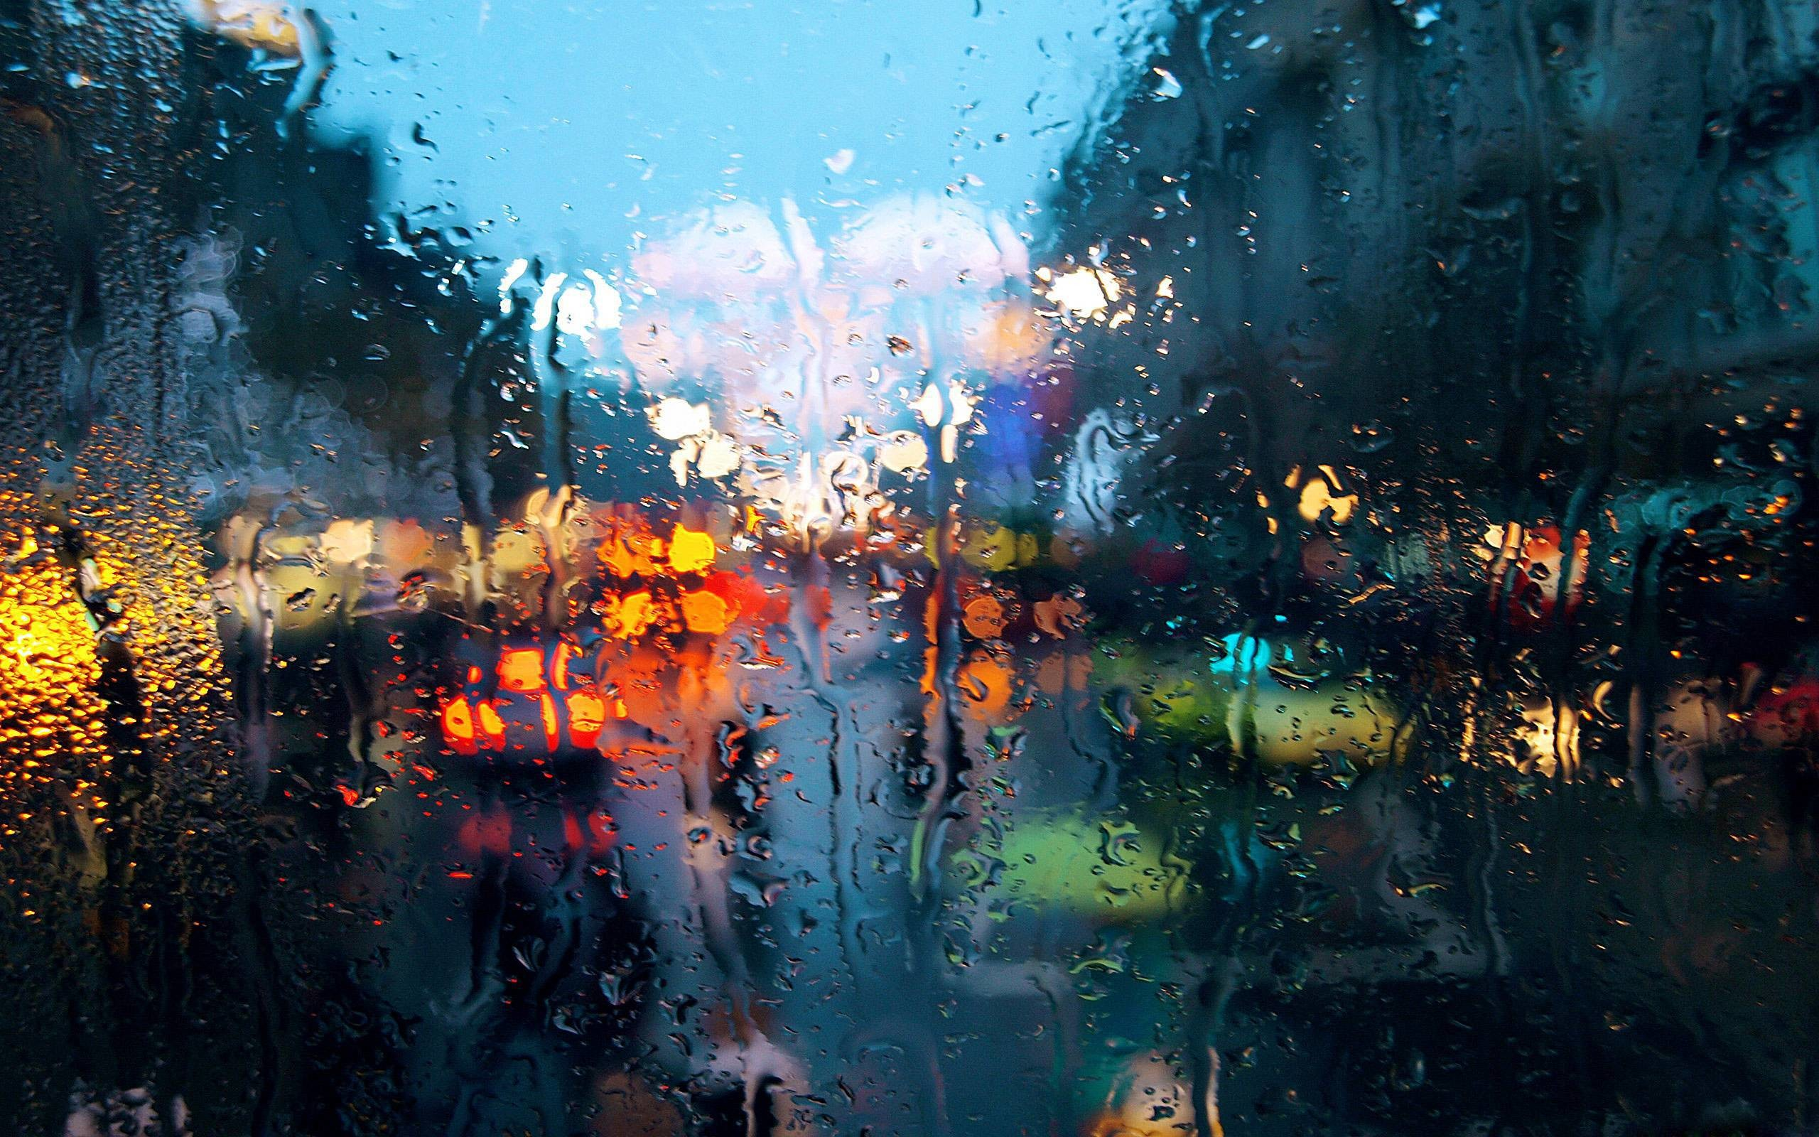
Name four instruments that we use to measure weather.
Quick Review…
rain gauge
anemometer
wind vane
thermometer
barometer
UNIT 5 WEATHER

Slide 29
Which one is which?
What do you remember?
UNIT 5 WEATHER

Slide 30
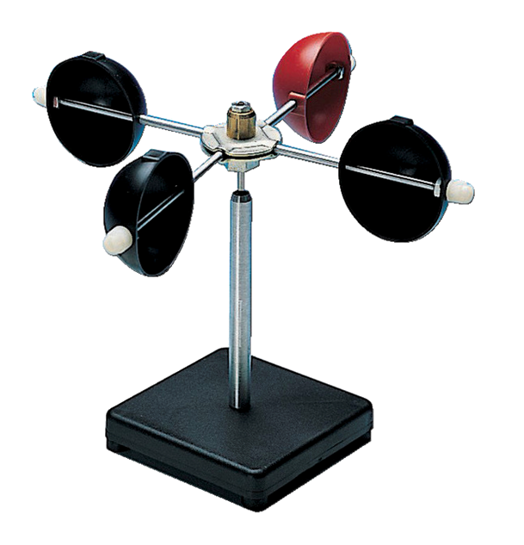
Anemometer
Wind Speed
UNIT 5 WEATHER

Slide 31
Barometer
Air Pressure
UNIT 5 WEATHER

Slide 32
Thermometer
Air Temperature
UNIT 5 WEATHER

Slide 33
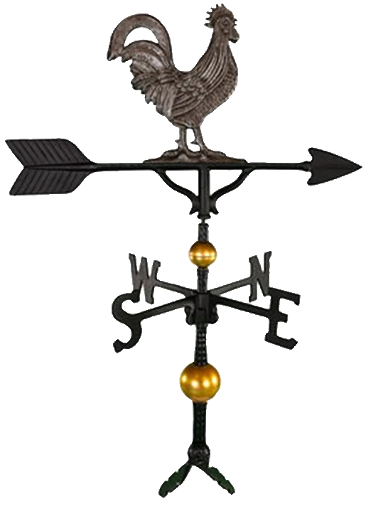
Weather Vane
Wind Direction
UNIT 5 WEATHER

Slide 34
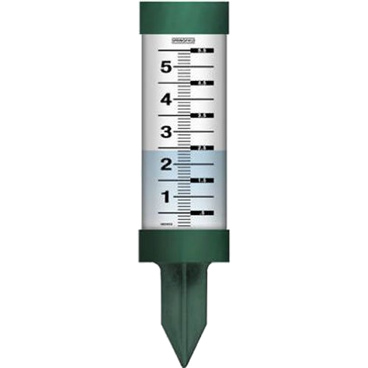
Rain Gauge
Rain Amount
UNIT 5 WEATHER

Slide 35
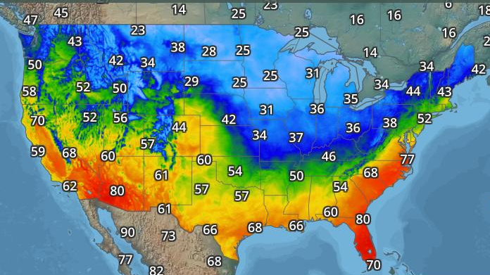
About how cold is it in Winnipeg Canada?
About how cold is it in Jacksonville Florida?
UNIT 5 WEATHER

Slide 36
About how cold is it in Jacksonville Florida?
UNIT 5 WEATHER

Slide 37
If cold air is moving, it is called a cold front.
UNIT 5 WEATHER

Slide 38
This is how we mark a cold front. The triangles point in the direction their going.
UNIT 5 WEATHER

Slide 39
A warm front is the same thing –
except it is red and has half circles on it.
UNIT 5 WEATHER

Slide 40
What is going to happen when they bang into each other?
UNIT 5 WEATHER

Slide 41
Cold – dry air mass
(formed over the North Pole)
↓
↑
Hot – wet air mass
(formed over the equator)
The cold air sinks – the hot air rises .
When they rub together they form static electricity (lightning) and the water “falls” out of the hot cloud.
↑
Because the air masses are moving, they create wind
UNIT 5 WEATHER

Slide 42
The question was… what will happen when they bang into each other?
Tell us what you think!
UNIT 5 WEATHER

Slide 43
CORRECT!
UNIT 5 WEATHER

Slide 44
I just wanted to see the storm again! How warm is it in NJ?
How warm was it in NJ before the fronts moved?
UNIT 5 WEATHER

Slide 45
How warm will it be in NJ after the storm?
UNIT 5 WEATHER

Slide 46
Read Pages 124-125
Read
UNIT 5 WEATHER

Slide 47
Look very carefully at the maps on these pages.
Think
UNIT 5 WEATHER

Slide 48
How did the cold front move from Day 1 to Day 2?
What do you see?
UNIT 5 WEATHER

Slide 49
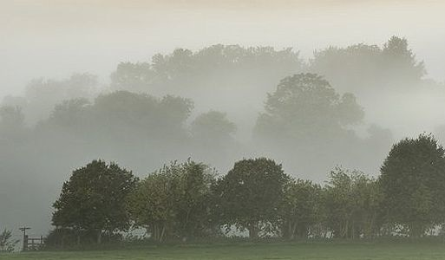
How did the warm front move from Day 1 to Day 2?
That’s all there is to it!
UNIT 5 WEATHER

Slide 50
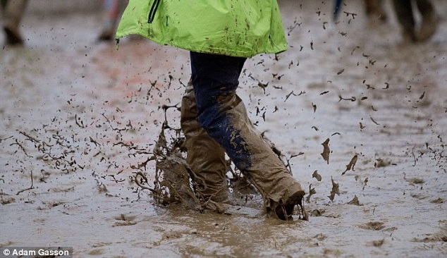
Decide what Day 3 will look like.
Get with your groups
UNIT 5 WEATHER

Slide 51
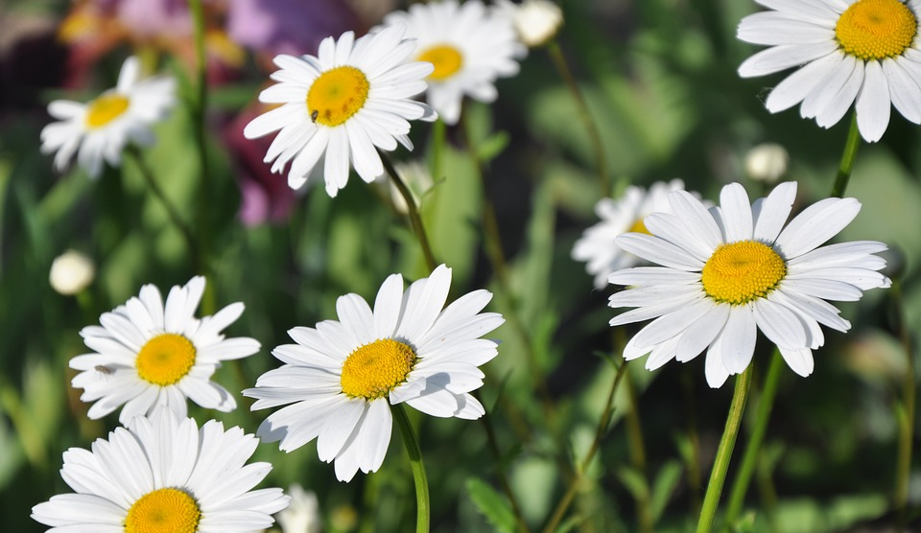
Use the worksheet with your group to predict the weather on those maps.
With your groups
UNIT 5 WEATHER

Slide 52
End of Day Four
UNIT 5 WEATHER

