Slide 1
What are Seasons?
ESSENTIAL QUESTION
UNIT 5 WEATHER

Slide 2
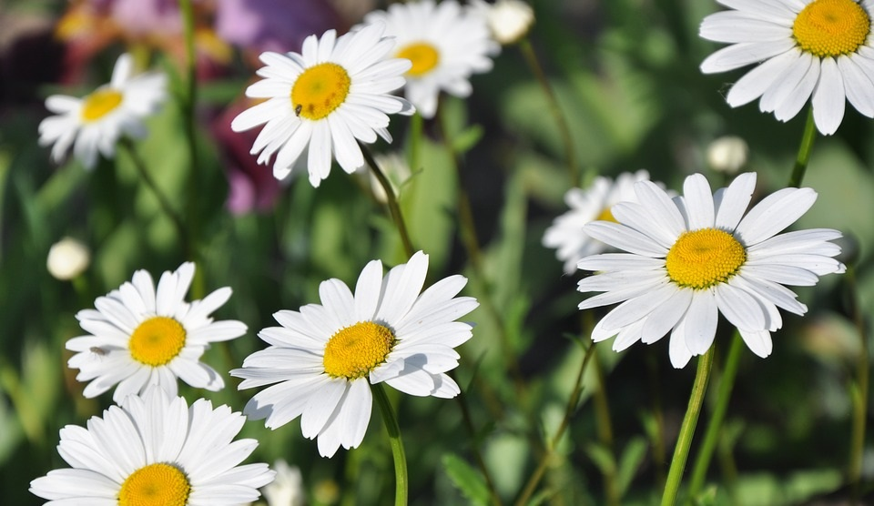
Seasons are caused by the tilt of the Earth as it revolves around the sun.
ESSENTIAL QUESTION
UNIT 5 WEATHER

Slide 3
Some parts of the world have only one or two seasons.
Did you know?
UNIT 5 WEATHER

Slide 4
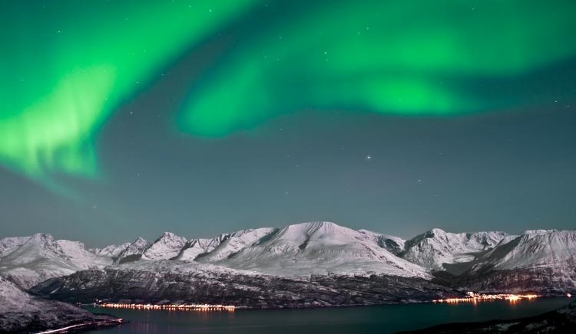
Near the North Pole the two seasons are Polar Day and Polar Night because there are times of the year when there is no sunlight at all during the day!
Did you know?
UNIT 5 WEATHER

Slide 5
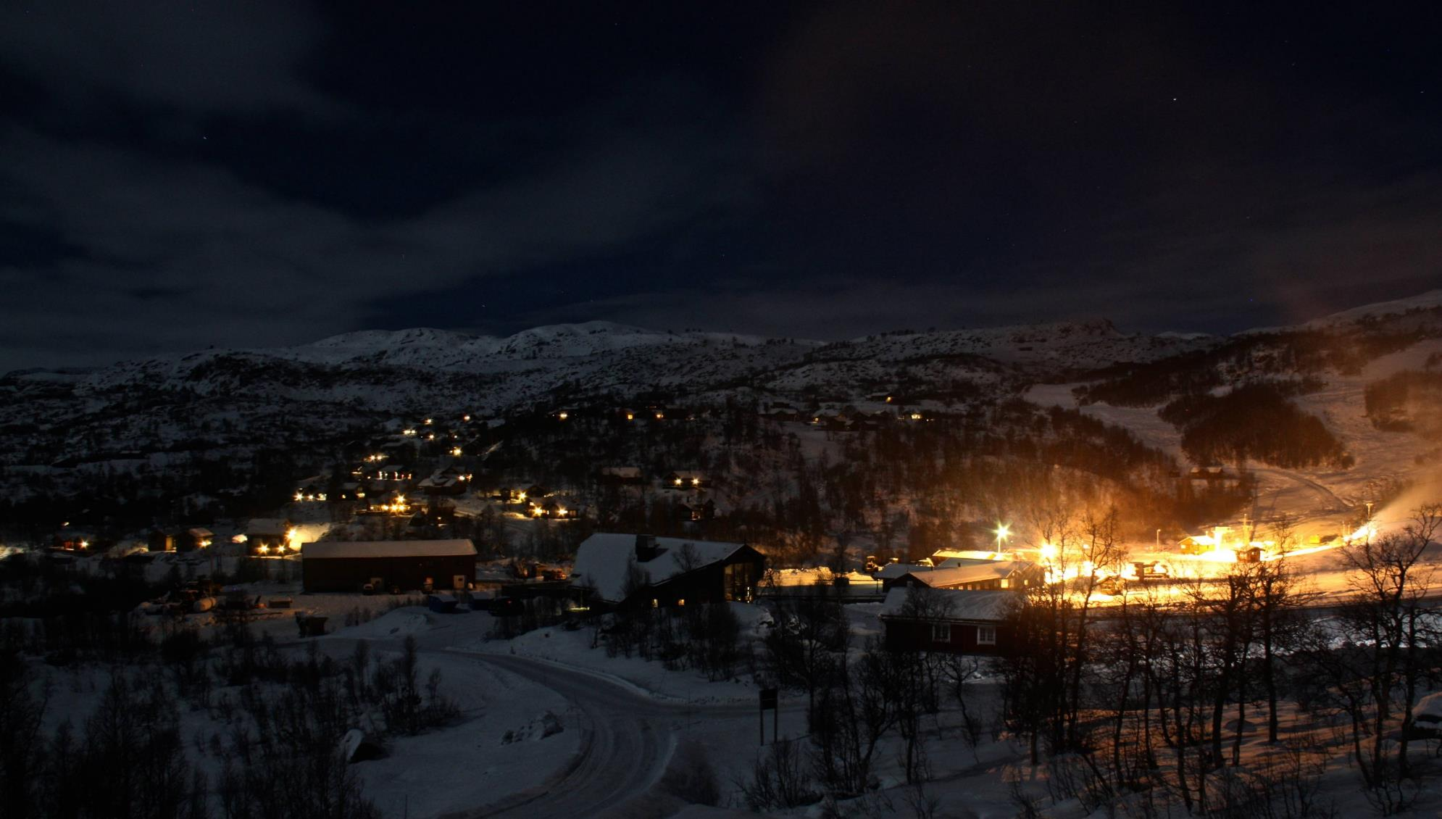
Imagine That!!!
Did you know?
UNIT 5 WEATHER

Slide 6
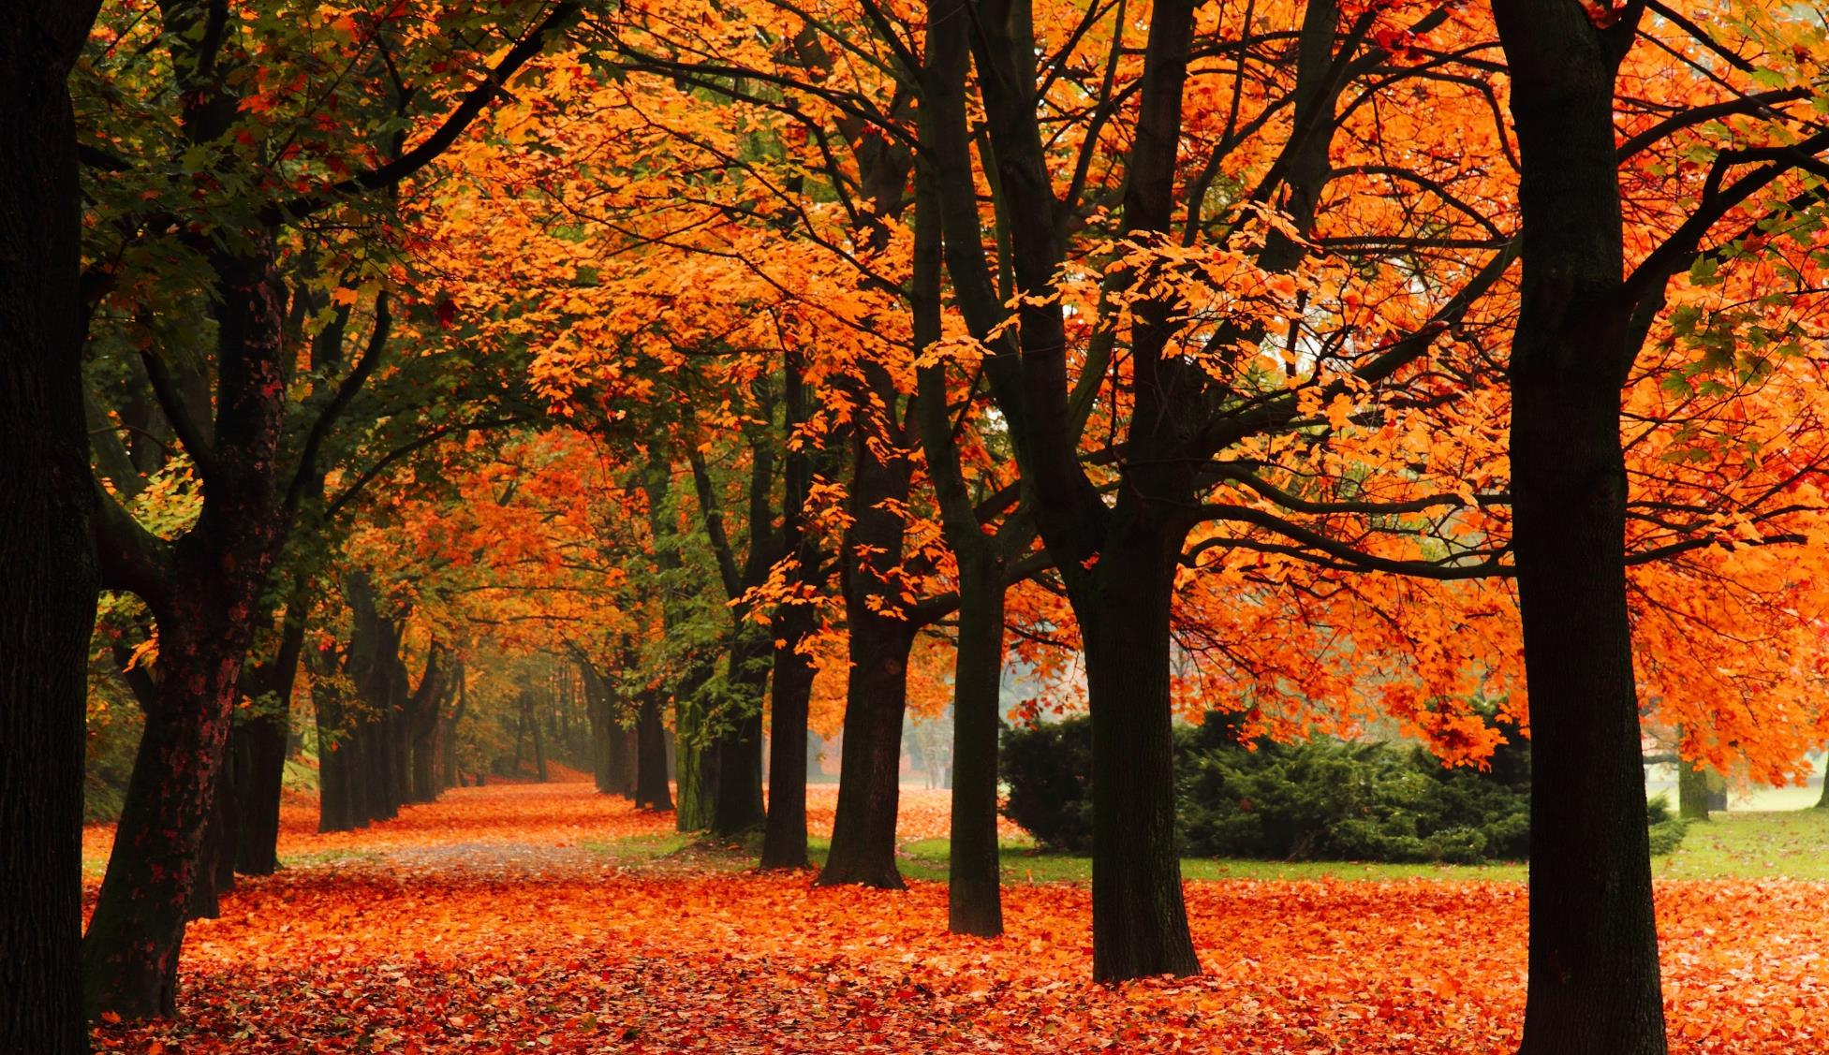
Near the Equator there are only two seasons the wet season and the dry season.
Did you know?
UNIT 5 WEATHER

Slide 7
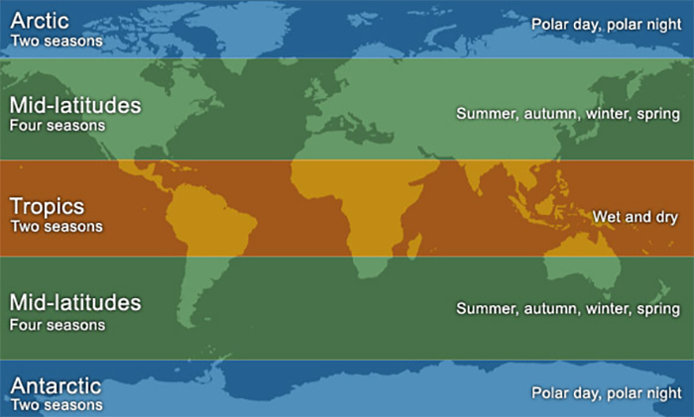
Most of the people living in the world have four seasons like we do.
Take a quick look at the map.
Did you know?
UNIT 5 WEATHER

Slide 8
UNIT 5 WEATHER

Slide 9
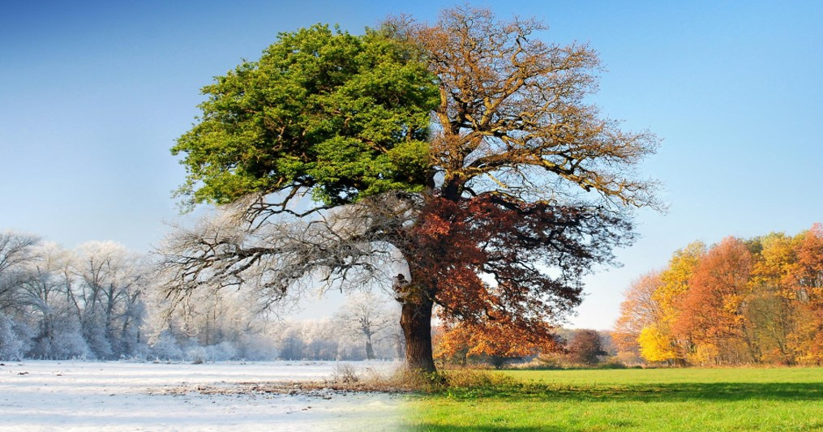
Can you name the seasons in order starting with Winter?
Read Pages 126 - 127
UNIT 5 WEATHER

Slide 10
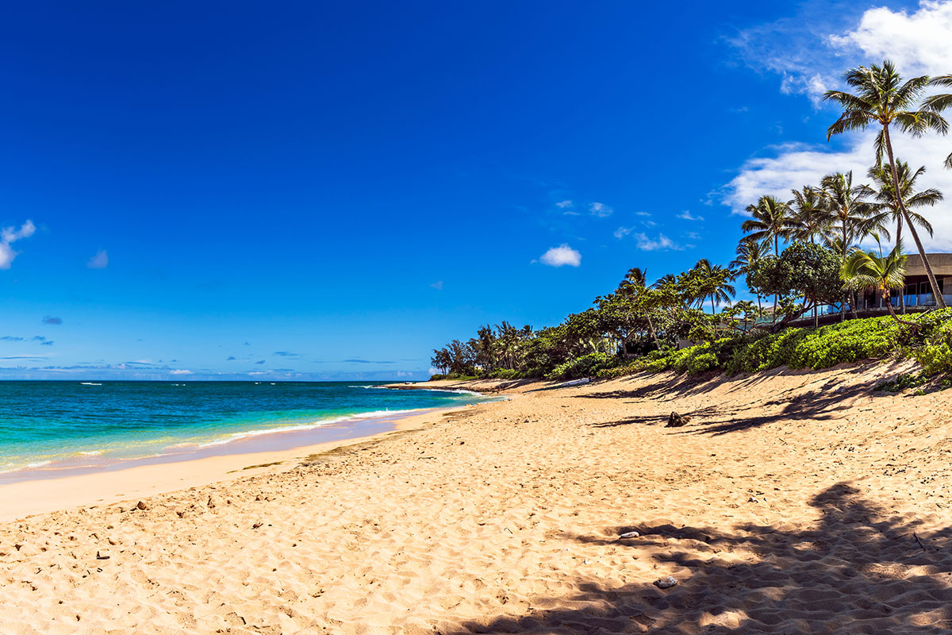
Scientists measure seasonal changes in temperature and precipitation.
How do we measure seasons?
UNIT 5 WEATHER

Slide 11
When scientists measure temperature they measure the high temperature and the low temperature for each day.
How do we measure seasons?
UNIT 5 WEATHER

Slide 12
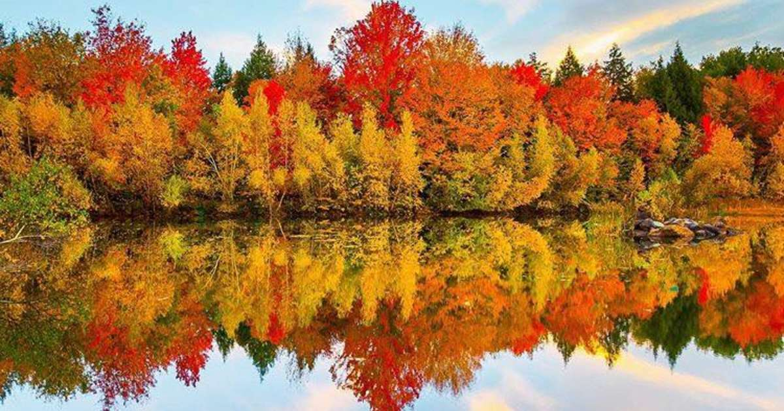
At dawn the temperature is usually much colder than it is in the afternoon.
How do we measure seasons?
UNIT 5 WEATHER

Slide 13
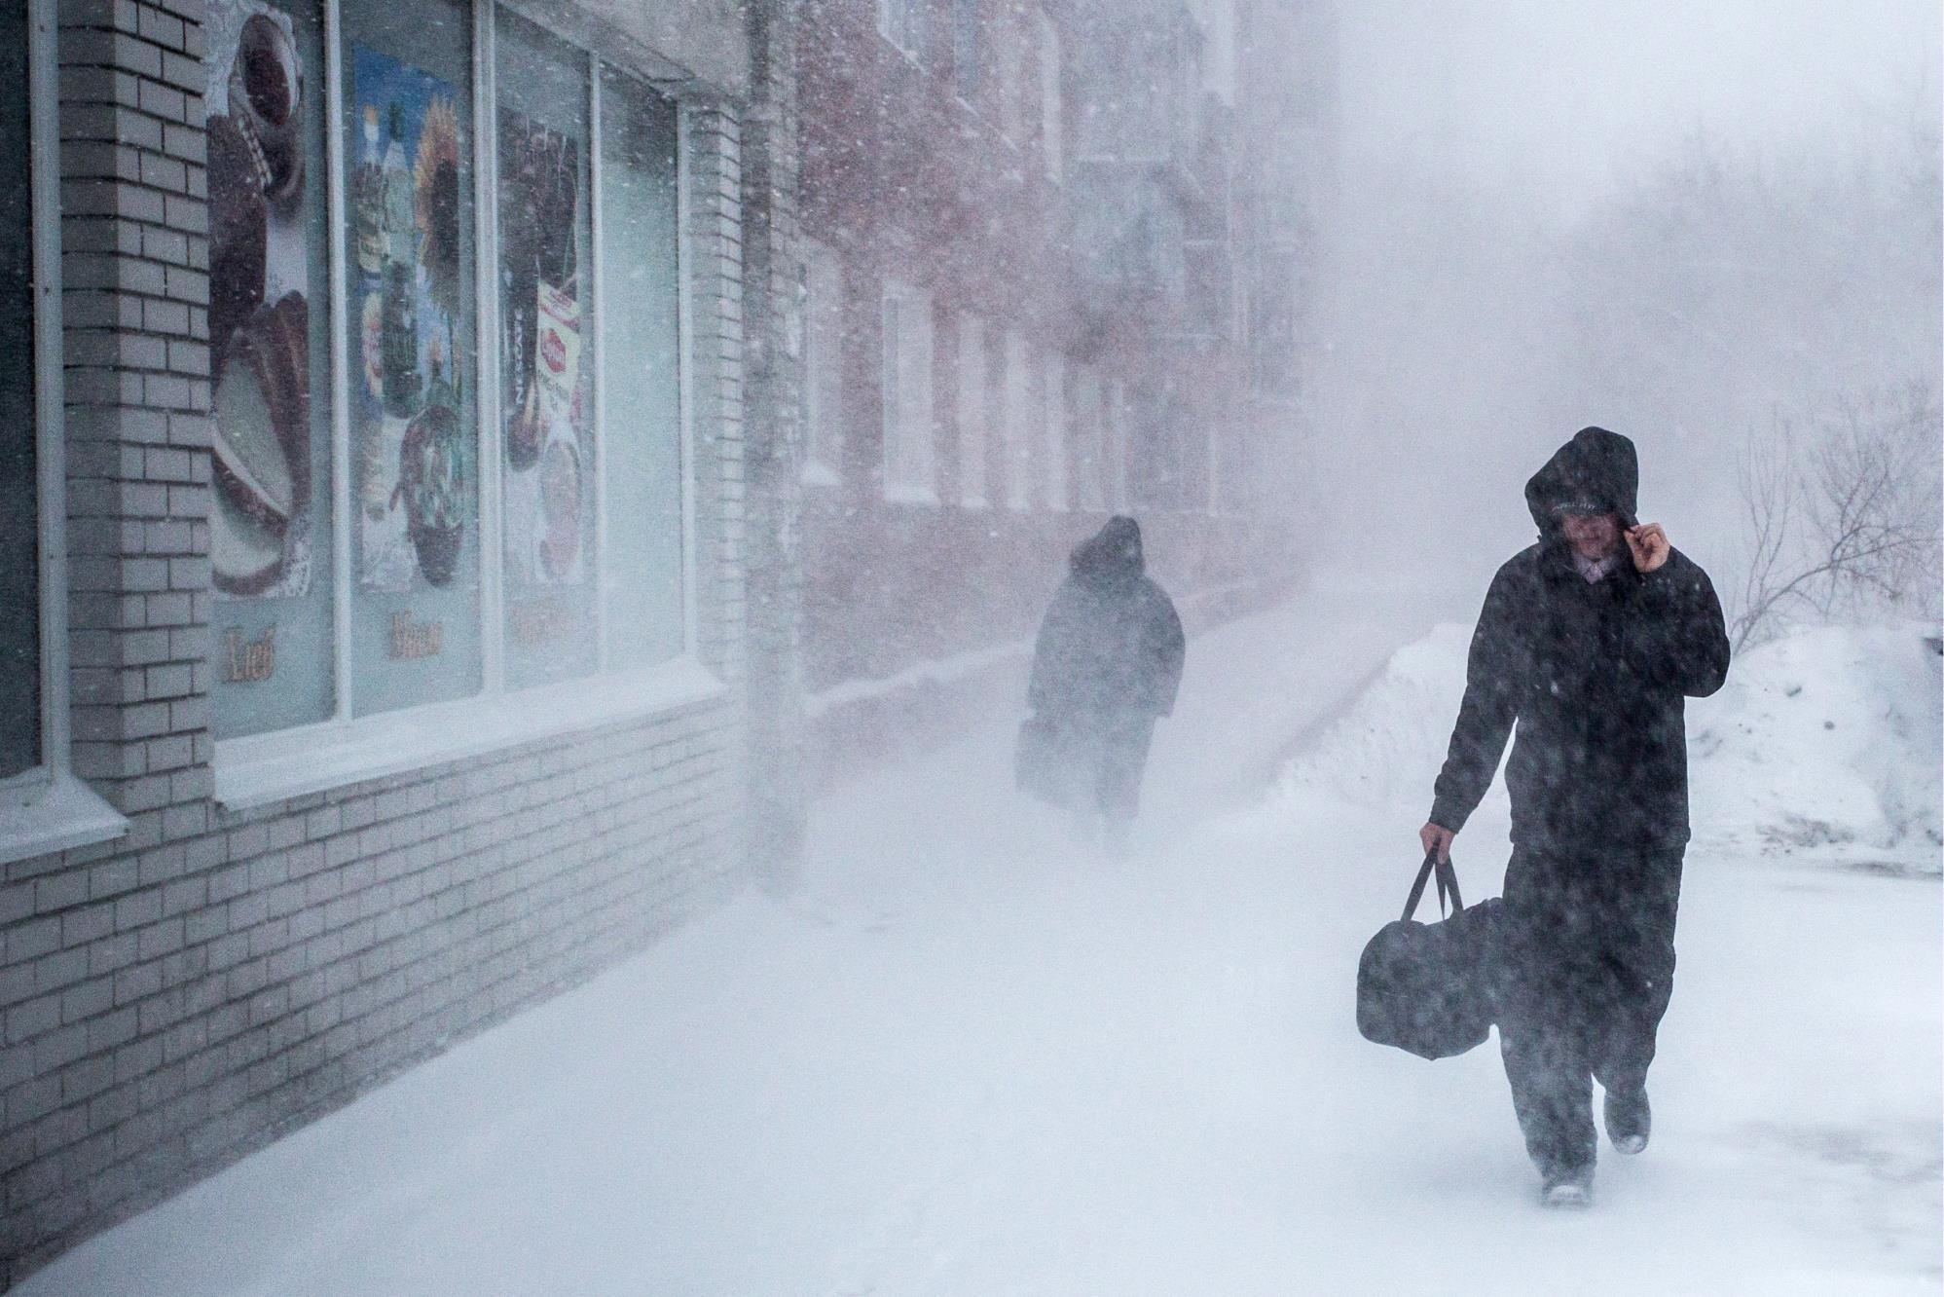
For example:
In March in New Jersey the afternoon high temperature should be about 55º and the low should be about 40º very early in the morning.
How do we measure seasons?
UNIT 5 WEATHER

Slide 14
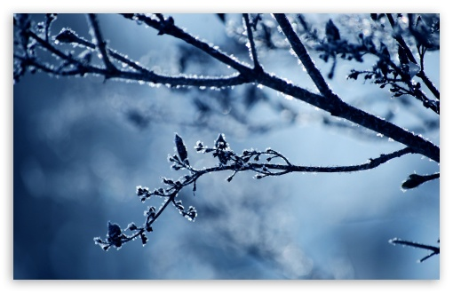
When you hear someone say that the average temperature in NJ in July is 82º it seems too cool.
But the nighttime average is 70º and the daytime average is 94º which makes a lot more sense.
Why do I care?
UNIT 5 WEATHER

Slide 15
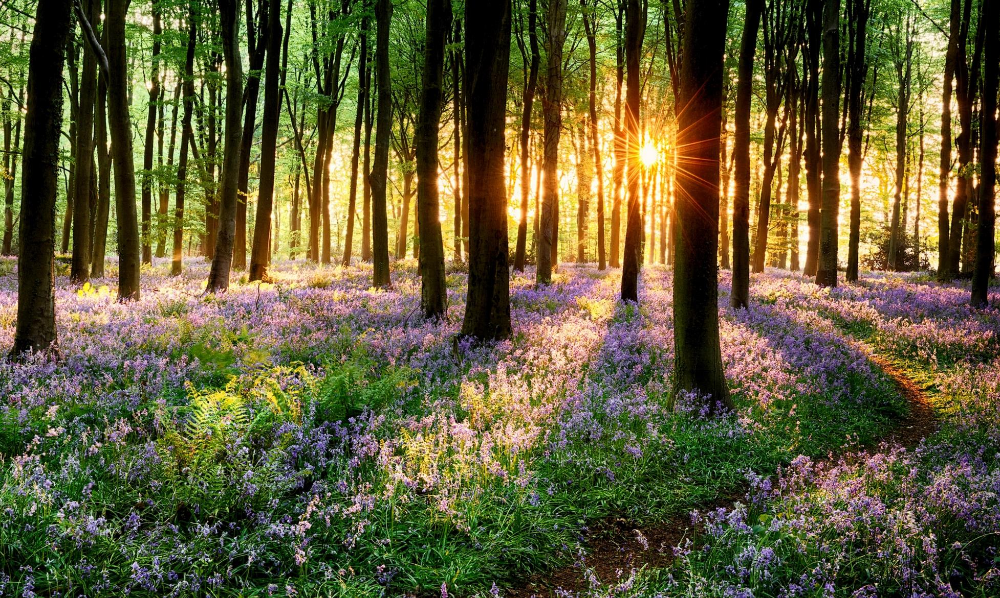
The average daytime temperature of a city in winter is 48º and in summer is 83º.
What temperature should it be in Spring?
Read Pages 126-127
UNIT 5 WEATHER

Slide 16
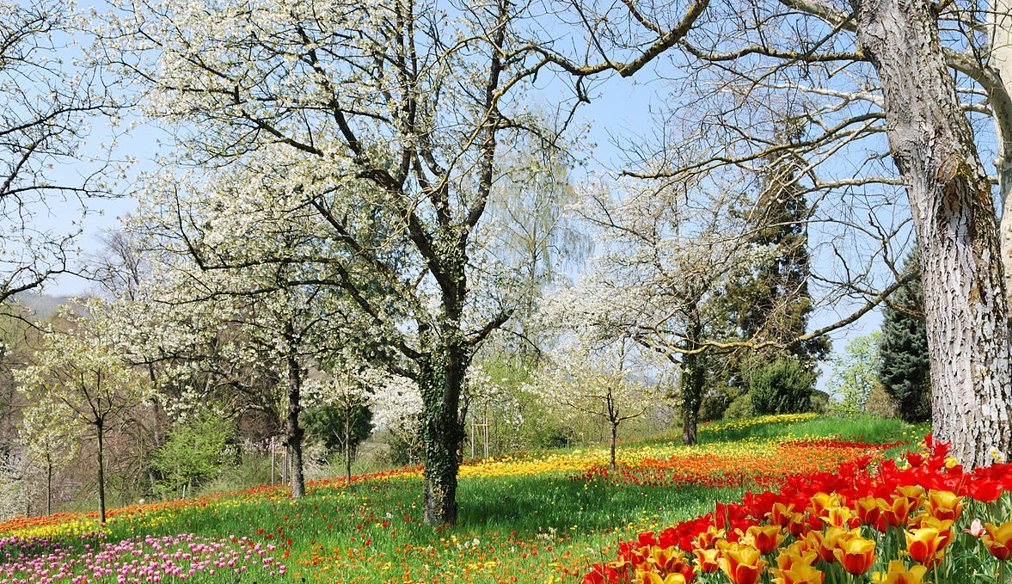
Follow directions reading the graphs.
Read Pages 128-129
UNIT 5 WEATHER

Slide 17
Each group will be given the data for one season in New Jersey.
Draw a bar graph to show how the high and low temperatures change during the season.
Add data or pictures to show precipitation.
Read Pages 130-131
UNIT 5 WEATHER

Slide 18
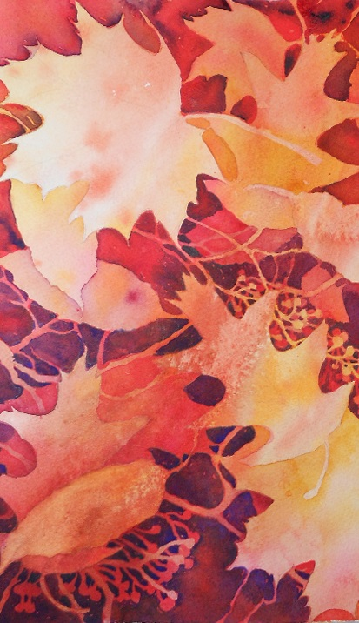
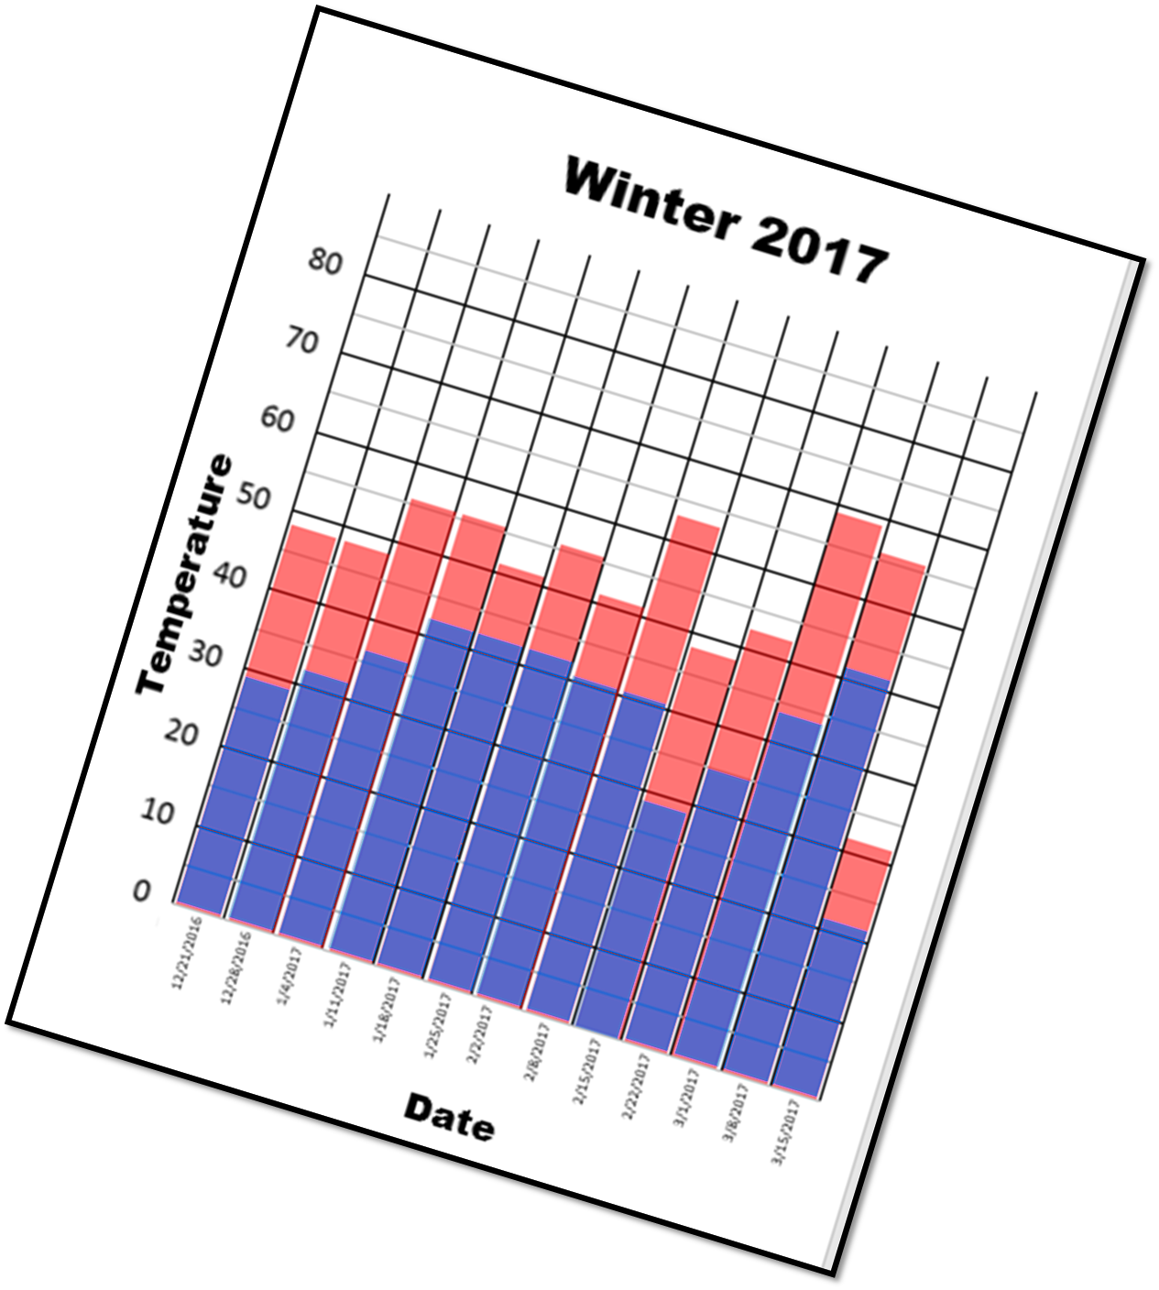
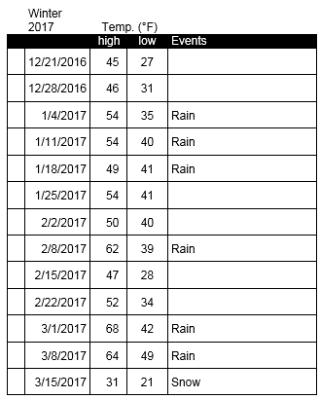
Your data and graph will look like this
UNIT 5 WEATHER

