Slide 1
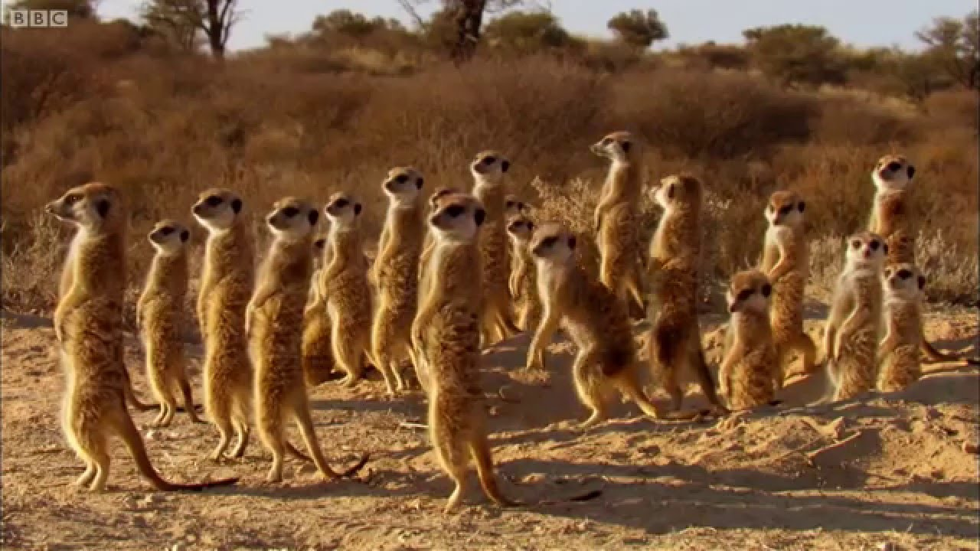
How does living in groups help animals survive?
Unit 2 Lesson 1 Living in Groups
Essential Question
https://lynncronin.weebly.com/unit-2-living-in-groups.html
A Mob of Meerkats

Slide 2
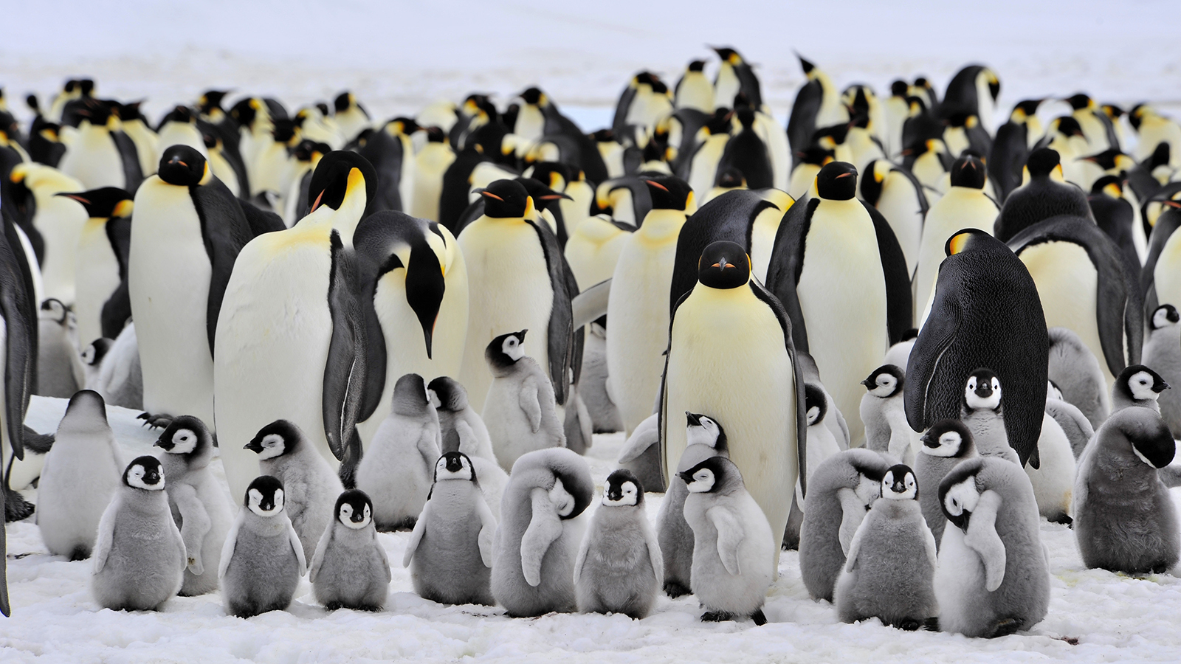
Watch this video https://youtu.be/sGsTRkIJSDA
Unit 2 Lesson 1 Living in Groups
Essential Question
https://lynncronin.weebly.com/unit-2-living-in-groups.html
A Colony of Penguins

Slide 3
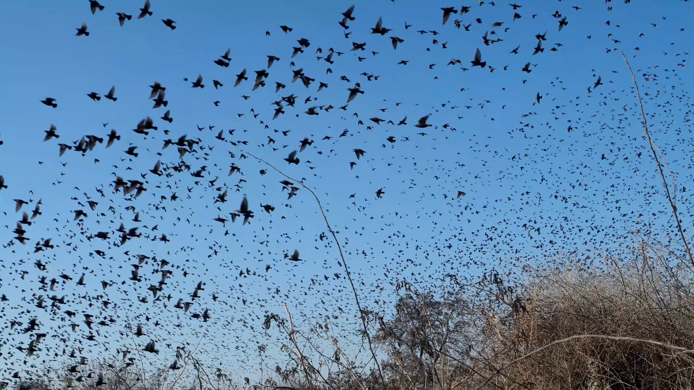
Read Pages 56 & 57
Unit 2 Lesson 1 Living in Groups
Living in Groups
https://lynncronin.weebly.com/unit-2-living-in-groups.html
A Flock of Blackbirds

Slide 4
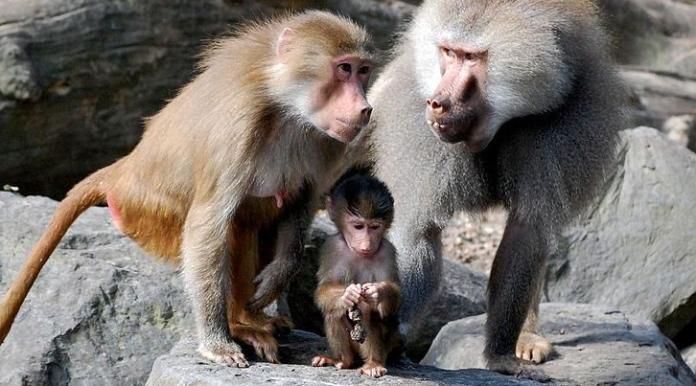
Fun Facts: You are a member of a class. What are animal groups called? https://www.youtube.com/watch?v=I-gTQFQU_1k Want some more? https://www.youtube.com/watch?v=EHAn3zi5Epw
Unit 2 Lesson 1 Living in Groups
Group Names
https://lynncronin.weebly.com/unit-2-living-in-groups.html
A Congress of Baboons

Slide 5
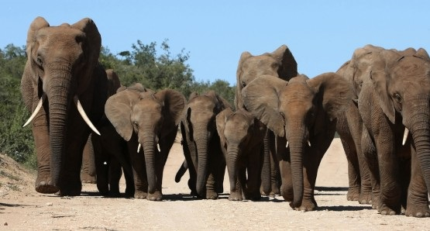
Unit 2 Lesson 1 Living in Groups
Think About it…
https://lynncronin.weebly.com/unit-2-living-in-groups.html
With your group list three reasons that an animal might live in a group
A Herd of Elephants

Slide 6
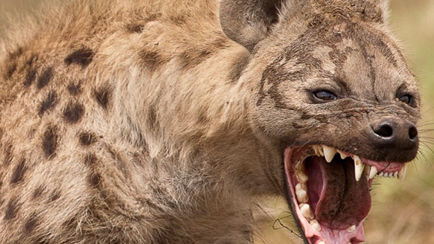
What do you call an animal that eats other animals?
Unit 2 Lesson 2 Getting Food
Do you remember?
https://lynncronin.weebly.com/unit-2-living-in-groups.html
A cackle of hyenas
A predator

Slide 7
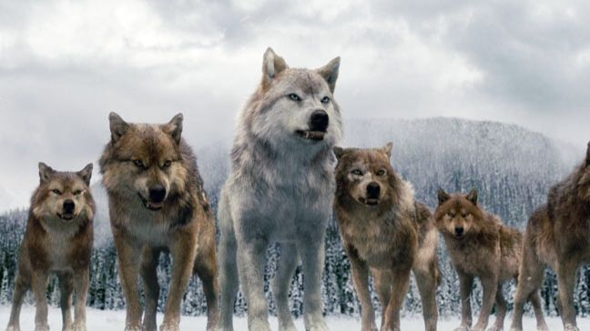
Unit 2 Lesson 2 Getting Food
Think About it…
https://lynncronin.weebly.com/unit-2-living-in-groups.html
Read pages 58 & 59
A pack of wolves

Slide 8
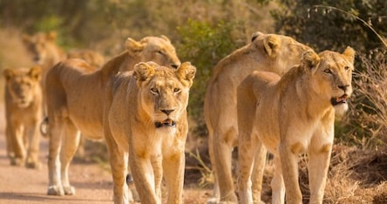
Unit 2 Lesson 2 Getting Food
Did you know?
https://lynncronin.weebly.com/unit-2-living-in-groups.html
Predators are called carnivores.
Carnivores eat only meat.
A pride of lions

Slide 9
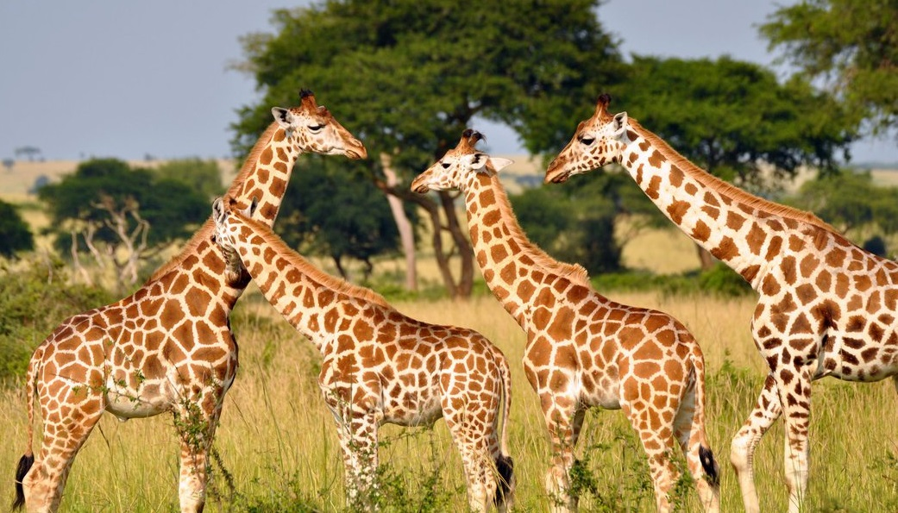
Unit 2 Lesson 2 Getting Food
Did you know?
https://lynncronin.weebly.com/unit-2-living-in-groups.html
Plant eaters are called herbivores.
Herbivores eat only plants.
Giraffes eat leaves
A tower of giraffes

Slide 10
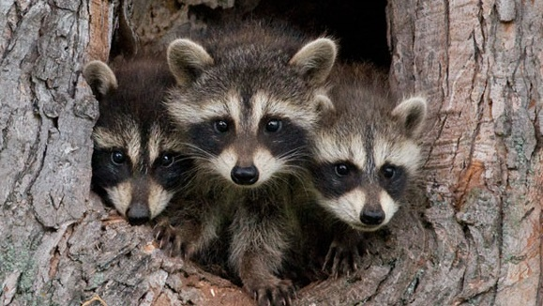
Unit 2 Lesson 2 Getting Food
Did you know?
https://lynncronin.weebly.com/unit-2-living-in-groups.html
Some animals are called omnivores.
Omnivores eat both plants and meat.
Raccoons eat everything
A group of raccoons

Slide 11
Unit 2 Lesson 2 Getting Food
Think about it…
https://lynncronin.weebly.com/unit-2-living-in-groups.html
What are humans?
Carnivore
Herbivore
Omnivore
We have lots of group names
class, group, mob, tribe, crowd…

