Slide 1
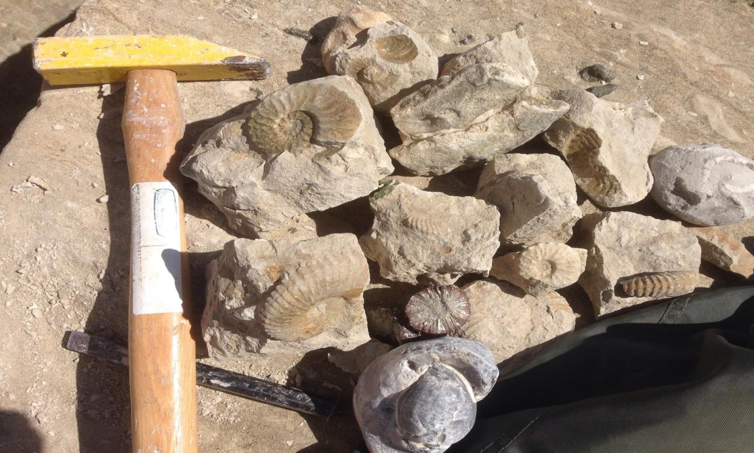
How do fossils teach us about the environment in ancient times?
Unit 3 Fossils – Lesson 1
Essential Question

Slide 2
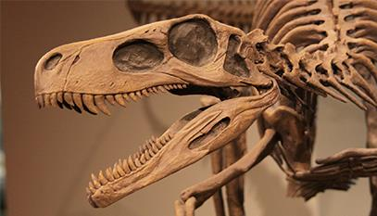
Watch this video https://www.youtube.com/watch?v=50MgMBsCcLM
Unit 3 Fossils – Lesson 1
Essential Question

Slide 3
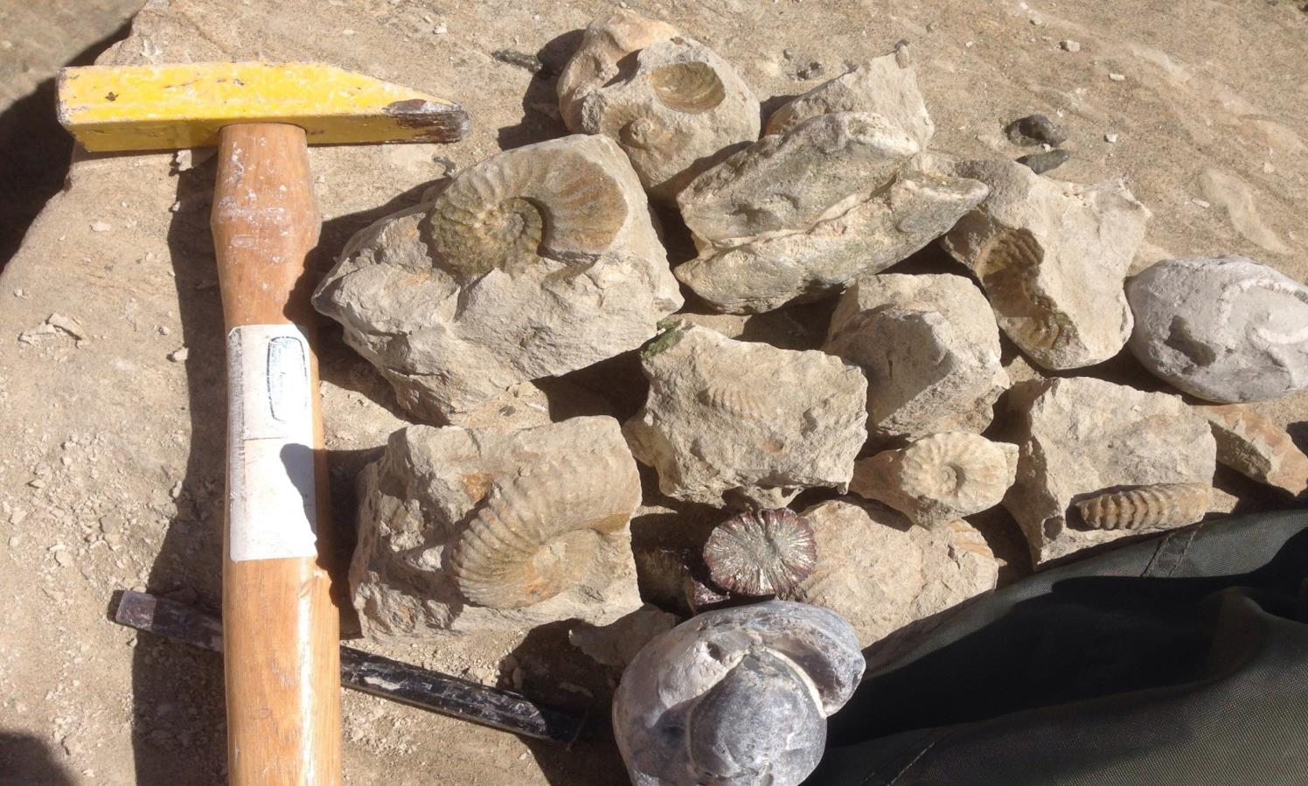
We think of fossils as pieces of rock that are the ancient remains of an animals body.
Unit 3 Fossils – Lesson 1

Slide 4
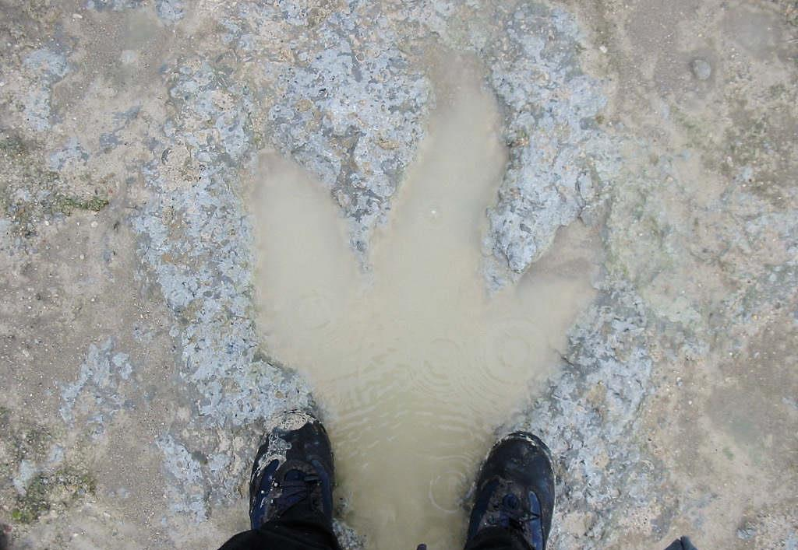
Can you see this dinosaur footprint?
Unit 3 Fossils – Lesson 1
But fossils are any impression that is left by ancient life. It could be a shell or a leaf, bones or even a footprint!

Slide 5
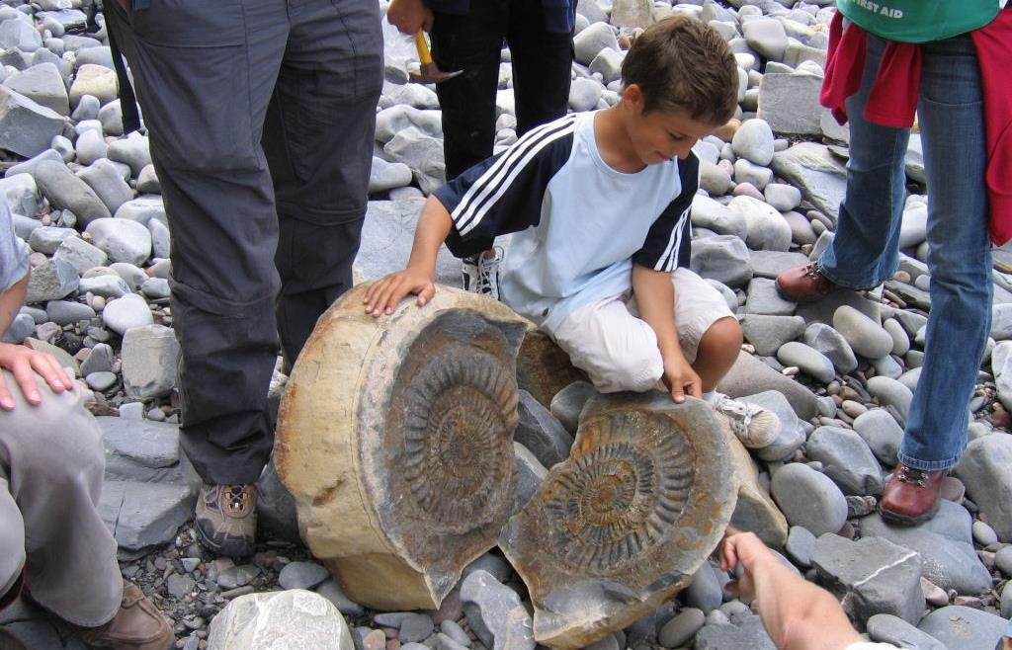
Sometimes the body of an ancient animal gets turned into stone by a chemical reaction.
Unit 3 Fossils – Lesson 1
But what are they?

Slide 6
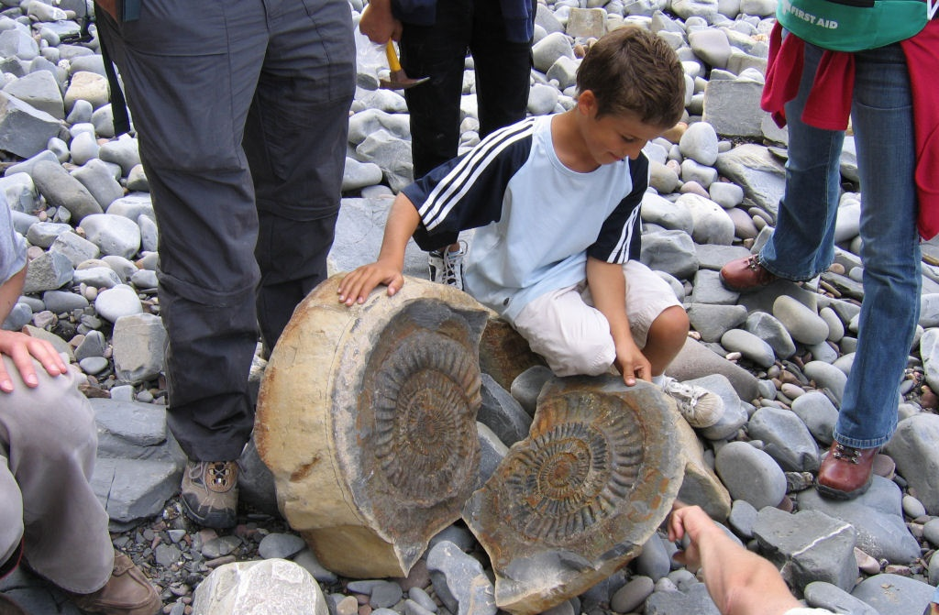
Unit 3 Fossils – Lesson 1
This ancient shell became rock. If you tap on the rock around a fossil just right it will split open and reveal the fossil!

Slide 7
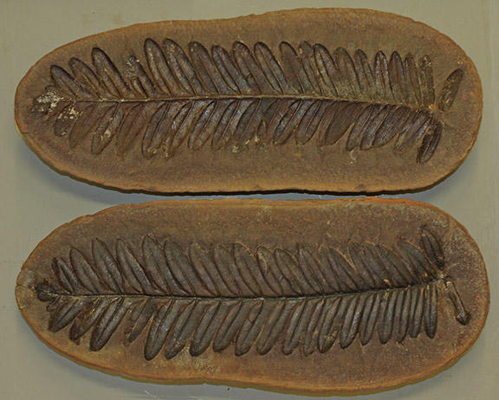
Unit 3 Fossils – Lesson 1
This fossil is called an impression. The plant decayed but the space that it took up in the mud left an opening that got filled with rock.

Slide 8
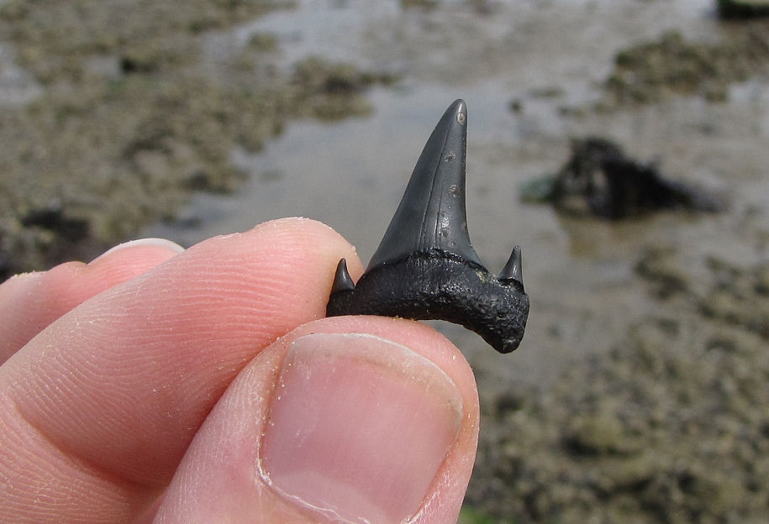
Unit 3 Fossils – Lesson 1
Sometimes the hard parts of an animals get fossilized (or turned into rock)
This is an ancient sharks tooth!

Slide 9
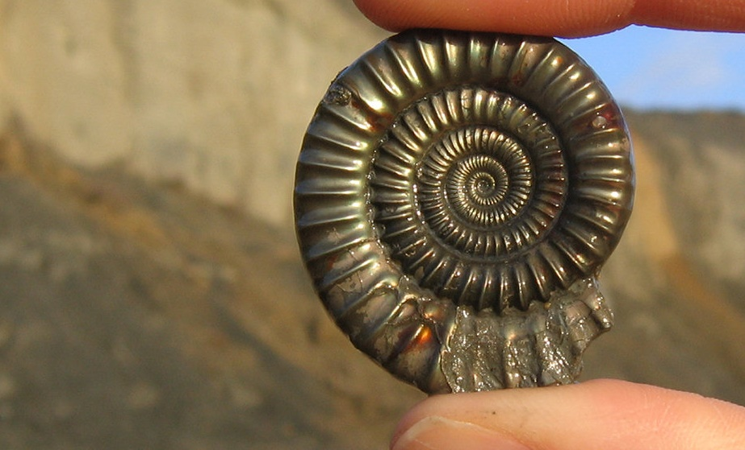
Unit 3 Fossils – Lesson 1
This is one of my favorites.
The rock that filled the space left by this shell impression has a metallic shine!

Slide 10
Read Pages 66 & 67
Unit 3 Fossils – Lesson 1
Read about it.

Slide 11
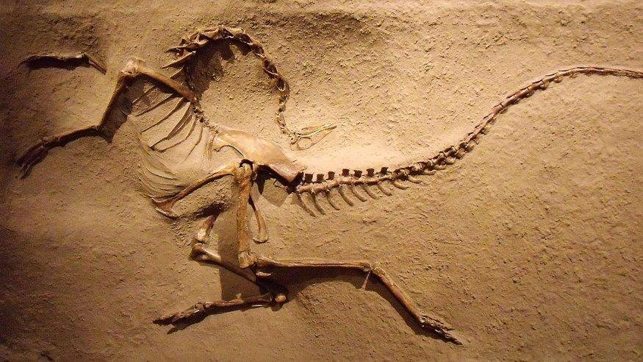
Dinosaur fossils usually show their bones but not their inner organs such as hearts and lungs. Why do you think that is so?
Unit 3 Fossils – Lesson 1
With your group

Slide 12
Fossils give us a quick peak into the earth as it was millions of years ago.
Unit 3 Fossils – Lesson 1
And why do we care?

Slide 13
Unit 3 Fossils – Lesson 1 – 3 days
This fossil was found in the middle of England. It was nowhere near the ocean.

Slide 14
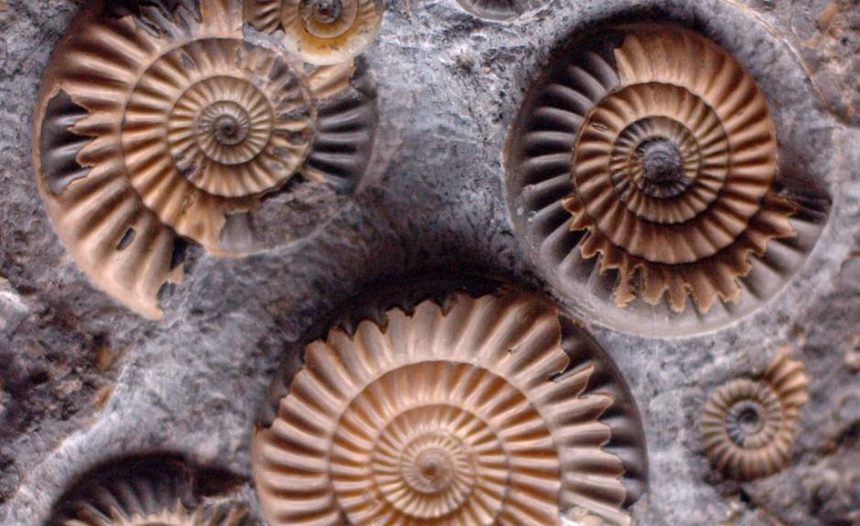
Unit 3 Fossils – Lesson 1
These seashells were found
at the top of a mountain

Slide 15
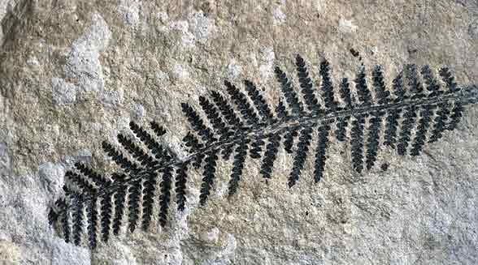
Unit 3 Fossils – Lesson 1
Ferns grow in warm places but this fossil was found in Antarctica

Slide 16
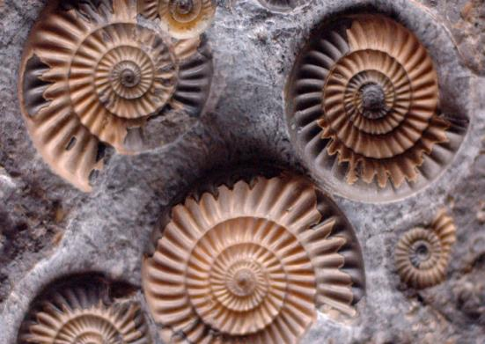
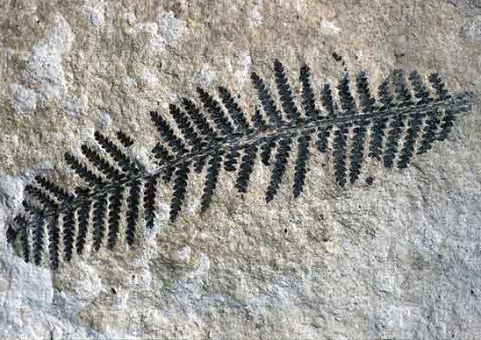
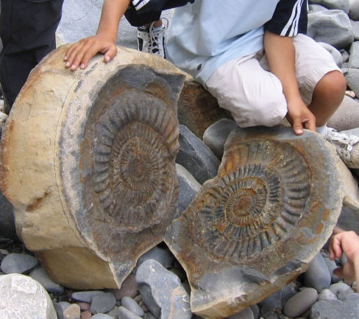
Unit 3 Fossils – Lesson 1 – 3 days
What do all of these fossils tell us about the area of earth where they were found?

Slide 17
How do fossils teach us about the environment in ancient times? With your group answer the essential question in your notebook.
Unit 3 Fossils – Lesson 1
Essential Question

Slide 18
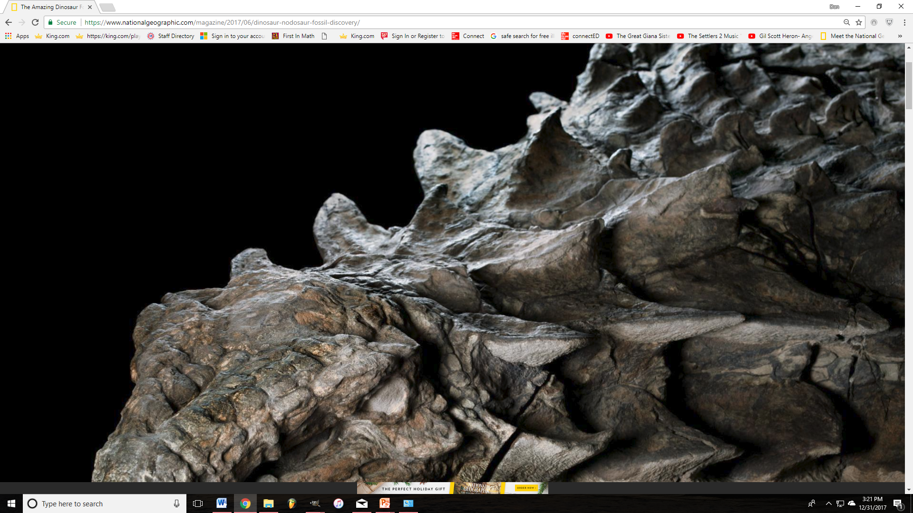
National Geographic's 3-D fossil! https://www.nationalgeographic.com/magazine/2017/06/nodosaur-3d-interactive-dinosaur-fossil/
STUNNING DISCOVERY Some 110 million years ago, this armored plant-eater lumbered through what is now western Canada, until a flooded river swept it into open sea. The dinosaur’s
undersea burial preserved its armor
in exquisite detail. Its skull
still bears tile-like plates
and a gray patina of
fossilized skins.
Unit 3 Fossils – Lesson 1 – 3 days
Let’s explore some online sites

Slide 19
National Geographic's 3-D fossil! https://www.nationalgeographic.com/magazine/2017/06/nodosaur-3d-interactive-dinosaur-fossil/
Unit 3 Fossils – Lesson 1 – 3 days
Unit 3 Fossils – Lesson 1
Let’s explore some online sites

Slide 20
With your group go to lynncronin.weebly.com and click on this image of the fossil. Once there use the down arrow to explore the find and answer questions.
Unit 3 Fossils – Lesson 1
Let’s explore some online sites

Slide 21
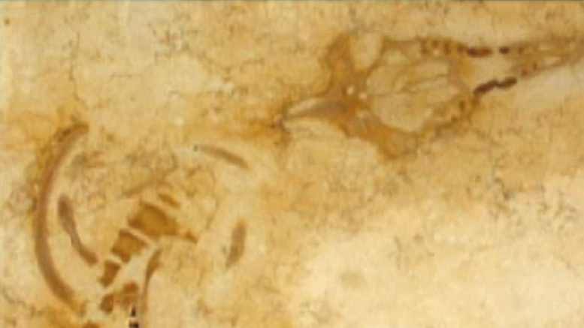
Fossils ruin a new marble countertop! https://www.youtube.com/watch?v=VXrsDHevV6I
Unit 3 Fossils – Lesson 1
Let’s explore some online sites

Slide 22
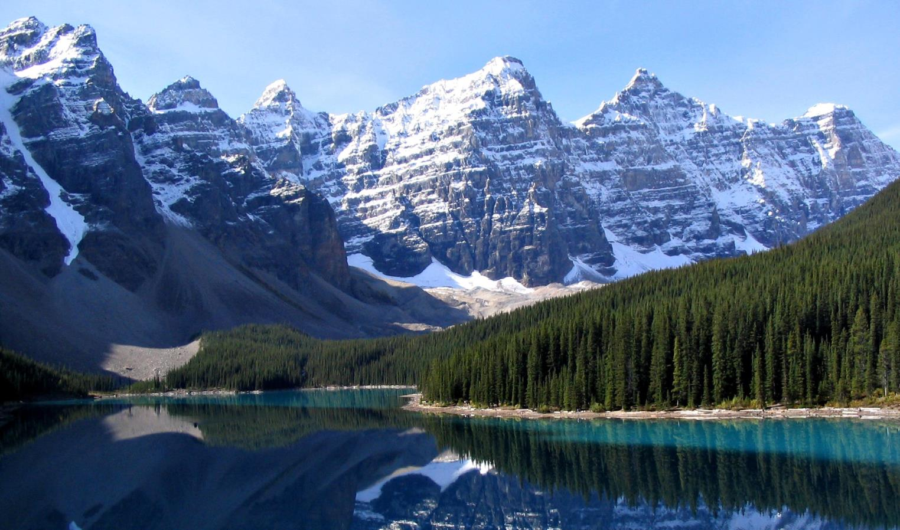
Unit 3 Fossils – Lesson 2
Unit 3 Fossils – Lesson 2
These are the Rocky Mountains

Slide 23
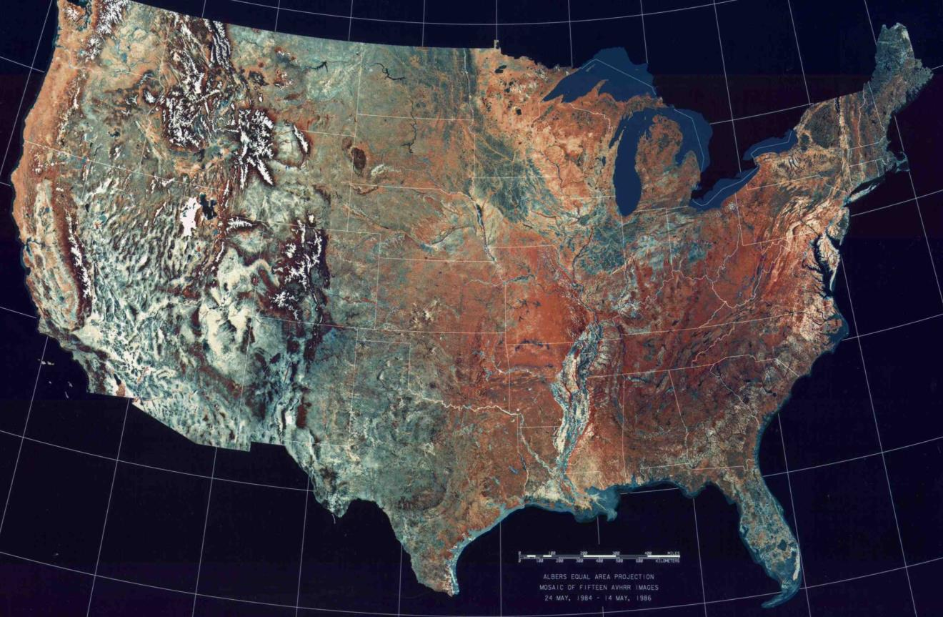
Unit 3 Fossils – Lesson 1
Unit 3 Fossils – Lesson 2
These are the Rocky Mountains

Slide 24
Unit 3 Fossils – Lesson 1
This is the Green River Formation

Slide 25
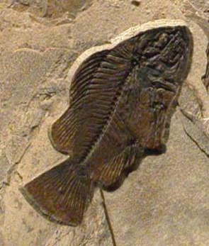
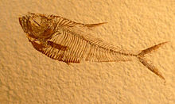
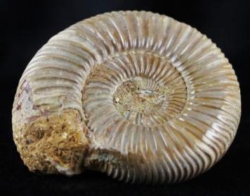
Unit 3 Fossils – Lesson 1
These fossils were found in the Green River Formation

Slide 26
How do fossils teach us about the United States in ancient times?
Unit 3 Fossils – Lesson 1
Essential Question

Slide 27
Watch this video https://www.youtube.com/watch?v=KVj5YwnMhyo
Unit 3 Fossils – Lesson 1
Essential Question

Slide 28
If the Green River Formation is on top of a mountain, but there are ancient fish and shells there, what was this land like millions of years ago?
Unit 3 Fossils – Lesson 1
Think about it…

Slide 29
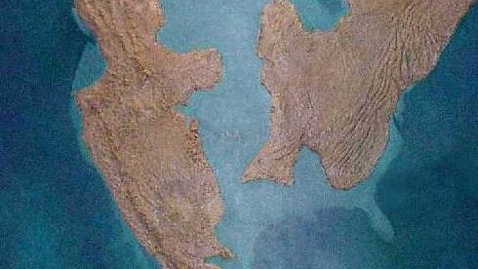
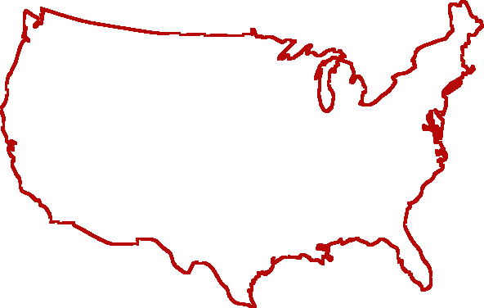
With evidence from fossils and from the rocks themselves, scientists have discovered that the United States was once broken in half by a huge ocean.
Unit 3 Fossils – Lesson 1
You should know
This is what the U.S. looked like 93 million years ago.
Did you notice that New Jersey is underwater too?

Slide 30
How do fossils teach us about the United States in ancient times? With your group answer the essential question in your notebook.
Unit 3 Fossils – Lesson 1
Essential Question

Slide 31
How is the environment of the Antarctic different today than it was in the past?
Unit 3 Fossils – Lesson 3
Essential Question

Slide 32
Where do you think ferns grow?
Unit 3 Fossils – Lesson 3
These are ferns

Slide 33
The closer you get to the equator, the warmer it gets.
Unit 3 Fossils – Lesson 3
These are ferns
Ferns live in warm places.

Slide 34
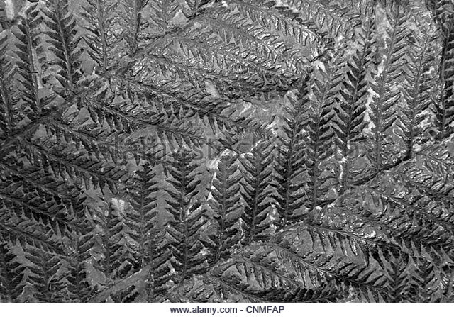
So why have we found these fern fossils in Antarctica?
Unit 3 Fossils – Lesson 3
Essential Question

Slide 35
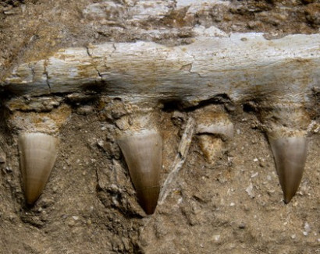
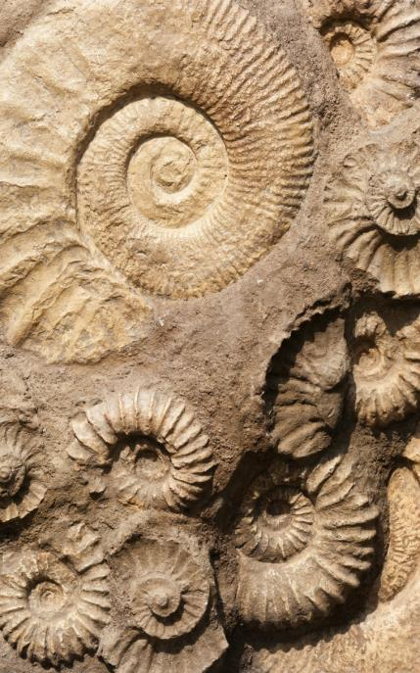
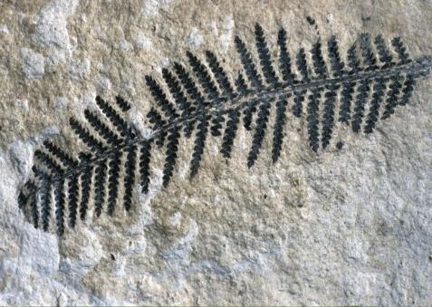
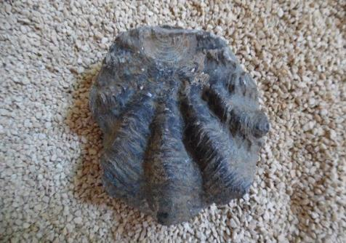
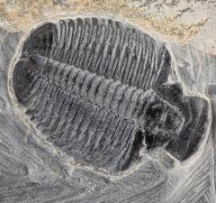
All of these fossils were found in the Antarctic
Unit 3 Fossils – Lesson 1 – 3 days
Unit 3 Fossils – Lesson 3

Slide 36
Read pages 70 & 71
Unit 3 Fossils – Lesson 3
Essential Question

Slide 37
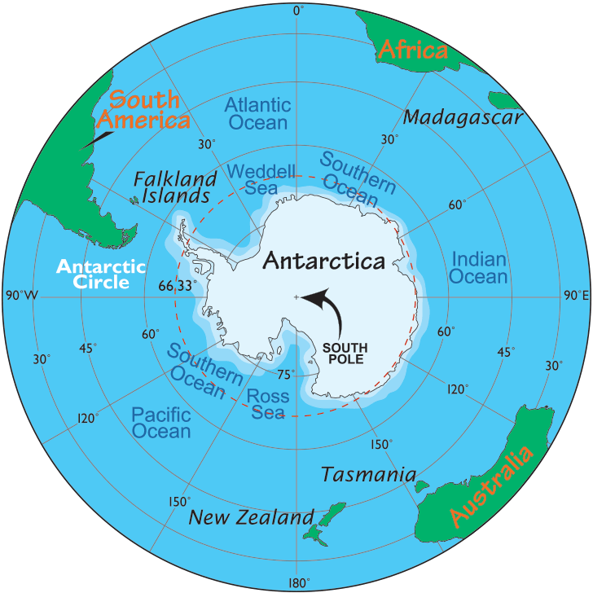
Antarctica is at the South Pole. What is the weather like there?
Unit 3 Fossils – Lesson 3

Slide 38
So how could ferns have ever grown there?
Unit 3 Fossils – Lesson 3
Essential Question

Slide 39
Watch this video https://www.youtube.com/watch?v=OMIzzpl1qJU
Unit 3 Fossils – Lesson 1 – 3 days
Unit 3 Fossils – Lesson 3

Slide 40
How is the environment of the Antarctic different today than it was in the past? With your group discuss this problem and write your answer in your notebooks.
Unit 3 Fossils – Lesson 3
Essential Question

Slide 41
Pangea eventually broke apart and the continents drifted to there current positions.
Unit 3 Fossils – Lesson 3

Slide 42
Millions and millions of years ago all of the land on earth was in one big island.
Unit 3 Fossils – Lesson 3

Slide 43
That island was called Pangea.
Unit 3 Fossils – Lesson 3

Slide 44
So… Antarctica could have grown ferns when it was much closer to the equator than it is now.
Unit 3 Fossils – Lesson 3

Slide 45
How has the world changed in the last hundred million years? With your group discuss this question and write your answer in your notebooks.
Unit 3 Fossils – Lesson 3
Essential Question

Slide 46
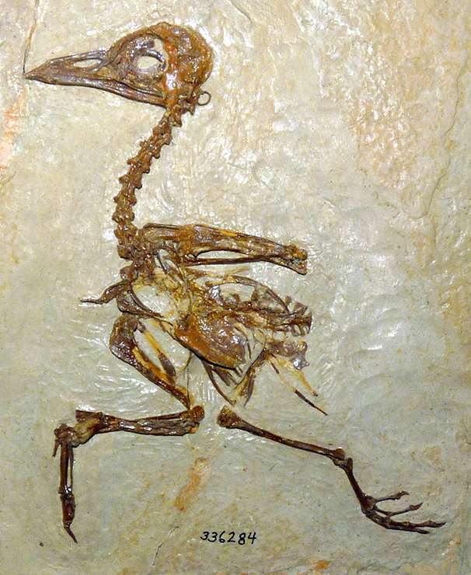
https://www.youtube.com/watch?v=C-6SfYJw3lo https://www.youtube.com/watch?v=SXoSD8u8Ck0
Unit 3 Fossils – Unit Investigation
Let’s watch a couple more videos!
Isn’t he cute?

Slide 47
Follow instructions on pages 74 & 75
Unit 3 Fossils – Unit Investigation
Think like a Scientist
Isn’t he cute?

