Slide 1
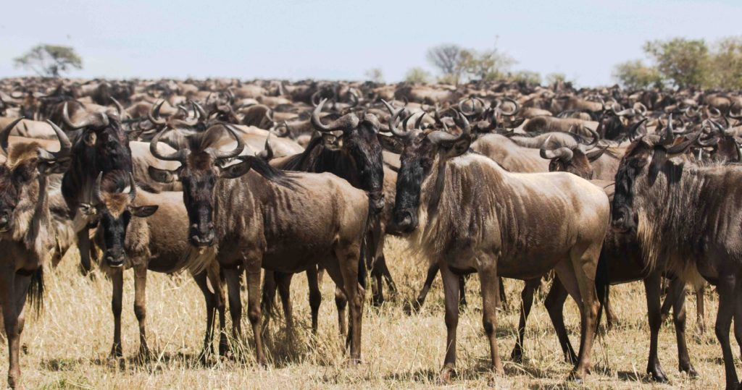
Why do you think these wildebeests hang out in a large group?
Unit 2 Lesson 3 Protection and Defense
Think about it…
https://lynncronin.weebly.com/unit-2-living-in-groups.html
A confusion of wildebeests

Slide 2
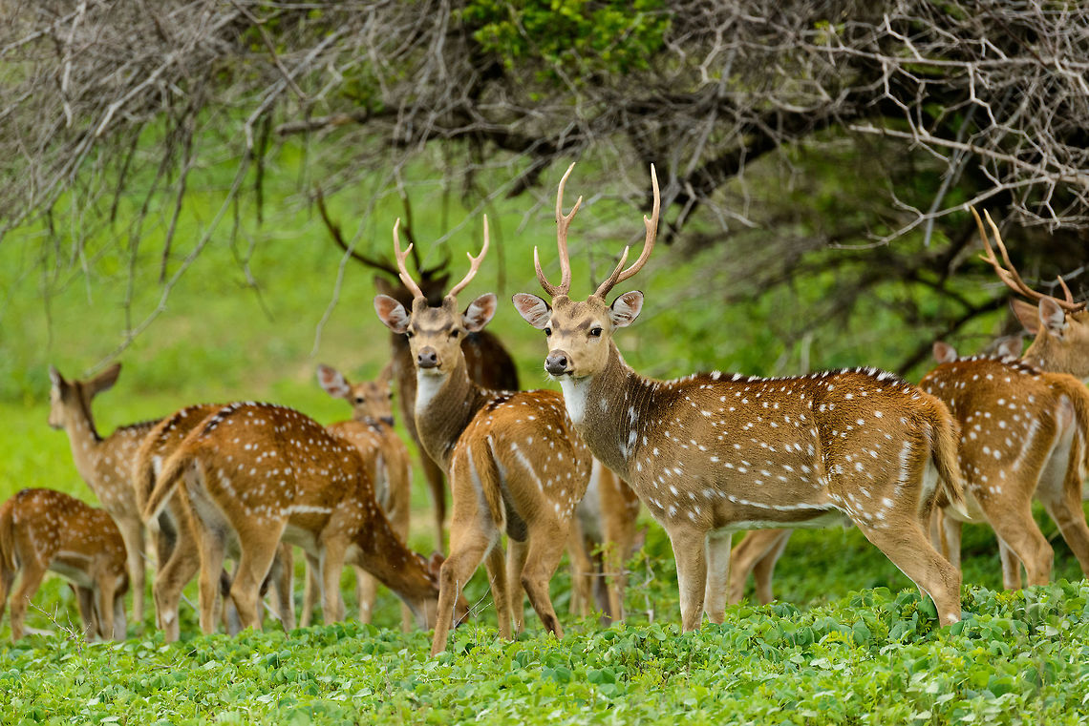
https://www.youtube.com/watch?v=o4lIz-CMWHw
Unit 2 Lesson 3 Protection and Defense
Watch this video
https://lynncronin.weebly.com/unit-2-living-in-groups.html
A herd of deer

Slide 3
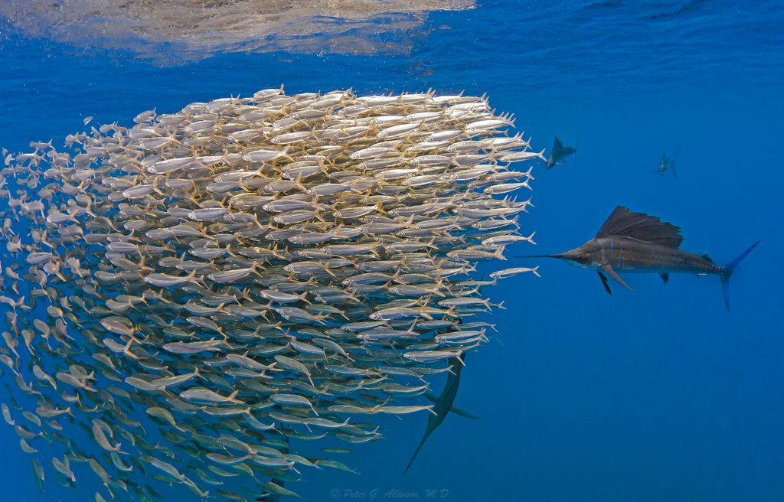
Read pages 60 & 61
Unit 2 Lesson 3 Protection and Defense
Think about it
https://lynncronin.weebly.com/unit-2-living-in-groups.html
A school of fish

Slide 4
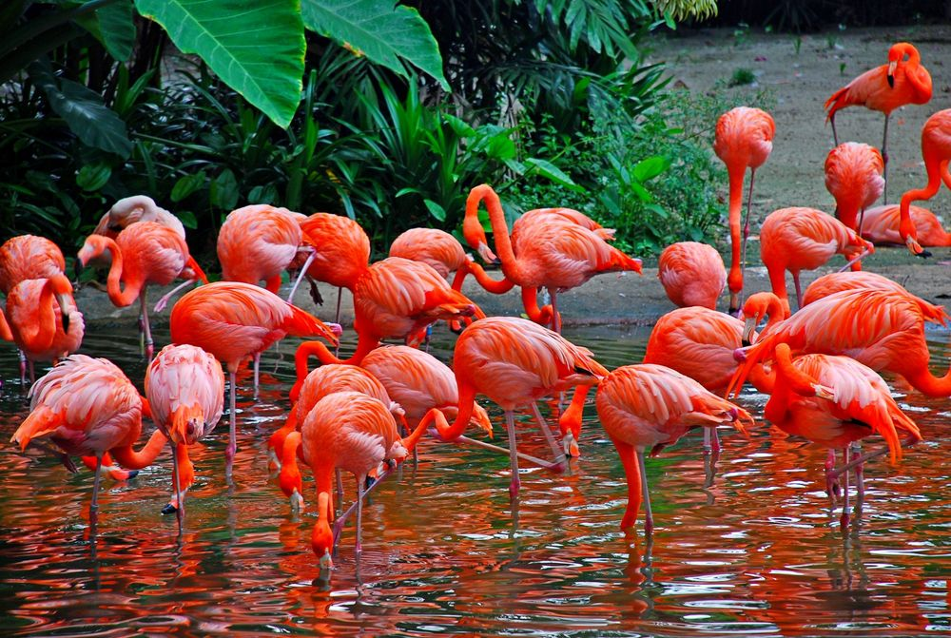
Read pages 60 & 61
Unit 2 Lesson 3 Protection and Defense
What did you learn?
https://lynncronin.weebly.com/unit-2-living-in-groups.html
How does staying in large groups help animals to survive?
A parcel of flamingos

Slide 5
This unit is titled Coping with Change What does that mean?
Unit 2 Lesson 4 Coping with Change
Think about it…
https://lynncronin.weebly.com/unit-2-living-in-groups.html
A sleuth of bears

Slide 6
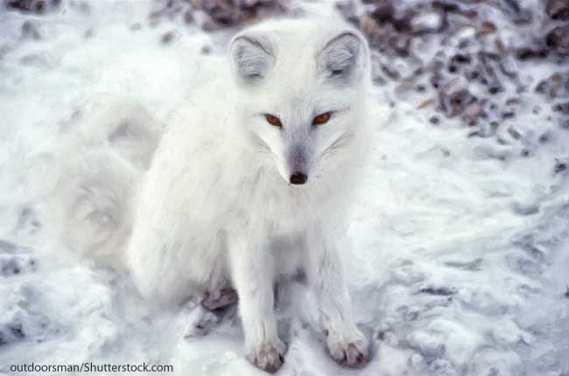
Many animals have winter adaptations to cope with the yearly change in temperature.
Unit 2 Lesson 4 Coping with Change
Coping with Change
https://lynncronin.weebly.com/unit-2-living-in-groups.html
A Skulk of Foxes

Slide 7
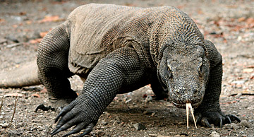
Watch this video https://www.youtube.com/watch?v=msTGoL-hGY0
Unit 2 Lesson 4 Coping with Change
Coping with Change
https://lynncronin.weebly.com/unit-2-living-in-groups.html
A Colony of Bees
A Bank of Komodo Dragons

Slide 8
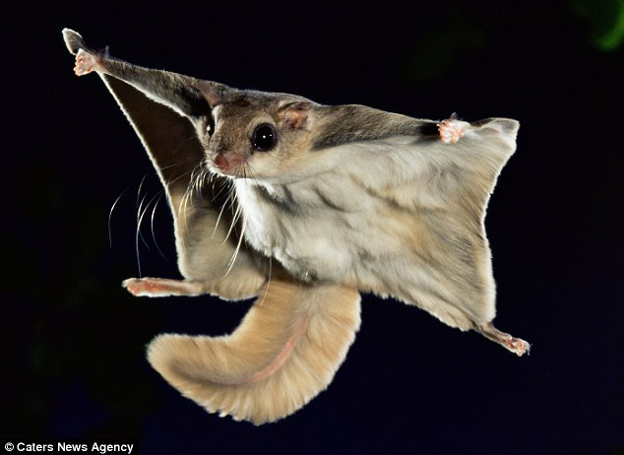
Read Pages 62 & 63
Unit 2 Lesson 4 Coping with Change
Unit 2 Lesson 1 Living in Groups
Coping with Change
https://lynncronin.weebly.com/unit-2-living-in-groups.html
Flying Squirrels nest
in groups in the winter – but not in the summer
A Dray of Flying Squirrels

Slide 9
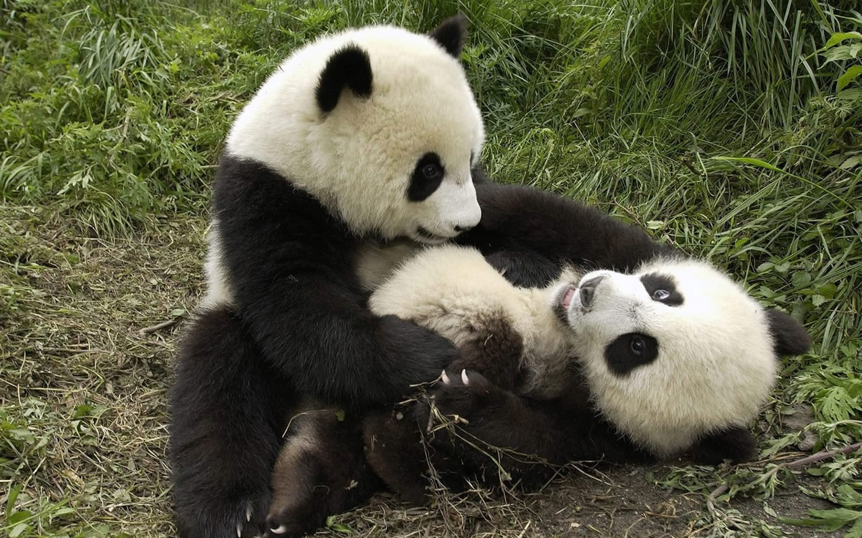
Animals also have begun to make changes because of climate change.
Unit 2 Lesson 4 Coping with Change
Coping with Change
https://lynncronin.weebly.com/unit-2-living-in-groups.html
A Bamboo of Panda

Slide 10
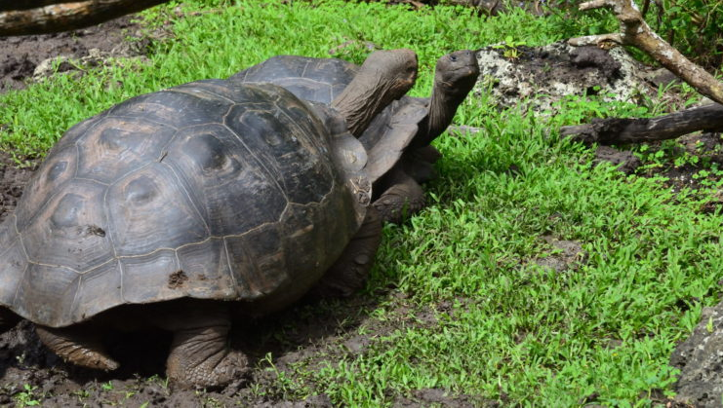
Watch this video https://www.youtube.com/watch?v=9h7P8gWpolQ
Unit 2 Lesson 4 Coping with Change
Coping with Change
https://lynncronin.weebly.com/unit-2-living-in-groups.html
A Creep of Tortoises

Slide 11
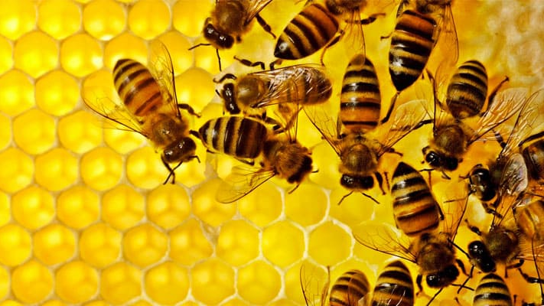
What condition causes bees to swarm? Re-read pages 62 & 63 if needed.
Unit 2 Lesson 4 Coping with Change
Coping with Change
https://lynncronin.weebly.com/unit-2-living-in-groups.html
A Colony of Bees

Slide 12
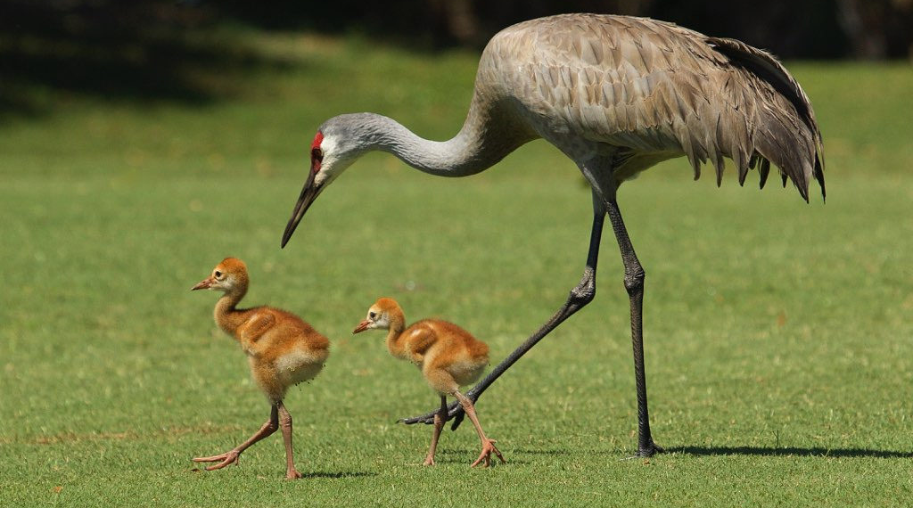
Watch this video https://www.youtube.com/watch?v=5asuptUEonE
Unit 2 Lesson 4 Coping with Change
Think About It…
https://lynncronin.weebly.com/unit-2-living-in-groups.html
A Flock of Sandhill Cranes

Slide 13
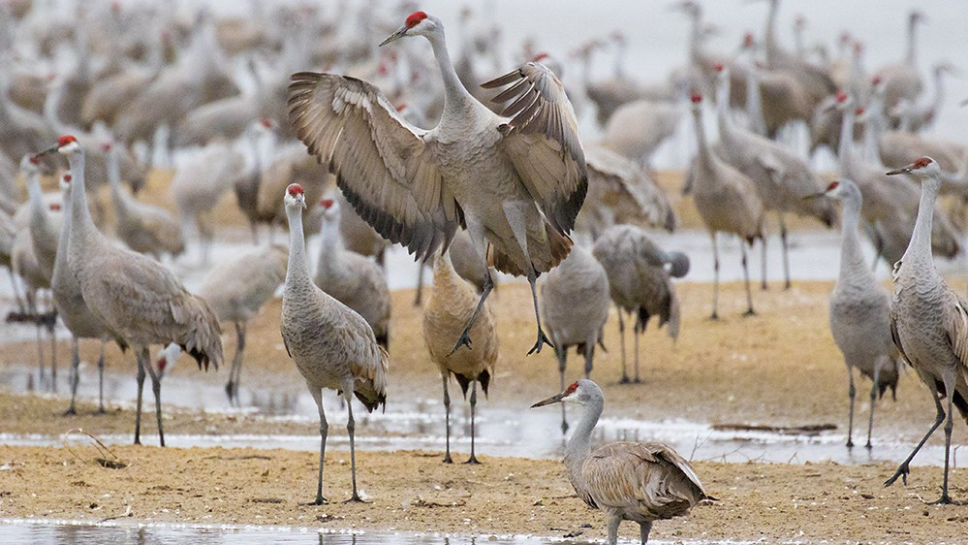
Read pages 65 & 65 and work with your group to write about Sandhill Cranes and the groups that they form.
Unit 2 Lesson 4 Coping with Change
Think About It…
https://lynncronin.weebly.com/unit-2-living-in-groups.html
A Flock of Sandhill Cranes

