Slide 1
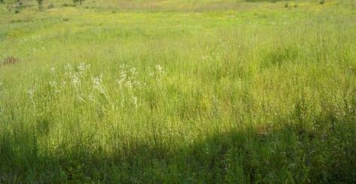
How do the living things
use the non-living things
in order to survive?
Pages 38 - 51
Essential Question

Slide 2
Name the living things in this picture
A salamander, the trees, ivy,
the fungus on the log
Name the non-living things in this picture
Water, rocks, soil, and even the air,
sunlight, and temperature
Read the pages
Look at the picture on page 38/39

Slide 3
How do the living things in
this ecosystem interact with
the non-living things?
The plants use the water and the sunlight.
The fungus needs the dead log.
The salamander drinks the water and eats something in this ecosystem
Look at the picture on page 38/39

Slide 4
Ecosystem
An environment and all of its
living and non-living things
Population
all of one type of living thing
in an environment
(all of the squirrels in my backyard, but not the skunks)
Essential Vocabulary

Slide 5
Each of you will be assigned
to a group to research a biome
Tropical Rainforest
Grasslands
Tundra
Desert
Coral Reef
Research

Slide 6
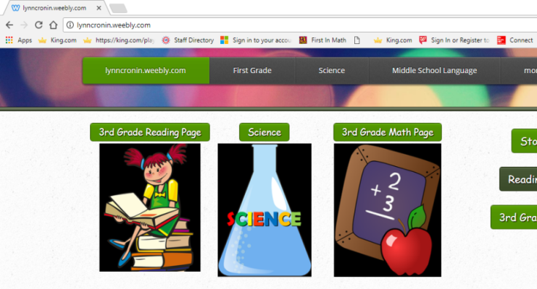
Research
go to lynncronin.weebly.com
Click on the science picture
CLICK ON THE SCIENCE PICTURE

Slide 7
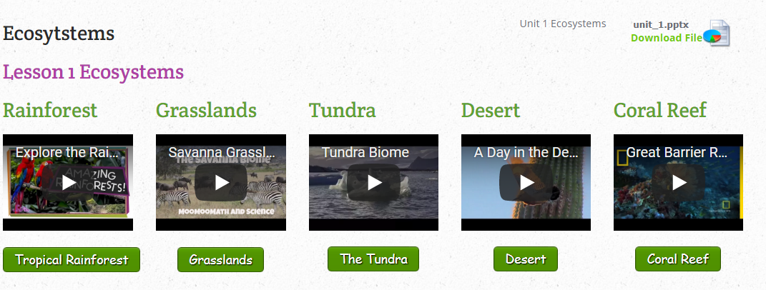
Research
CLICK ON THE VIDEO FOR YOUR BIOME

Slide 8
Research
IF YOU FINISH EARLY
CLICK ON THE BUTTON TO WATCH ANOTHER VIDEO!
BUTTON

Slide 9
Research Question
What is your ecosystem called?
What is the weather like?
What animals live there?
How do the living and non-living things interact?

Slide 10
Now that you know a little more….
Wrap it Up!
What is an ecosystem?
Look back at the picture on page 38/39
What do you see now?

Slide 11
How do the living things use the non-living things in order to survive?
Essential Question

Slide 12
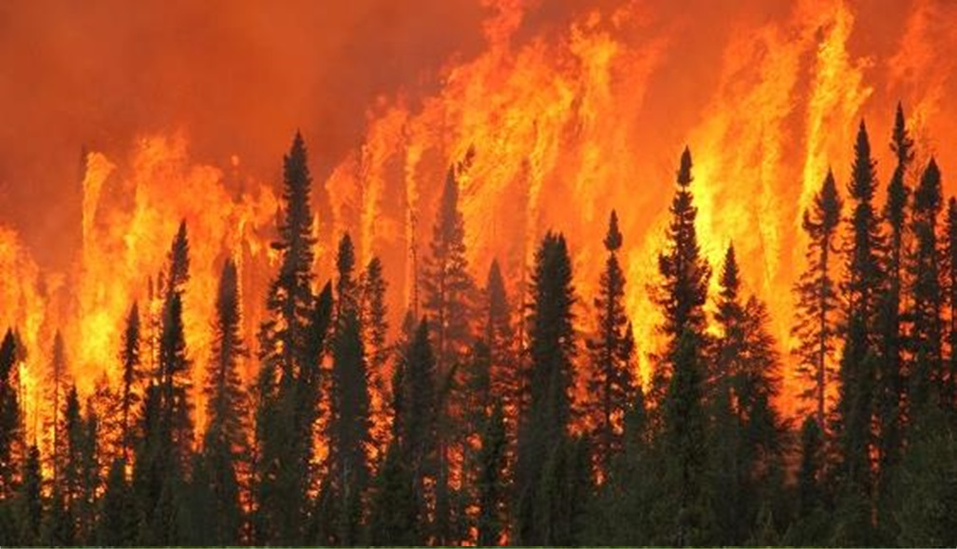
How do changes in an environment affect the populations that live there?
Essential Question

Slide 13
Essential Vocabulary
Ecosystem An environment & all of its living and non-living things
Population all of one type of living thing in an environment
Physical Characteristics
Things that you can see (blue eyes, green grass)

Slide 14
Look at the picture on page 40/41
What are the physical characteristics that you see?
Burning trees, fallen blackened trees, new trees
beginning to grow. New grasses growing
How would this fire have affected the animal populations?
Birds flew away, larger animals ran away, some animals died.
Read the pages

Slide 15
Think about it…
After the fire, can the deer move right back in?
No, the fire destroyed their food supplies and their shelters.
How could some species benefit from a fire like this?
The burned wood adds nutrients, flowers and grasses grow New pine trees grow from the seeds

Slide 16
Watch this Video
Forests born of Fire
https://www.youtube.com/watch?v=1BmTq8vGAVo

Slide 17
Talk with your partners
How might the number of
rabbits in this forest change
after the fire?
Why?

Slide 18
Talk with your partners
How might a hurricane
change an environment?

Slide 19
How do changes in an environment affect the populations that live there?
Essential Question

Slide 20
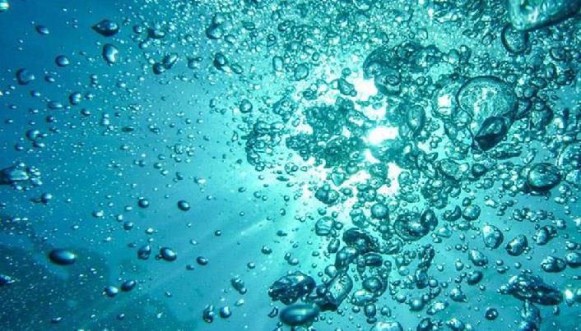
How does the availability of water affect organisms living in an environment?
Essential Question

Slide 21
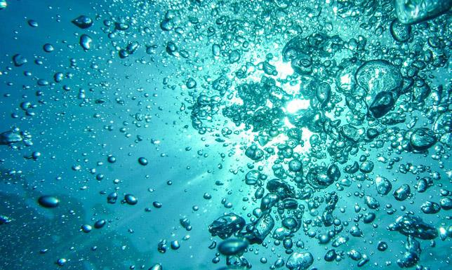
Vocabulary
Ecosystem An environment & all of its living and non-living things
Population all of one type of living thing in an environment
Physical Characteristics Things that you can see
Migration
The annual movement of animals to another location. (Birds fly south)
Drought
A period with very little or no rain

Slide 22
Look at the picture on page 42/43
i
What do some of the animals
do in the dry season?
Big animals migrate to a nicer place. Birds sometimes fly
away and sometimes they stay around hunting for tiny
puddles of water to drink. Most fish die, but some
hibernate in the mud until it rains again!
Read the pages

Slide 23
Watch this Video
The African Savanna
https://www.youtube.com/watch?time_continue=12&v=9bQNRVyI4I0

Slide 24
Talk with your partners
How do you think a flood would affect the animals on the African Savanna?

Slide 25
Talk with your partners
What might happen to the population of wildebeests if they did not migrate?

Slide 26
How does the availability of water affect organisms living in an environment?
Essential Question

Slide 27
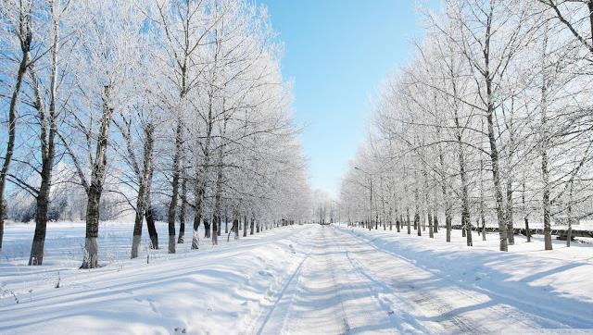
Essential Question
How do you think cold temperatures affect the populations of animals that live in an environment?

Slide 28
Vocabulary Review
Ecosystem An environment & all of its living and non-living things
Population all of one type of living thing in an environment
Physical Characteristics Things that you can see
Migration The annual movement of animals to another location
Drought a period with little or no rain

Slide 29
Vocabulary
Deciduous Trees
Trees that lose their leaves in the winter.
Hibernate
A period deep sleep to save energy when an animal can’t eat

Slide 30
Look at the picture on pages 44/45
Which of these organisms are experiencing cold temperatures? Why?
The dormouse is hibernating in her warm nest. She is sleeping very deeply so that she does not use much energy because she does not eat until spring.
The honeybees are working in the summertime to make enough
honey to eat through the long, cold winter.
Read the pages

Slide 31
Watch this Video
Winter Adaptations
https://www.youtube.com/watch?v=NK058-HUK24

Slide 32
Watch this Video
How would you like to prepare for winter?

Slide 33
Essential Question
How do you think cold temperatures affect the populations of animals that live in an environment?

Slide 34
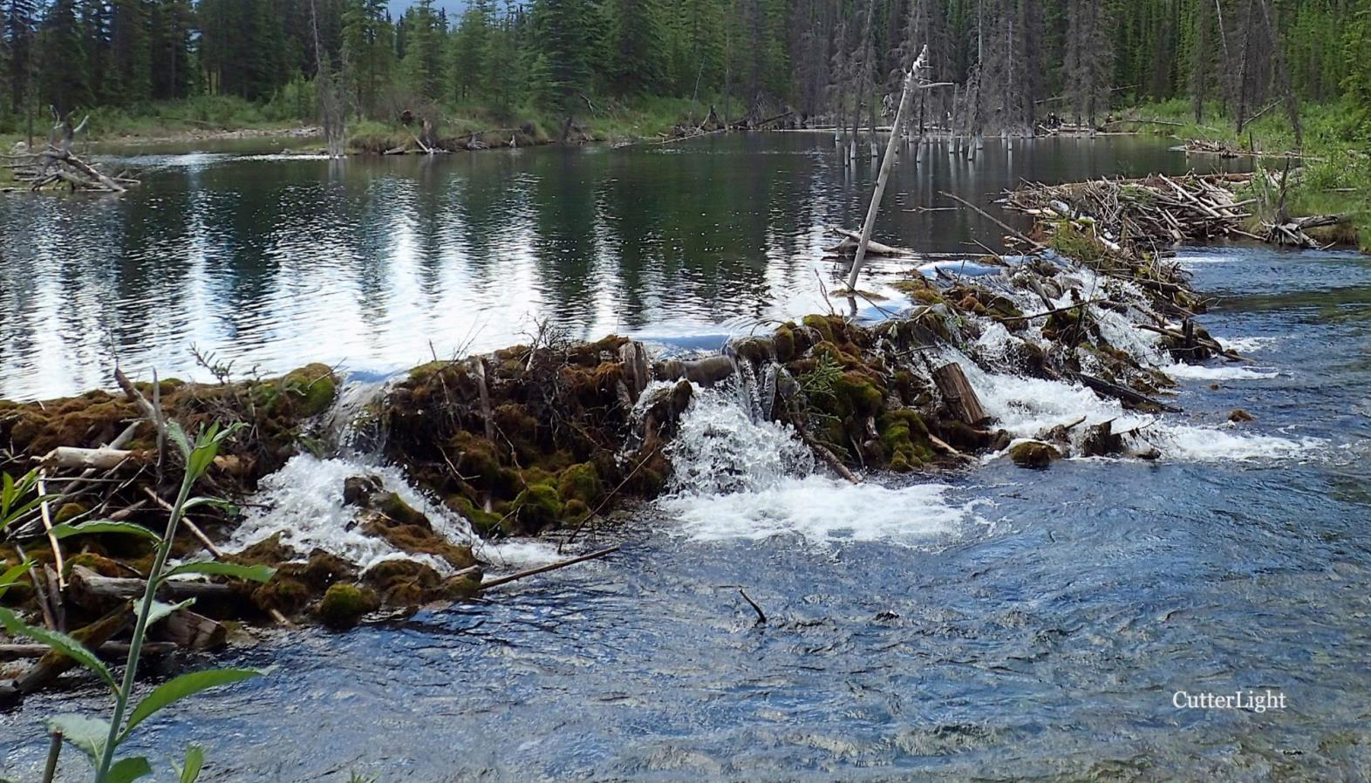
This is a beaver dam. How do you think this changes the ecosystem?

Slide 35
Essential Questions
How do living things change the environment that they live in?
How do those changes affect the
other organisms that live there?

Slide 36
Vocabulary Review
Ecosystem An environment & all of its living and non-living things
Population all of one type of living thing in an environment
Physical Characteristics Things that you can see
Migration The annual movement of animals to another location
Drought a period with little or no rain
Hibernation deep sleep to save energy
Deciduous Trees trees that lose their leaves in winter

Slide 37
New Vocabulary
Habitat
The place where a plant or animal lives
and gets everything it needs to survive
Predator
An animal that eats other animals in order to survive

Slide 38
Look at the picture on page 46/47
How did the beavers make this dam?
Beavers use sticks and mud to build a dam.
Read the pages

Slide 39
Watch this video
Fooled by Nature
Beaver Dams
https://www.youtube.com/watch?v=Na2HYq11yuM

Slide 40
Look at the picture on page 46/47
How do you think the beaver’s dam helped other organisms
in this habitat?
The beaver’s dam creates a pond that is the perfect place
for frogs, plants, fish and small mammals to live.

Slide 41
Talk with your partners
Could a plant change the
habitat that it lives in?

Slide 42
Watch this video
The wolves at Yellowstone
https://www.youtube.com/watch?v=ysa5OBhXz-Q

Slide 43
Research with your partners
Re-watch these videos on lynncronin.weebly.com
“Fooled by Nature -Beaver Dams”
“Great Beaver Dam Flood”
“The Wolves at Yellowstone”

Slide 44
Essential Questions
How do living things change the environment that they live in?
How do those changes affect the
other organisms that live there?

Slide 45
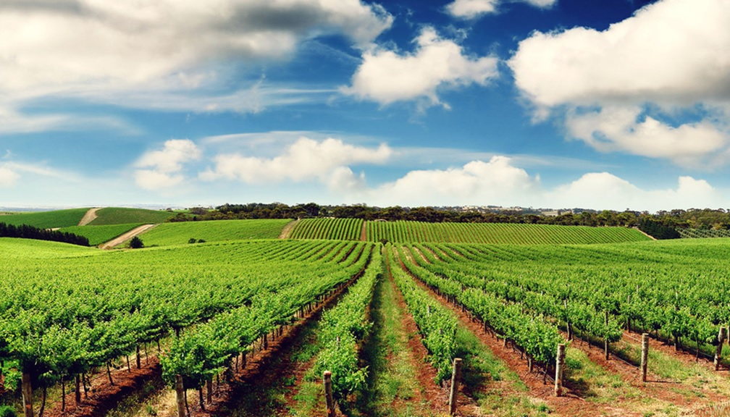
This is an apple tree orchard.
How would an apple orchard affect the organisms that live in this environment?

Slide 46
Which human activities
change land?
How do those activities affect the organisms in the ecosystem?
Essential Questions

Slide 47
Vocabulary Review
Ecosystem An environment & all of its living and non-living things
Population all of one type of living thing in an environment
Physical Characteristics Things that you can see
Migration The annual movement of animals to another location
Drought a period with little or no rain
Hibernation deep sleep to save energy
Deciduous Trees trees that lose their leaves in winter
Habitat the place where plants or animals live and get everything they need to survive
Preditor an animal that eats other animals in order to survive

Slide 48
New Vocabulary
Climate Change
A long term change in Earth’s climate caused by human activities
Reduce
Re-Use
Recycle
Buy things that use less packaging.
Use less of everything
Use anything you can again. Like using shopping bags for trash.
Never throw anything out until you find out if we can make something new out of it.

Slide 49
Look at the picture on page 48/49
What are these people doing?
The people in the big picture are loggers
They cut down trees so that we can build things like houses.
The other people are planting trees.
Can you name 5 things that people
do to change the land around them?
Logging, farming, building houses, dams and bridges.
Read the pages

Slide 50
Watch This Video
Climate Change 101
https://www.youtube.com/watch?v=oJAbATJCugs

Slide 51
Plant Trees?
Watch this video
https://www.youtube.com/watch?v=XVUAgcSCP_U

Slide 52
Talk to your partners
Discuss how trees can help fight global warming with your partners.

Slide 53
Research
With your group
choose 2
Global Warming videos
on lynncronin.weebly.com

Slide 54
Research
As a group
decide on 5 things
that you can do to
reduce global warming.

Slide 55


Will these trees help or hurt?
American farmers use
pesticides & fertilizers that pollute
And…
Farmers make sure their fields
are NOT good for insects
and animals to live in .
American farmers grow more food than any other country in the world!
Our trees help to make more oxygen!
There is no good answer to that question.

Slide 56
Research
Create a poster to educate
other students about what we
need to do to save our planet.

Slide 57
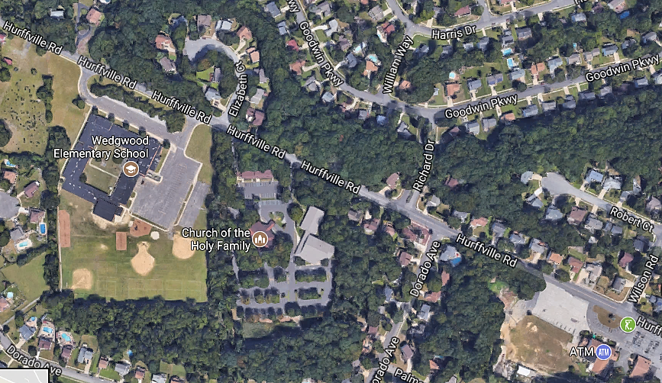
This is our neighborhood.
What do you think this looked like before we arrived?

Slide 58
Essential Questions
How do human activities
affect the organisms
in the ecosystem?

Slide 59
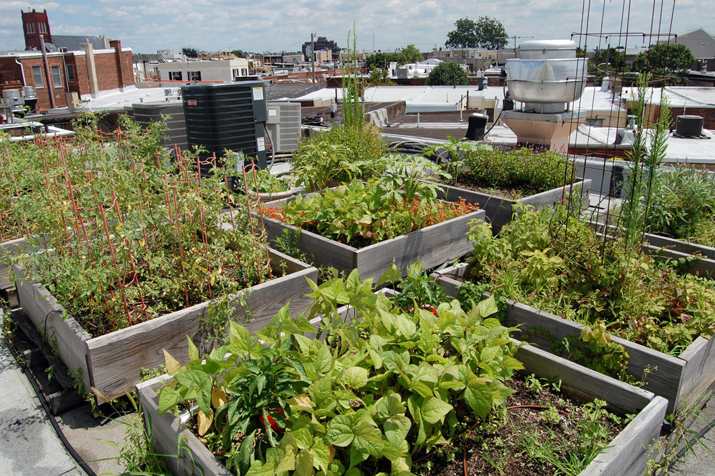
Think About it…
This rooftop garden is in Philadelphia.

Slide 60
Think About it…
How does this garden help
with the ecosystem of the city?
The garden produces oxygen
and helps to clean the air.
It also provides a safe place for
birds and insects.
They also help to control rainwater and they could be used to grow food.

Slide 61
Think About it…
What are some problems with
building a garden on a roof?
It is very heavy – water weighs a lot.
Some of the insects might hurt the plants
and using insecticides might be a problem
if they run off into the city streets.

Slide 62
Think About it…
How might the rooftop gardens effect the bird population in the city?
The number of birds should rise because they have a safe place to live and plenty of food.
The type of birds in the city might also change.

Slide 63
Think About it…
How could a garden planner
help the birds?
By planting crops that are make good homes and
that are good food for certain types of birds.
For example, there are certain flowers that attract hummingbirds. As long as you also provide water, some hummingbirds could live their entire lives on the roof in Philly!

