Slide 1
Wegener was Right!

Slide 2
Wegener believed that the Continents were moving.
Everyone said he was crazy.

Slide 3
He spent most of his life trying to prove that he was correct, but when he died in 1930 he had still not found the evidence

Slide 5
Then, during World War Two ships began to map the sea-floor with sonar.
And in the 50s Hess began collection more evidence.

Slide 6
And by the late 1960s all the evidence was in – Wegener had been right! And Hess figured out how it all worked!

Slide 7
http://www.youtube.com/watch?v=GyMLlLxbfa4
Sea-Floor Spreading
Explain how sea-floor spreading provides a way for continents to move.
Describe how new oceanic lithosphere forms at mid-ocean ridges.

Slide 8
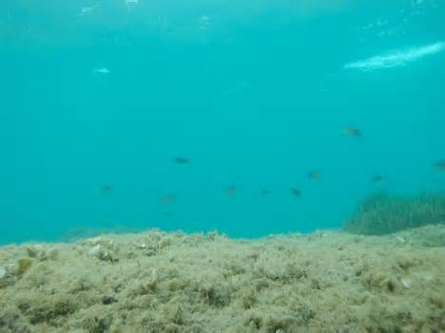
The Ocean Floor
Before World War II, people thought the seafloor was completely flat and featureless. There was no reason to think otherwise.

Slide 9
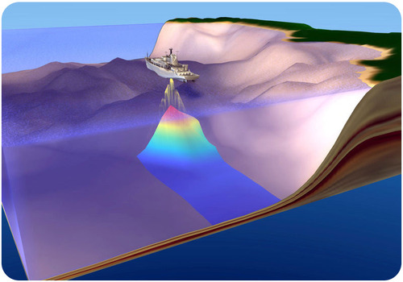
Echo
During the World War 2, battleships and submarines carried echo sounders. Their goal was to locate enemy submarines.
Echo sounders produce sound waves that travel outward in all directions. When the sound bounces back to the ship they can figure out what is out there.
Most of these sound waves did not hit submarines. They instead were used to map the ocean floor.
Sounders

Slide 10
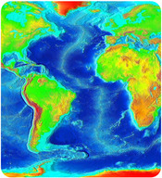
Features of
The Seafloor
Scientists were surprised to find huge mountains and deep trenches when they mapped the seafloor. In the middle of the Atlantic Ocean there were huge mountains.
Near the edges of South America there were very deep spots that they now call trenches.
This map uses dark blue to show the deepest parts of the oceans

Slide 11
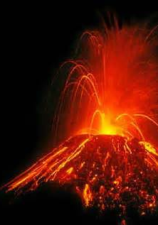
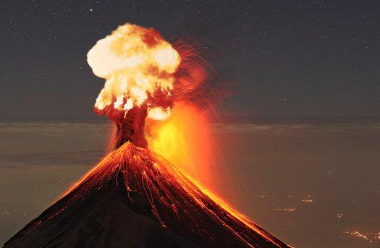
Near the trenches were volcanoes!
Deep sea trenches are found near chains of active volcanoes. These volcanoes can be at the edges of continents or in the oceans.
Trenches are the deepest places on Earth. The deepest trench is the Mariana Trench in the southwestern Pacific Ocean.

Slide 12
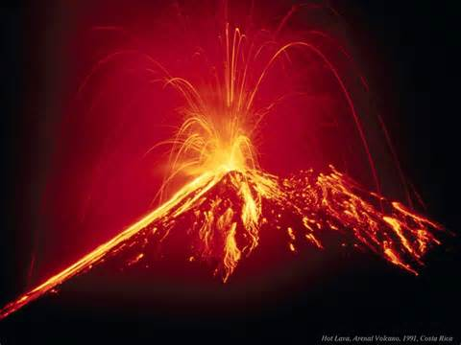
Near the trenches were volcanoes
Deep sea trenches are found near chains of active volcanoes. These volcanoes can be at the edges of continents or in the oceans. Trenches are the deepest places on Earth. The deepest trench is the Mariana Trench in the southwestern Pacific Ocean. This trench plunges about 11 kilometers (35,840 feet) beneath sea level. The ocean floor does have lots of flat areas. These abyssal plains are like the scientists had predicted.

Slide 13
They knew something was going on.
But What?

Slide 14
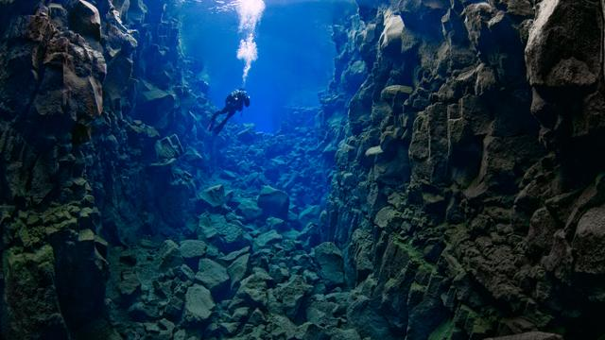
The Sea-floor
The scientists used geologic dating techniques on seafloor rocks. They found that the youngest rocks on the seafloor were at the mid-ocean ridges. The rocks get older with distance from the ridge crest.

Slide 15
The Sea-floor
They were surprised to find that even the oldest rocks on the seafloor where less than 180 Million years young!
Young?
Yes – young – the rocks at the edges of the continents were incredibly young.
180 million years is young because the oldest continental crust is around 4 billion years old.

Slide 16
Crazy but true…
Scientists found that the youngest crust that they could find in the ocean was very, very new.
And it was all in the middle of the oceans.
And it was all found in the trench shown here.
The mid-ocean ridge.

Slide 17
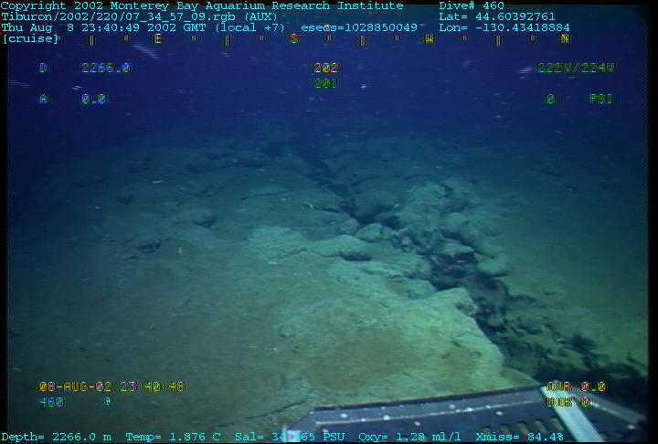
Scientists also discovered that the mid-ocean ridge crest is nearly sediment free. The crust is also very thin there. With distance from the ridge crest, the sediments and crust get thicker. This also supports the idea that the youngest rocks are on the ridge axis and that the rocks get older with distance away from the ridge (Figure below). Something causes the seafloor to be created at the ridge crest. The seafloor is also destroyed in a relatively short time.

Slide 18
Scientists also discovered that the crust at the mid-ocean ridge crest is very thin and that as new sea-floor is created the older rock gets pushed towards the shores of the Ocean.
Older Crust
New Crust
Older Crust

Slide 19
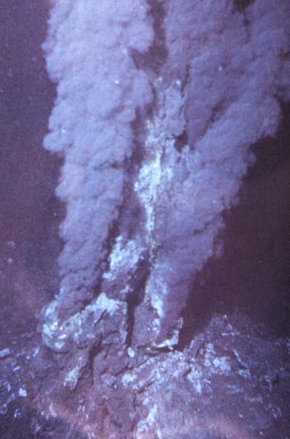
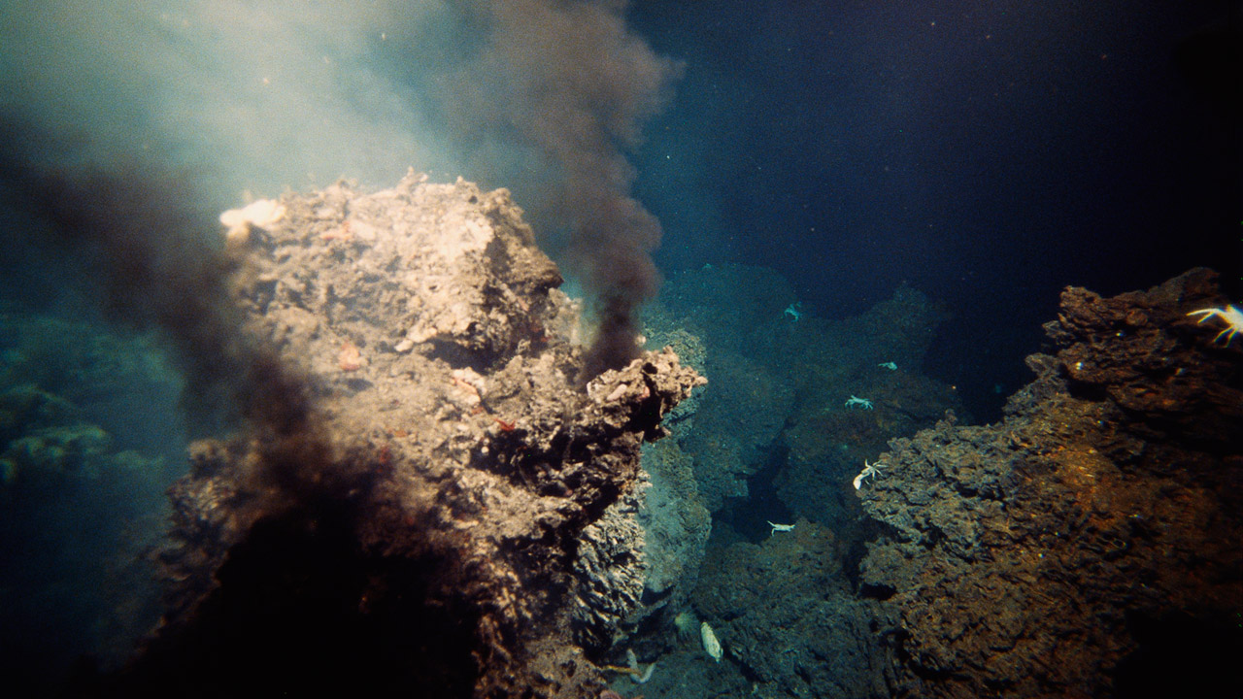

Slide 20
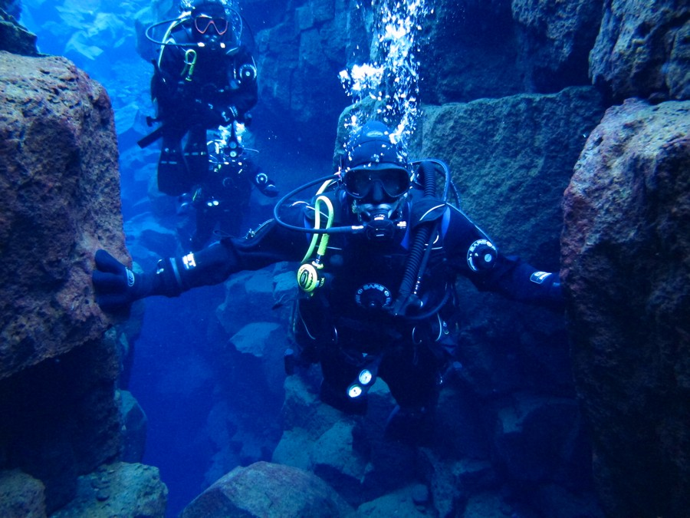

Slide 21
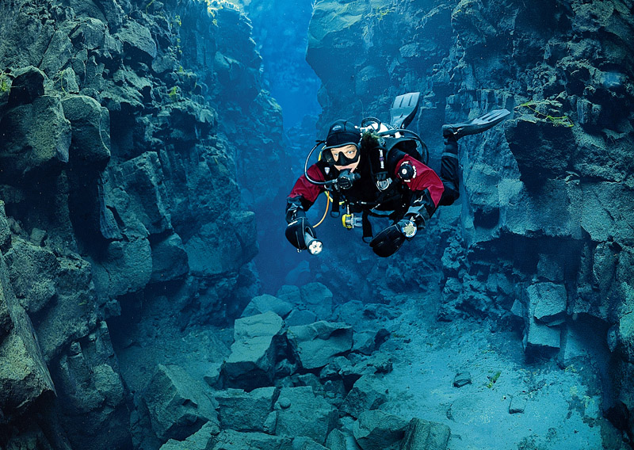

Slide 22
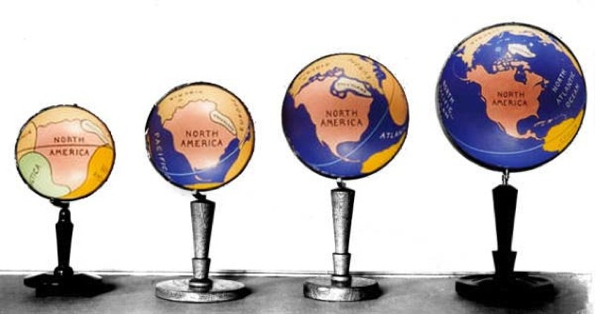
But
if new sea-floor is being added to the Earth
then the Earth should be getting bigger like this…
BUT EARTH IS NOT GETTING BIGGER!
Older Crust
New Crust
Older Crust

Slide 23
If Earth was getting bigger we would have more mass.
If we had more mass we would have more gravity.
If we had more gravity we would be getting closer and closer to the sun.
If we had more gravity our moon would have crashed into Earth by now because of our immense gravity.
BUT EARTH IS NOT GETTING BIGGER!
Older Crust
New Crust
Older Crust

Slide 24
SO… IF EARTH IS NOT GETTING BIGGER – WHY NOT?
If we are adding more rock to the crust of our planet – our planet should be getting bigger – BUT IT IS NOT.
So somewhere on Earth rock must be disappearing!
Older Crust
New Crust
Older Crust

Slide 25
https://www.youtube.com/watch?v=ryrXAGY1dmE
Subduction
Explain why the Earth is not getting larger

Slide 26
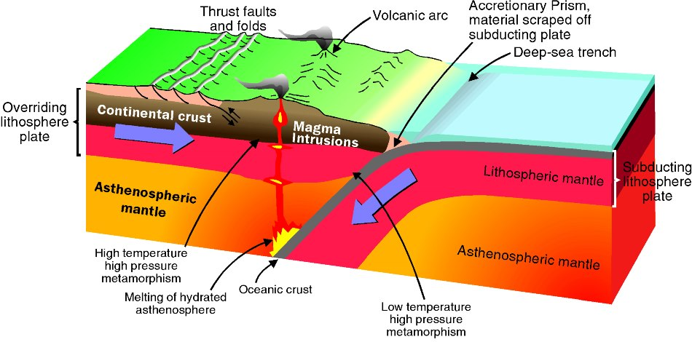
Trenches are the deepest places on earth.
Deep-sea trench

Slide 27
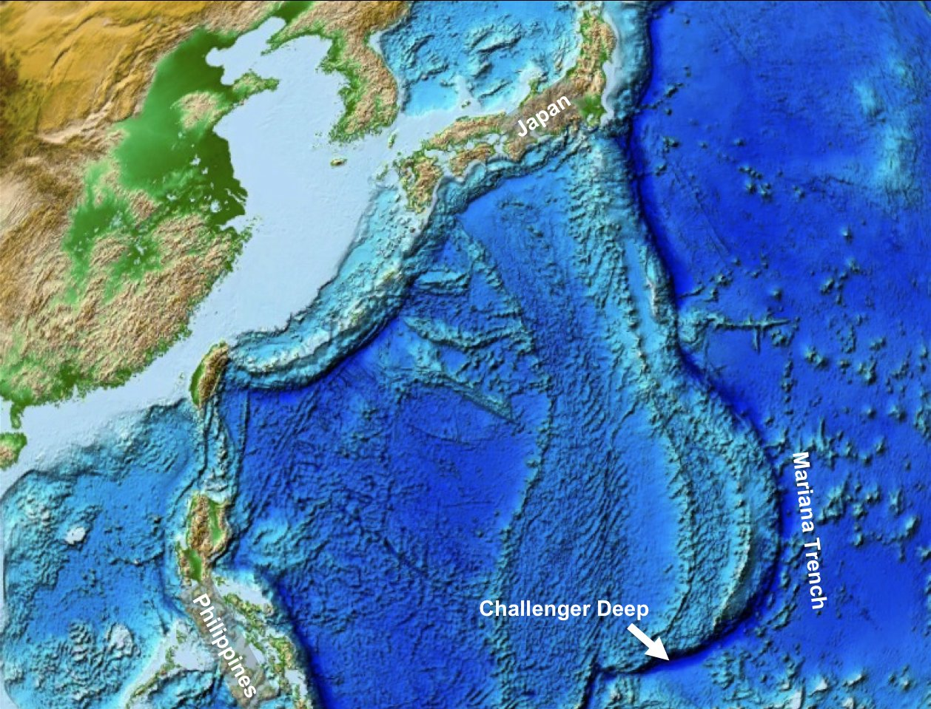
The Mariana Trench

Slide 28
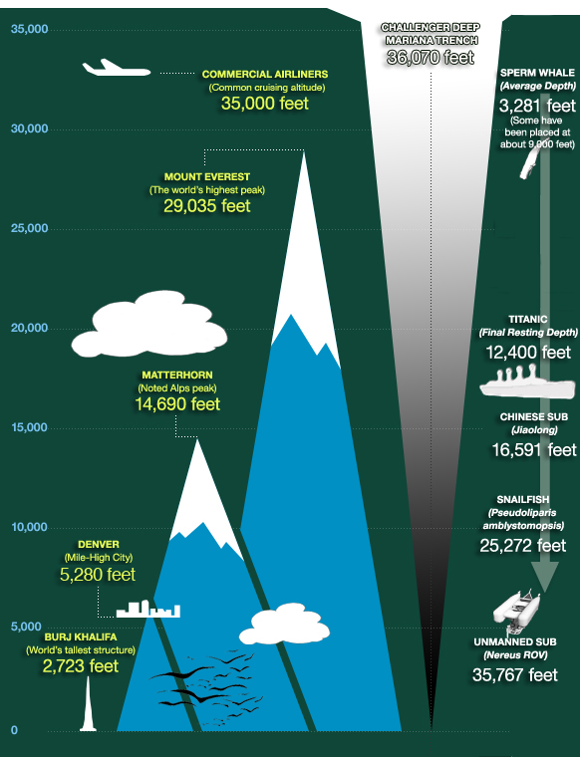
The Mariana Trench is a crescent-shaped scar in the Earth’s crust that measures more than 1,500 miles (2,550 kilometers) long and 43 miles (69 kilometers) wide on average. The distance between the surface of the ocean and the trench’s deepest point—the Challenger Deep, which lies about 200 miles (322 kilometers) southwest of the U.S. territory of Guam—is nearly 7 miles (11 kilometers). If Mount Everest were dropped into the Mariana Trench, its peak would still be more than a mile (1.6 kilometers) underwater.
Deep-sea trench

Slide 29
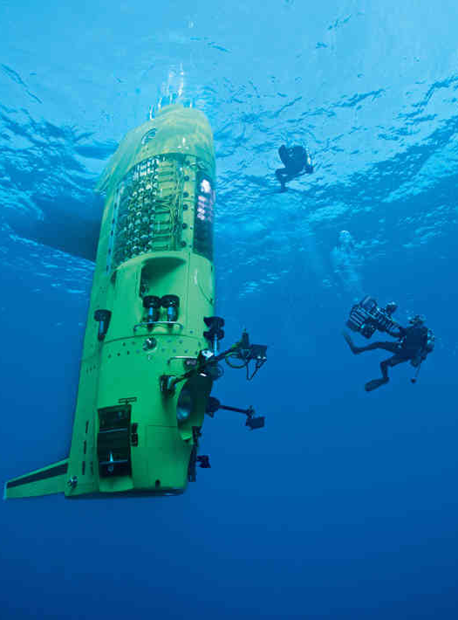
The Challenger went to the bottom of the Mariana Trench

Slide 30
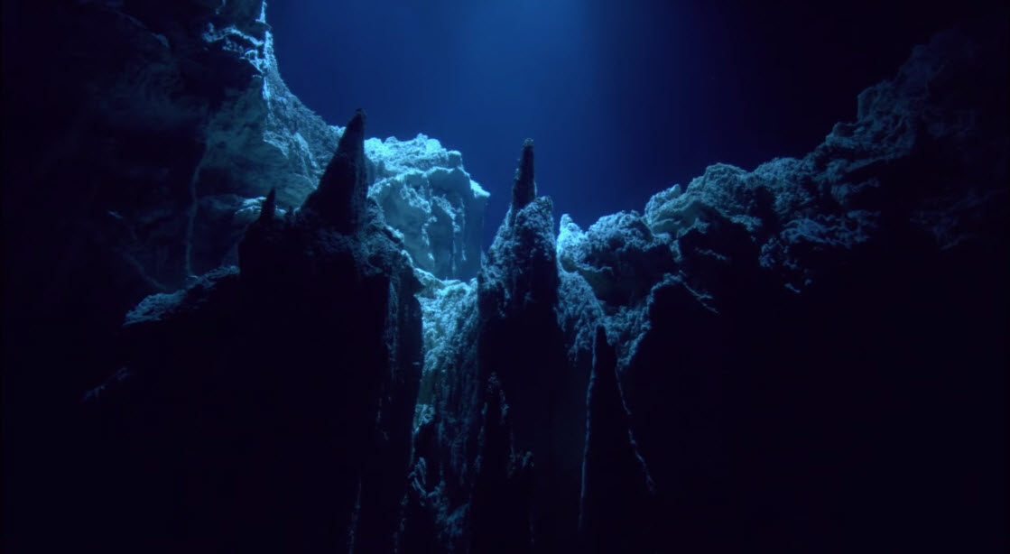
The Challenger went to the bottom of the Mariana Trench

Slide 31
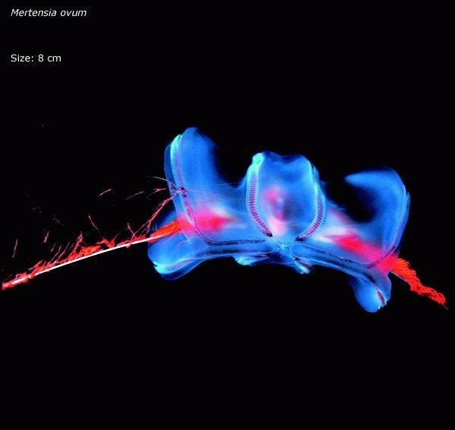

Slide 32
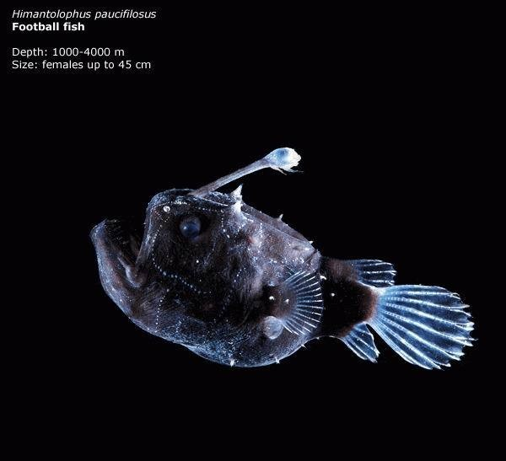

Slide 34
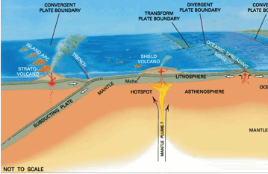
The big picture

