Slide 1
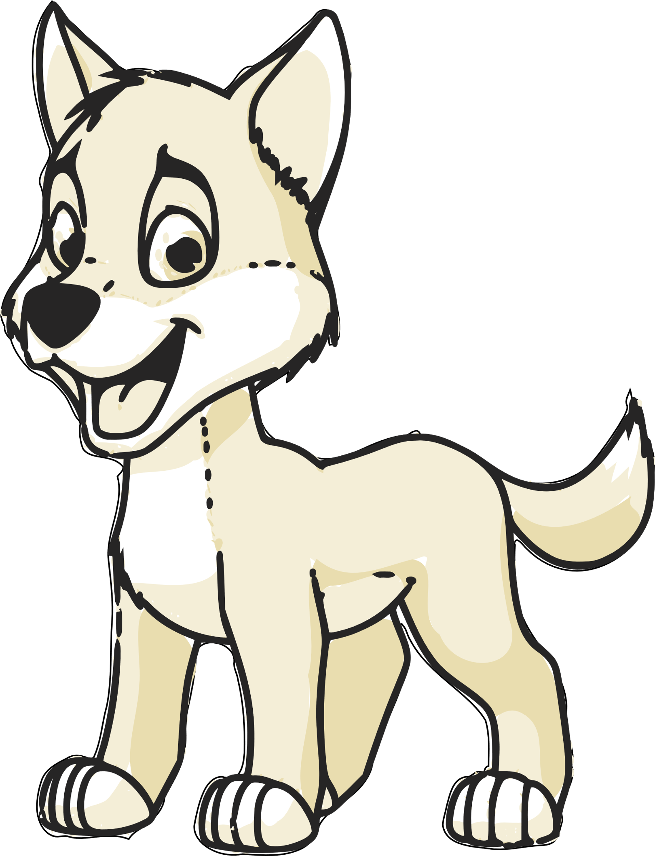
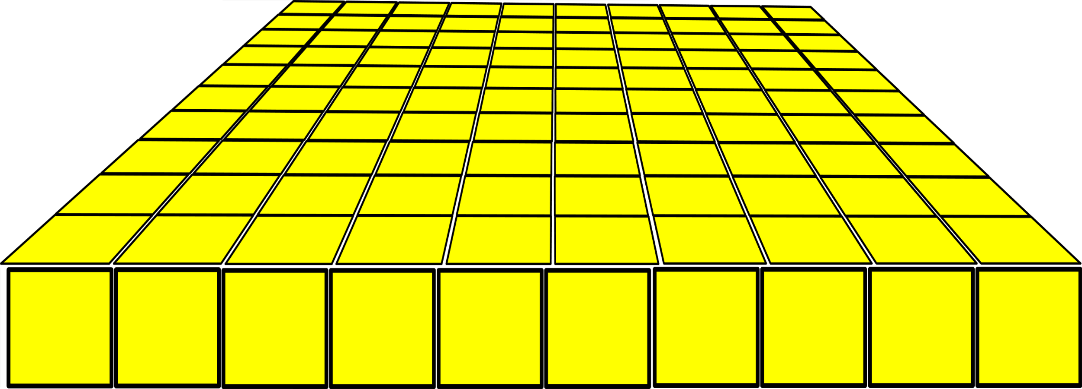
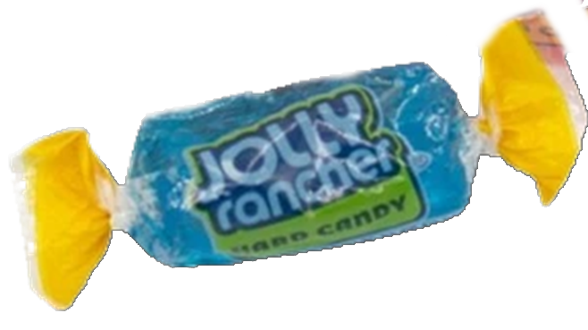
Today I think we should have a scavenger hunt!
Click around the screen and see what you find!
(there are 10 clues to click on)
When you are done, please fill out the “All about me” page below this picture.

Slide 2
Today I think we should have a scavenger hunt!
Click around the screen and see what you can find!
This is where you will find your homework
The post-it will give you other information!
Back to the Scavenger Hunt

Slide 3
Today I think we should have a scavenger hunt!
Click around the screen and see what you can find!
This is where you will find your homework
The post-it will give you other information!
Back to the Scavenger Hunt

Slide 4
Today I think we should have a scavenger hunt!
Click around the screen and see what you can find!
This is where you
will find your
homework
The post-it will give you other info!
Back to the Scavenger Hunt

Slide 5
Today I think we should have a scavenger hunt!
Click around the screen and see what you can find!
This is my baby Leo!
Leo is tiny! He sleeps on the half of my pillow that I don’t use.
Leo is very happy that we are teaching from home right now!
Do you have a pet who is happy that you are still at home?
Back to the Scavenger Hunt

Slide 6
Today I think we should have a scavenger hunt!
Click around the screen and see what you can find!
Good eyes! I did not expect anyone to find my creepy crawly gecko!
I think he/she needs a name.
What should we name
him or her?
Back to the Scavenger Hunt

Slide 7
Pretzels are my favorite snack.
Today I think we should have a scavenger hunt!
Click around the screen and see what you can find!
What is your favorite snack?
Back to the Scavenger Hunt

Slide 8
Can you tell time?
Today I think we should have a scavenger hunt!
Click around the screen and see what you can find!
We will work on it this year!
It is not as hard as it looks!
21?
12
6
Back to the Scavenger Hunt

Slide 9
What is your favorite
Day of the year?
Today I think we should have a scavenger hunt!
Click around the screen and see what you can find!
Do you have any idea what mine is?
Back to the Scavenger Hunt

Slide 10
Is that your desk?
Today I think we should have a scavenger hunt!
Click around the screen and see what you can find!
Oh – wait – I must have dropped one of my favorite candies!
Finders Keepers?
Back to the Scavenger Hunt

Slide 11
When we get back to the classroom we will figure out what to do with this.
Today I think we should have a scavenger hunt!
Click around the screen and see what you can find!
Here is a hint: it has numbers on it!
Back to the Scavenger Hunt

