Slide 1
No Internet Emergency Plans
Run Around the Number Grid

Slide 2
Let’s play Run Around the Number Grid!
I will give you a starting number and then give you 4 directions.
When you are finished doing the math, check the answer to see who won the round!

Slide 3
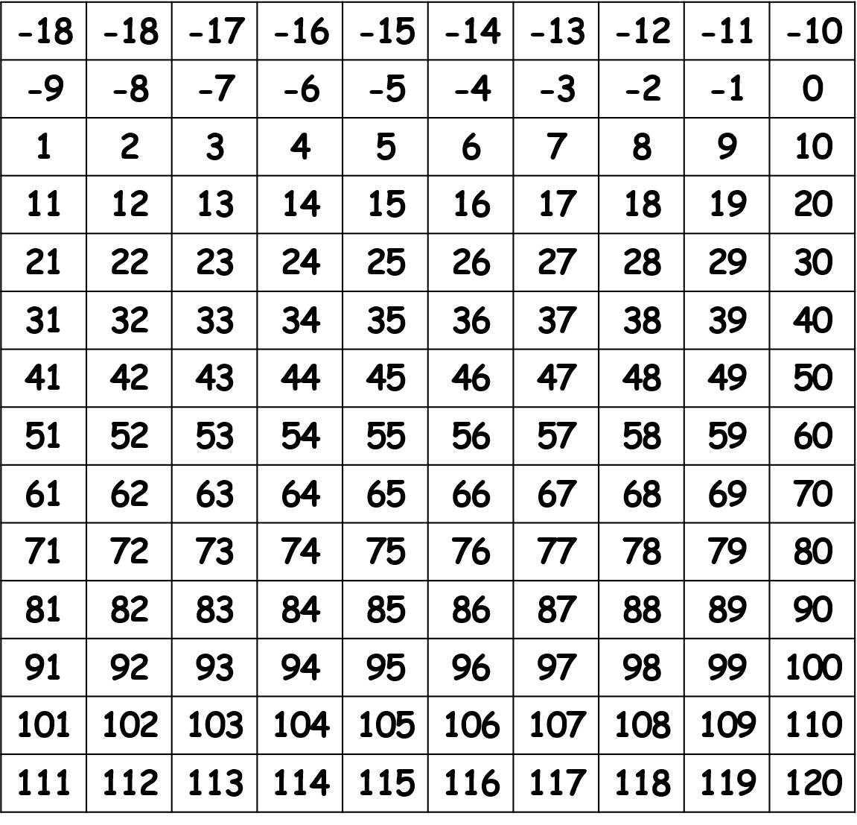
Use your number grid to follow these directions:
Start on 36
37
add 42
add 42
subtract 16
subtract 16
add 52
add 52
subtract 87
subtract 87

Slide 4
Use your number grid to follow these directions:
1
Start on -16
add 87
add 87
subtract 45
subtract 45
add 73
add 73
subtract 100
subtract 100

Slide 5
Use your number grid to follow these directions:
Start on 119
Start on 119
19
Subtract 87
Subtract 87
Subtract 87
Add 82
Add 82
Add 82
Subtract 112
Subtract 112
Subtract 112
Add 17
Add 17
Add 17

