Slide 1
Section 2
What You Will Learn
Restless Continents
Describe Wegener’s hypothesis of continental drift.
Explain how sea-floor spreading provides a way for continents to move.
Describe how new oceanic lithosphere forms at mid-ocean ridges.

Slide 2
Have you ever looked at a map of the world and noticed how the coastlines of continents on opposite sides of the oceans appear to fit together like the pieces of a puzzle? Is it just coincidence that the coastlines fit together well? Is it possible that the continents were actually together sometime in the past?

Slide 3
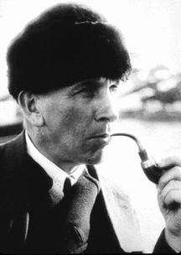
Wegener’s Continental Drift Hypothesis
One scientist who looked at the pieces of this puzzle was Alfred Wegener (VAY guh nuhr). In the early 1900s, he wrote about his hypothesis of continental drift.

Slide 4
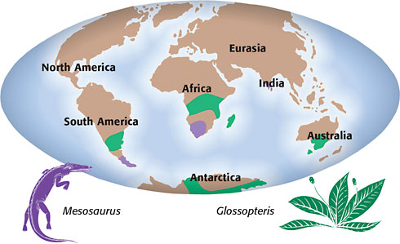
Pangaea
Continental drift is the hypothesis that states that the continents once formed a single landmass, broke up, and drifted to their present locations.
This hypothesis seemed to explain a lot of puzzling observations, including the observation of how well continents fit together.

Slide 5
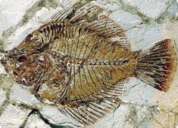
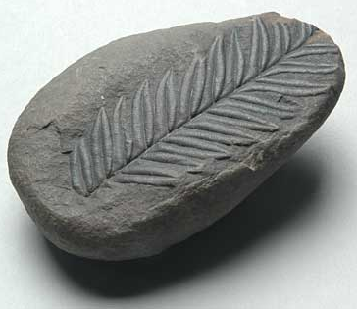
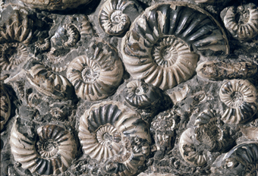
The Evidence
Continental drift explained why fossils of the same plant and animal species are found on continents that are on different sides of the Atlantic Ocean.

Slide 6
The Evidence
Many of these ancient species could not have crossed the Atlantic Ocean.
Without continental drift, this pattern of fossils would be hard to explain.

Slide 7
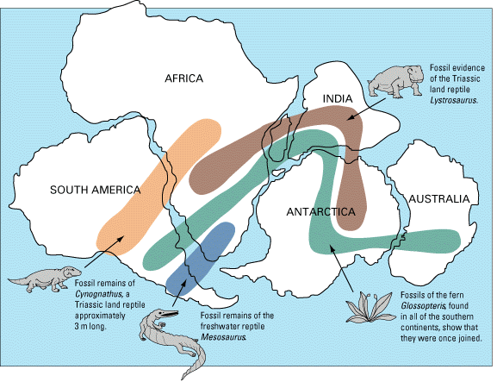
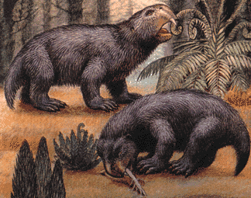
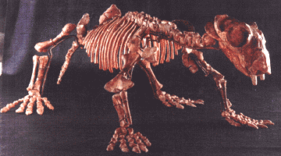
Lystrosaurus Georgi
Fossils of the Lystrosaurus Georgi have been found in Africa, India and Antarctica!
This guy was about the size of a small dog.
It was an herbivore

Slide 8
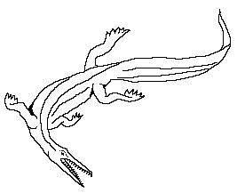
Mesosaurus
This is Mesosaurus “middle lizard”
It lived about 300 million years ago. It was a land lizard that lived in water.
It was about a foot and a half long.
It ate shrimp and fish.
Mesosaurus fossils were found in both South America and Africa.

Slide 9
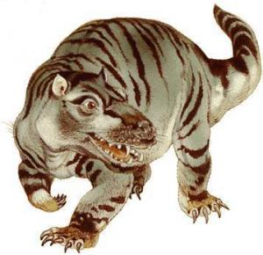
Cynognathus “dog jaw”
A mammal like dinosaur that was warm blooded and probably gave birth to live babies (instead of laying eggs)
A fast moving carnivore with powerful jaws and doglike teeth
Hunted herbivores in packs like wolves do today.
5 feet long.
Found in South America and Africa

Slide 10
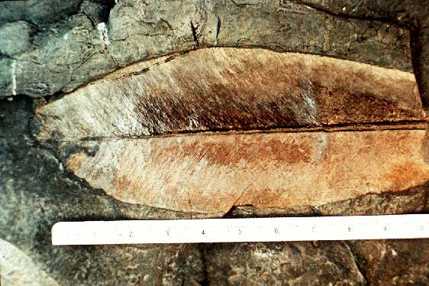
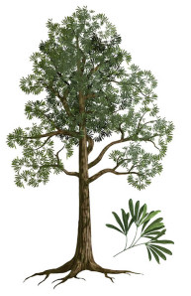
Glossopteris
Glossopteris was an early tree that was found in South America, South Africa, India, Antarctica and in Australia.
This fossil told more of a story than the animal fossils because it was in so many places.
It showed how many continents were once together and it showed that all of these continents once had a similar environment!
In other words, it showed that Antarctica was once tropical!

Slide 11
Pangaea http://www.bbc.co.uk/science/earth/earth_timeline/pangaea#p00fztwb
What all of these fossil records showed was that all of the land masses (continents) were once one big land mass.
This land mass was called Pangaea.
It also showed that the Oceans were once one big ocean that we call Panthalassa.
We believe that Pangaea began to breakup about 245 Million years ago.

Slide 12
The Breakup
By about 180 million years ago Pangaea had broken into two pieces.
The Northern part would become the North America and Europe
The southern part would become South America, Africa, Australia and Antarctica.
We have named the northern part Laurasia and the southern part Gondwana

Slide 13
The Breakup
Finally by about 65 Million years ago the continents began to break up enough that we can recognize them today.
The Indian plate moved the fastest – you can see it in red next to Africa.
It kept moving north until it crashed into Asia.
The crash was so hard that it built the Himalaya Mountains!

Slide 14
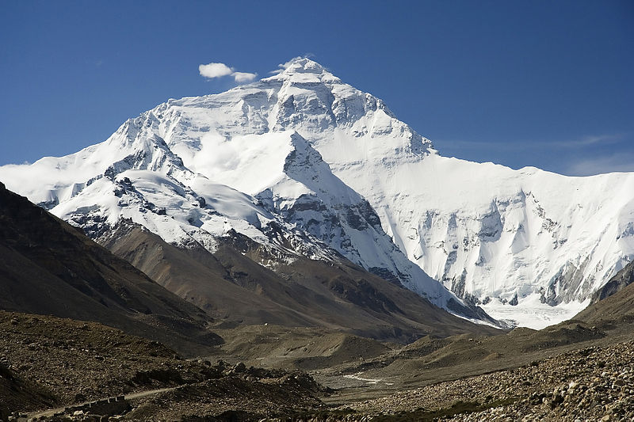
The Himalaya Mountains
http://www.youtube.com/watch?v=L8CT3UHp0IE http://www.youtube.com/watch?v=HulKSWjlnzQ http://www.youtube.com/watch?v=HuSHOQ6gv5Y

