Slide 1
This is an emergency plan that uses the internet.
You will be asked to do a few different things online.
The first asks you to practice your shape names.

Slide 2
We will re-learn our shape names by using pattern shape blocks.
Equilateral Triangle*
Right Triangle
* Equilateral means that all of the sides are exactly the same length, and that all of the angles are identical
Square
Make sure you can name each of these shapes the next time I see you!
Parallelogram
Trapezoid
* This shape is technically a hexagon because it has 6 sides, but it is NOT equilateral.
Rhombus
Equilateral Hexagon*

Slide 3
Think about the names of your shapes while you try to make a:
Turtle
Fish
Duck
Doggie
Take a screen shot of your artwork to show the whole class!
Click the link here
https://apps.mathlearningcenter.org/pattern-shapes/
You can even change the colors of the blocks with the color dots at the bottom!

Slide 4
We will practice more shapes by using an online geoboard! Try to make each of these shapes!
Equilateral Triangle*
Right Triangle
* Equilateral means that all of the sides are exactly the same length, and that all of the angles are identical
Square
Make sure you can name each of these shapes the next time I see you!
Parallelogram
Trapezoid
* This shape is technically a hexagon because it has 6 sides, but it is NOT equilateral.
Rhombus
Equilateral Hexagon*

Slide 5
Can you make a hexagram on a Geoboard?
Click this link to try for yourself!
https://apps.mathlearningcenter.org/geoboard/
Or go to 5th Grade Math at:
lynncronin.weebly.com
Do you think you could make a Duckie?

Slide 6
Need one more
thing to do?

Slide 7
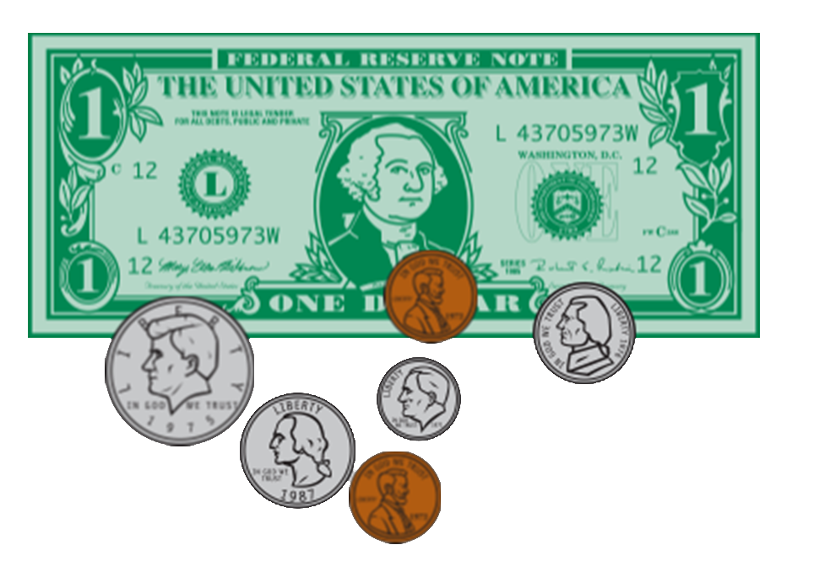
Put some money on the page then help your partner count it out!
Click this link to try for yourself!
https://apps.mathlearningcenter.org/money-pieces/
How much should we charge for duckie?

