Slide 1
Which succession begins with bare rock?
Primary Succession

Slide 2
What is the pioneer species in primary succession?
LICHEN

Slide 3
Lichen produces acid that breaks down rock . When lichen dies it leaves behind a little bit of dirt and a little bit of broken rock that looks like sand.

Slide 4
More lichen grow for many many generations – until there is enough dirt to grow…
MOSS

Slide 5
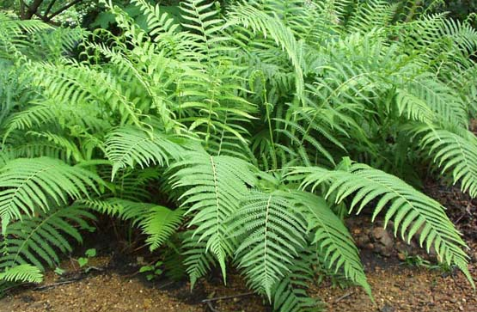
Finally ferns and other, larger plants move in and eventually the area becomes a forest.

Slide 6
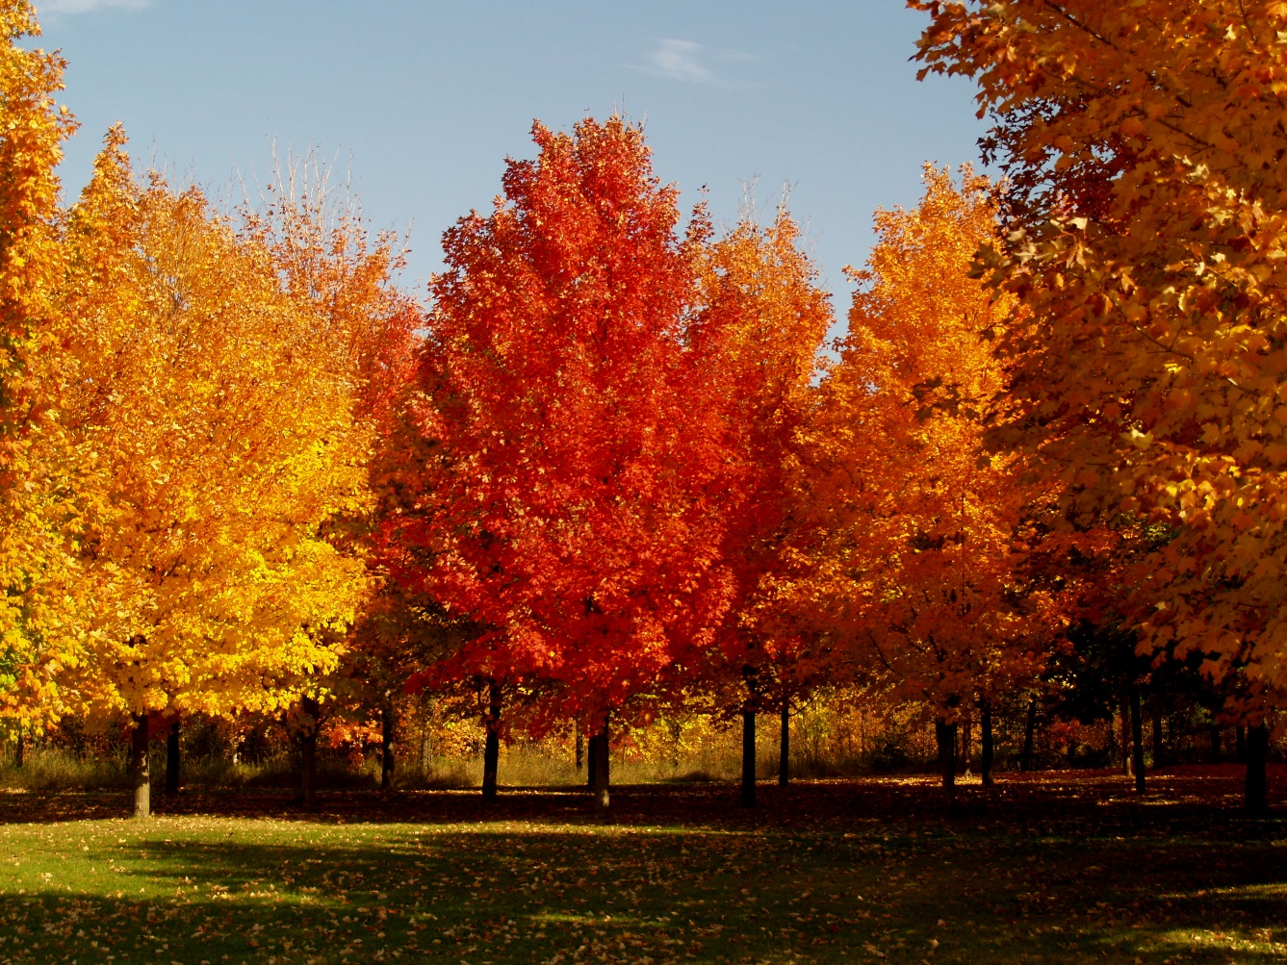
The climax species in both primary and secondary succession is…
OAK AND MAPLE TREES

Slide 7
So…lichen, moss, ferns, shrubs and then mature trees

Slide 8
Which succession begins when a catastrophic event strips an area down to the dirt.
SECONDARY SUCCESSION

Slide 9
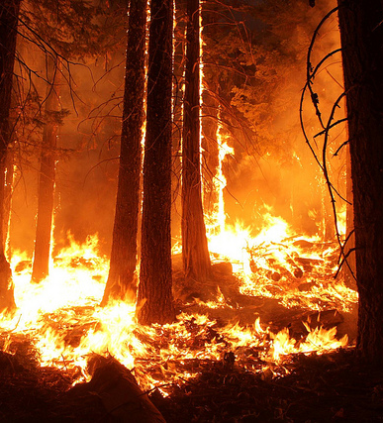
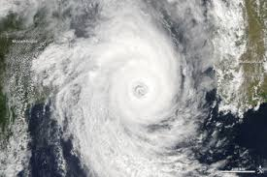
The catastrophic event could be
FIRE
FLOOD
TSUNAMI
TORNADO
HURRICANE
Any event that leaves the soil

Slide 10
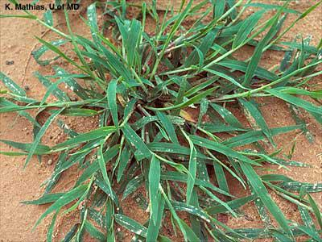
The pioneer species in secondary succession is usually
CRAB GRASS

Slide 11
The climax species in secondary succession is…
OAK OR MAPLE TREES (yup – the climax species for both primary & secondary succession is the same)

Slide 12
Compare and contrast Primary Succession with Secondary Succession
PRIMARY SUCCESSION | BOTH | SECONDARY SUCCESSION
Starts with bare rock | Replace one species with another species | Starts with soil
Pioneer Species - Lichen | Finish with Oak or Maple trees as the climax species | Pioneer Species – crab grass
Takes a VERY long time | End with climax community | Shorter than Primary
After a glacier melts or a volcano erupts and leaves rock | Take longer than one human life | After a farmer abandons his field or after a fire, tornado, hurricane, flood

Slide 13
Explain the two ways that water is cleaned naturally.
Filtration – bad stuff gets stuck in the layers of soil and only pure water reaches the aquifers
Evaporation - Only H₂O molecules evaporate – any dirt or salt in the water is left behind.

Slide 14
How are photosynthesis, respiration, decomposition, and combustion are related to carbon cycle?
Photosynthesis takes carbon out of the air.
Respiration, decomposition and combustion put carbon back into the air
Photosynthesis uses carbon and releases oxygen.
Respiration uses oxygen and releases carbon

Slide 15
Nitrogen is in the air all around us. What must happen before plants can use nitrogen?
Bacteria that grows on plant roots must “fix” the nitrogen
so that the plant can “drink” it in with water.

Slide 16
How do animals get nitrogen?
Animals (consumers) eat the plant, or they eat another animal that has eaten the plant.

Slide 17
Did you know that lightning can “fix” nitrogen too?
When the lightning heats up the sky it “fixes” the nitrogen so that when it drops to the soil a plant
can use it with out the help of bacteria!

Slide 18
Which equation is represented below? Carbon dioxide + water → sugars + oxygen
plus sunlight
Photosynthesis!

Slide 19
What supplies the energy for this to occur?
The Sun!

Slide 20
A cycle has no beginning and no end but…

Slide 21
Can you tell me the “story” of the water cycle?
Water vapor evaporates from oceans and rises through the atmosphere. When it gets high enough and cold enough it condenses into water droplets (clouds). When the droplets get too heavy they fall to earth as precipitation. Precipitation either runs-off or filters through the ground into aquifers. Trees add water vapor to the air with transpiration - which is when plants “breathe”.

Slide 22
Can you tell me the “story” of the Nitrogen cycle
Plants live in air that is 78% Nitrogen, but they can’t get Nitrogen from air. Instead they use Nitrogen fixation. When a plant or animal dies and decomposes, all the minerals go into the dirt. Bacteria lives on the roots of plants and “fix” nitrogen it into a form that plants can “drink”. We get nitrogen by eating producers or consumers. We need Nitrogen to make DNA.

Slide 23
Can you tell me the “story” of the Carbon cycle
A little bit of carbon dioxide is in the air around us. Plants use it for photosynthesis - they mix carbon dioxide with water and add sunlight to make sugars and oxygen. Both plants and animals release carbon dioxide through respiration. When plants and animals die they either decompose - and release carbon dioxide into the air or they become fossil fuels and carbon is released into the air when we use them for combustion.

