Slide 1
http://www.youtube.com/watch?v=jXnp4a1t6y8
How do Earthquakes Travel?

Slide 2
With seismographs
So how do we find the focus?

Slide 3
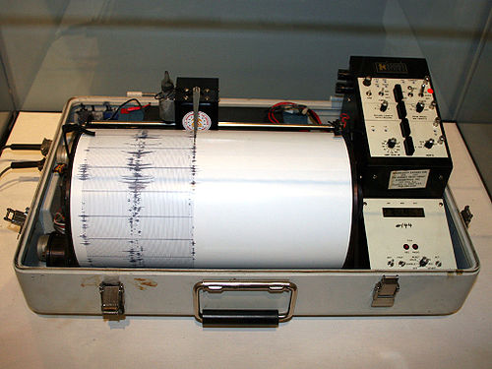
Seismic waves are measured by seismographs
We have seismographs in an amazing number of places in the world. They can sense even the smallest tremor.

Slide 4
Seismographs draw lines side to side to show a tremor
Seismogram
The paper that comes out of a seismograph is called a seismogram.
Seismograph

Slide 5
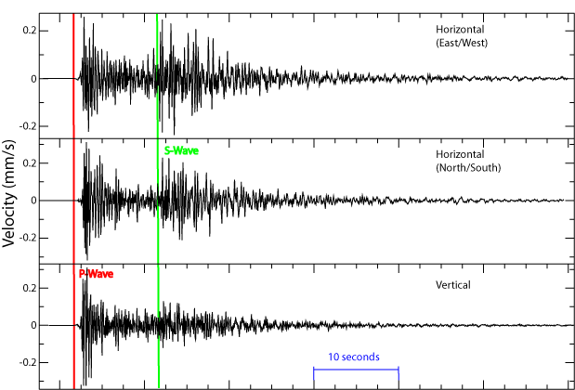
A seismogram looks like this

Slide 6
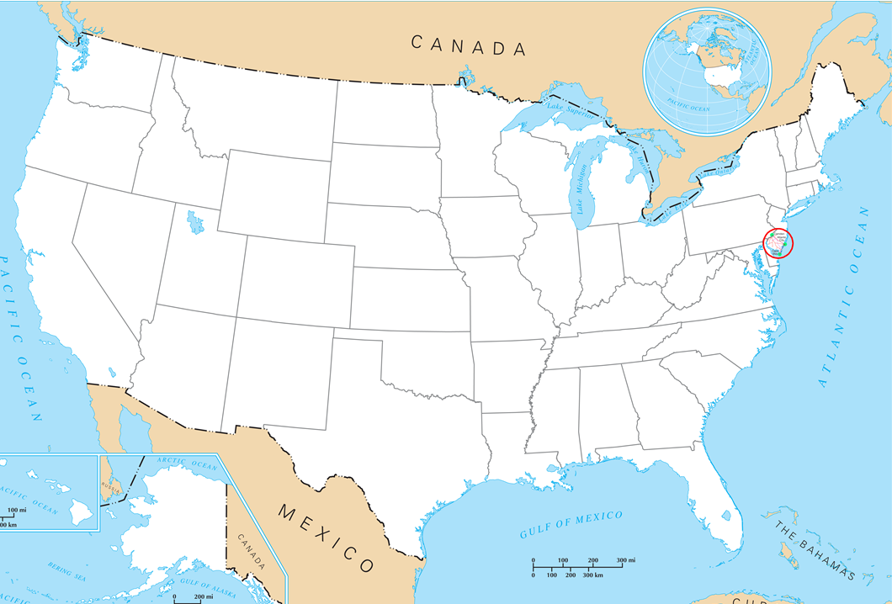
How do we figure out where an earthquake happened?
How do we locate the
We have seismographs in cities all over the country.
A seismograph can tell how far away an Earthquake occurs.

Slide 7
How do we figure out where an earthquake happened?
How do we locate the
So what do we know now?
Since we know that the quake occurred 600 miles from NJ – we know that the epicenter MUST be somewhere on the line.
600 miles
If a seismograph in New Jersey detects an earthquake they can tell how far away it is.
If this one measured a quake at 600 miles away – we would draw a circle with a diameter of 600 miles.

Slide 8
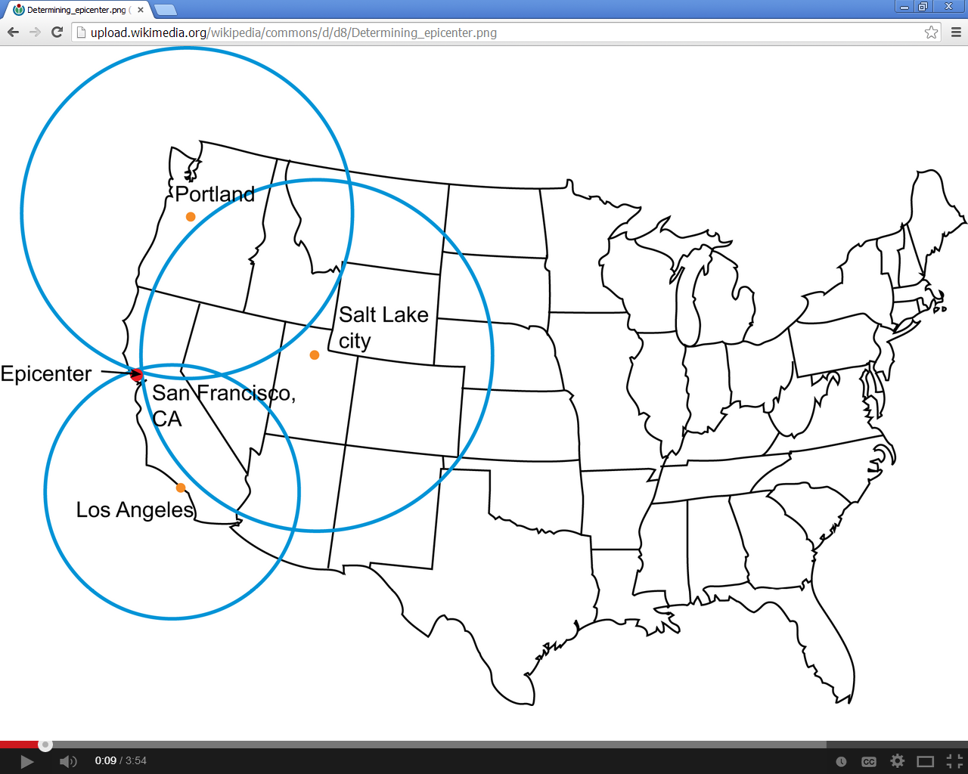
Then we have to find out what two other seismograph’s say.

Slide 9
How do we figure out where an earthquake happened?
How do we locate the
So what do we know now?
We know that the epicenter of the quake has to be on both the 600 mile circle AND the 200 mile circle.
That means the quake happened on one of two points.
600 miles
200 miles
If the seismographs in North Carolina say the quake was 200 miles away we would draw another circle with a 200 mile diameter.

Slide 10
So let’s ask one more machine – then we will know exactly where it was.

Slide 11
How do we figure out where an earthquake happened?
How do we locate the
So what do we know now?
We know that the epicenter of the quake has to be on the 600 mile circle AND the 200 mile circle AND on the 400 mile circle
That means the quake happened right here
600 miles
400 miles
200 miles
If the seismographs in Indiana say the quake was 400 miles away we would draw another circle with a 400 mile diameter.

Slide 12
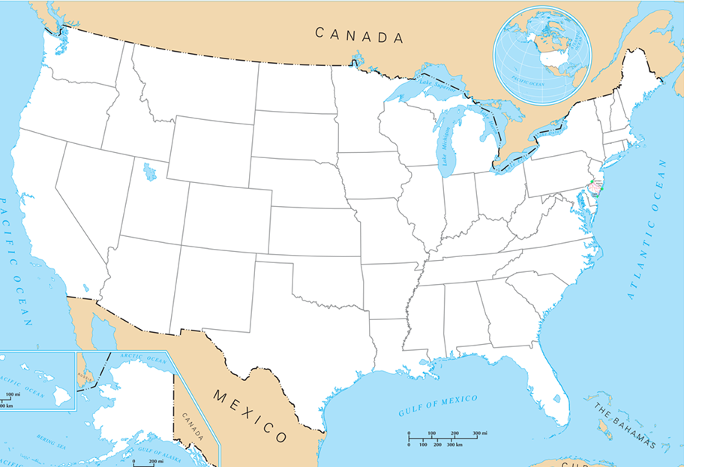
How do we locate the
Where did this quake happen?
The seismograph in Salt Lake City sensed an Earthquake 750 miles away.
This is a circle with a diameter of 750 miles
Salem Oregon
Boise Idaho
San Francisco California
Salt Lake City Utah
Denver Colorado
Los Angeles California

Slide 13
How do we locate the
Where did this quake happen?
Salem Oregon
Boise Idaho
San Francisco California
Salt Lake City Utah
Denver Colorado
Los Angeles California
The seismograph in Los Angeles sensed an Earthquake 350 miles away.
This is a circle with a diameter of 350 miles

Slide 14
How do we locate the
Where did this quake happen?
Salem Oregon
Boise Idaho
San Francisco California
Salt Lake City Utah
Denver Colorado
Los Angeles California
So where was
the Earthquake?
Finally the seismograph in Salem Oregon sensed and earthquake 600 miles away.

Slide 15
How do Seismographs work
http://www.youtube.com/watch?v=c6XB5QLoPt0

Slide 16
So what makes the ground shake?
Elastic Rebound

Slide 17
Huh?
http://youtu.be/HQFTDAzhbZM

Slide 18
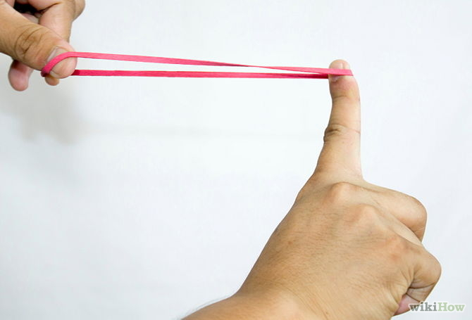
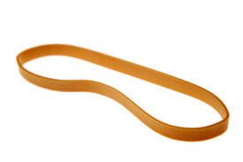
Rubber bands work with elastic rebound too…
You can stretch and stretch and stretch –
And as long as you keep the pressure on the band will stay long.
But when the pressure lets go….
The rubber band SNAPS back to its original shape
The SNAP is elastic rebound
It’s what causes the earth to SNAP back into shape
It’s the earthquake!

Slide 19
Huh?
https://www.youtube.com/watch?v=mEYRZLQKT24&ebc=ANyPxKp_6PVldU2qBjyvzRZo8VYNSo1f9Qh4_RjohFWnKq8LxB9CBt---EvT9Ax-3v1RBQNqtRREDT6lZ9pRw1Owj8n9ly_s_A

Slide 20
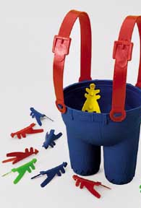
Remember this game?
You push the ant down and it gets flattened out. But when you let go it snaps back to its original shape and it flies!
That’s what elastic rebound is – the rock gets pushed on and it changes its shape
but the second that the pressure lets up it SNAPS back to its original shape!

