Slide 1
EARTHQUAKES!
INTRO:
http://video.nationalgeographic.com/video/101-videos/earthquake-101?source=relatedvideo

Slide 2
http://www.youtube.com/watch?v=jXnp4a1t6y8
EARTHQUAKES!

Slide 3
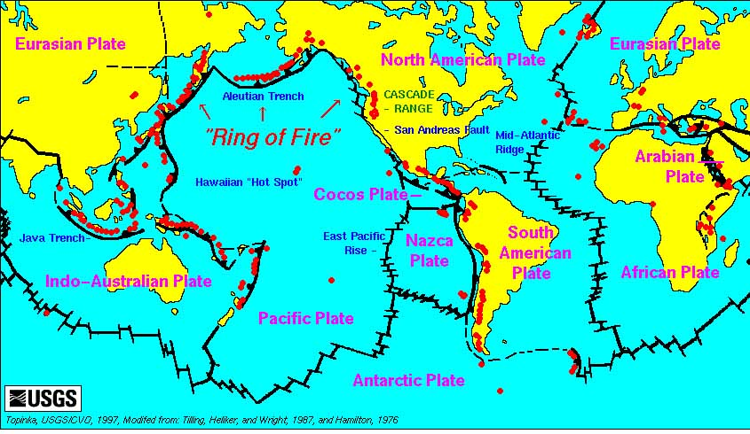
90 percent of all Earthquakes happen along the ring of Fire

Slide 4
90 percent of all Earthquakes happen along the ring of Fire
The ring of fire is surrounding which plate?

Slide 5
We will look at earthquakes in 4 locations on the ring of fire
Alaska
Japan
Chile
California

Slide 6
The Chilean earthquake happened here – in Valdivia Chile

Slide 7
1960 Valdivia, Chile 9.4 – 9.6 the largest earthquake ever recorded
This quake was an aftershock from an 8.1 earthquake
The shaking lasted for 10 minutes

Slide 8
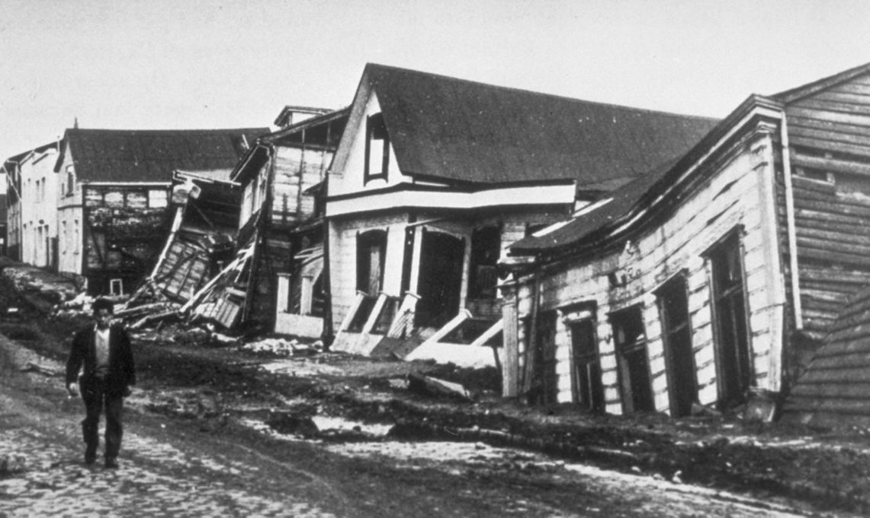
A street in Valdivia, Chile on May 22, 1960

Slide 9
1960 Valdivia, Chile 9.4 – 9.6 the largest earthquake ever recorded
1960 Valdivia, Chile 9.4 – 9.6 the largest earthquake ever recorded
The earthquake triggered the eruption of the volcano Cordón Caulle on May 24th

Slide 10
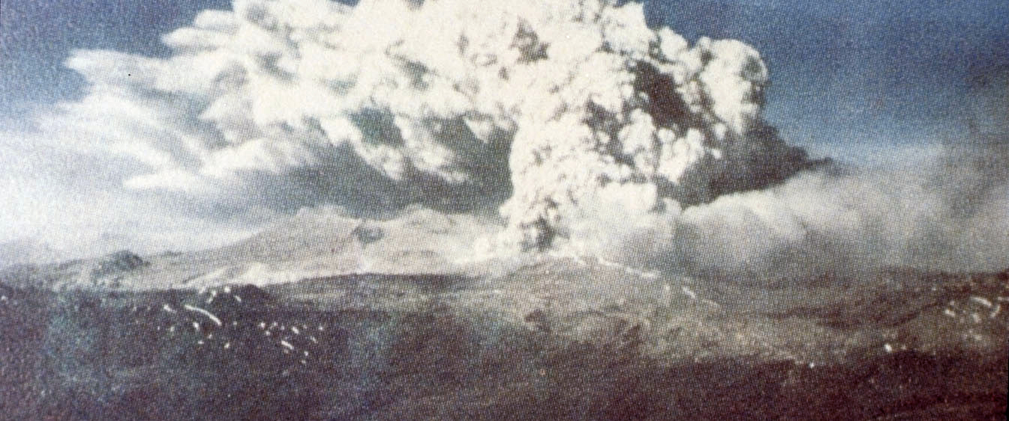
The volcano Cordón Caulle erupted on May 24th

Slide 11
1960 Valdivia, Chile 9.4 – 9.6 the largest earthquake ever recorded
1960 Valdivia, Chile 9.4 – 9.6 the largest earthquake ever recorded
1960 Valdivia, Chile 9.4 – 9.6 the largest earthquake ever recorded
Localized tsunamis hit southern Chile with waves up to 82 feet tall

Slide 12
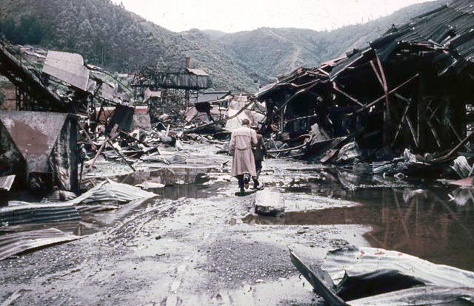
A steel factory in Corral, Chile in 1960

Slide 13
1960 Valdivia, Chile 9.4 – 9.6 the largest earthquake ever recorded
1960 Valdivia, Chile 9.4 – 9.6 the largest earthquake ever recorded
1960 Valdivia, Chile 9.4 – 9.6 the largest earthquake ever recorded
The main tsunami hit Hawaii with waves up to 35 feet tall

Slide 14
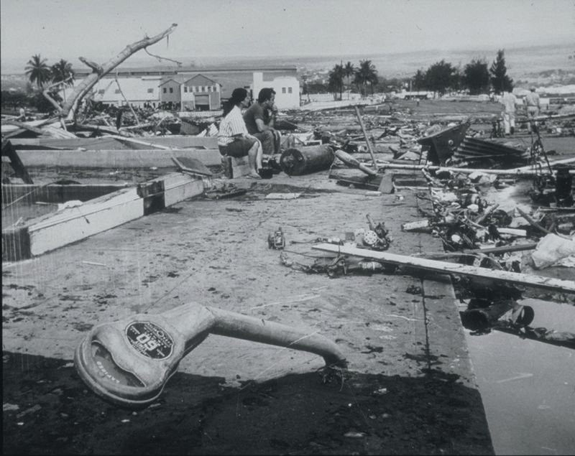
This is Hilo, Hawaii after the tsunami

Slide 15
1960 Valdivia, Chile 9.4 – 9.6 the largest earthquake ever recorded
1960 Valdivia, Chile 9.4 – 9.6 the largest earthquake ever recorded
1960 Valdivia, Chile 9.4 – 9.6 the largest earthquake ever recorded
That tsunami also hit Japan and the Philippines causing local flooding and landslides

Slide 16
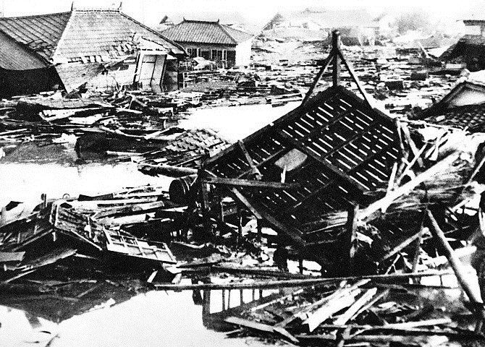
This is Kamaishi Japan after the tsunami caused mudslides

Slide 17
1960 Valdivia, Chile 9.4 – 9.6 the largest earthquake ever recorded
1960 Valdivia, Chile 9.4 – 9.6 the largest earthquake ever recorded
The quake is called a megathrust earthquake that resulted from the release of mechanical stress between the subducting Nazca Plate and the South American Plate.
The focus was only 21 miles below ground – so it was close to the surface and could do a lot of damage

Slide 18
This is the San Andreas Fault

Slide 19
1960 Valdivia, Chile 9.4 – 9.6 the largest earthquake ever recorded
The San Andreas Fault
The San Andreas Fault is a crack in California that causes all of the earthquakes that we think of when we think of California.
California quakes are not considered to be large quakes.
The worst occurred in 1906

Slide 20
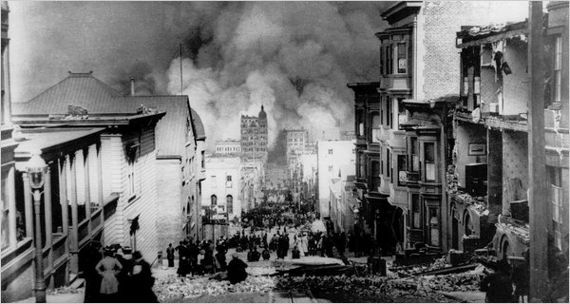
The 1906 quake in San Francisco broke gas lines – so after the shaking stopped the fires began.

Slide 21
A huge earthquake hit Alaska in 1964
Alaska

Slide 22
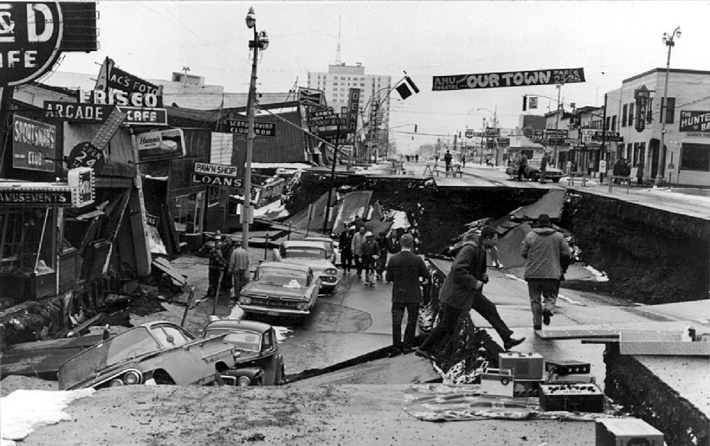
This 9.2 megathrust quake killed 139 and lasted for four minutes and thirty eight seconds. It ranks as #2 ever.

Slide 23
This is Japan

Slide 24
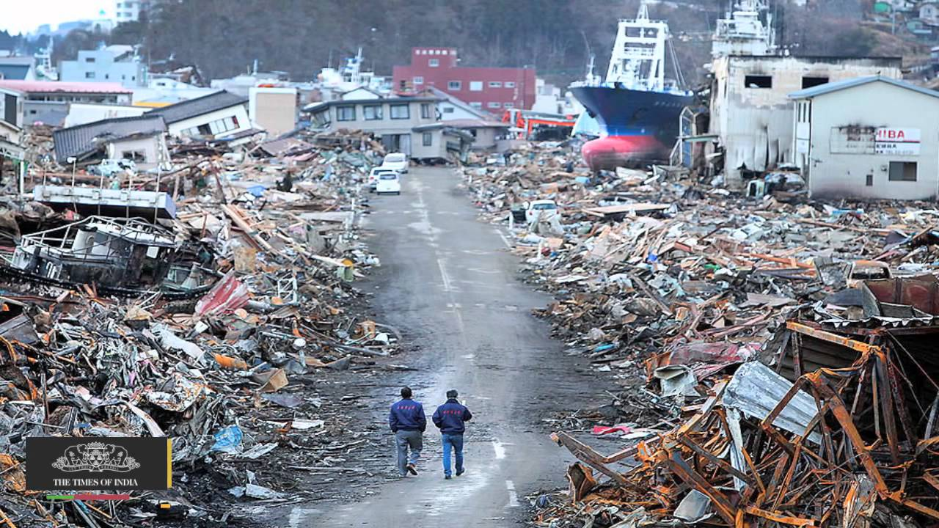
In 2011 an 8.0 quake hit off the coast of Japan.
The tsunami caused the destruction and death.

Slide 25
Where else would you expect an Earthquake?
The Bering Sea
Western Canada
Washington State
The Philippines

