Slide 1
EARTHQUAKES!
INTRO:
http://video.nationalgeographic.com/video/101-videos/earthquake-101?source=relatedvideo

Slide 2
http://www.youtube.com/watch?v=jXnp4a1t6y8
EARTHQUAKES!

Slide 3
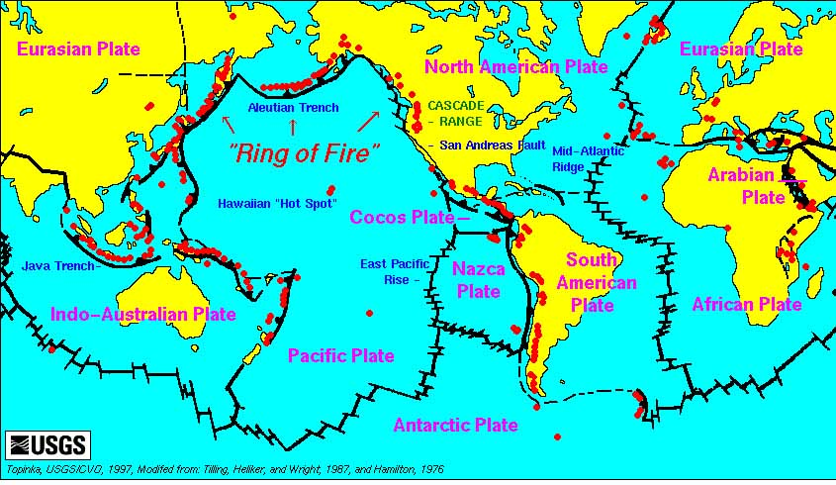
90 percent of all Earthquakes happen along the ring of Fire

Slide 4
The Chilean earthquake happened here

Slide 5
This is the San Andreas Fault

Slide 6
The biggest Earthquake ever happened here in 1964
Alaska

Slide 7
This is Japan

Slide 8
Where else would you expect an Earthquake?

Slide 9
So what makes the ground shake?
Elastic Rebound

Slide 10
Huh?
http://youtu.be/HQFTDAzhbZM

Slide 11
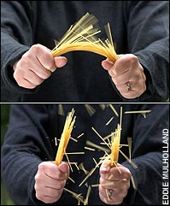
Elastic Rebound
This spaghetti started out straight.
By slowly adding pressure the spaghetti started to bend.
But it was still straight spaghetti.
And then – SNAP!
The spaghetti breaks down the middle – and the pieces go back to being straight – like they always wanted to be – they are just not where they used to be.

Slide 12
Huh?
http://youtu.be/HQFTDAzhbZM

Slide 13
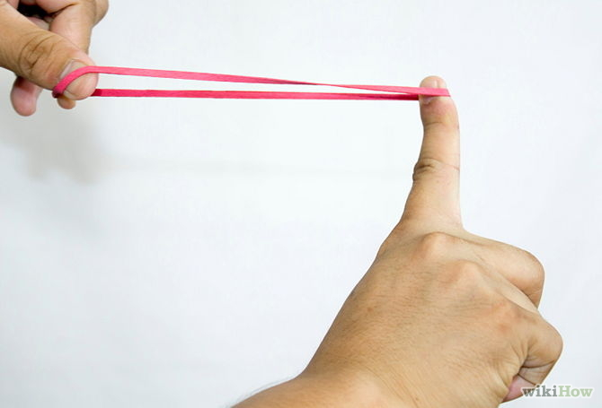
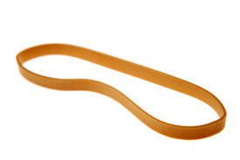
Rubber bands work the same way.
You can stretch and stretch and stretch –
And as long as you keep the pressure on the band will stay long.
But when the pressure lets go….
The rubber band SNAPS back to its original shape
The SNAP is elastic rebound
It’s what causes the earth to SNAP back into shape
It’s the earthquake!

Slide 14
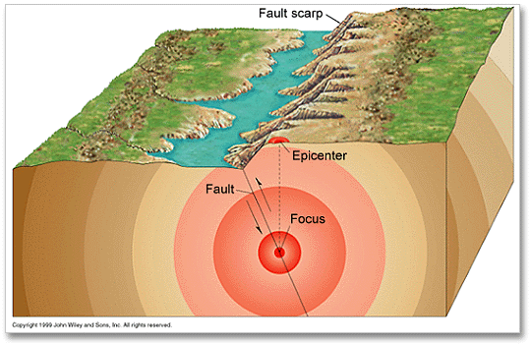
Earthquakes occur on a single spot on a fault. They only rarely occur near the surface.
The spot above the focus is the epicenter
The spot where
the earthquake
actually occurs
is the focus

Slide 15
http://www.youtube.com/watch?v=jXnp4a1t6y8
How do Earthquakes Travel?

Slide 16
Seismic Waves

Slide 17
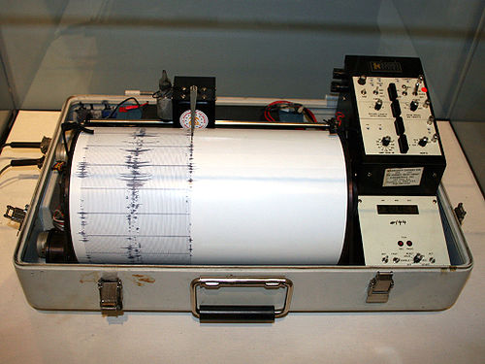
Seismic waves are measured by seismographs
We have seismographs in an amazing number of places in the world. They can sense even the smallest tremor.

Slide 18
Seismographs draw lines side to side to show a tremor
Seismogram
The paper that comes out of a seismograph is called a seismogram.
Seismograph

Slide 19
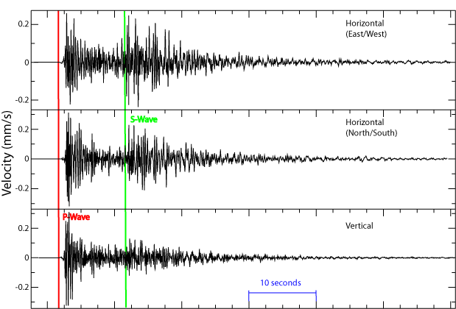
A seismogram looks like this

Slide 20
So what exactly is a seismic wave?
So what exactly is a seismic wave?

Slide 21
Seismic waves are energy that travels on waves like sound and light.
Seismic waves are energy that travels on waves like sound and light.

Slide 22
Some Seismic Waves travel from side to side like this one.
And some travel like a slinky on the floor

Slide 23
Side-to-side waves are called S-Waves – and they come second!
Slinky waves arrive first – they are called P-Waves

Slide 24
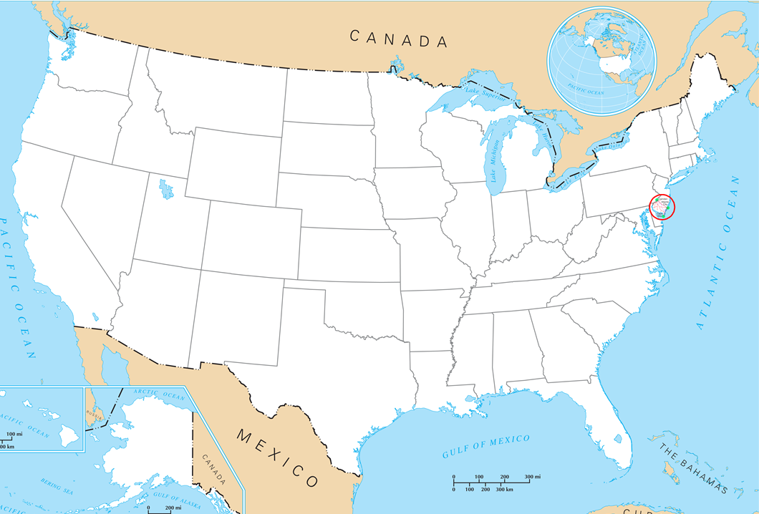
How do we figure out where an earthquake happened?
How do we locate the
We have seismographs in cities all over the country.
A seismograph can tell how far away an Earthquake occurs.

Slide 25
How do we figure out where an earthquake happened?
How do we locate the
So what do we know now?
Since we know that the quake occurred 600 miles from NJ – we know that the epicenter MUST be somewhere on the line.
600 miles
If a seismograph in New Jersey detects an earthquake they can tell how far away it is.
If this one measured a quake at 600 miles away – we would draw a circle with a diameter of 600 miles.

Slide 26
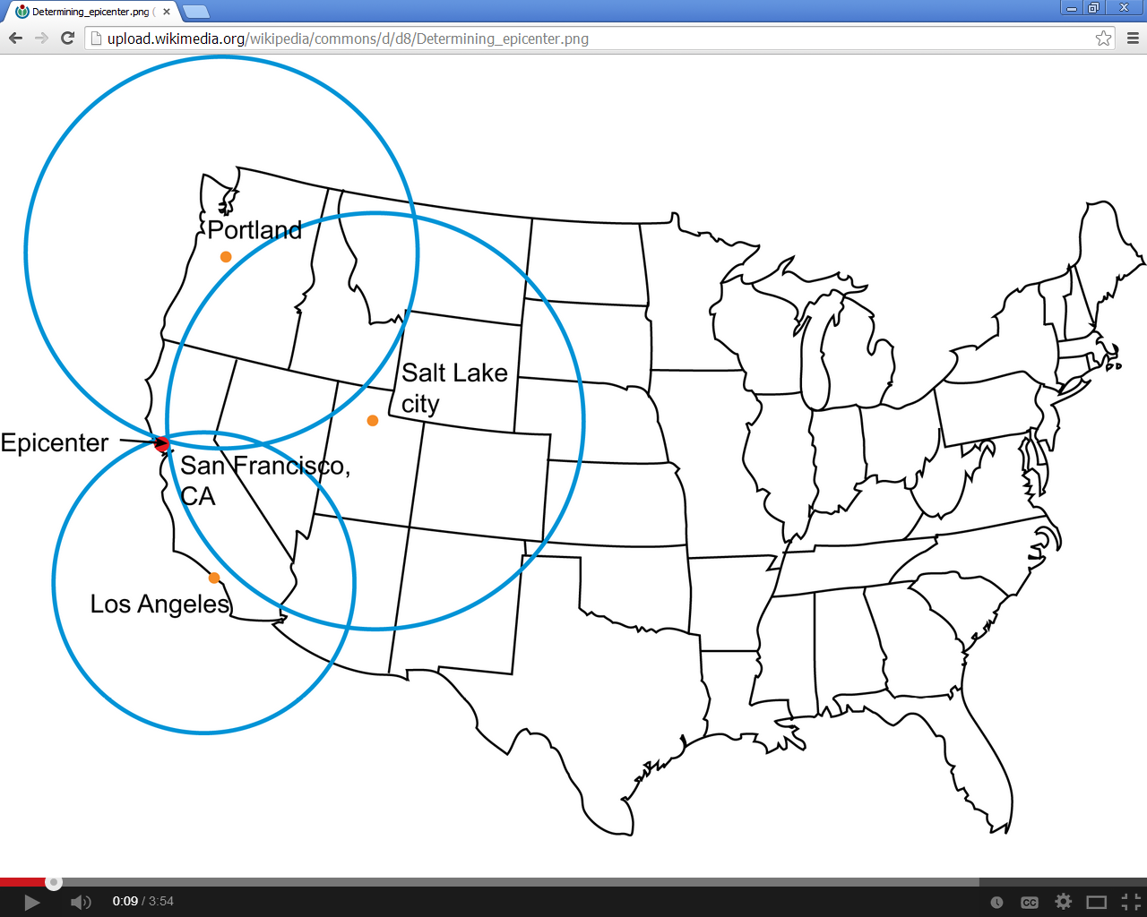
Then we have to find out what two other seismograph’s say.

Slide 27
How do we figure out where an earthquake happened?
How do we locate the
So what do we know now?
We know that the epicenter of the quake has to be on both the 600 mile circle AND the 200 mile circle.
That means the quake happened on one of two points.
600 miles
200 miles
If the seismographs in North Carolina say the quake was 200 miles away we would draw another circle with a 200 mile diameter.

Slide 28
So let’s ask one more machine – then we will know exactly where it was.

Slide 29
How do we figure out where an earthquake happened?
How do we locate the
So what do we know now?
We know that the epicenter of the quake has to be on the 600 mile circle AND the 200 mile circle AND on the 400 mile circle
That means the quake happened right here
600 miles
400 miles
200 miles
If the seismographs in Indiana say the quake was 400 miles away we would draw another circle with a 400 mile diameter.

Slide 30
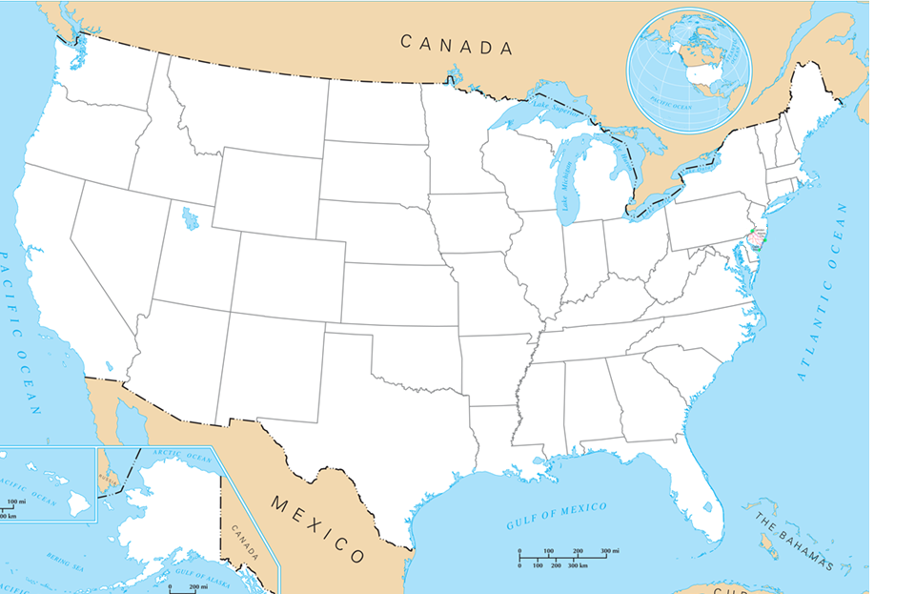
How do we locate the
Where did this quake happen?
The seismograph in Salt Lake City sensed an Earthquake 750 miles away.
This is a circle with a diameter of 750 miles
Salem Oregon
Boise Idaho
San Francisco California
Salt Lake City Utah
Denver Colorado
Los Angeles California

Slide 31
How do we locate the
Where did this quake happen?
Salem Oregon
Boise Idaho
San Francisco California
Salt Lake City Utah
Denver Colorado
Los Angeles California
The seismograph in Los Angeles sensed an Earthquake 350 miles away.
This is a circle with a diameter of 350 miles

Slide 32
How do we locate the
Where did this quake happen?
Salem Oregon
Boise Idaho
San Francisco California
Salt Lake City Utah
Denver Colorado
Los Angeles California
So where was
the Earthquake?
Finally the seismograph in Salem Oregon sensed and earthquake 600 miles away.

Slide 33
How do Seismographs work
http://www.youtube.com/watch?v=c6XB5QLoPt0

