Slide 1
Deforming Earth’s Crust

Slide 2
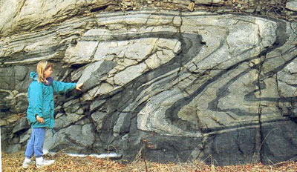
Deformation
Rock that has been changed by stress.
Caused by heat and pressure

Slide 3
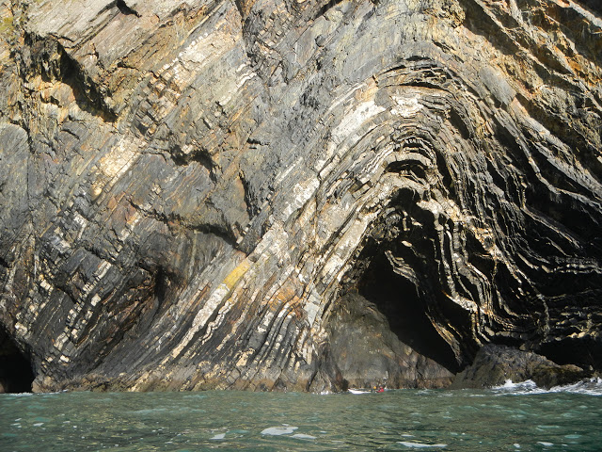
Deformation
Deformation
These rocks have been folded because of convergent pressure

Slide 4
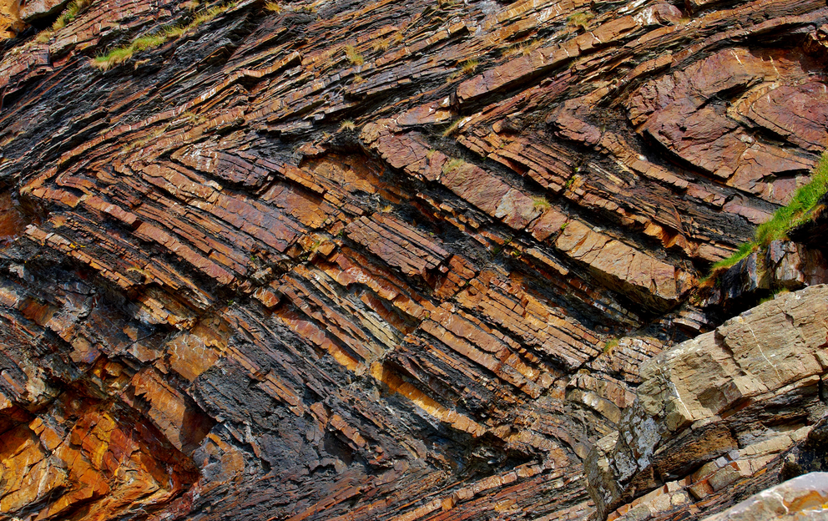
Deformation
Millook Haven Cliffs in Cornwall, England - These rocks folded under pressure then cracked.

Slide 5
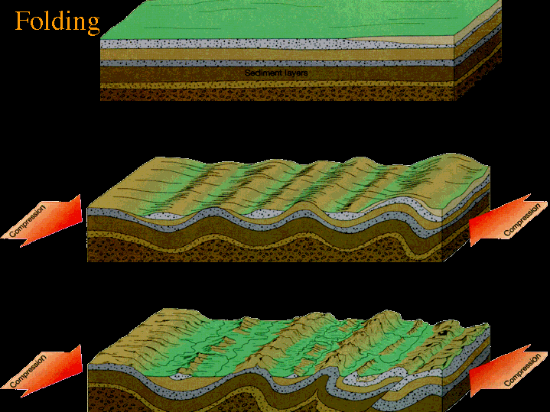
Compression
Rocks get folded when they are under pressure in a convergent boundary.
This is called Compression

Slide 6
Compression
Rocks get folded at what kind of tectonic plate boundary?
Divergent
Transform
Convergent

Slide 7
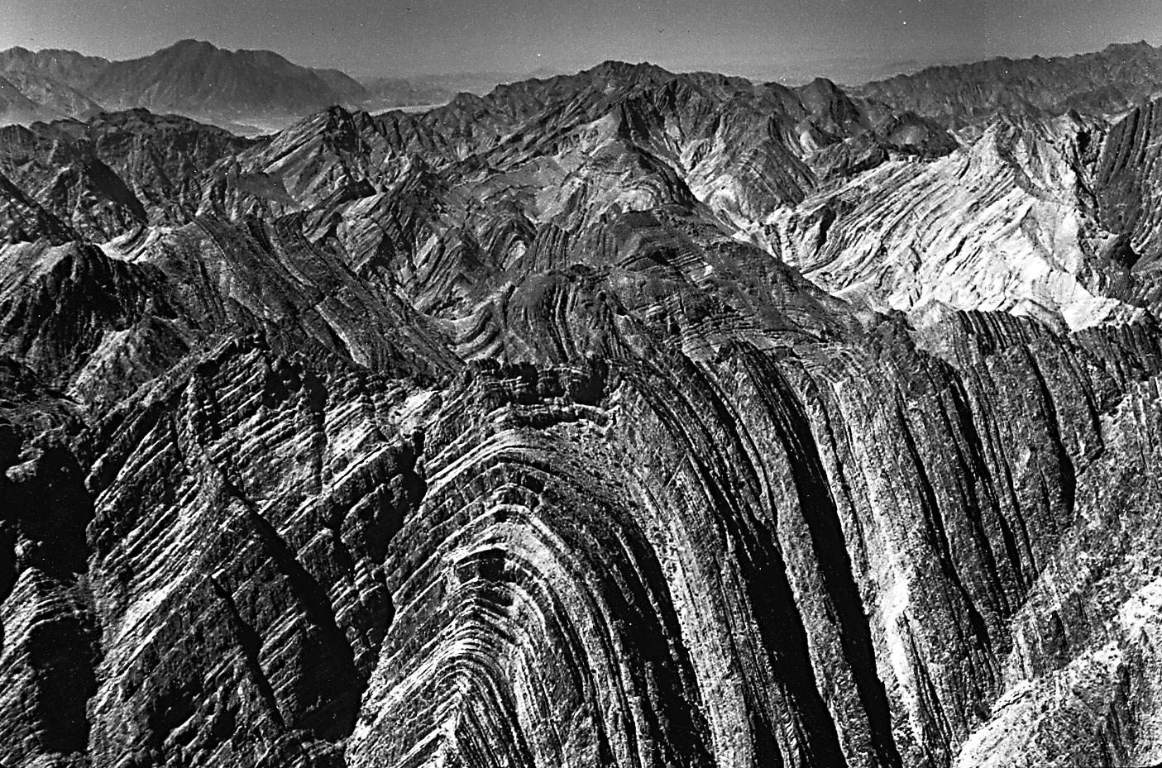
How did these rocks get folded?
Divergence
Compression
Subduction

Slide 8
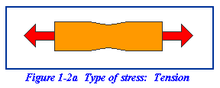
Tension
Sometimes rocks get stretched in a divergent boundary. This is called Tension

Slide 9
Tension
Rocks get stretched at what kind of tectonic plate boundary?
Divergent
Transform
Convergent

Slide 10
Faulting
Faulting occurs when tension is applied to a rock.
First the middle gets thinner – then the rocks snap and one side rises up.
The grand Teton Mountains are Fault Block Mountains.
This is the fault

Slide 11
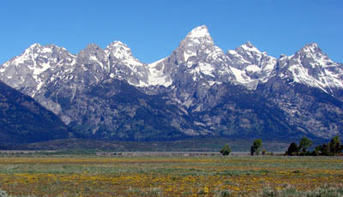
The Grand Tetons
This is the fault
The Grand Tetons are Fault Block Mountains in Wyoming

Slide 12
Faulting
A fault is a crack in rock.
It can be a crack in a small rock.
Or it can be a crack in Earth’s surface.

Slide 13
Faulting
Faulting occurs when a cracked piece of crust moves because of stress
→compression← or ←tension →
There are Three types of Faults:
Normal Fault
Reverse Fault
Strike Slip Fault

Slide 14
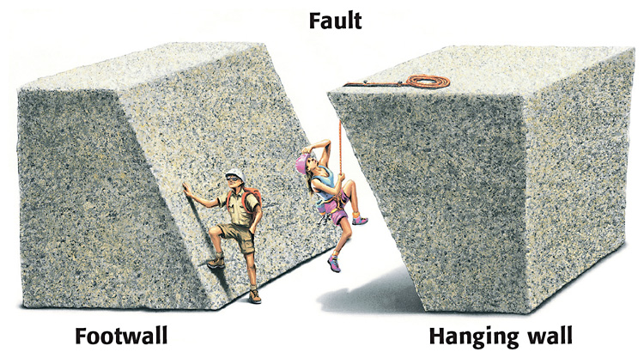
Faulting
The crack in the crust is called a fault.
Faults are never straight up and down, they are on an angle and have their own names.

Slide 15
Normal Fault
When faults move they move in one of three ways.
A Normal fault is when the hanging wall moves down under ←tension →

Slide 16
Reverse Fault
A reverse fault is when the hanging wall moves up because of →compression←

Slide 17
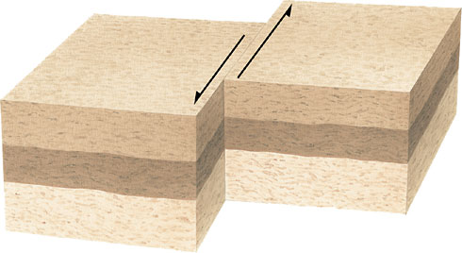
Strike Slip Fault
A strike slip fault is the same as it is when continents move – the fault moves side to side.

Slide 18
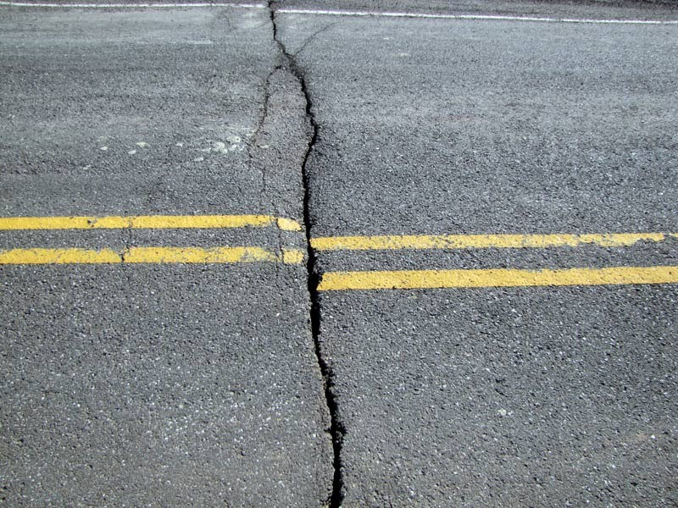
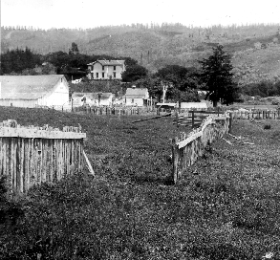
Strike Slip Fault
This is how you end up with roads and fences moved during earthquakes!
This road only moved a few inches – but this fence moved 8.5 feet!

Slide 19
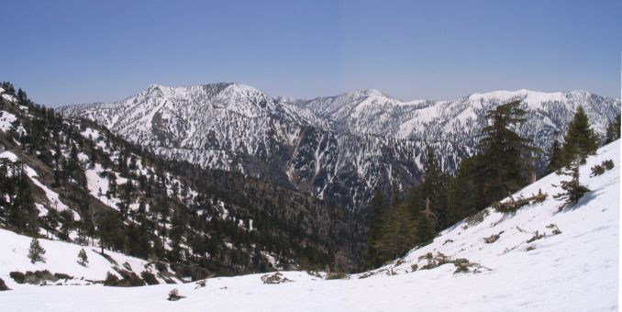
Mountain Building
There are three types of mountains:
Folded mountains
Volcanic mountains
Fault Block Mountains

Slide 20
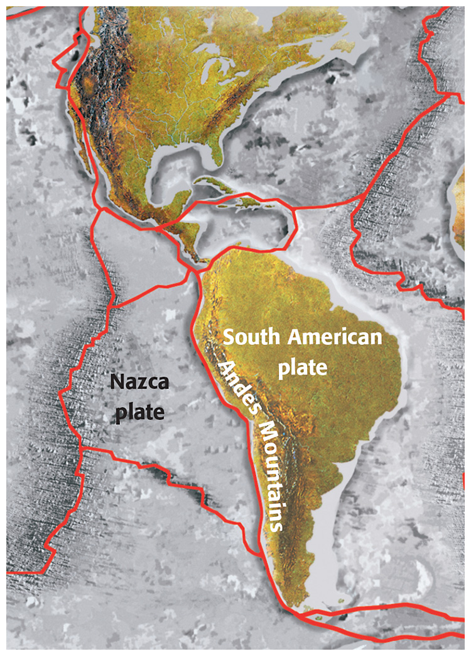
Folded Mountains
Folded Mountains occur between plates that are converging.
The Andes Mountains are between the Nazca Plate and the South American Plate
The plates are moving towards each other

Slide 21
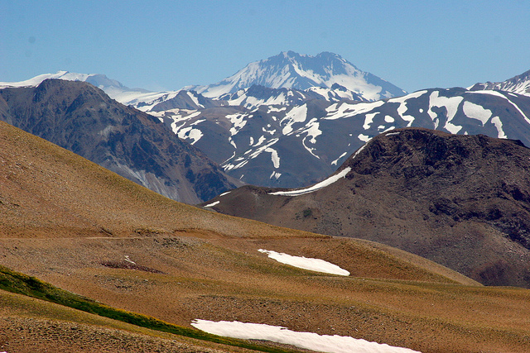
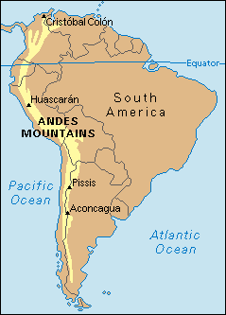
Andes Mountains

Slide 22
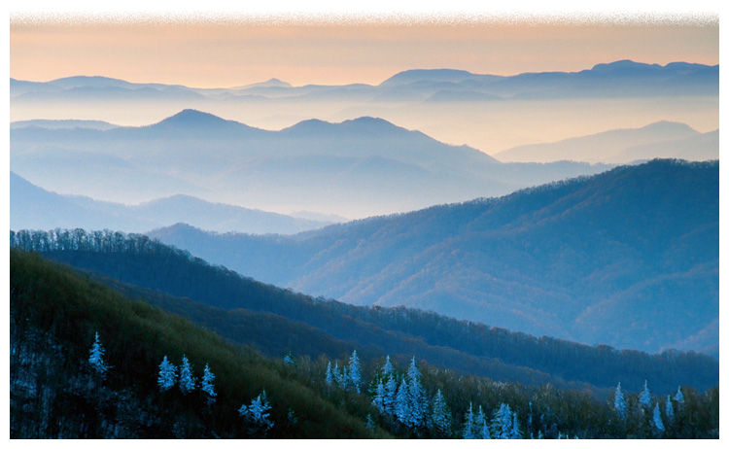
Appalachian Mountains
The Appalachian Mountains were once as tall as the Himalaya Mountains but have been worn down by hundreds of millions of years of weathering and erosion.

Slide 23
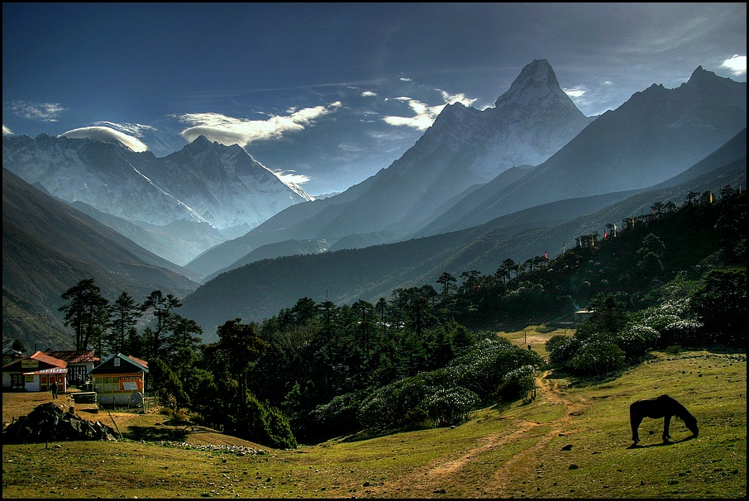
Himalaya Mountains

Slide 24
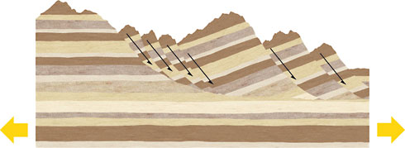
Fault Block Mountains
Fault block mountains occur when rock begins to fold – then snaps under ←tension →
Large chunks of the mountain fall

Slide 25
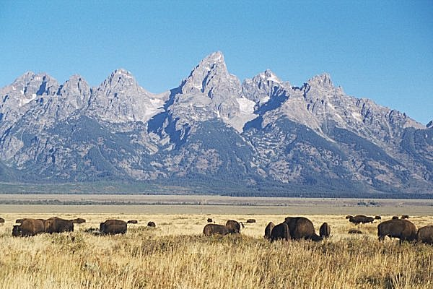
The Grand Tetons in Wyoming

Slide 26
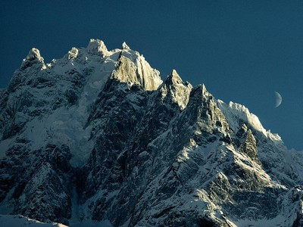
Sierra Nevada
The Sierra Nevada Mountains are Fault Block between California and Nevada.

Slide 27
Volcanic Mountains
Volcanic Mountains are mountains that are formed by Volcanoes.
We don’t always know when a volcano is dormant (asleep) – so we live on the sides of the volcanic mountain.

Slide 28
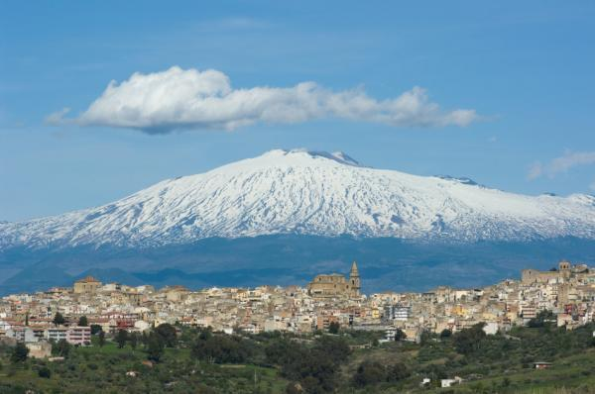
Mount Etna - Italy

Slide 29
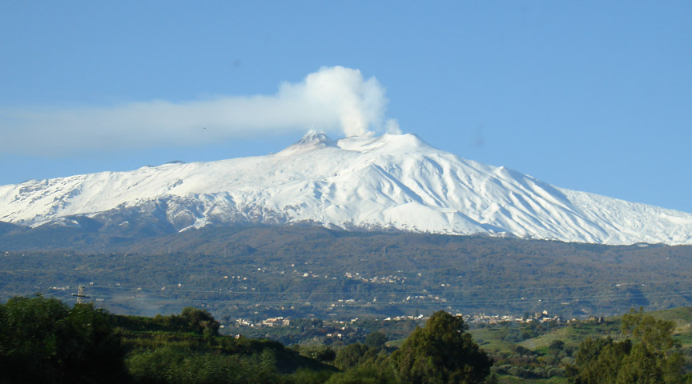
Mount Etna - Italy

Slide 30
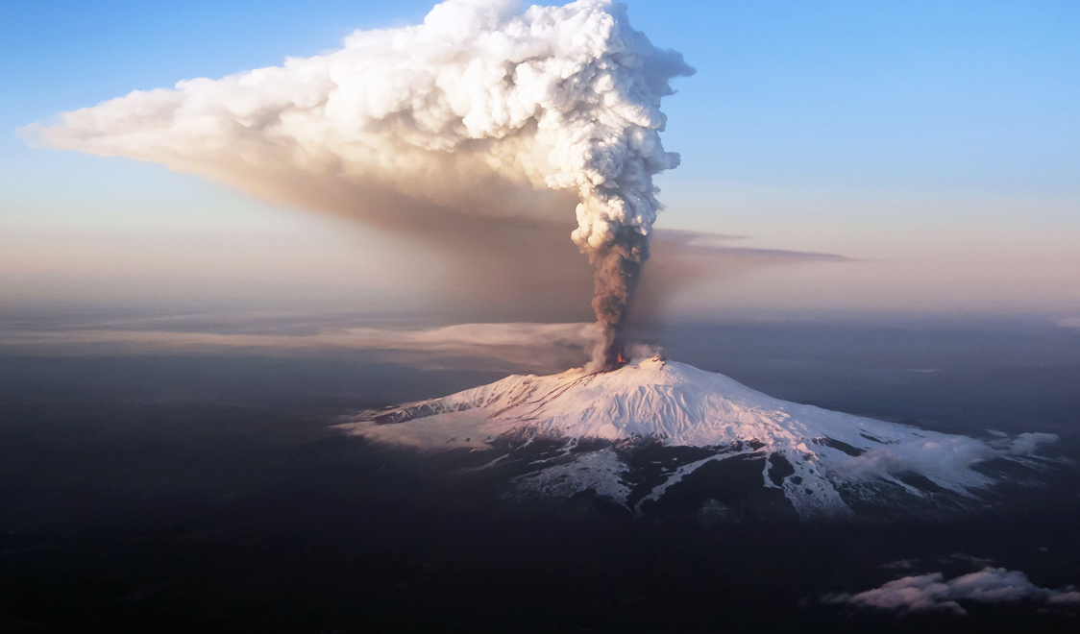
Mount Etna - Italy

Slide 31
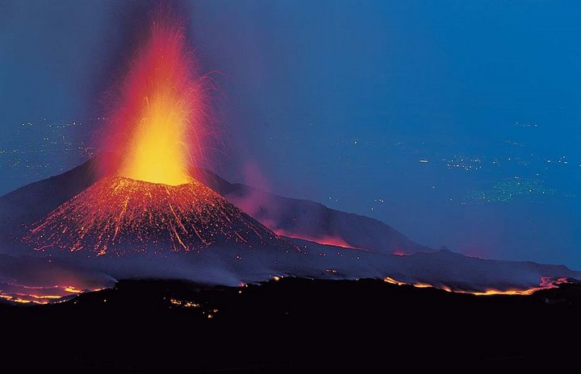
Mount Etna - Italy

Slide 32
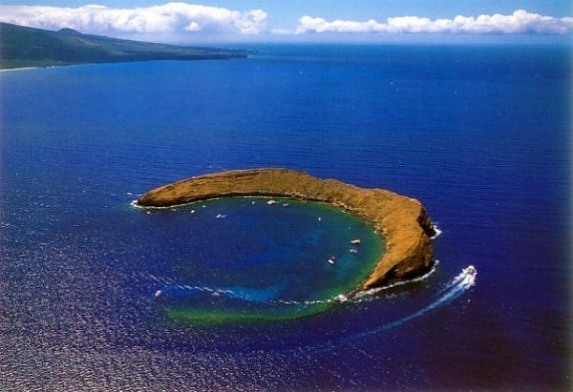
Volcanic Mountains can also be under the Ocean.
This is Molokini Crater in Hawaii – it once stuck up above the water but it blew its top!

Slide 33
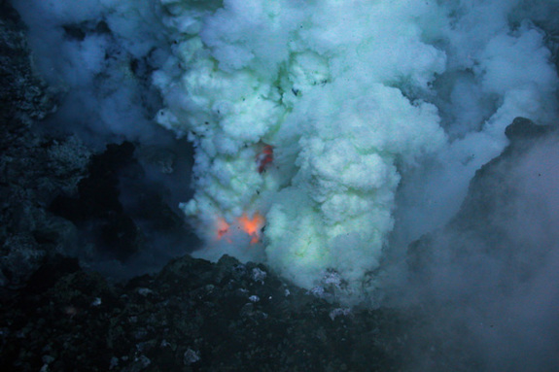
Volcanic Mountains can also be under the Ocean.
This volcano is erupting on the floor of the Pacific Ocean

Slide 34
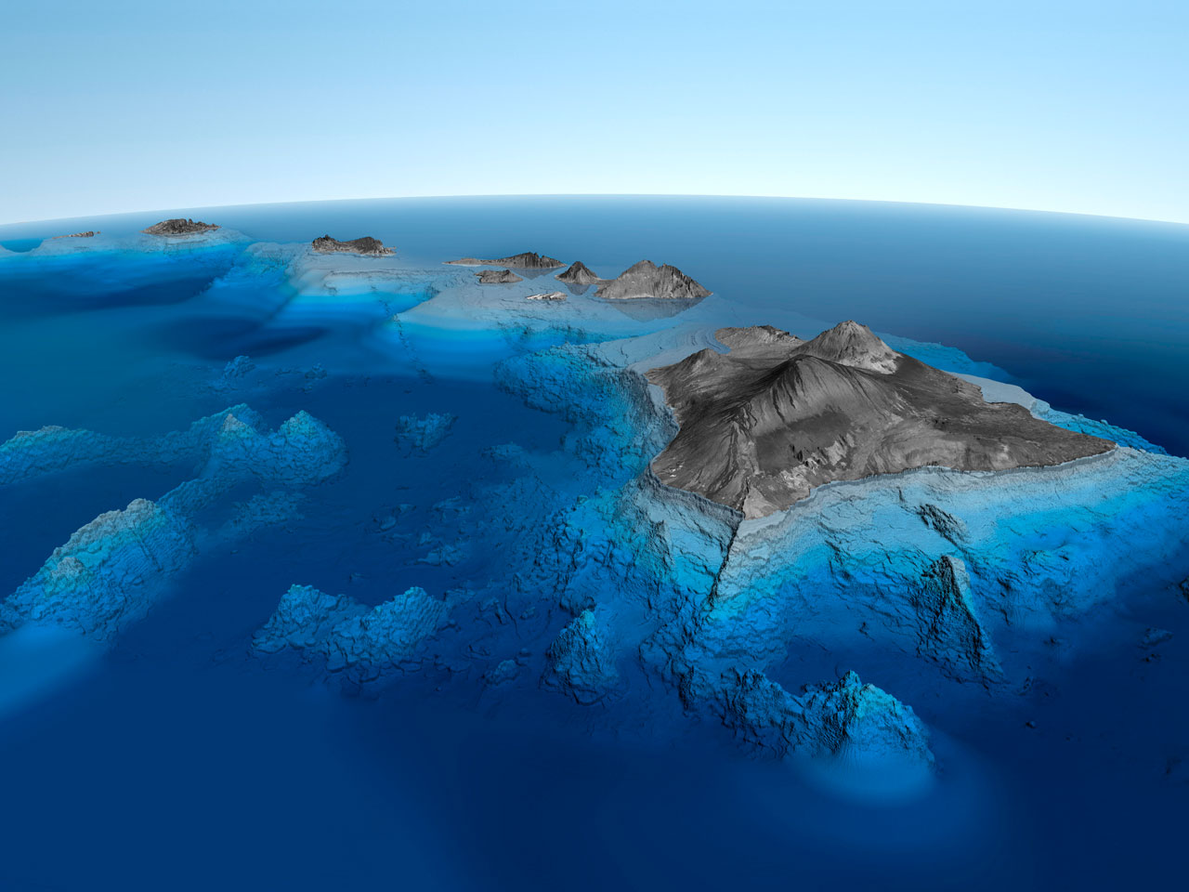
Underwater Volcanic Mountains can also form islands.

Slide 35
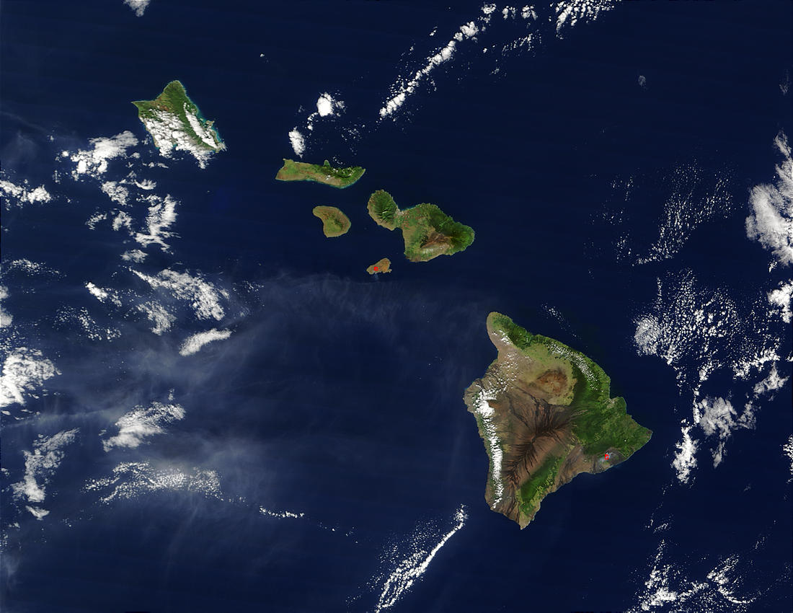
Underwater Volcanic Mountains can also form islands.

Slide 36
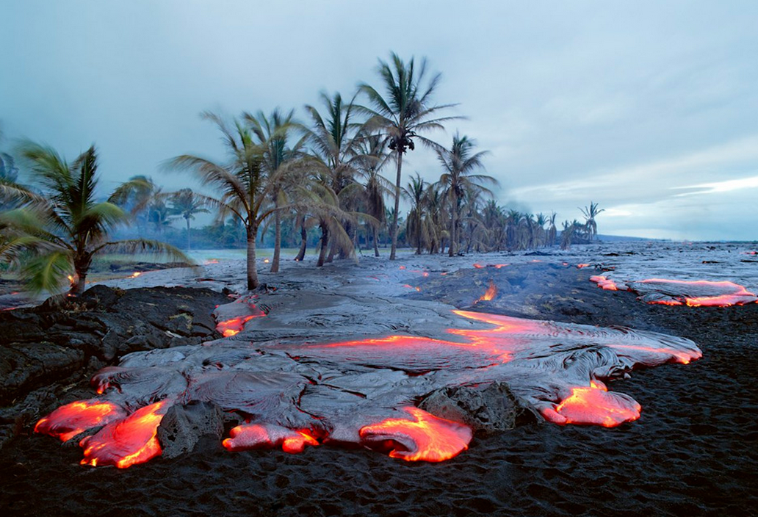
Like Hawaii

Slide 37
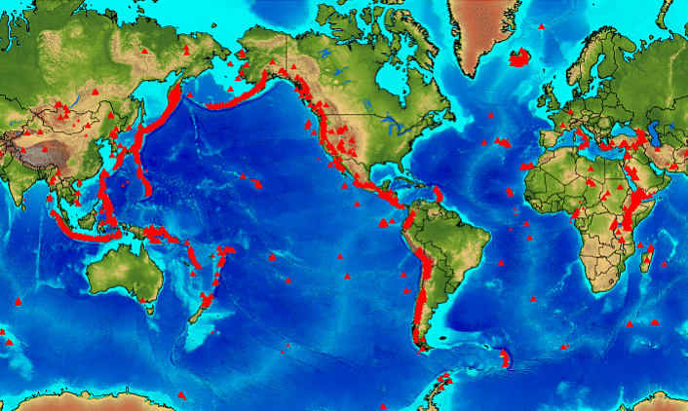
Most Volcanoes occur around the Pacific plate along the Ring of Fire.

Slide 38
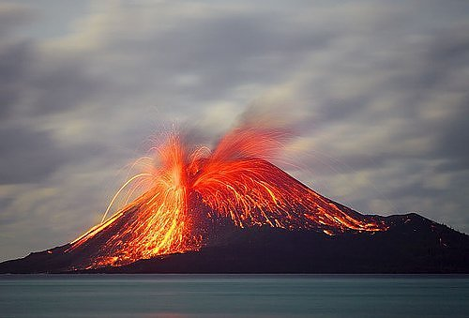
Llaima volcano in Melipeuco, Chile

Slide 39
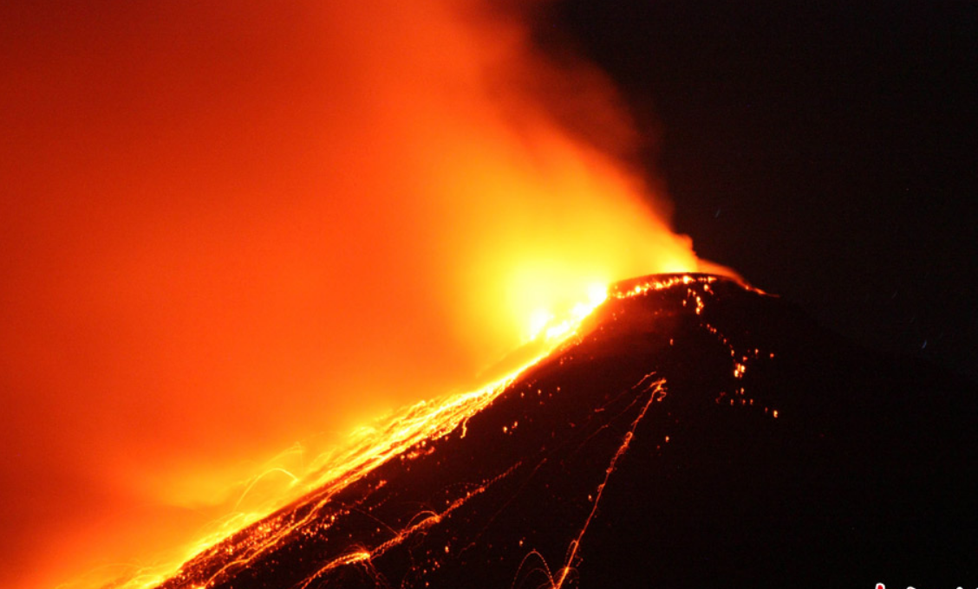
Indonesian Volcano Mount Karangetang

Slide 40
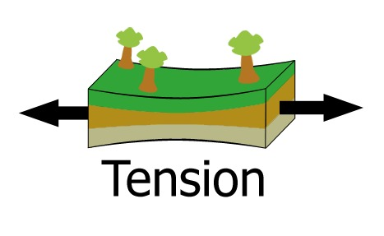
Uplift
Uplift is when large areas of land move up without deforming.
Elastic Rebound is one form of Uplift it happens when you pull rocks apart – then let go.
Where the rock had been thin in the middle it goes back to its original shape and the land rises.
←tension →

Slide 41
Subsidence
The opposite of uplift, subsidence occurs when large areas of land drop either quickly or over time.

Slide 42
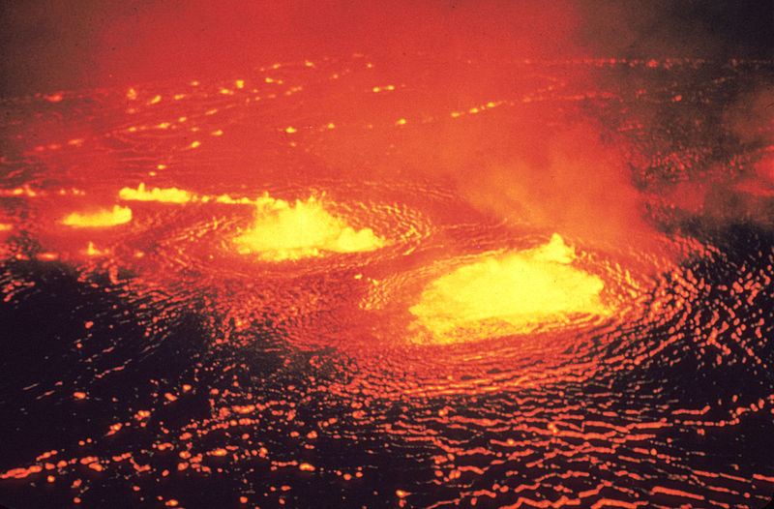
Kilauea Volcano, Hawaii

