Slide 1
Cumulus
Puffy white clouds with flat bottoms

Slide 2
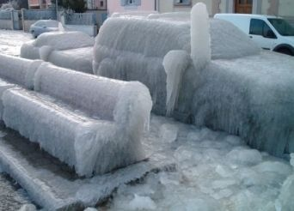
Frozen Rain
Sleet

Slide 3
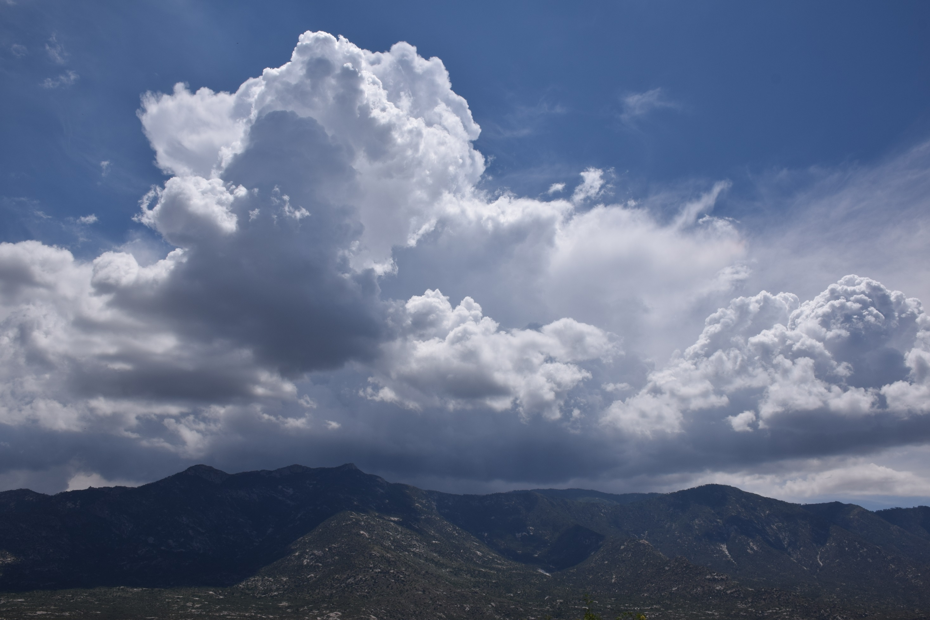
cumulonimbus
Dark cumulus clouds that cause thunderstorms

Slide 4
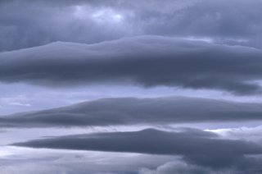
nimbostratus
A blanket cloud that is dark – causes rain – but NOT lightning

Slide 5
Very high clouds – made of ice – they look like swooshes
cirrus
and cumulus

Slide 6
from vapor to solid
snow

Slide 7
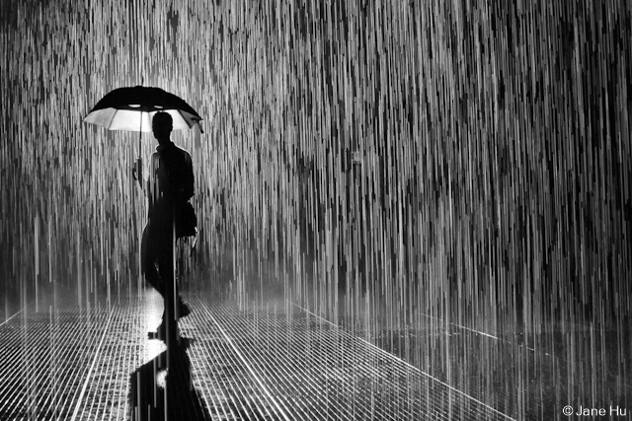
You already know this type of precipitation
Rain
(duh)

Slide 8
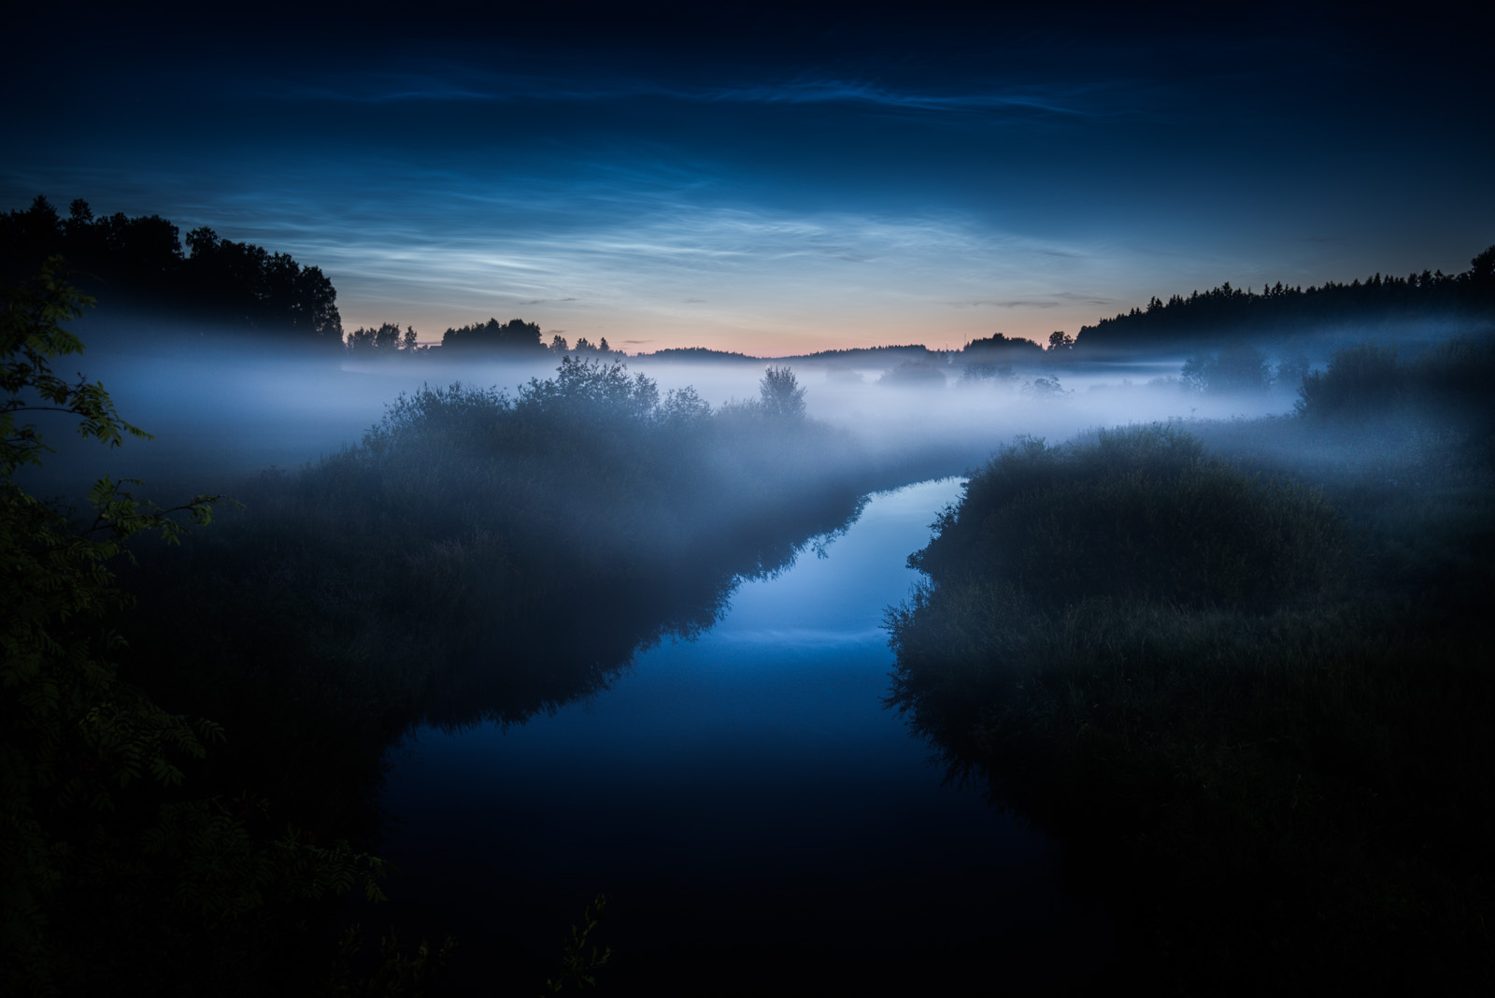
Stratus (fog)

Slide 9
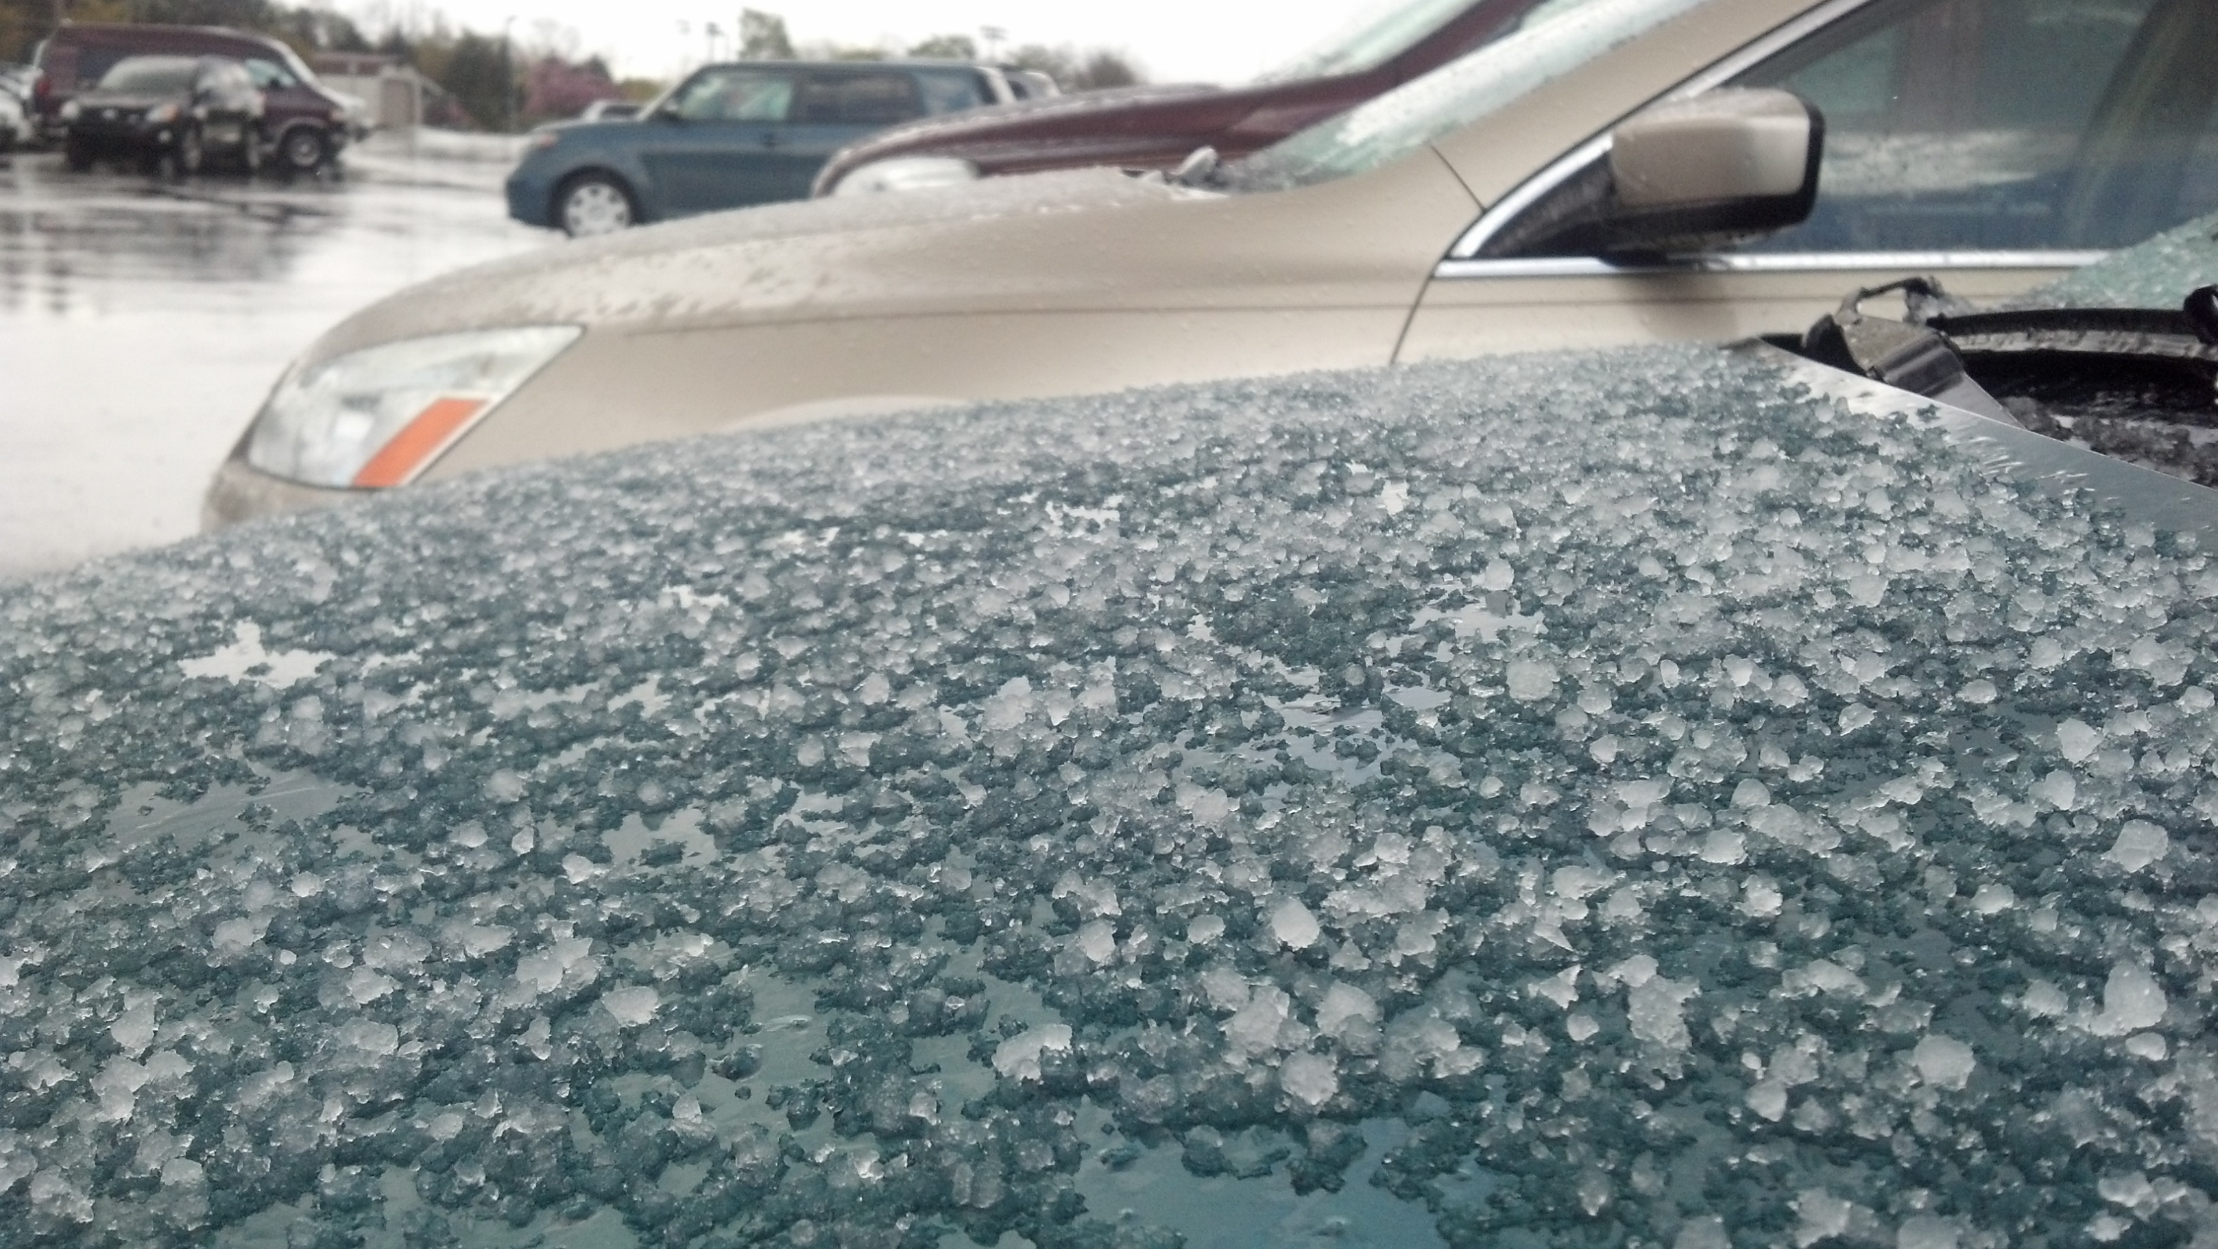
Frozen Rain
Sleet

Slide 10
cumulus

Slide 11
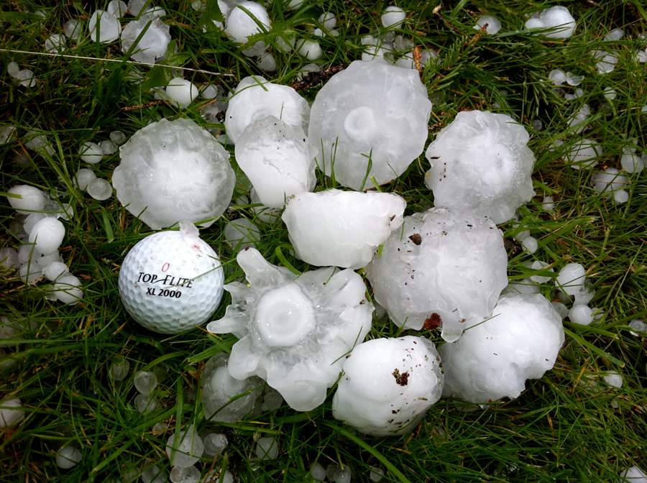
Precipitation that is made of balls of ice
Look the layers show!
Hail is made when a raindrop gets pushed up by an updraft – then it freezes and falls again – and again it is pushed up to refreeze. and again… and again…
hail

Slide 12
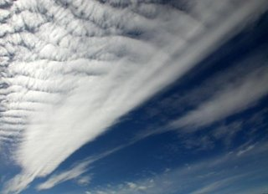
??

Slide 13
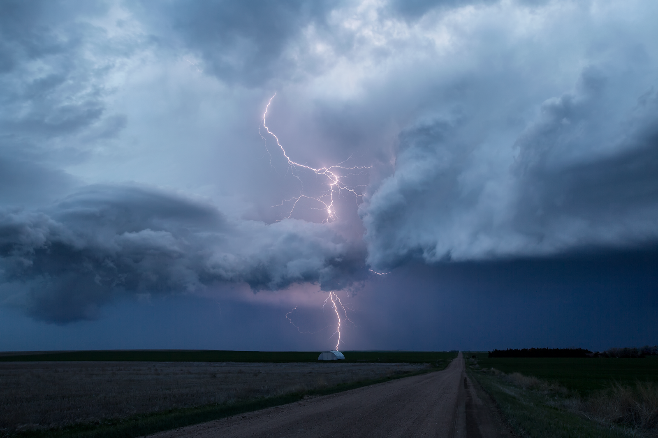
cumulonimbus
Has to be – there is lightning

Slide 14
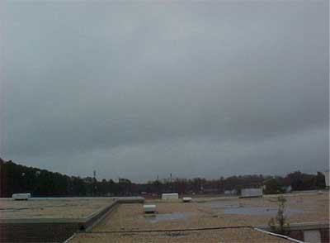
Stratus

Slide 15
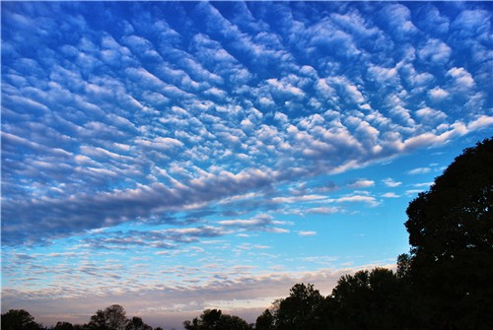
Cumulus? Cumulostratus?

Slide 16
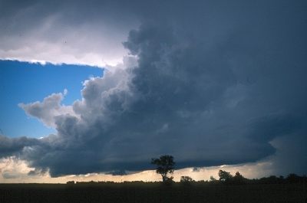
cumulonimbus

Slide 17
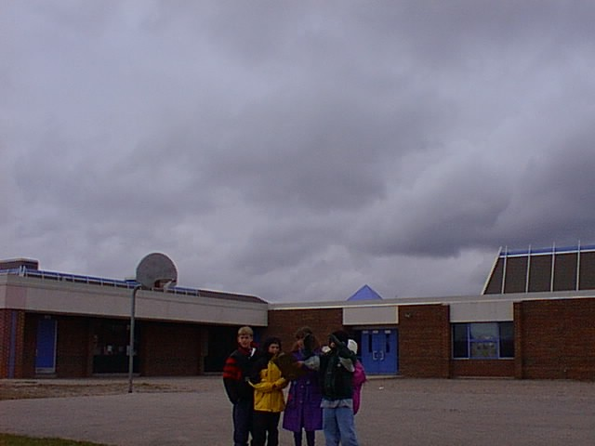
nimbostratus

Slide 18
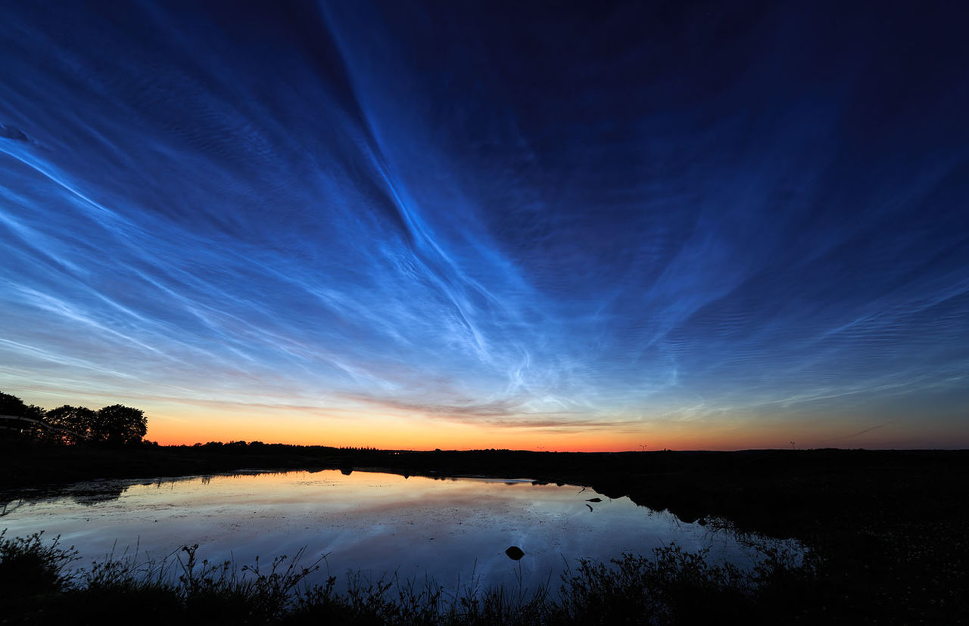
??
Photo by Mikko Lagerstedt

Slide 19
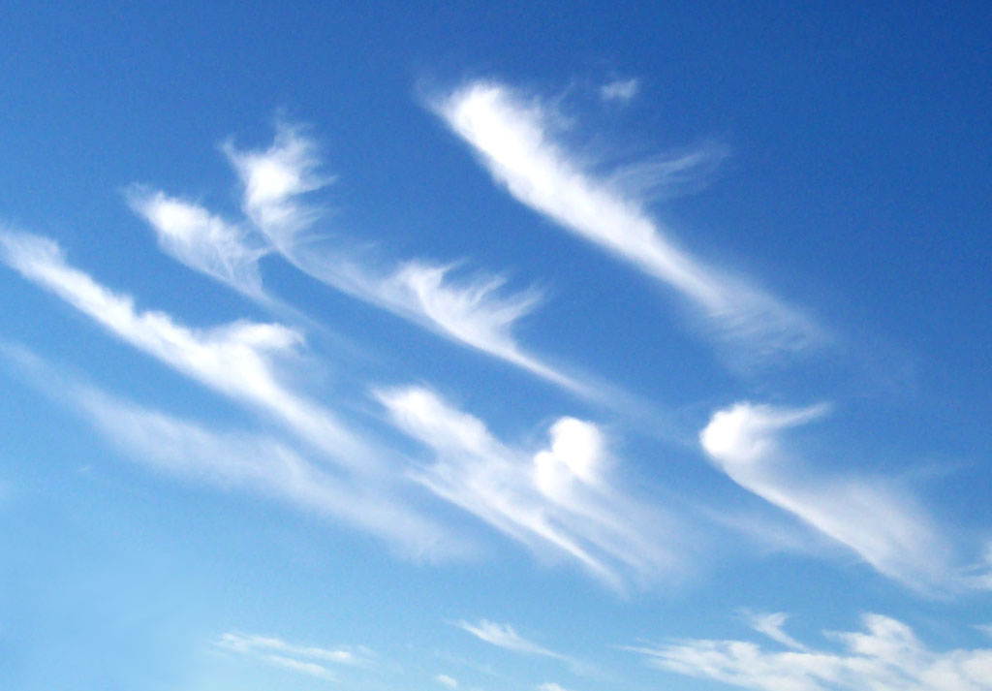
Cirrus

