Slide 1
Cumulus

Slide 2
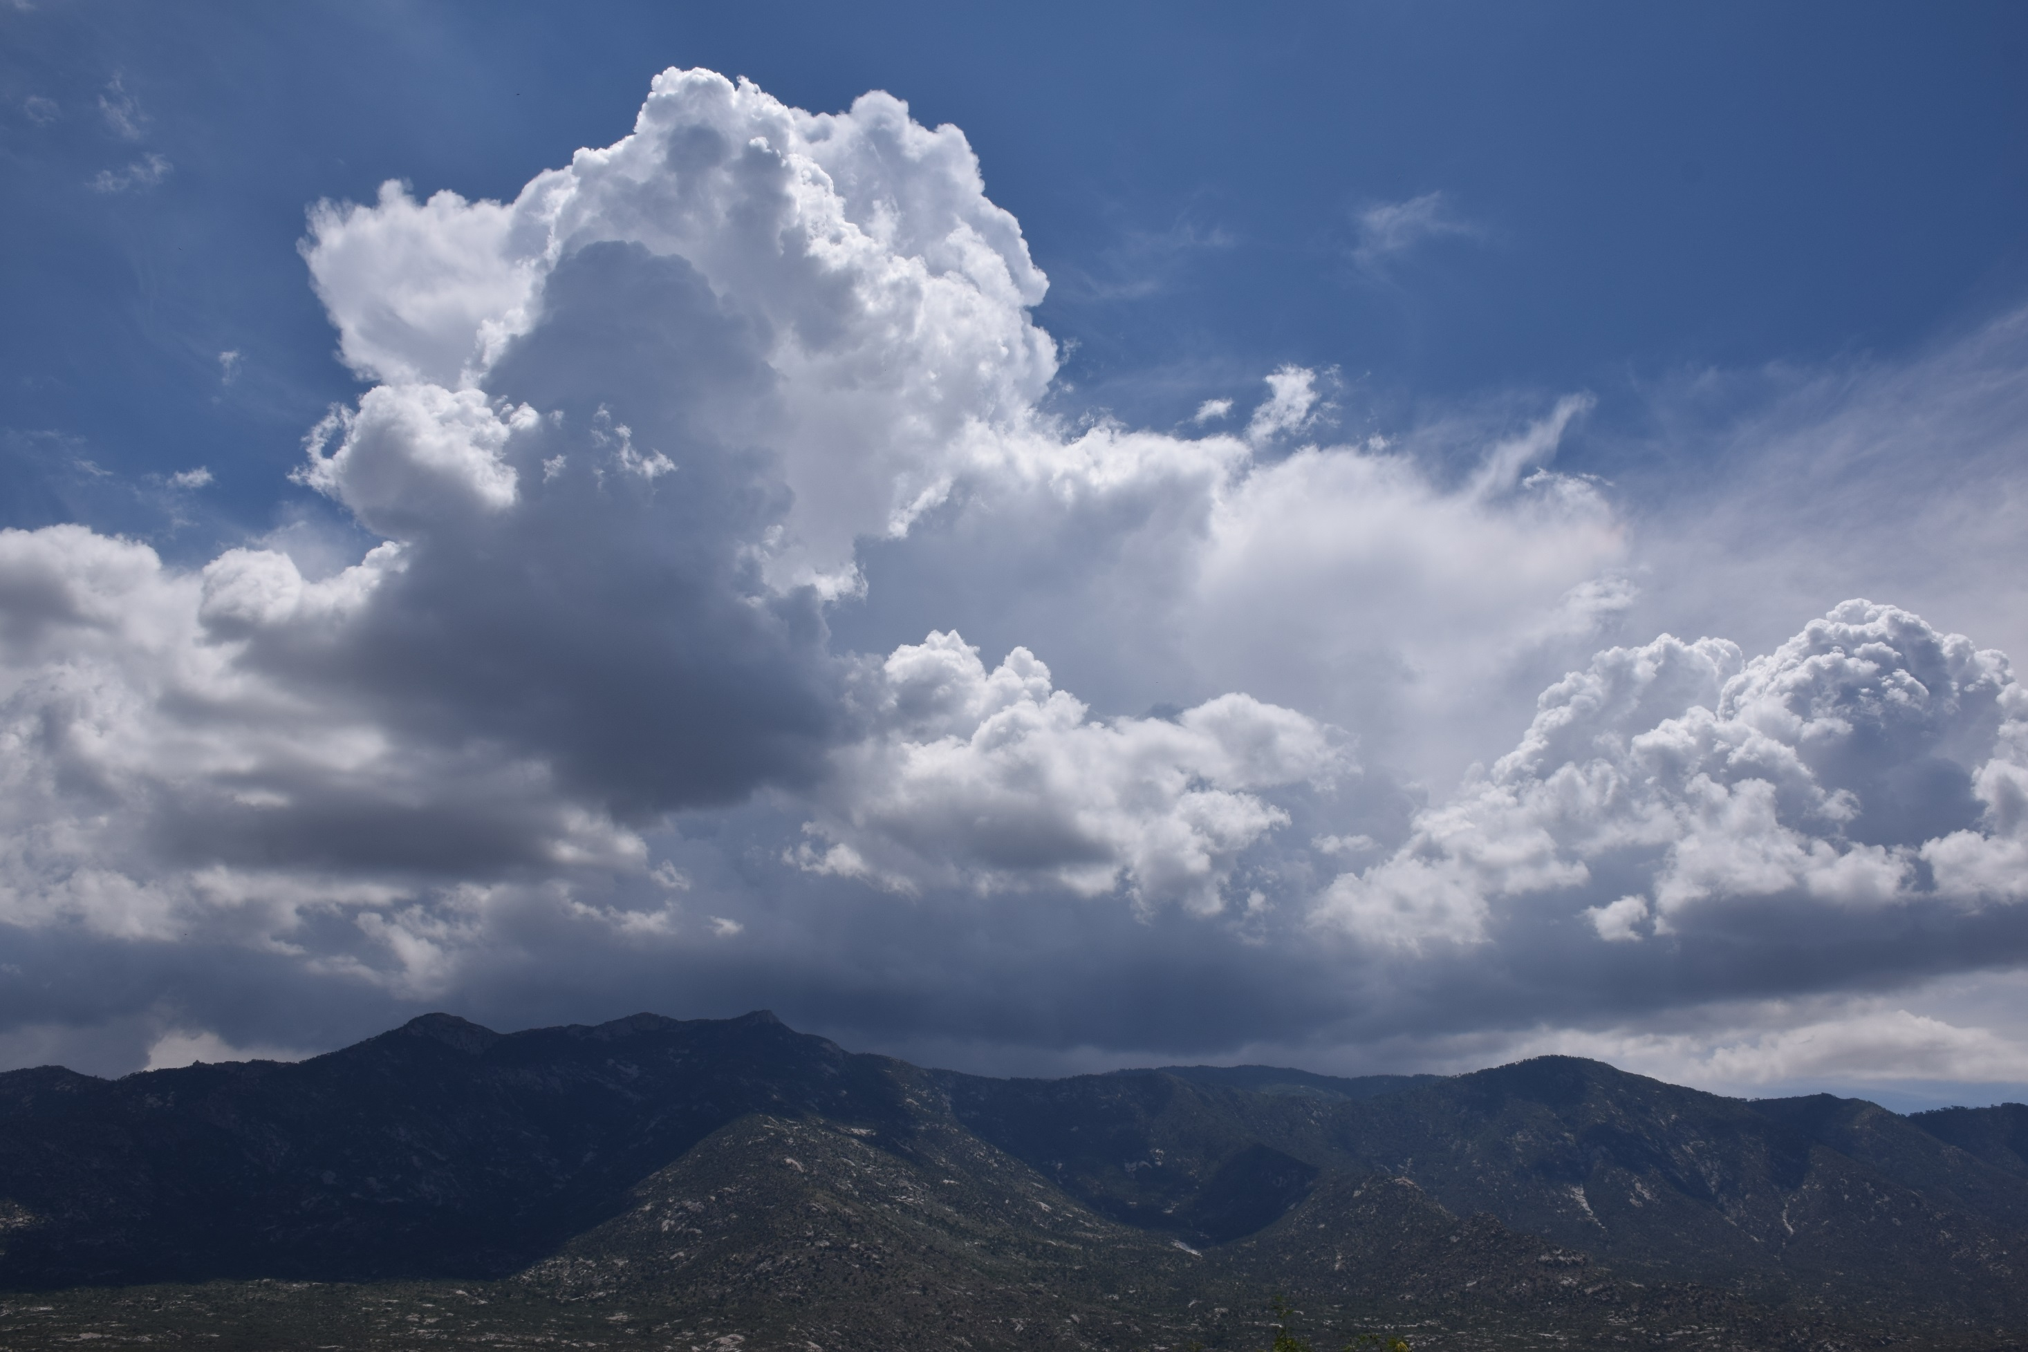
cumulonimbus

Slide 3
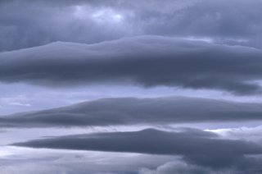
nimbostratus

Slide 4
cirrus
and cumulus

Slide 5
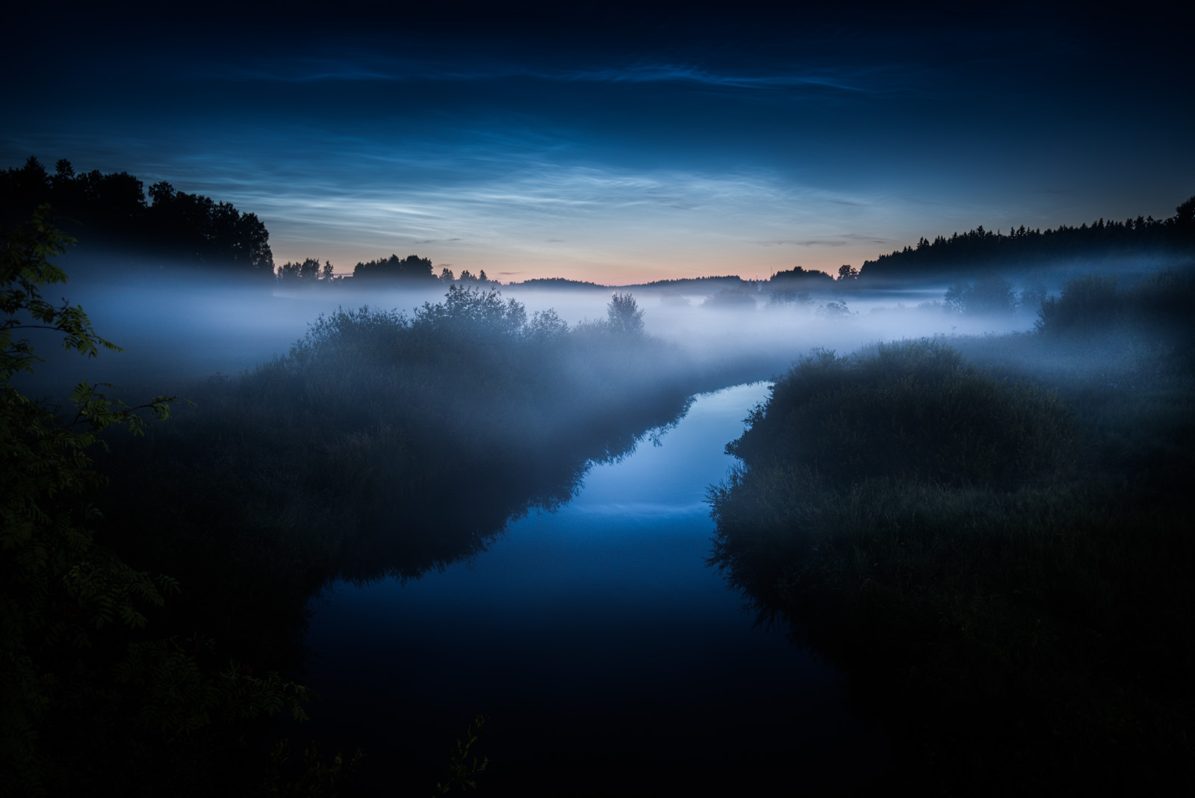
Stratus (fog)

Slide 6
cumulus

Slide 7
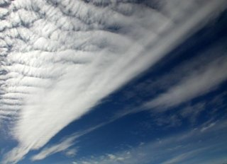
??

Slide 8
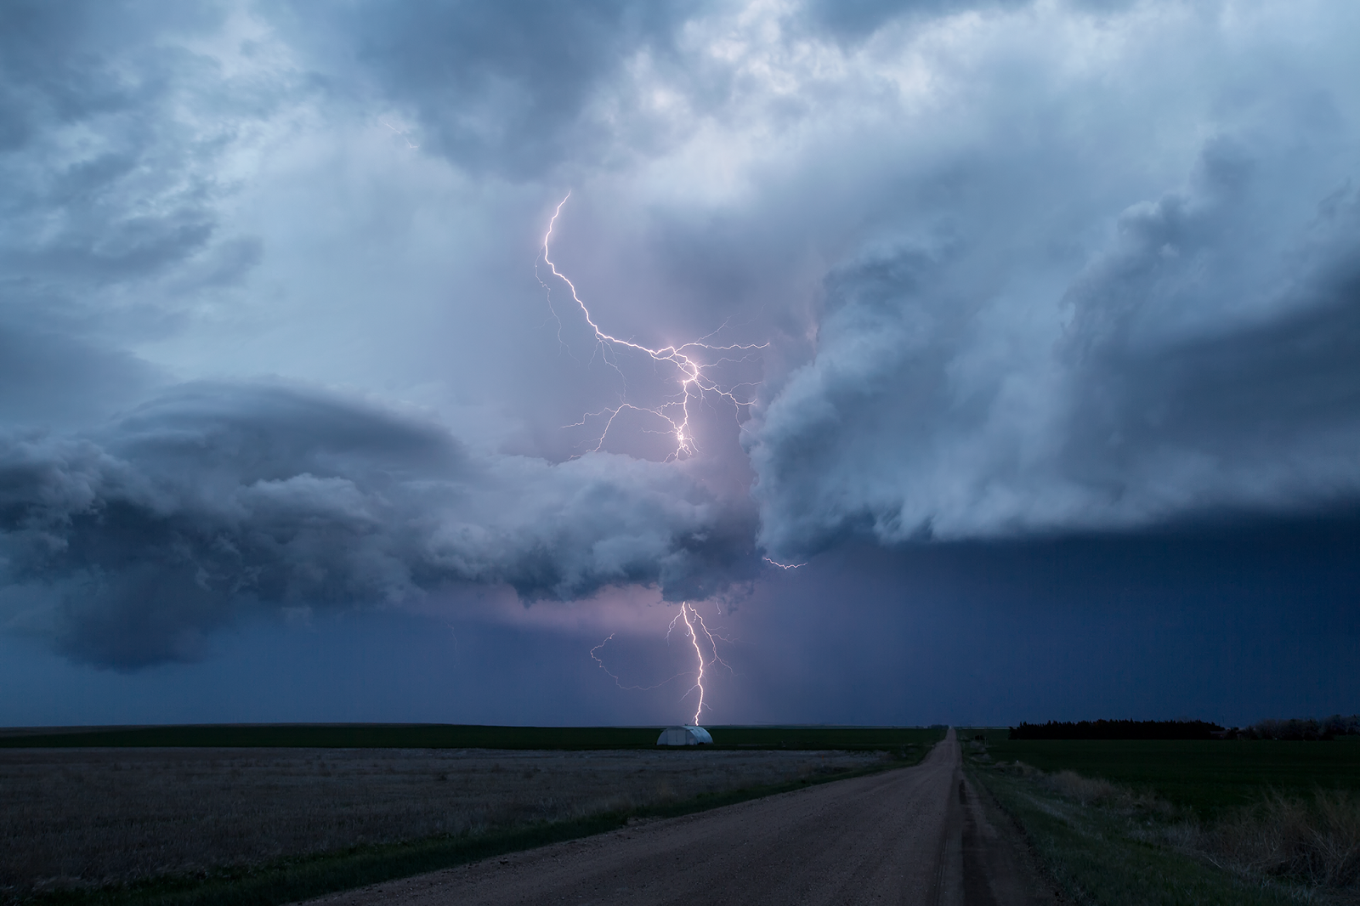
cumulonimbus
Has to be – there is lightning

Slide 9
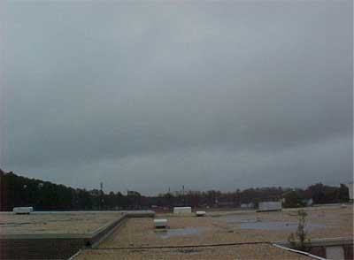
Stratus

Slide 10
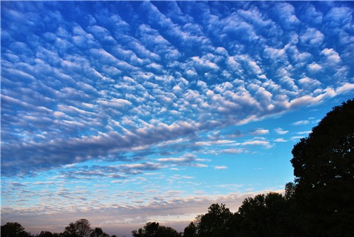
Cumulus? Cumulostratus?

Slide 11
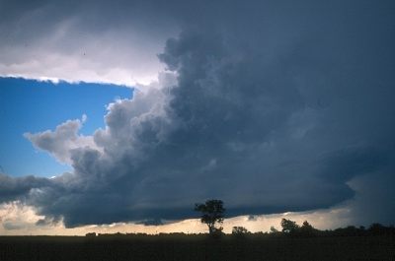
cumulonimbus

Slide 12
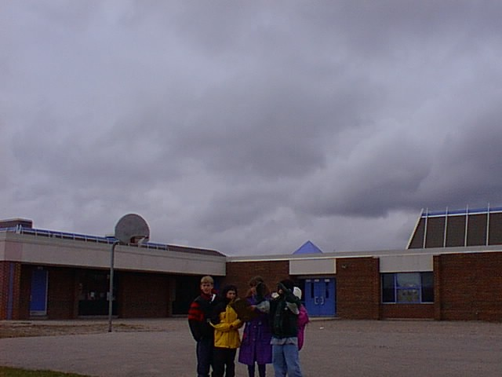
nimbostratus

Slide 13
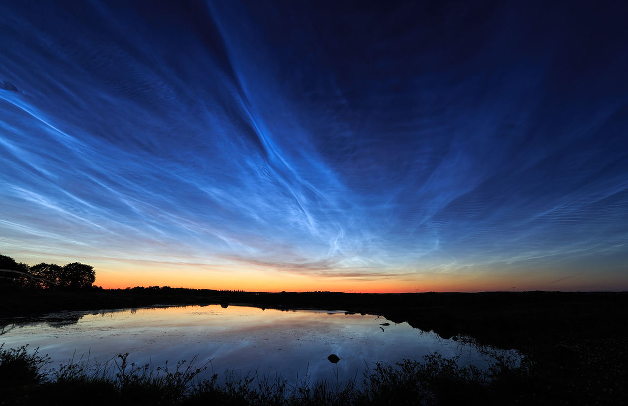
??
Photo by Mikko Lagerstedt

Slide 14
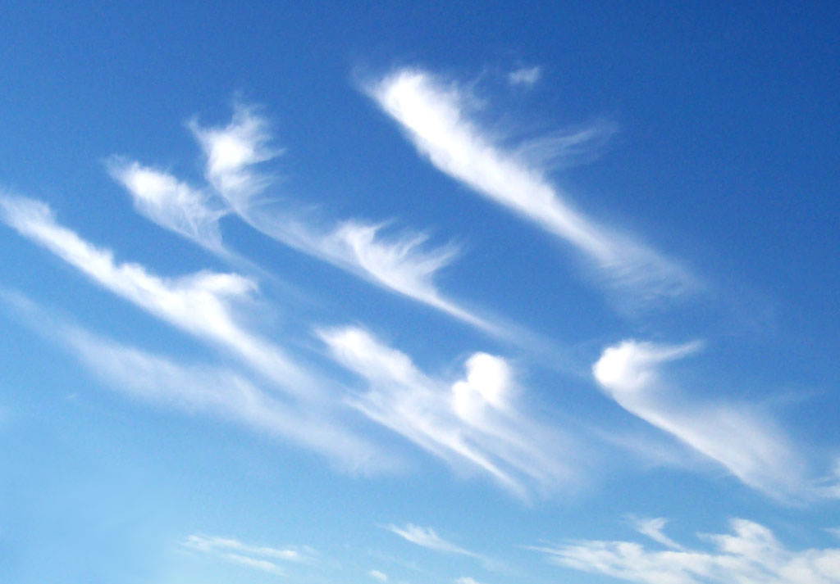
Cirrus

