Slide 1
Where Would You Find These Plants & Why?
Look at the pictures and name the biome where you would find these plants. Why do you think they would be found in that biome?

Slide 2
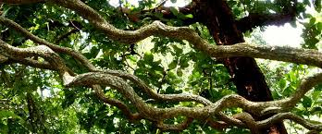
Which Biome & Why?

Slide 3
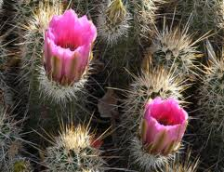
Which Biome & Why?

Slide 4
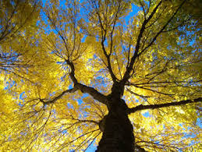
Which Biome & Why?

Slide 5
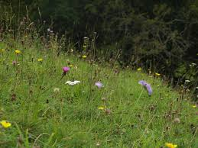
Which Biome & Why?

Slide 6
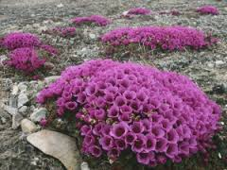
Which Biome & Why?

Slide 7
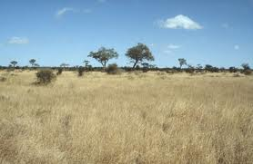
Which Biome & Why?

Slide 8
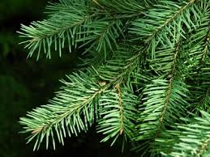
Which Biome & Why?

