Slide 1
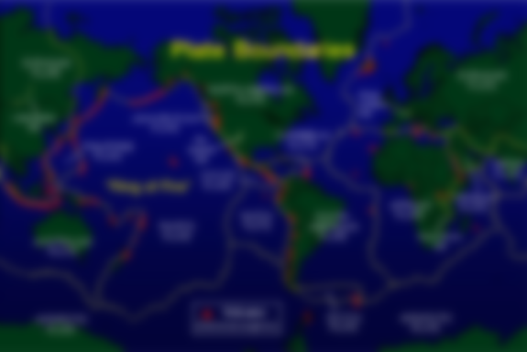
Continental Drift
How does it work?

Slide 2
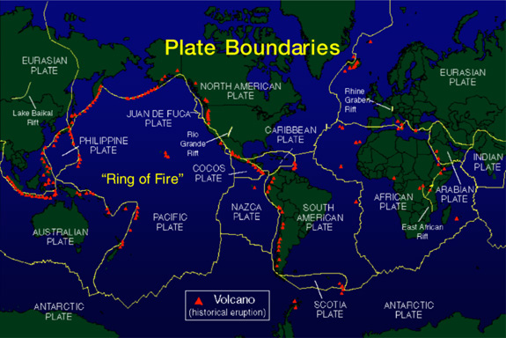

Slide 3
The Theory of Plate Tectonics
Earth’s Lithosphere is broken into many pieces called plates
Plates mover very slowly – only a few centimeters per year
We measure that movement with GPS

Slide 4
But how does it work?

Slide 5
Convection starts the process
As the hot magma convects it gently
pushes the crust away.

Slide 6
We are not entirely sure
Plates separate here
This is called a Divergent Boundary
We know that the inside of our earth convects.
It has to – that’s what hot liquid does.
This convection should be shifting the plates just a little tiny bit.
Convection pushes plates apart

Slide 7
We are not entirely sure
Plates separate here
We know that the inside of our earth convects.
It has to – that’s what hot liquid does.
This convection should be shifting the plates just a little tiny bit.
Convection pushes plates apart
Divergent plate boundaries include the Mid-Atlantic ridge and the East African Rift Valley

Slide 8
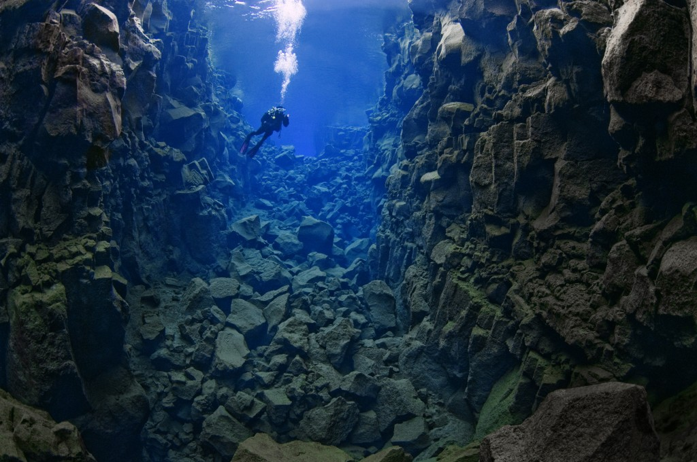
The Mid-Atlantic Ridge is a Divergent Boundary!
The Mid-Atlantic Ridge is where the sea floor is spreading. New Oceanic crust is being formed
right now!

Slide 9
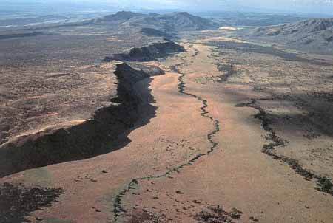
The East African Rift Valley is a Divergent Boundary!
In the East African Rift Valley new continental crust is being formed right now!

Slide 10
Divergent Boundary

Slide 11
Once convection starts making new rock, old rock needs to be removed – or else our planet would be growing
This is called a Convergent Boundary
This happens when tectonic plates get pushed towards each other.

Slide 12
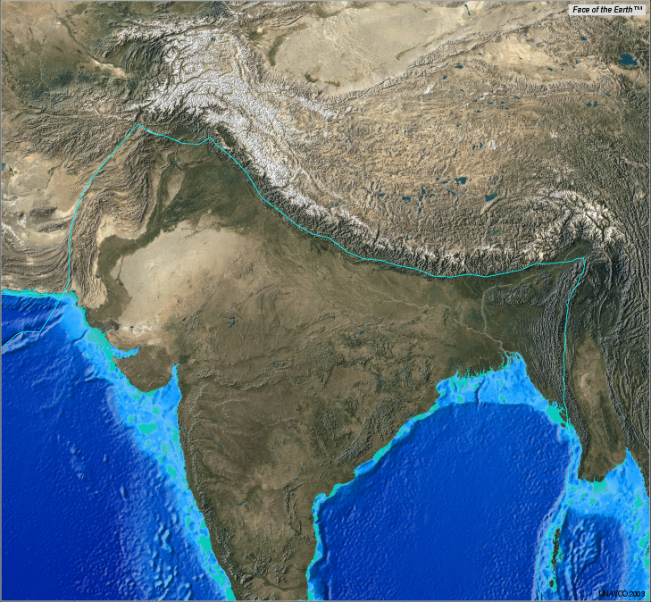
The Himalayan Mountains are on a Convergent Boundary.
This is a continental to continental plate collision.
The Himalayan Mountains are a Convergent Boundary

Slide 13
Convergent Boundary

Slide 14
When two plates slide past each other its called a Transform Boundary

Slide 15
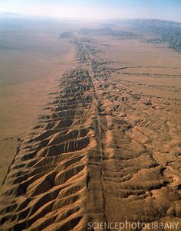
The San Andreas Fault runs through southern California
The San Andreas Fault is a Transform Boundary

Slide 16
Transform Boundary

Slide 17
But how does it work?

Slide 18
Why do the plates move?

Slide 19
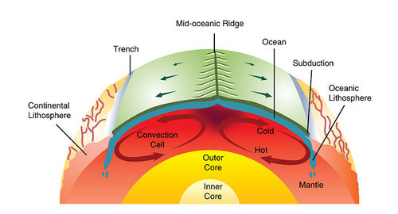
Why do plates move?
1. Convection – convection cells inside the mantle push the crust sideways

Slide 20
Why do plates move?
2. Slab Pull– when thin oceanic crust meets thick continental crust the oceanic crust sinks and pulls the rest of the plate with it

Slide 21
Why do plates move?
2. Ridge Push – because the mid ocean ridge is higher than the sea floor new rock slides down hill away from the center of the ridge

Slide 22
How do we know?

Slide 23
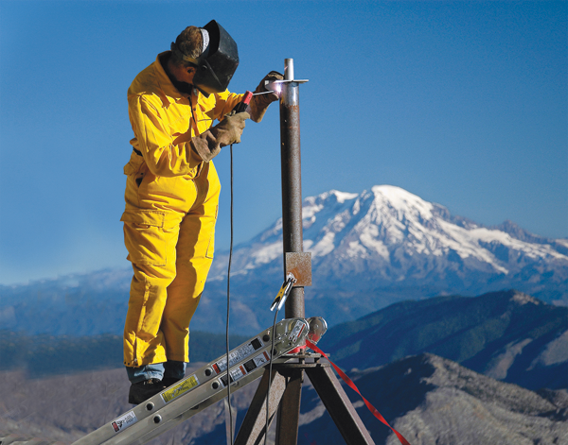
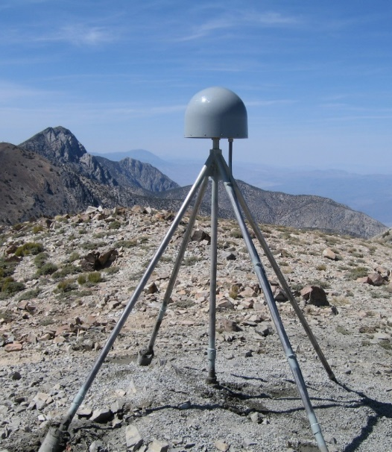
We have GPS (Global Positioning Systems) all over the world that chart where the plates are and where they are moving to.

Slide 24
Use your notes to define these vocabulary terms: tectonic plates convection divergent convergent transform ridge push slab pull

Slide 25
Locate which type of boundary these places are on. San Andreas Fault East African Rift Valley Mount Everest (in the Himilayas) The Mid-Atlantic Ridge

