Slide 1
When it comes to teaching kids writing, one of the most important strategies to teach is how to write a hook.

Slide 2
The hook is the very first sentence in the essay, and a good one creates a lasting impression with the reader.

Slide 3
One mistake I see kids frequently making is writing general statements for a hook such as:
Hello, my name is _____________and today I a m going to write about…

Slide 4
The hook statement needs to be interesting. Not like this…
Volunteering after school is an important part of learning responsibility…

Slide 5
The hook statement needs to be interesting. Not like this…
Volunteering after school is an important part of learning responsibility…

Slide 6
There are 8 types of hooks for writing an essay:

Slide 7
Question
When writing a question, try to create a picture in the reader’s mind.
Use the words who, what, when, where, why, is, how, or are at the beginning of the sentence.

Slide 8
Quote
You can find a quote in lots of places
from a book
at TV show
Your favorite movie
or even from a famous person.

Slide 9
Onomatopoeia
Onomatopoeia is a word that makes sounds.
Those can be animal sounds, car sounds, or any other sound.
Examples include: Bang! Woof! or Cock-a-doodle-doo!

Slide 10
Poem
Use a poem from a famous author, or make up your own.

Slide 11
Song
Use a line or two from your favorite song on the radio.
Make sure you relate it to your essay.

Slide 12
Interjection
Interjections express emotions. Examples are Aha!, Stop!, Ugh!, Help!, Well!, YOW!, Brrrr!, Yummy!

Slide 13
Startling Statistic
Statistics show relationships with numbers. Find a surprising statistic involving your topic.

Slide 14
Dialogue
Dialogue features two or more people talking.

Slide 15
Here is an example of 8 different hooks which could be used for writing an expository essay about my favorite television show, Spongebob Squarepants:

Slide 16
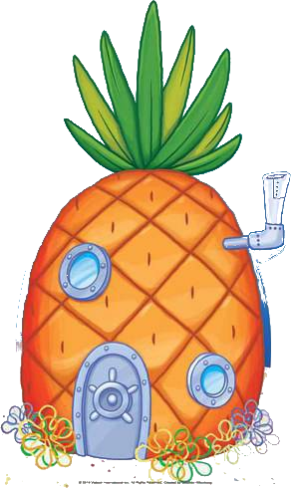
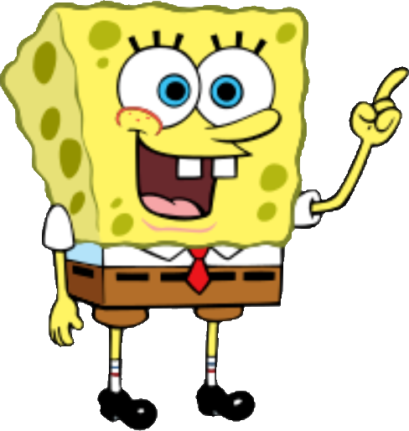
QUESTION
Where in the Pacific Ocean can you find a delicious Krabby Patty to eat, live in a pineapple, and drive in an underwater boat?
Bikini Bottom, of course!

Slide 17
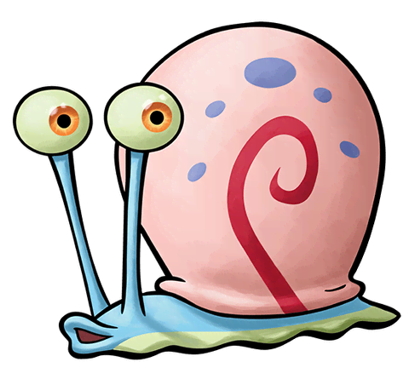
QUOTE
"Do you smell that? That smell--It's the smell of a smelly smell that smells smelly,"
stated Spongebob from the show Spongebob Squarepants

Slide 18
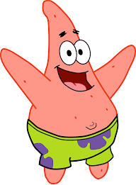
ONOMATOPOEIA
“Meoooww!” said Gary

Slide 19
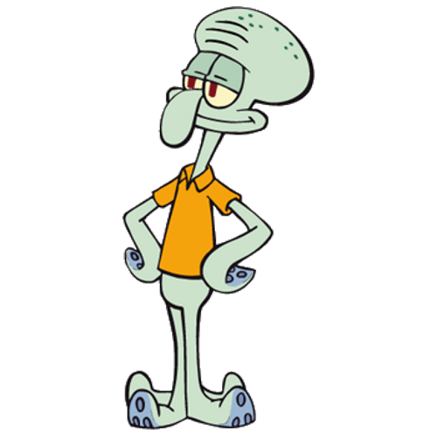
POEM
Roses are red, violets are blue.
I love Spongebob Squarepants, do you?

Slide 20
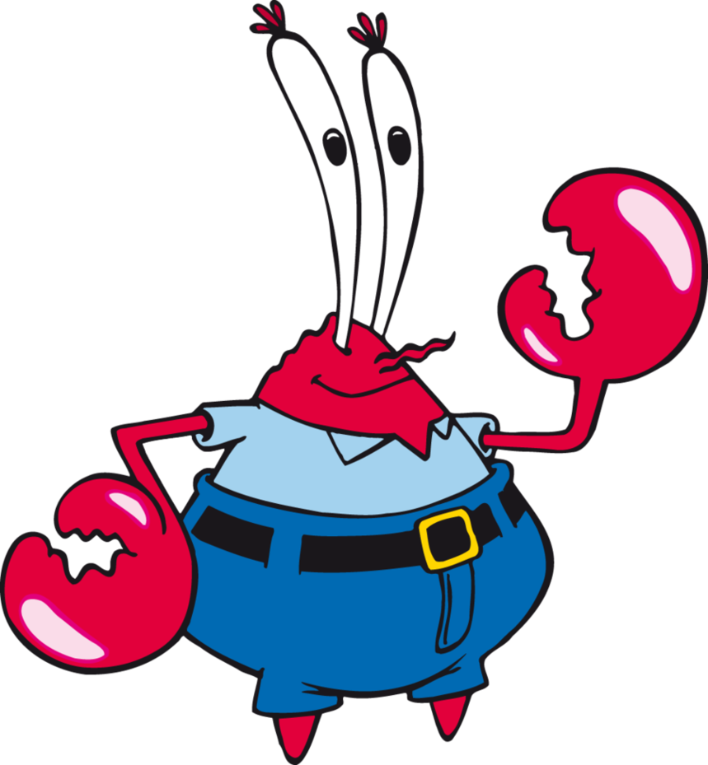
SONG
"Are ya ready kids? Aye, aye, Captain. I can't hear you! Aye, aye Captain. Ohhhh!"
My favorite TV show started to play on Nickelodeon.

Slide 21
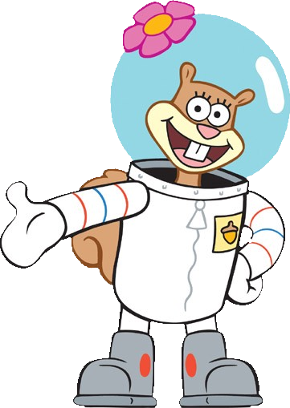
INTERJECTION
"Noooo!" Don't touch the TV, I am watching my favorite show, Spongebob Squarepants.

Slide 22
STARTLING STATISTIC
Over 1 million adults and children worldwide tune in to watch the TV show, Spongebob Squarepants on a weekly basis

Slide 23
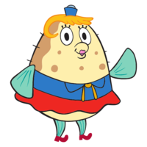
DIALOGUE
"There's nothing wrong with getting kissys from your grandmother," said Spongebob. "No, especially if you're a big baby who wears diapers!" responded Fish

