Slide 1
Why do we get
Lightning?

Slide 2
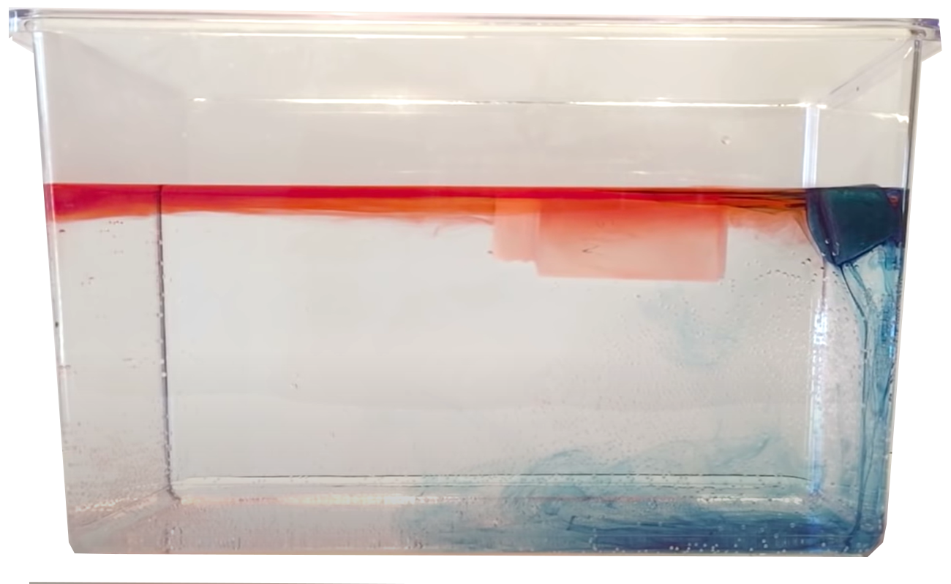
https://www.youtube-nocookie.com/embed/yBBVSTBLRNk?autoplay=1&iv_load_policy=3&loop=1&modestbranding=1&playlist=yBBVSTBLRNk

Slide 3
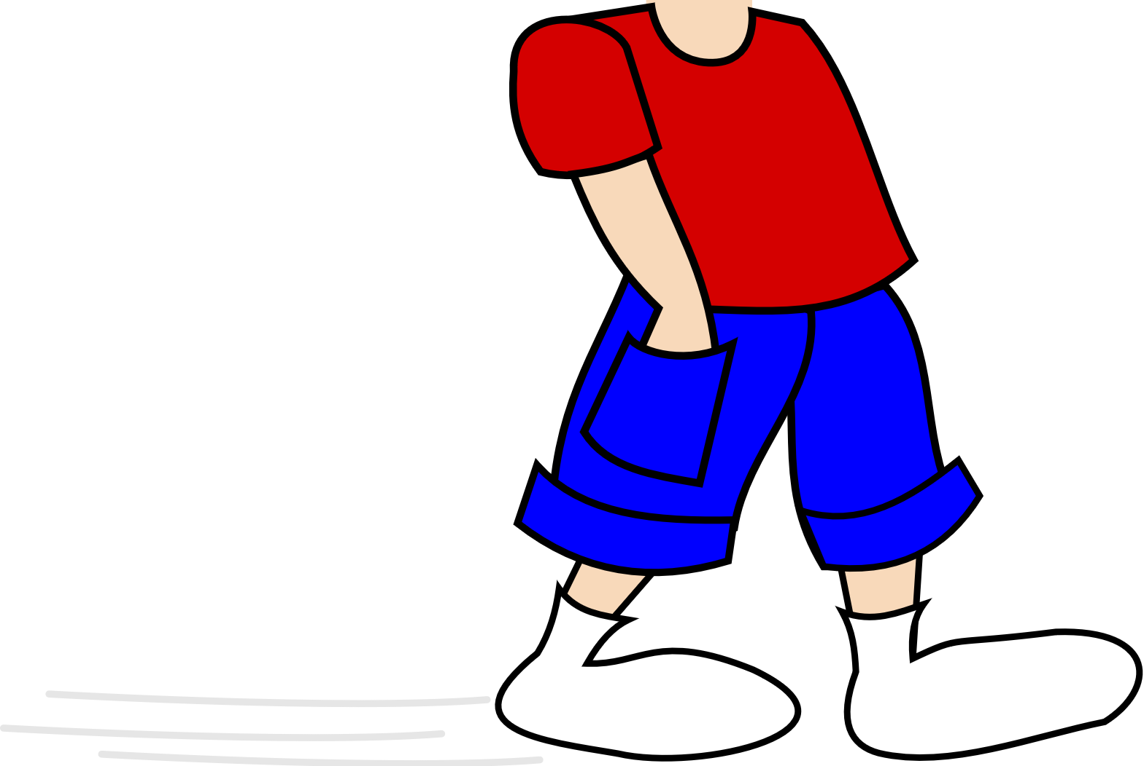
Have you ever walked across a carpet in your socks..
and then touched the doorknob?

Slide 4
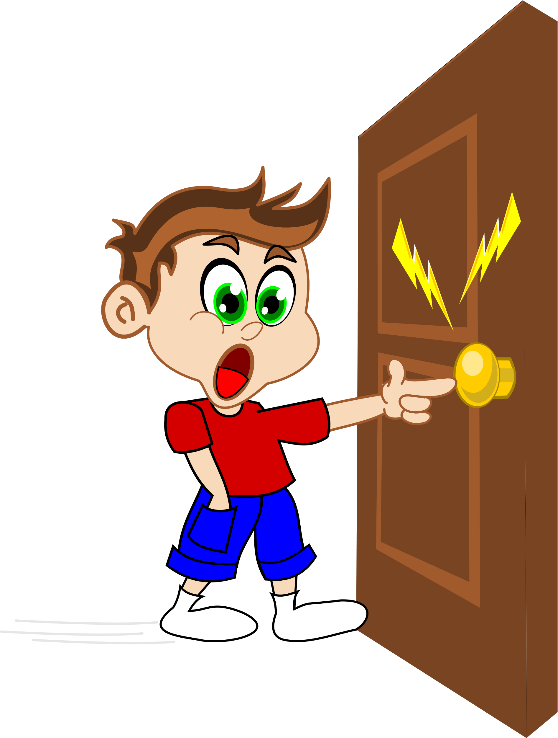
When you rub your feet
on the carpet you are building up static electricity.
Anytime you rub
two things together, you buildup static electricity.

Slide 5
When you rub your feet
on the carpet you are building up static electricity.
Anytime you rub
two things together, you buildup static electricity.

Slide 6
Air on the earth gets heated by the sun.
But it does not heat evenly.
Over the oceans it heats slowly
Over land it heats fast.

Slide 7
The air over the ocean is cold
What do you think happens here?
The air over the land is hot

Slide 8
The cold air
is sinking
and they are rubbing against each other here.
Hot air is rising
What is going to happen?

Slide 9
The air does not need to be wearing socks!
As long as they are rubbing against each other, they will create static electricity

Slide 10
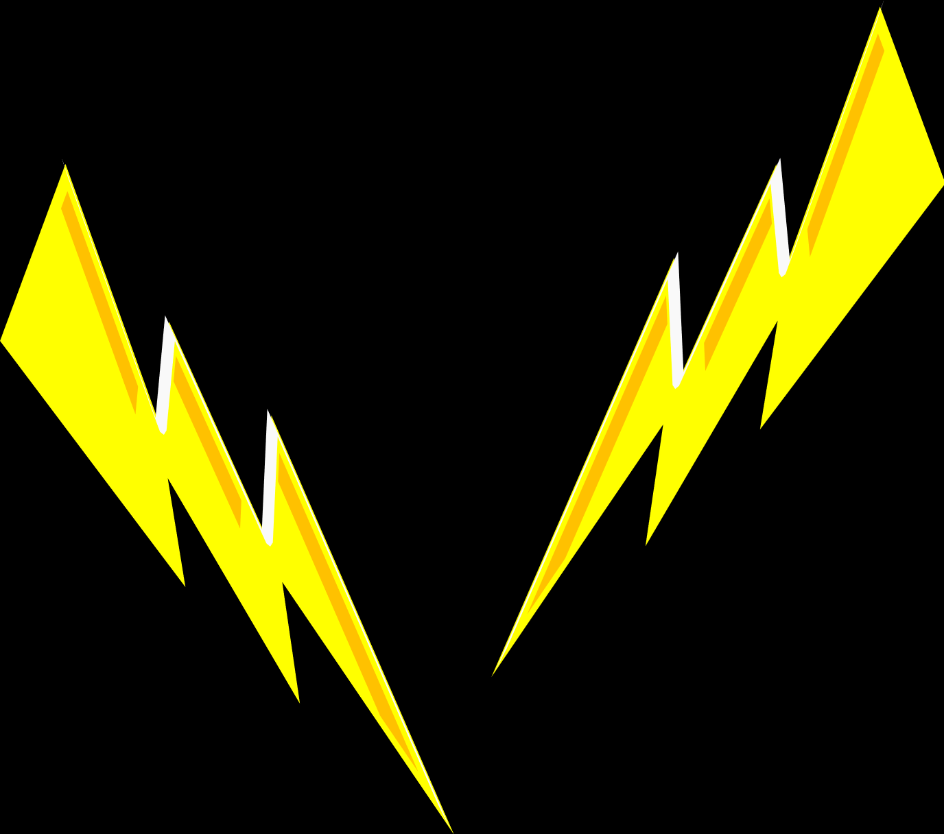
Static in the air is called lightning.

Slide 11
But do not play with lightning
It is much
much stronger than static
from your socks!

