Slide 1
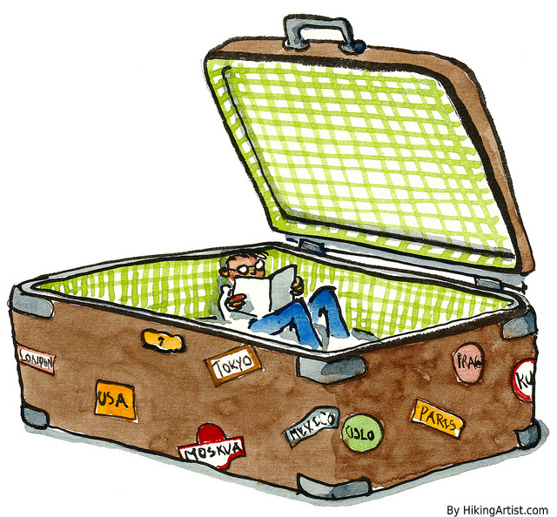
You just found a suitcase!
Look at what is inside to decide where the traveler was going.

Slide 2
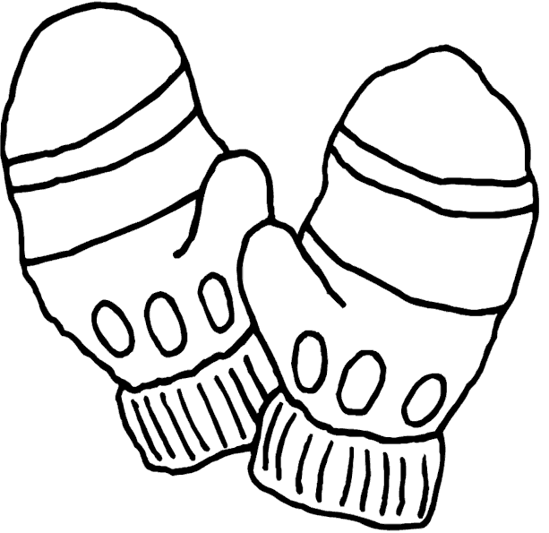
Mittens

Slide 3
H²O

Slide 4
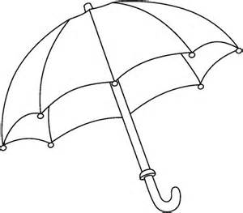
Umbrella

Slide 5
Snow Shovel

Slide 6
Bathing Suit

Slide 7
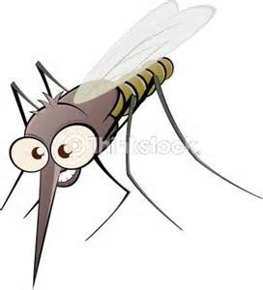
Mosquito Netting

Slide 8
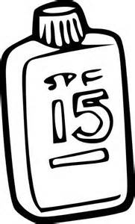
Sunscreen

