Slide 1
Physics?
ESSENTIAL QUESTION
UNIT 6 PHYSICS

Slide 2
Everyone Push in your chair and stand behind it.
Follow Instructions
UNIT 6 PHYSICS

Slide 3
Are you ready? Close your eyes.
Follow Instructions
UNIT 6 PHYSICS

Slide 4
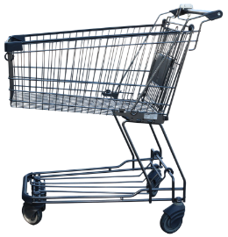
You are in a supermarket. You get to push the cart. It is heavy!
Imagine…
UNIT 6 PHYSICS

Slide 5
Follow instructions, but don’t walk away from your desk. Open your eyes.
Follow Instructions
UNIT 6 PHYSICS

Slide 6
Push your cart forward.
Imagine…
UNIT 6 PHYSICS

Slide 7
Push it faster!!
Imagine…
UNIT 6 PHYSICS

Slide 8
Whoa Slow down a little!
Imagine…
UNIT 6 PHYSICS

Slide 9
Turn your cart left.
Imagine…
UNIT 6 PHYSICS

Slide 10
Turn your cart right.
Follow Instructions
UNIT 6 PHYSICS

Slide 11
Quick Someone is in the way!! Stop your cart!!
Follow Instructions
UNIT 6 PHYSICS

Slide 12
Phew! Missed! Push the cart again.
Imagine…
UNIT 6 PHYSICS

Slide 13
What would happen if you let go of the cart?
Follow Instructions
UNIT 6 PHYSICS

Slide 14
It would continue moving in the same direction at the same speed.
Correct!
UNIT 6 PHYSICS

Slide 15
Take your seats
Follow Instructions
UNIT 6 PHYSICS

Slide 16
We just learned the first two vocabulary words “push” and “pull”
think about it…
UNIT 6 PHYSICS

Slide 17
push and pull explain the type of force that is being placed on something.
think about it…
UNIT 6 PHYSICS

Slide 18
A force is the energy being used on something. (you used your muscles to place force on your shopping cart)
think about it…
UNIT 6 PHYSICS

Slide 19
What forces are acting upon you right now?
think about it…
UNIT 6 PHYSICS

Slide 20
Molecules in the air, gravity, and your own weight are all pushing/pulling you down. Plus the chair is pushing up at you.
think about it…
UNIT 6 PHYSICS

Slide 21
if the forces pushing down (air, gravity, weight) are equal to the forces pushing up (the chair) the forces are BALANCED
Air
Gravity
Weight
think about it…
The Chair
UNIT 6 PHYSICS

Slide 22
Air
Gravity
Weight
think about it…
When forces are balanced nothing moves. (another vocabulary word)
The Chair
UNIT 6 PHYSICS

Slide 23
balanced force equal forces that keep an object still
Air
Gravity
Weight
definition
The Chair
UNIT 6 PHYSICS

Slide 24
When forces are un-balanced things move in the direction of the stronger force.
Air
Gravity
Weight
think about it…
The Chair
UNIT 6 PHYSICS

Slide 25
un-balanced force un-equal forces that make an object move
Air
Gravity
Weight
definition
The Chair
UNIT 6 PHYSICS

Slide 26
If forces are un-balanced and they change direction – the motion changes direction too.
think about it…
UNIT 6 PHYSICS

Slide 27
In other words… an object moves in exactly the same direction that the force moved in.
think about it…
UNIT 6 PHYSICS

Slide 28
Patterns of Motion
Read Page 14 - 15

Slide 29
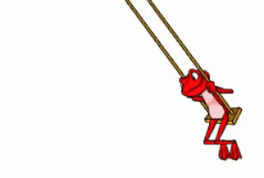
When you designed your marble roller coasters you were using your experience to predict how the marble would react.
think about it…
UNIT 6 PHYSICS

Slide 30
Try the experiment on page 18-19 to see if you can predict the motion of a washer on a string.
think about it…
UNIT 6 PHYSICS

Slide 31
Do you think you could make a ball do this?...
https://www.youtube.com/watch?v=H2LIlu7_-xc
check this out!
UNIT 6 PHYSICS

