Slide 1
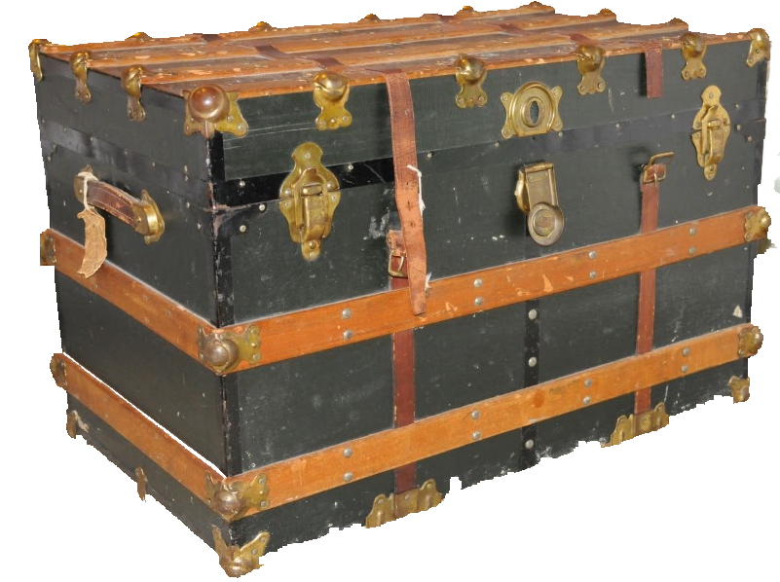
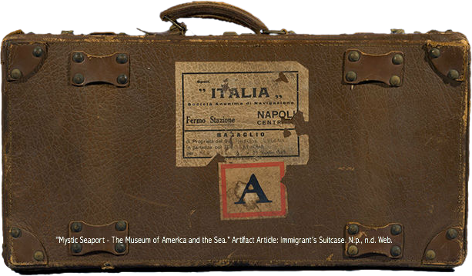
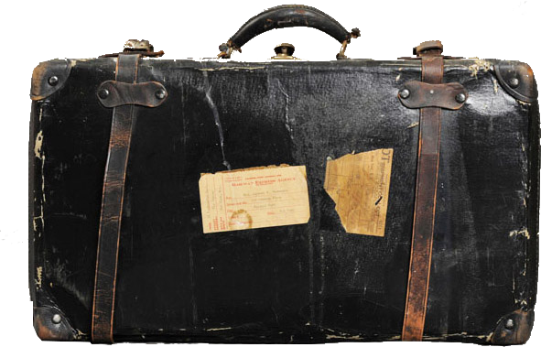
longing
A desire for something
A very long trip
Nice!
I think not!
group
able to use two languages equally well
traditional Japanese clothing with long sleeves
That’s your best guess?
Really?
NO

Slide 2
immigrant
surprised
a person who permanently moves to a country where he or she was not born.
No – I don’t think so.
Correct!!
group
able to use two languages equally well
a very long trip
That’s your best guess?
Really?
NO

Slide 3
homesick
Traditional Japanese clothing with long sleeves and a wide sash
Able to use two languages equally well
Oops!
I think not!
group
a very long trip
longing for one’s home
That’s your best guess?
Very good!

Slide 4
foreign
in or from a country that is not your own
A very long trip
Nice!
I think not!
group
able to use two languages equally well
longing for one’s home
That’s your best guess?
Really?
NO

Slide 5
astonished
a person who permanently moves to a country where he or she was not born.
No – I don’t think so.
Correct!!
surprised
group
able to use two languages equally well
a very long trip
That’s your best guess?
Really?
NO

Slide 6
bilingual
surprised
Able to use two languages equally well
No – I don’t think so.
Correct!!
group
A desire for something
a very long trip
That’s your best guess?
Really?
NO

Slide 7
kimono
Traditional Japanese clothing with long sleeves and a wide sash
Able to use two languages equally well
Nice!
I think not!
group
a very long trip
The period of time when one is a child
That’s your best guess?
Really?
NO

Slide 8
journey
surprised
A very long trip
No – I don’t think so.
Correct!!
group
able to use two languages equally well
A desire for something
That’s your best guess?
Really?
NO

Slide 9
childhood
Traditional Japanese clothing with long sleeves and a wide sash
Able to use two languages equally well
Oops!
I think not!
group
a very long trip
A period of time when one is a child
That’s your best guess?
Very good!

Slide 10
bewildered
confused
Able to use two languages equally well
Nice!
I think not!
group
a very long trip
traditional Japanese clothing with long sleeves
That’s your best guess?
Really?
NO

Slide 11
nationality
A long trip sometimes by sea or into space
Able to use two languages equally well
Oops!
I think not!
group
a very long trip
Being a citizen of a specific nation (almost all of us are American
That’s your best guess?
Very good!

Slide 12
inspire
surprised
To influence ore excite someone to greatness. An artist is inspired by a view.
No – I don’t think so.
Correct!!
group
able to use two languages equally well
a very long trip
That’s your best guess?
Really?
NO

Slide 13
voyage
Being a citizen of a specific nation (almost all of us are American
Able to use two languages equally well
Oops!
I think not!
group
a very long trip
A long trip sometimes by sea or into space
That’s your best guess?
Very good!

Slide 14
inspiration
Being a citizen of a specific nation (almost all of us are American
Able to use two languages equally well
Oops!
I think not!
group
A new idea that is exciting
A long trip sometimes by sea or into space
You rock!
Guess again!

