Slide 1
Thunderstorms
small area storms formed by the strong upward movement of warm, moist air
usually occurs ahead of a cold front as the colder, denser air shoves the warmer air upward – causing the friction needed to cause lightning

Slide 2
Thunderstorms
These storms are accompanied by heavy rain, thunder, lightning, sometimes hail, and can also produce tornadoes and hurricanes

Slide 3
A thunderstorm is a storm with lightning – which is the discharge of static electricity
Lightning can travel from the cloud to the ground, cloud to cloud, or even from the ground to a cloud!
Thunder is the result of the air quickly expanding from the heat of the lightning bolt (causes a sound wave)
You cannot have lightning without thunder!!

Slide 4
Take Notes
Thunderstorms
Before a cold front – warm air rises rapidly – cold air sinks – friction causes static buildup – and Zap
Can produce tornadoes and hurricanes
Lightning can travel cloud to cloud, cloud to ground and ground to cloud
Thunder is a sonic boom

Slide 5
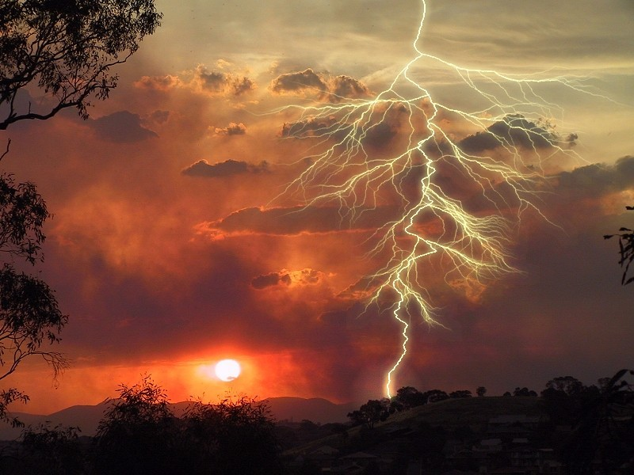

Slide 6
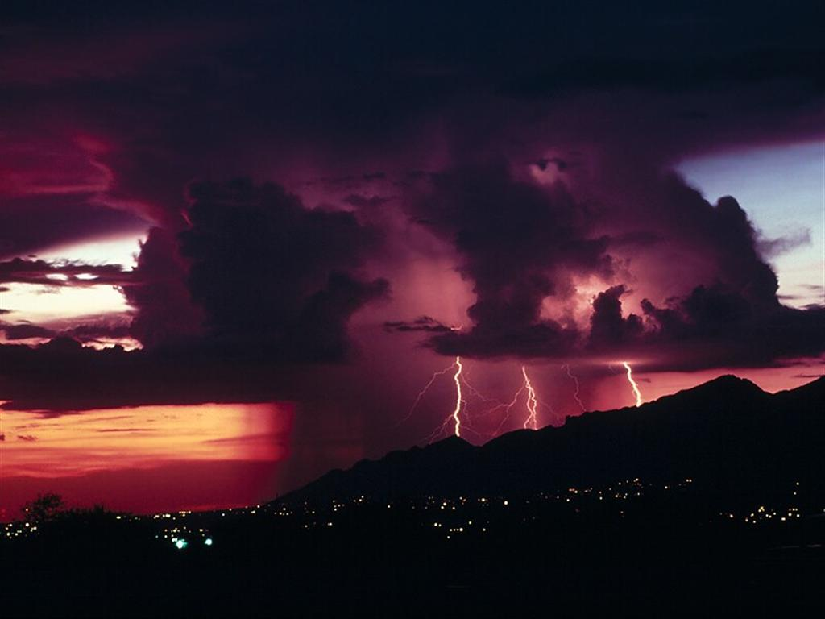

Slide 7
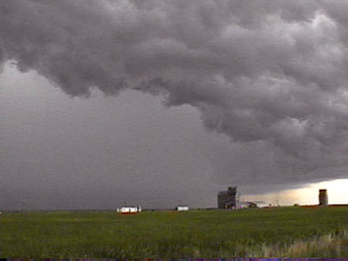
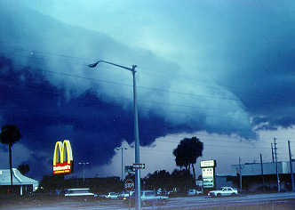
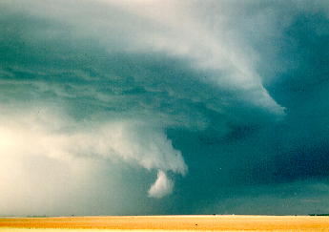
Supercell Thunderstorm formations – will form SEVERE storms and tornadoes! THIS IS ONE BIG STORM SYSTEM!

Slide 8
Cyclones:
Tornado- a small, compact storm with strong winds
AKA:
Twister
Willy-Willy (Australia)

Slide 9
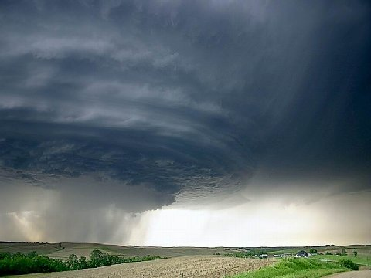

Slide 10
Tornadoes
form from very powerful thunderstorms (cumulonimbus clouds)
These are funnel shaped columns of spiraling winds that extend down to the ground from the base of a cloud
The winds move into a tornado (low pressure), and can reach a maximum of 318 mph!

Slide 11
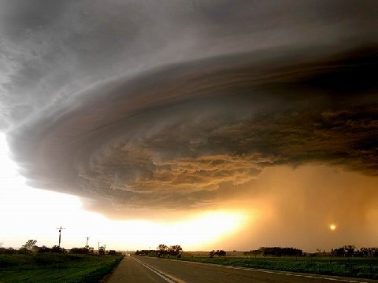

Slide 12
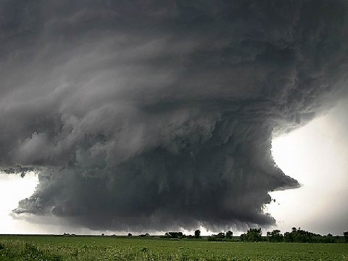

Slide 13
Types of Cyclones - Tornadoes
Spin COUNTER CLOCKWISE (like a hurricane)
The actual funnel is made by water droplets (clouds) and dust
Form from clouds caused by severe thunderstorms

Slide 14
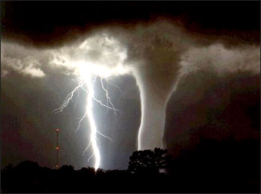

Slide 15
Tornadoes are especially dangerous because it is so difficult to predict where they will form
Damage is usually along a narrow path where the tornado traveled
They usually last less then one hour

Slide 16
Take Notes
Tornado
AKA twister or Willy-Willy in Australia
Formed from thunderstorms
Spin Counter Clockwise
Funnels are rain and dust
Becomes a tornado when the tail touches down
Winds move into the low pressure center of a tornado

Slide 17
Most tornadoes occur in an area of the United States called
Tornado Alley

Slide 18
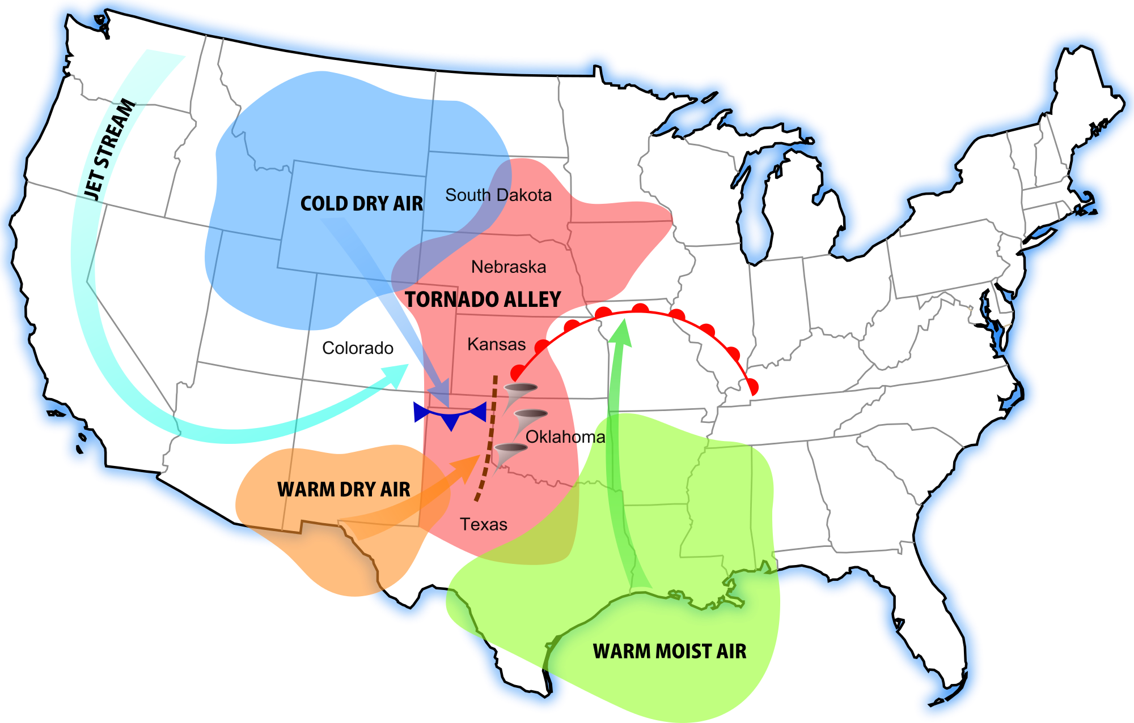
Tornado Alley is an area of the Great Plains where cold, dry Polar air meets wet, hot Tropical air.

Slide 19
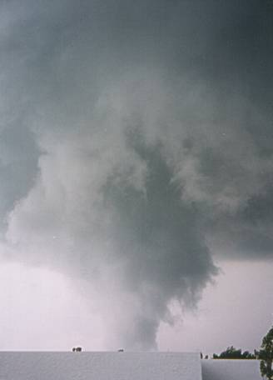
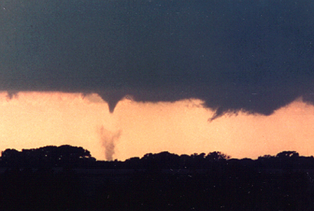
TORNADOES!

Slide 20
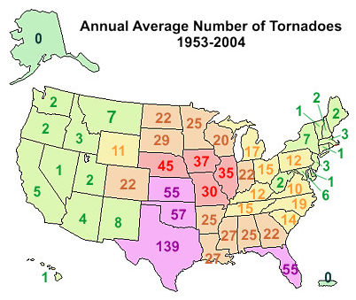
This map shows the average number of tornadoes per year in each of the United States.
Check out Texas!

Slide 21
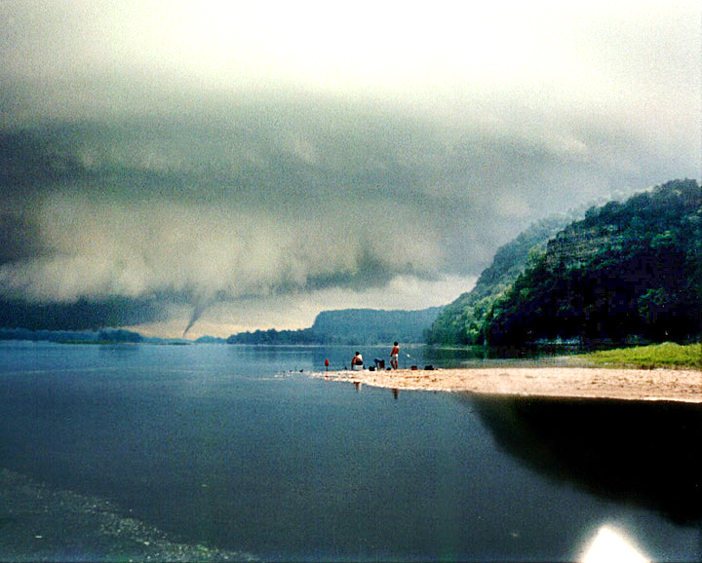

Slide 22
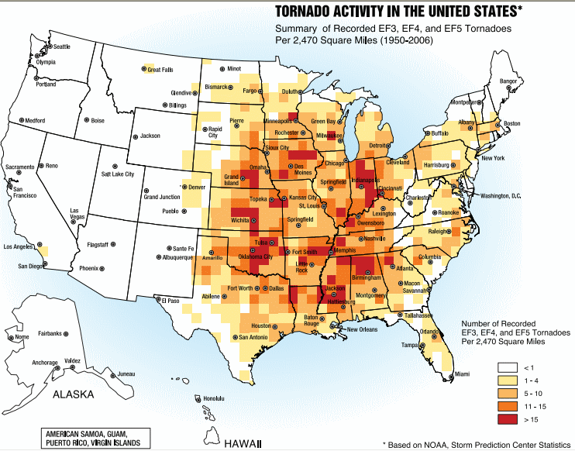
This map shows the total number of severe tornadoes that have occurred.
A severe tornado is considered an F3 – F5.

Slide 23
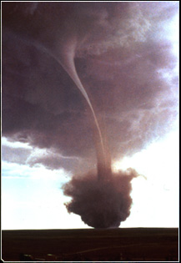
Tornadoes will pick up dust and debris from the ground when they “touch down” – this creates a wider swirl at the bottom of the tornado

Slide 24
Take Notes
6. Last less than one hour
7. Tornado alley – where most tornados occur
a. Over the Great Plains
b. Cold, dry Canadian air clashes with hot, wet Tropical air causing severe thunderstorms and then tornadoes
c. Most deadly over Texas, Oklahoma
and Kansas

Slide 25
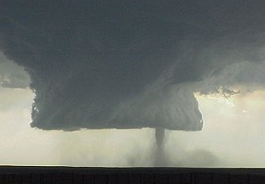

Slide 26
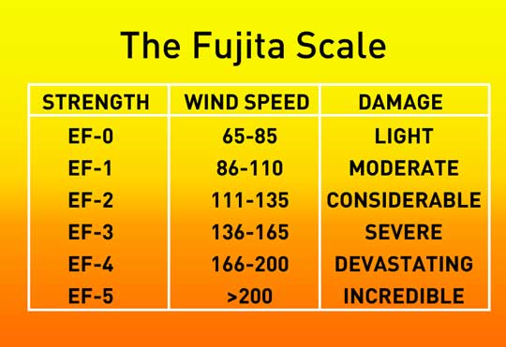
Tornadoes are measured using the Fujita Scale

Slide 27
Tornadoes are measured using the enhanced Fujita Scale.
The Fujita Scale was originally created to determine how bad a tornado was by looking at the damage that was done.
The enhanced Fujita Scale also uses wind speeds to determine the scope of the tornado.

Slide 31
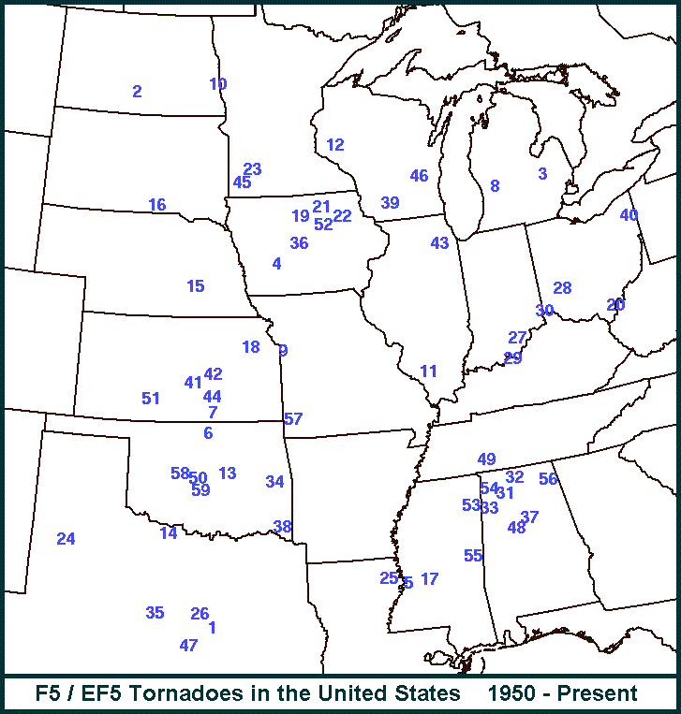

Slide 32
Take Notes
Measured by the Fujita Scale:
SCALE | WIND SPEED | DAMAGE
EF-0 | 65-85 | Light – branches broken – some roof tiles off
EF-1 | 86-110 | Moderate - roof tiles removed – windows broken
EF-2 | 111-135 | Considerable – roof missing – trees down
EF-3 | 136-165 | Severe – dwellings destroyed – walls gone
EF-4 | 166-200 | Devastating – houses gone – trucks lifted
EF-5 | 200+ | Incredible – only small bits of rubble left

Slide 33
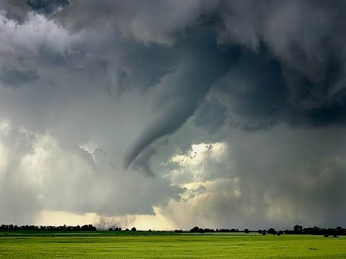

Slide 34
For those of you who aren't familiar with tornadoes, here is a short glossary to help you understand. Fujita Scale: Scale used to measure wind speeds of a tornado and their severity.
F1: Laughable little string of wind unless it comes through your house, then enough to make your insurance company drop you like a brick. People enjoy standing on their porches to watch this kind.
F2: Strong enough to blow your car into your house, unless of course you drive an Expedition and live in a mobile home, then strong enough to blow your house into your car.

Slide 35
F3: Will pick your house and your Expedition up and move you to the other side of town.
F4: Usually ranging from 1/2 to a full mile wide, this tornado can turn an Expedition into a Smart Car, then gift wrap it in a semi truck.
F5: The Mother of all Tornadoes, you might as well stand on your front porch and watch it, it’ll be quite a sight and it's probably going to be the last sight you’ll ever see.

Slide 36
Meteorologist: A rather soft-spoken, mild-mannered type person until severe weather strikes, and they start yelling at you through the TV: "GET TO YOUR BATHROOM OR YOU'RE GOING TO DIE!“
Storm Chaser: Meteorologist-rejects who are pretty much insane but get us really cool pictures of tornadoes. We release them from the mental institution every time it starts thundering, just to see what they'll do.

Slide 37
Types of Cyclones
Hurricane- A large, organized storm with strong winds and heavy rain
AKA
Typhoon- in the Pacific
Form over warm ocean waters when two or more thunderstorms combine
The largest storms on earth

Slide 38
Hurricanes
Massive storms with a size that can be more than 300 miles in diameter.
Feed on warm water
Biggest danger is the storm surge in coastal areas

Slide 39
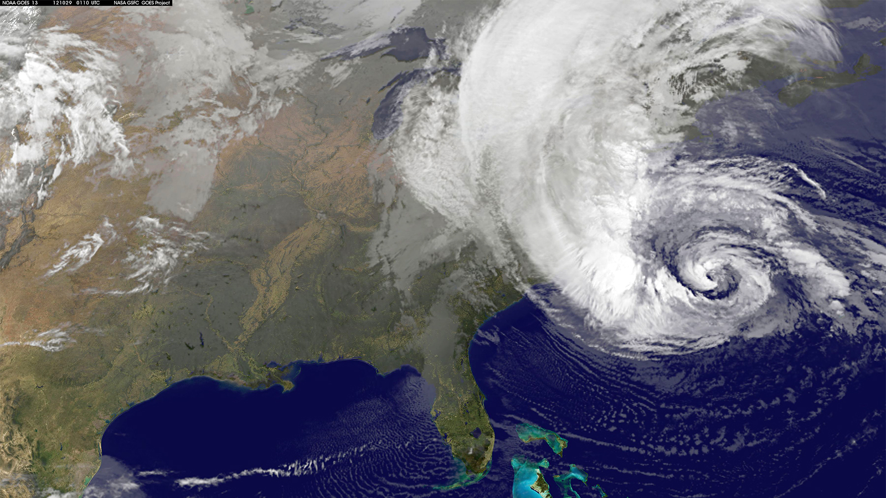
Hurricane Sandy

Slide 40
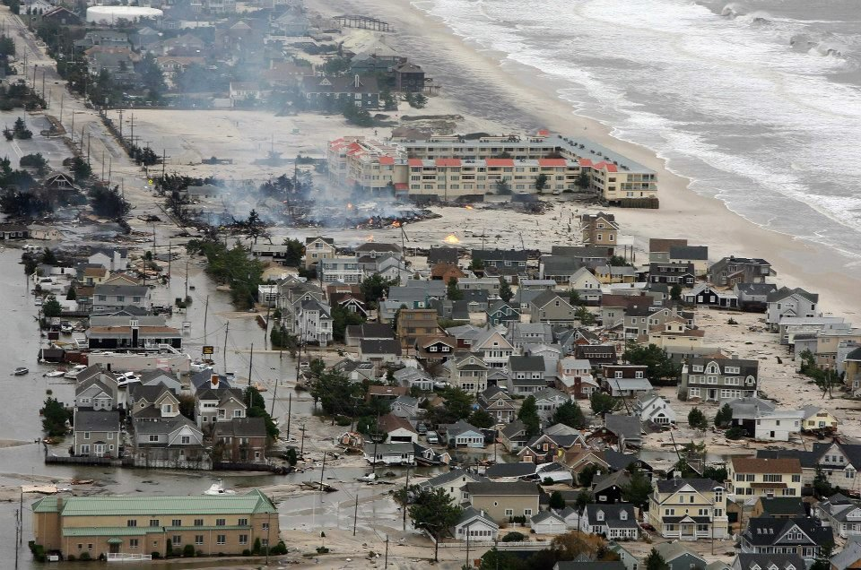
Hurricane Sandy

Slide 41
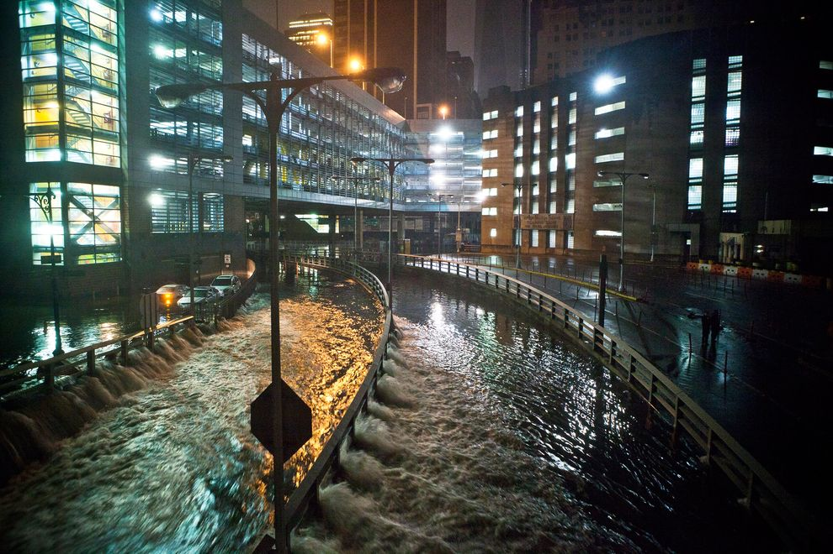
Hurricane Sandy

Slide 42
Hurricane far off shore
Rough surf
hundreds of
miles away.
Storm Surge

Slide 43
Hey! Let’s check out the storm!

Slide 45
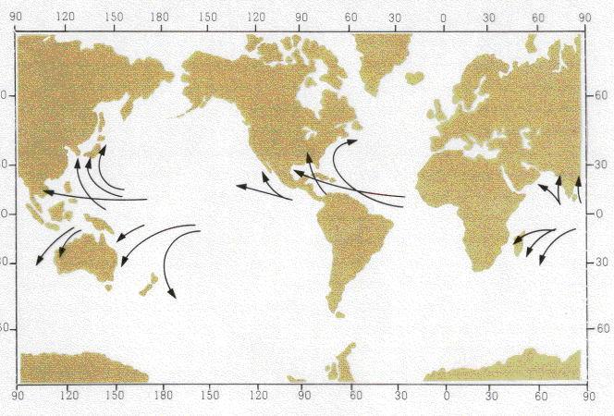
Hurricane Tracks

Slide 46
The BIG STORM TIP of the day:
When your electricity goes out, and you go to bed at night, be sure to turn off everything that was on before it went out, or when it is unexpectedly restored in the middle of the night, every light, every computer, your dishwasher, your blow dryer, your washing machine, your microwave and your fans will all come on all at once. 1) You'll just about have a heart attack when they all come on at the same time, waking you from a dead sleep. And 2) Your circuit breakers will blow, leaving you in the dark once again.

