Slide 1
the continents

Slide 2
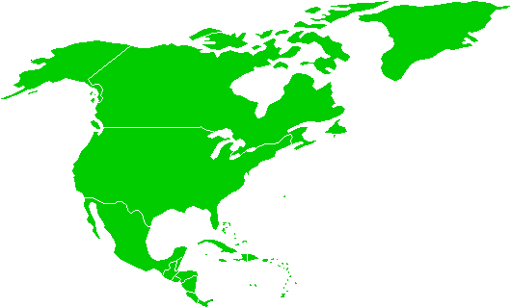
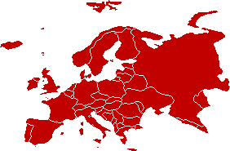
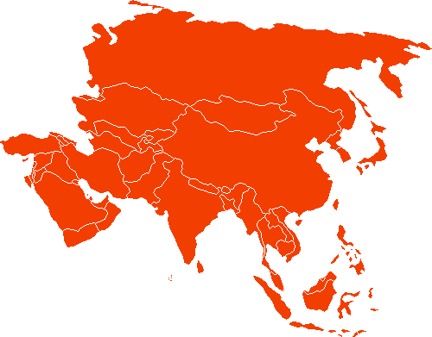
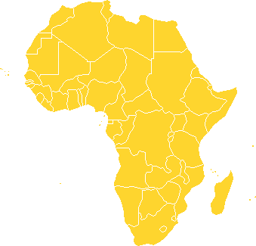
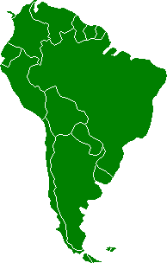
4
4

Slide 3
4
4
North America

Slide 4
4
4
North America
South America

Slide 5
4
4
Europe
North America
South America

Slide 6
4
4
Europe
Asia
North America
Africa
South America

Slide 7
4
4
Europe
Asia
North America
South America

Slide 8
4
4
Europe
Asia
North America
Africa
South America
Australia

Slide 9
4
4
Europe
Asia
North America
Africa
South America
Australia
Antarctica

Slide 10
4
4
Europe
Asia
North America
Africa
South America
Australia
7
Antarctica

Slide 11
The oceans

Slide 12
4
4
Arctic
Europe
Asia
North America
Atlantic
Pacific
Indian
Africa
South America
Australia
Southern
Antarctica

