Slide 1
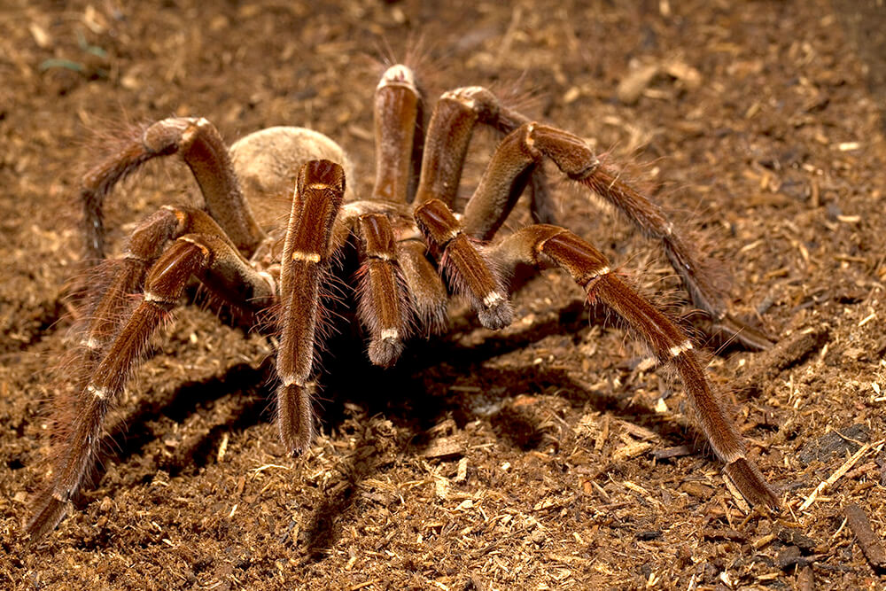
Unit 4 Lesson 1 Warm or Cold
explain that organisms need a specific temperature to live in.
SWBAT

Slide 2
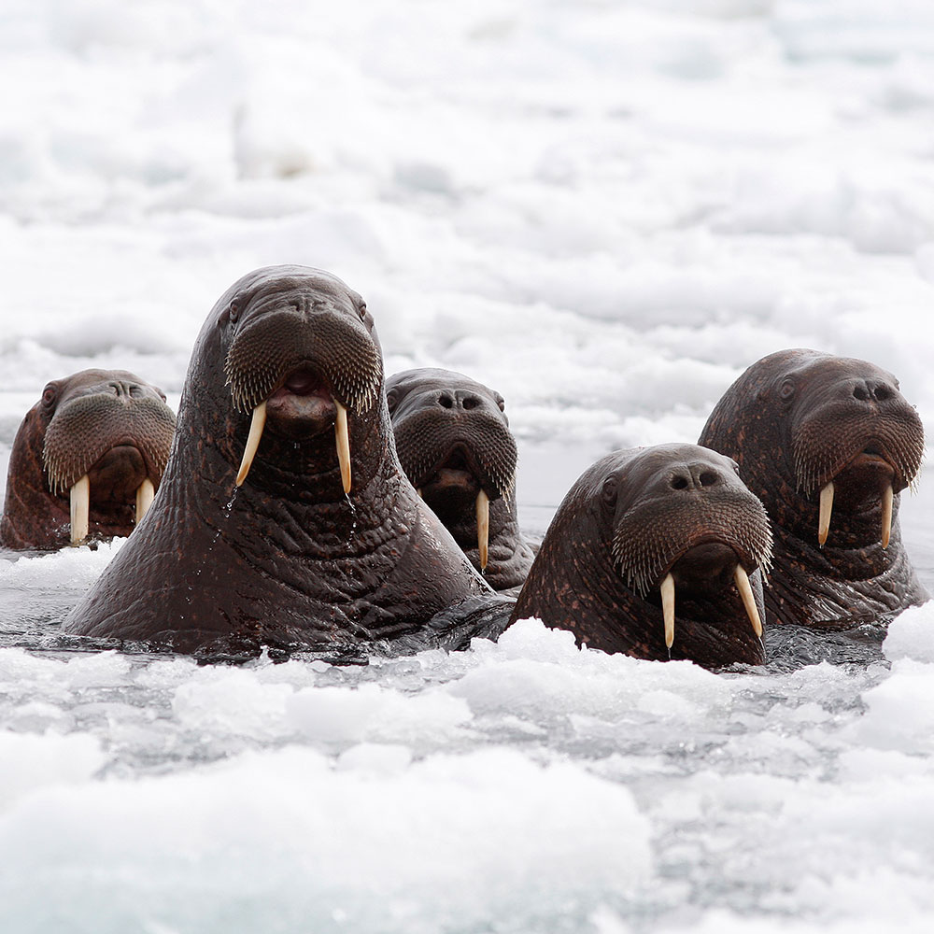
How do animals adapt to the temperature in the environment that they live in?
Essential Question

Slide 3
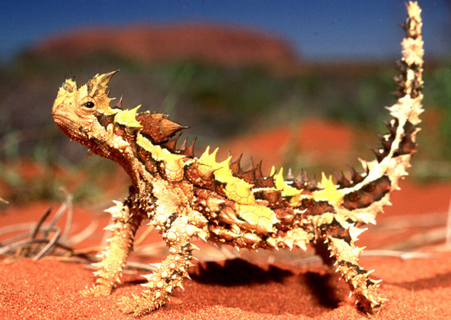
Read pages 76-77
Read
This lizard lives in the deserts of Australia.
Why do you think it looks like it does?

Slide 4
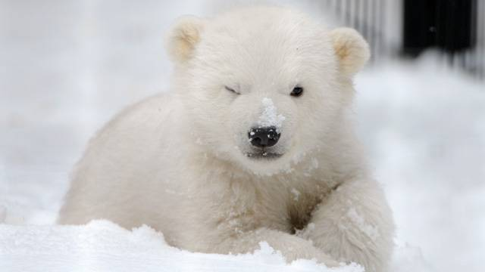
adaptation
Vocabulary
A trait or characteristic that allows an animal to survive in its specific environment

Slide 5
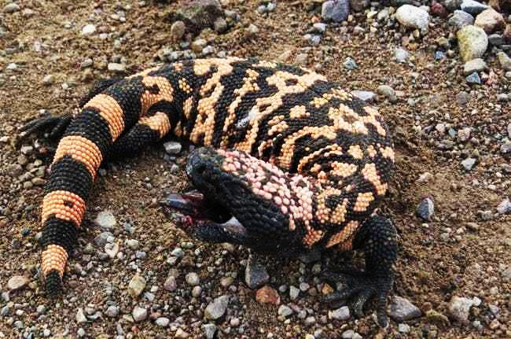
Watch this video
https://www.youtube.com/watch?v=iBw4gCqq4E8
Watch this video

Slide 6
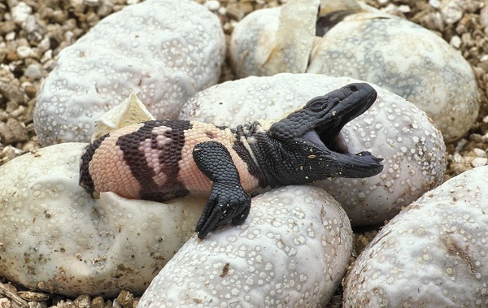
What do Gila monsters do to survive in their environment?
Think about it…

Slide 7
Gila monsters have claws for digging burrows. It is cooler under the dirt and they won’t get sunburned.
They eat up to 3,000 ants a day and they store fat in their tails so that they can hibernate during the long winter.
Gila monsters

Slide 8
Gila monsters are lizards which are considered cold-blooded. Their blood is the same temperature as the air around it.
That is another good reason that they burrow in the cool dirt. Their blood would get too hot.
Cold-blooded
Could this desert fox survive in a snowstorm?

Slide 9
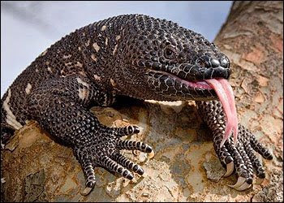
Cold Blooded
An animal that does not heat its own body.
The animals body is the same temperature as the environment it lives in, so you won’t find cold blooded creatures in areas that freeze.
Vocabulary

Slide 10
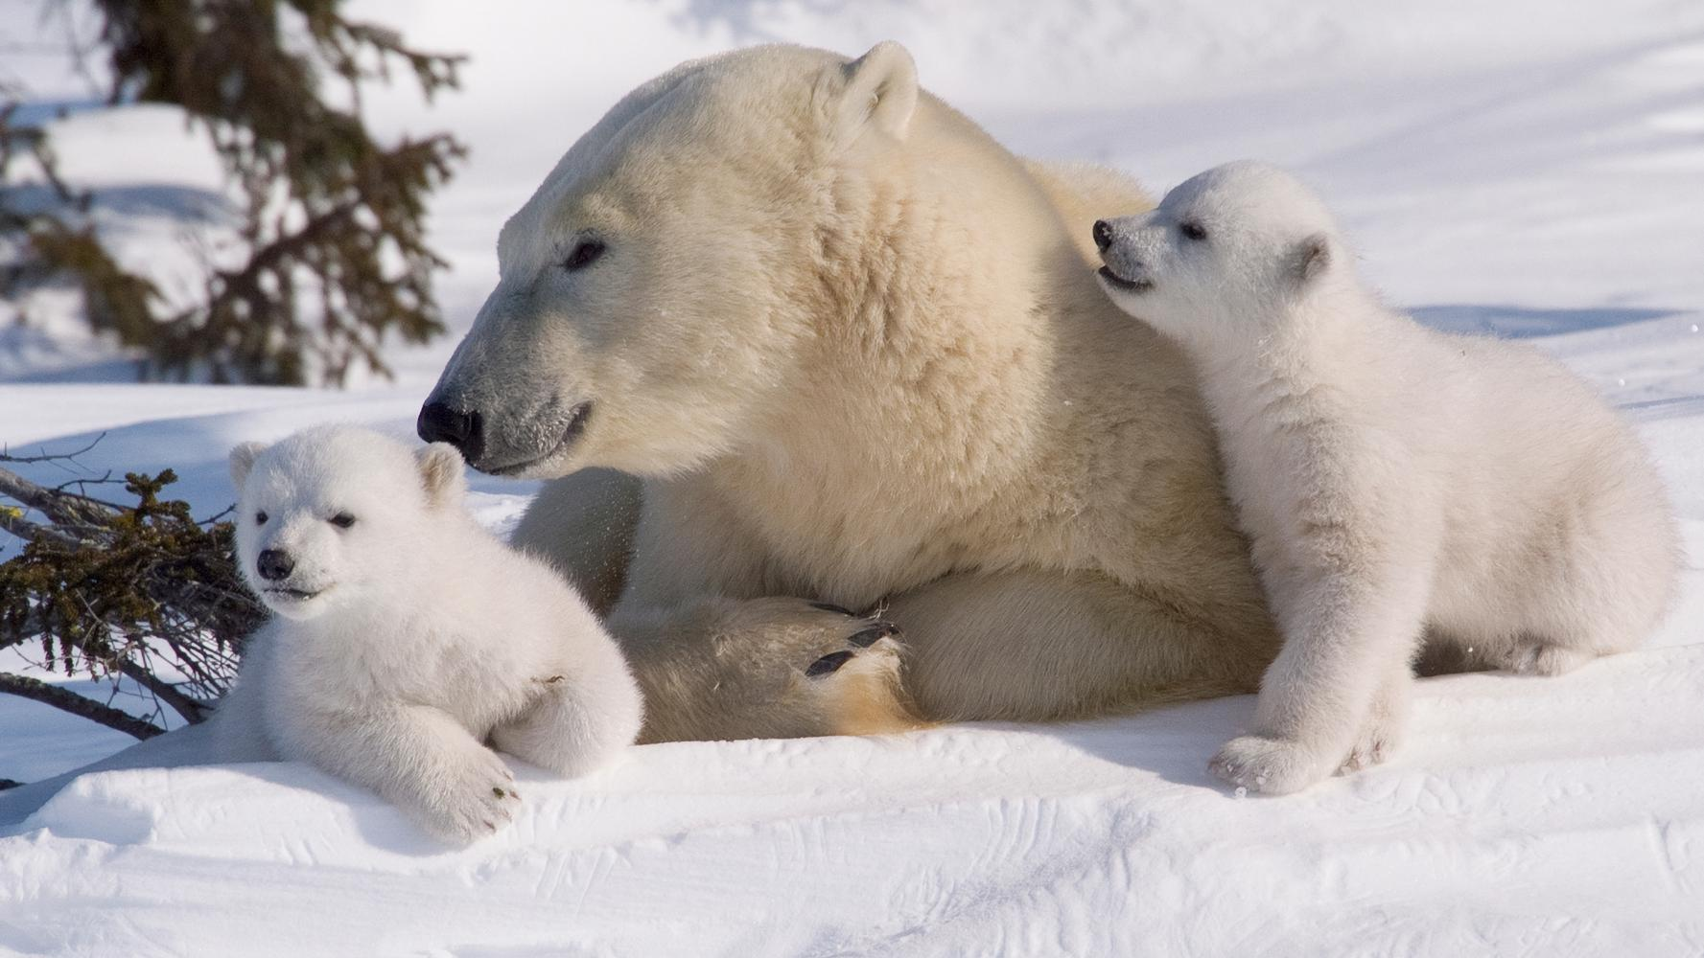
What adaptations do polar bears have so that they can live in their environment?
What do you remember?

Slide 11
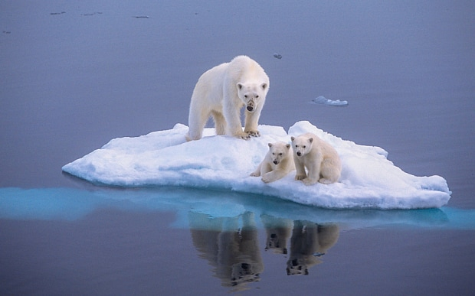
They have an extra layer of fat to help keep them warm. Their fur keeps them dry even in the water and they have huge hands and feet to swim with.
What do you remember?

Slide 12
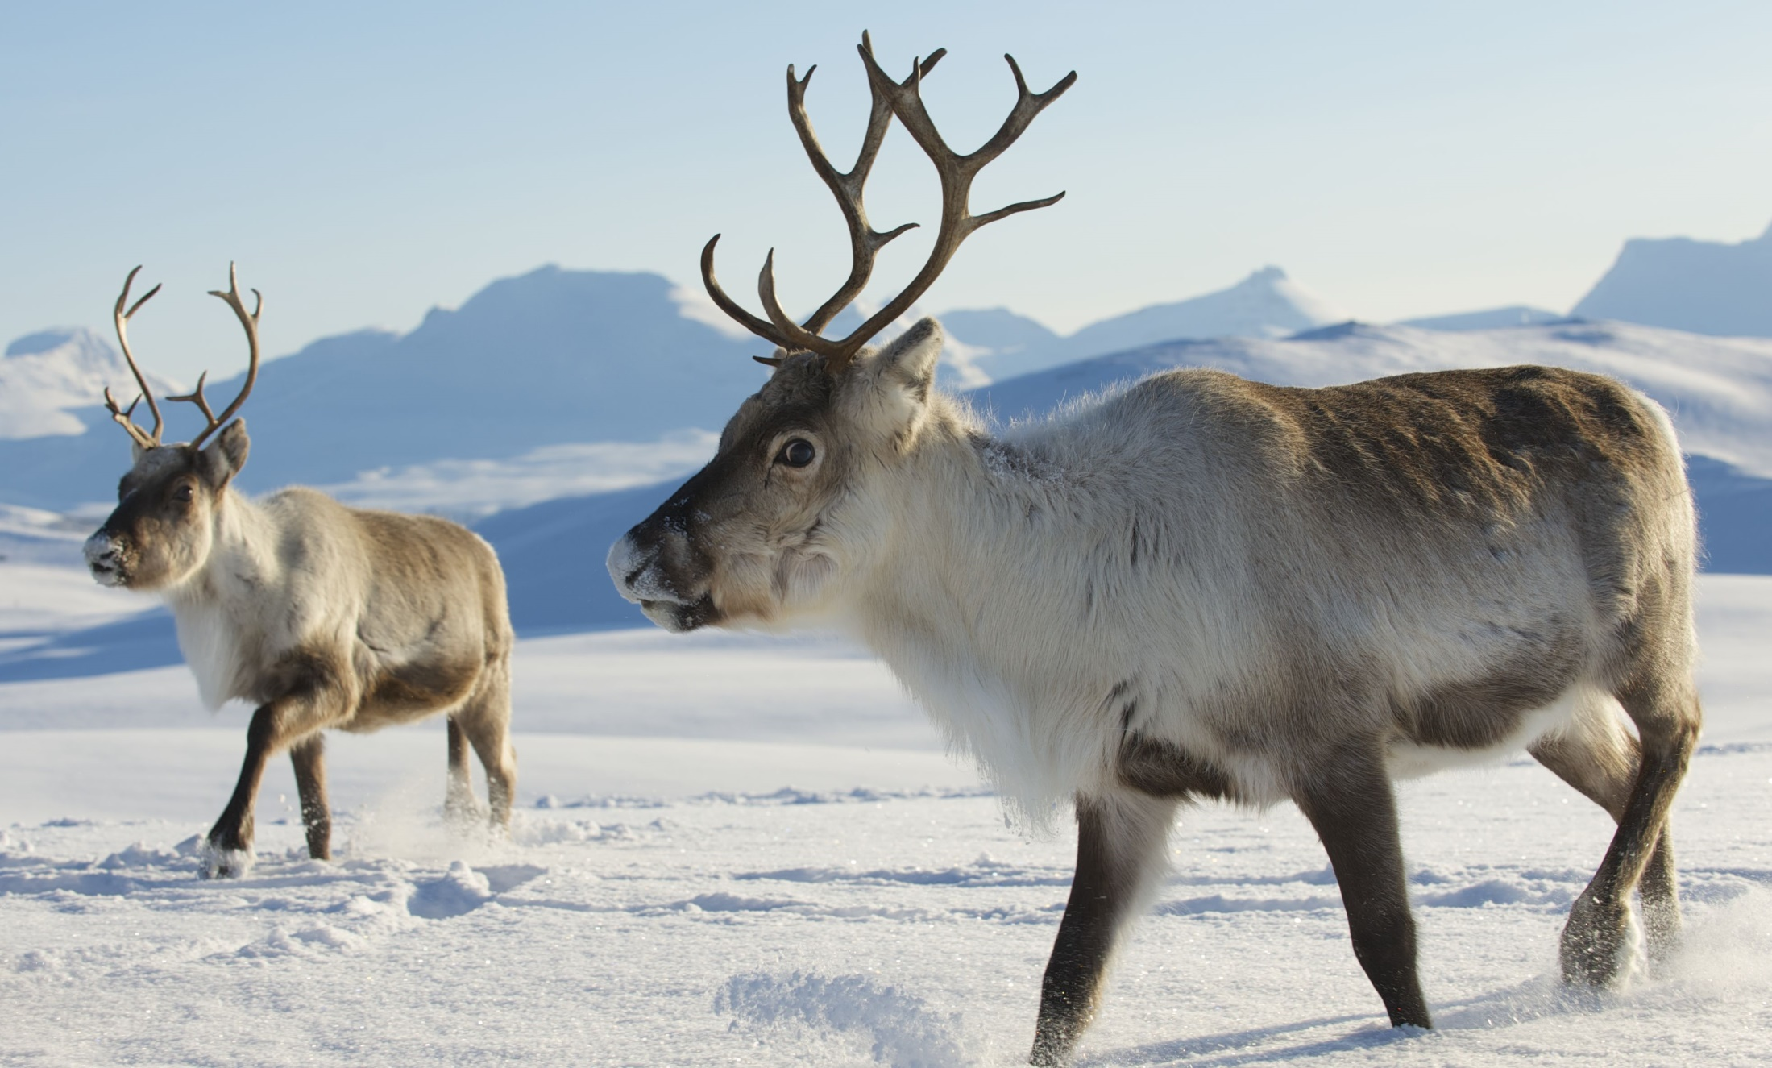
Could a Gila Monster and a Polar Bear trade habitats?
With your group write 3 reasons why or why not.
Work with your group

Slide 13
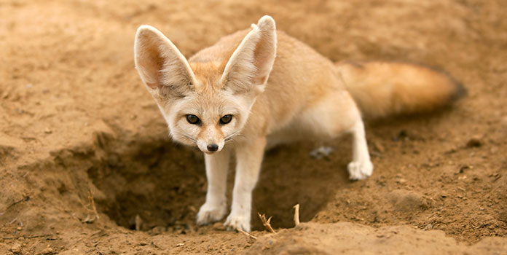
How do animals adapt to the temperature in the environment that they live in?
Think about it…
Could this desert fox survive in a snowstorm?

Slide 14
Do all animals need water?
Think about it…
Yes – all animals need water. Some get it by drinking, some get it through their skin like this Thorny Devil. He walks through plants with dew on them and he gets the water through his skin.

Slide 15
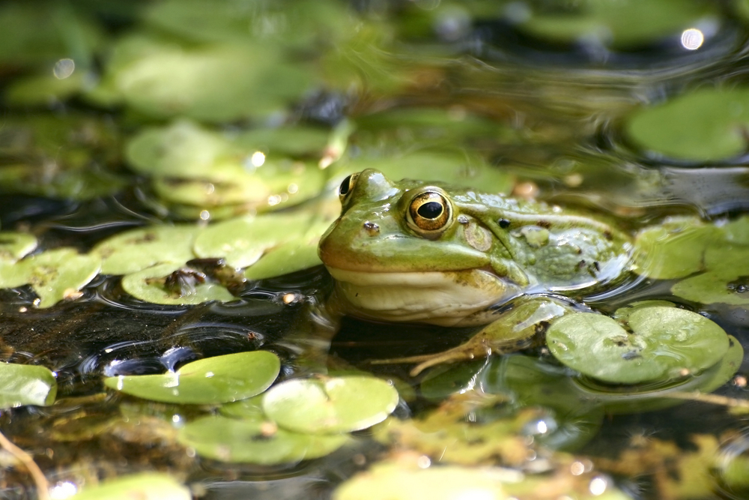
Which animals live in or very near water?
Think about it…

Slide 16
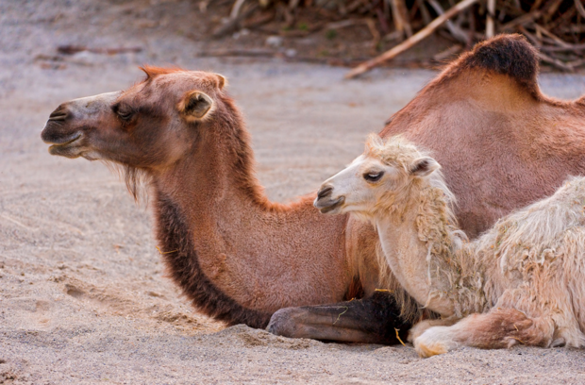
Which animals live only on dry land?
https://www.youtube.com/watch?v=gaZKEc59g1w
Think about it…

Slide 17
Read pages 78 - 79
Read
Rhinos live near rivers and eat mostly river grass.

Slide 18
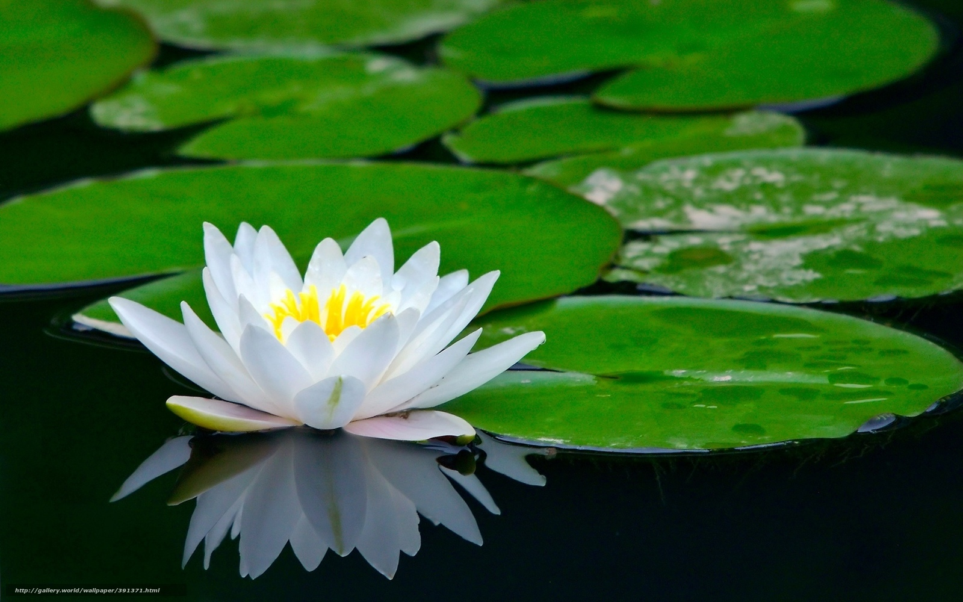
Some plants live on or in water, but every plant must have access to sunlight in order to survive
Think about it…
Water lilies live on the top of shallow lakes. They have long roots that dig into the soft mud at the bottom. The leaves are strong enough to hold a small frog.

Slide 19
Some animals live mostly on land, but lay their eggs in the water.
Think about it…

Slide 20
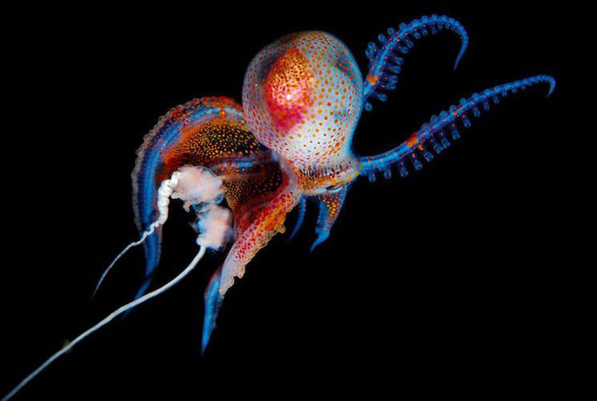
Did you ever try to walk around your house with your eyes closed?
Think about it…
This octopus lives where
sunlight never reaches. Deep in the
ocean, it hunts for other animals of the
deep by smell and by the motions in the water.

Slide 21
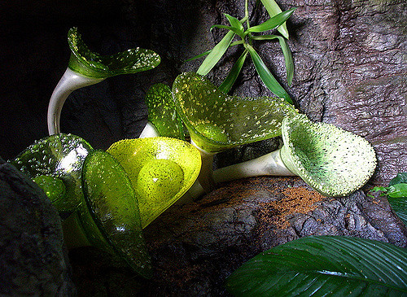
This giant species of moss grows in caves where it gets almost no light at all. Scientists are studying it to figure out how it survives,
Read pages 80 and 81
Read

Slide 22
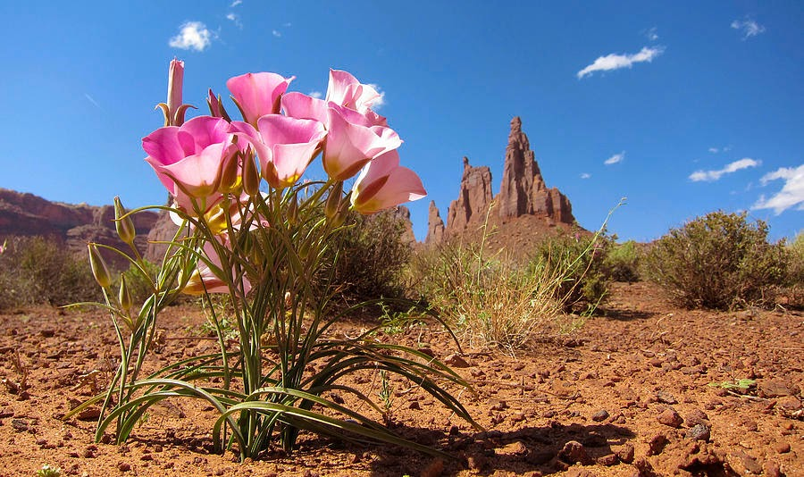
In the desert plants have to protect themselves from the sun, but they use sunlight for energy. Animals get that energy by eating them!
Every living thing on earth gets its energy
from the sun!
Think about this…

Slide 23
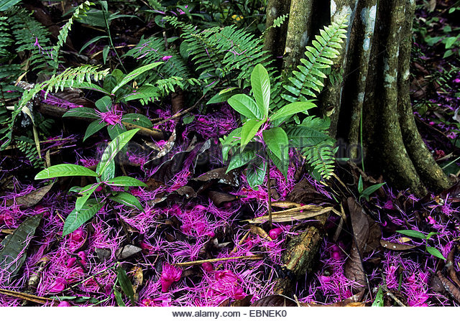
On the forest floor plants try to get as much sunlight as possible to create energy.
Either the living thing makes its own energy
from the sun or it eats something that got its energy from the sun.
Think about this…

Slide 24
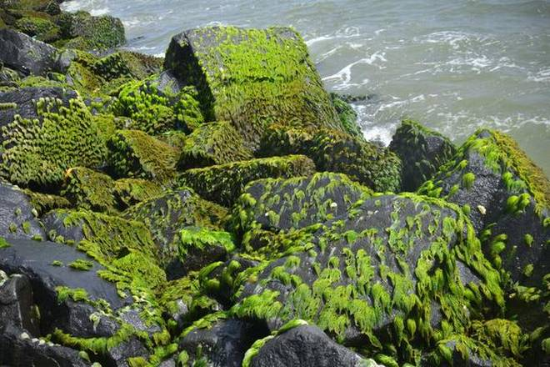
Wherever they grow, plants provide food for the local animals.
Even if an animal eats only other animals, that energy originally came from plants
Think about this…

Slide 25
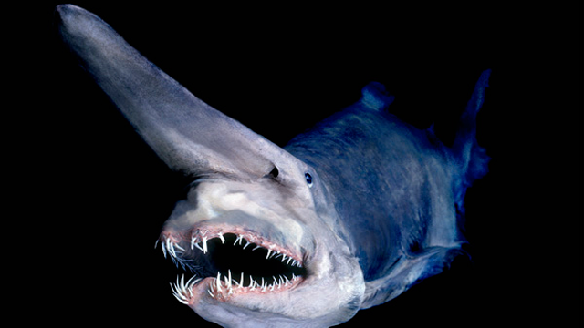
This guy
eats other
animals that
live deep in
the ocean
where this
is almost no light
Where does his sun energy come from?
Even in places where there is almost no light, all of the energy came from the sun.
Think about this…
It eats plant
eaters – so the
plant energy goes
from the plant to the first fish and then to this fish!

Slide 26
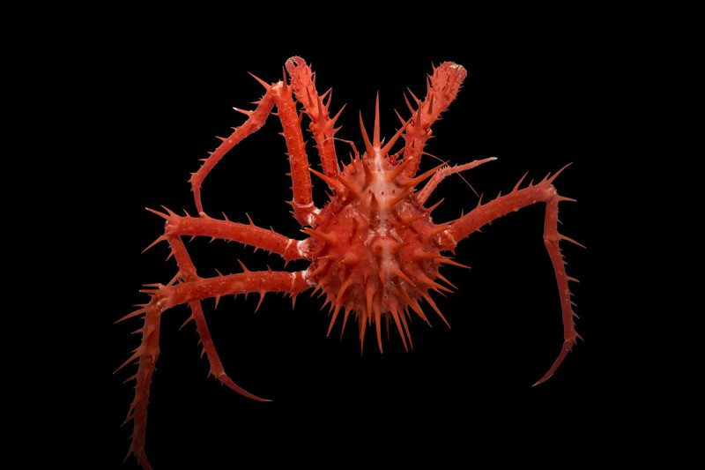
Here are some more creatures that live deep in the ocean with no water.
Check this out!

Slide 27
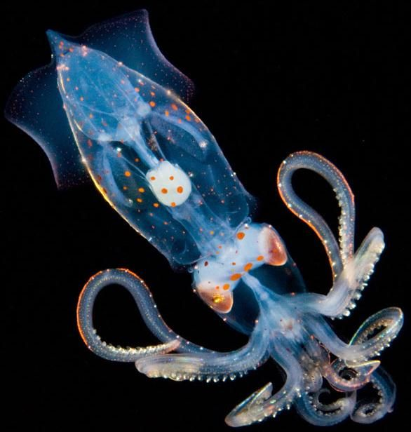
Scientists do not know how these animals live because they are so hard to get to.
Think about this…

Slide 28
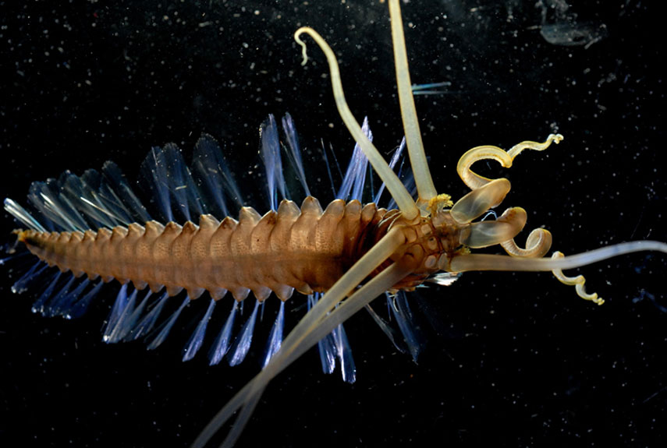
We have to go down in submarines just to get pictures of them.
Think about this…

Slide 29
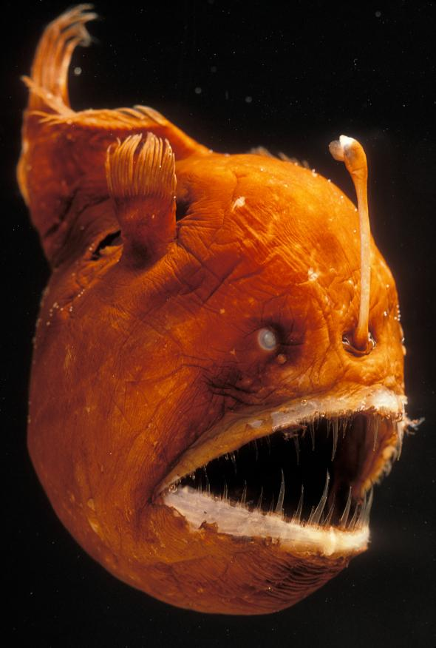
This angler fish can grow up to 40” long.
It lives in the deep ocean and
has a light on its head that it
uses to find other fish to eat and also to confuse predators.
And some of them are really scary!!
Think about this…

Slide 30
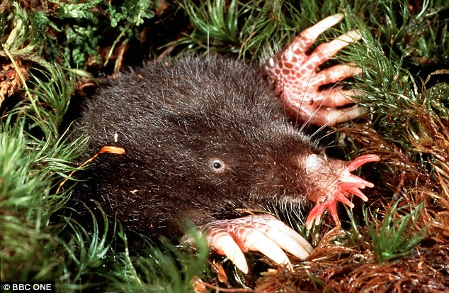
This is another view of the star-nosed mole. It is not quite as odd looking as it is in the book.
Read pages 82 and 83
Think like a scientist

Slide 31
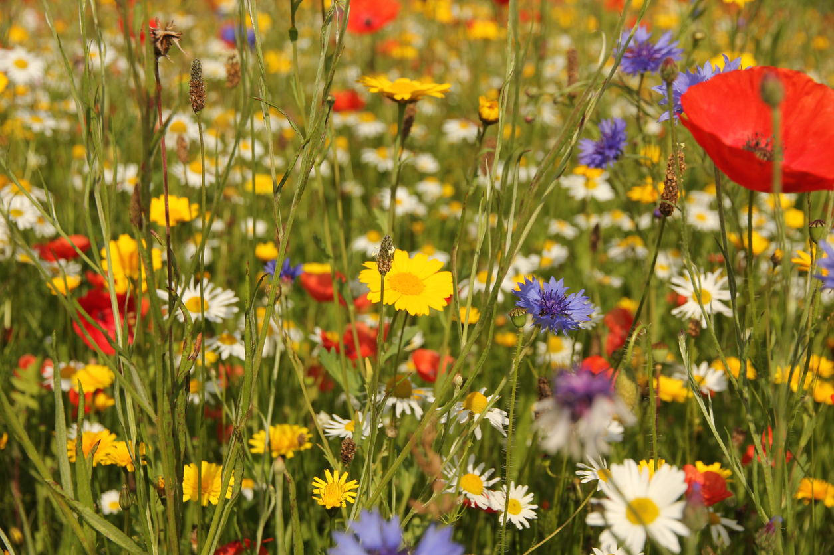
Make sure that your argument considers the temperature, sunlight, water, and food that is available to the animal.
With your group choose two of the animals pictured and write a paragraph for each that describes the environment where the animal would be found.
Don’t forget the details: temperature, water, sunlight, food
Read

