Slide 1
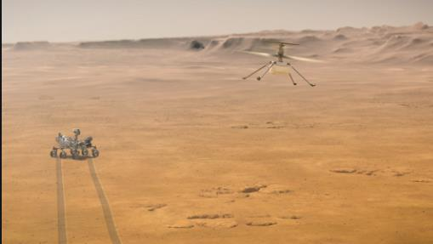
Rover Landing on Mars

Slide 2
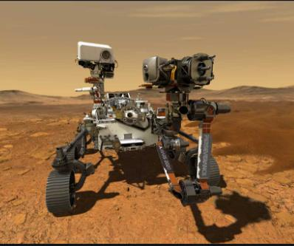
Rover on MARS

Slide 3
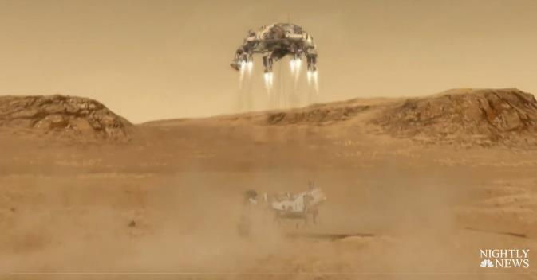
Watch it land!
https://www.nbcnews.com/nightly-news/video/nasa-s-perseverance-rover-lands-on-mars-to-search-for-signs-of-ancient-life-101256773940

Slide 4
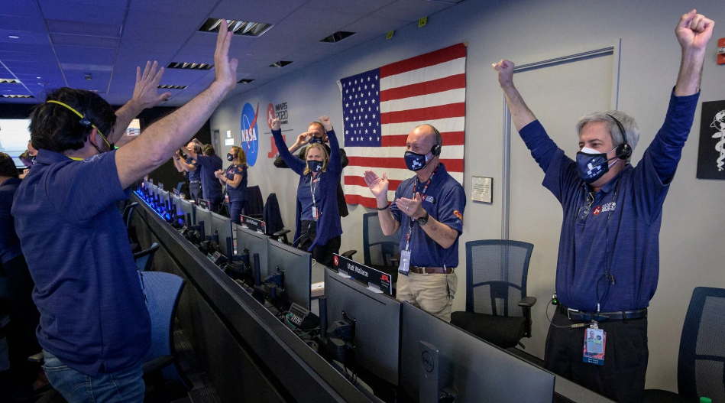

Slide 5
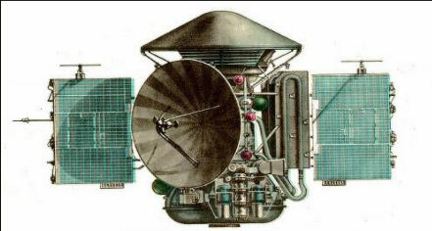
What’s the big deal?
The Russians landed a ship on Mars in 1970.
It took some pictures and then stopped working.

Slide 6
We humans have tried to go to Mars 56 times. And 26 of them have been successful.
So why do we keep going there?
To put it simply.
We think that of all the places in the Universe, Mars might, just might, be the one that shows signs of life.

Slide 7
You mean like this guy?
No, more like these guys
We are looking for microscopic life!

Slide 8
But we don’t know of life anywhere else in.
in....
in....
in....
We don’t know about life anywhere but on Earth.

Slide 9
and wouldn’t it be cool to find out that we are not the only living things in the entire…
Everything?

Slide 10
Some background.
Mars is one of the 8 planets that “orbit” our sun.
To orbit means to “float” around the sun the way that our moon “floats” around earth.

Slide 11
Mars is called the Red Planet because it really looks red.
Because we humans have been there before we know that Mars is
red because its rocks have rust in them.

Slide 12
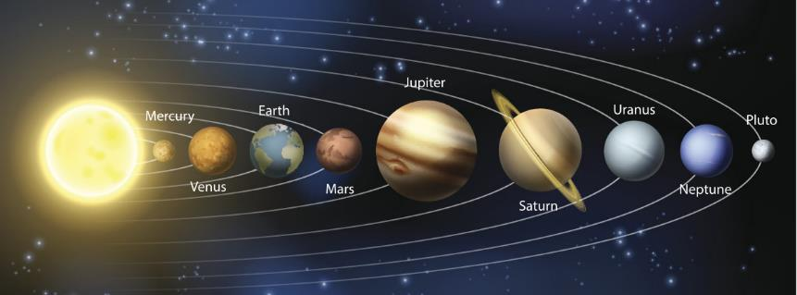
Did you know that our sun is actually a star?

Slide 13
This is Earth

Slide 14
This is Mars.

Slide 15
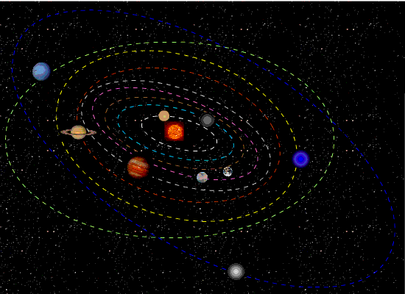
Yesterday NASA landed a spaceship on Mars.
The scientists waited until Mars and Earth were as close together as possible and then launched the spaceship.

Slide 16
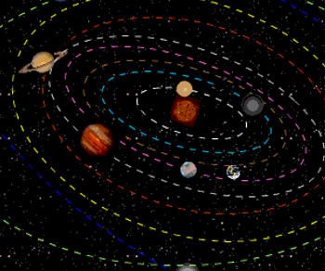
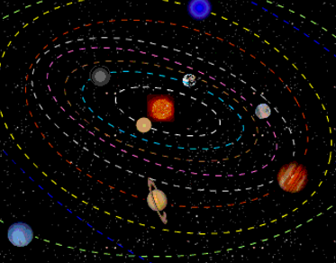
Can you see that Mars and Earth are sometimes much closer to each other than at other times?

Slide 17
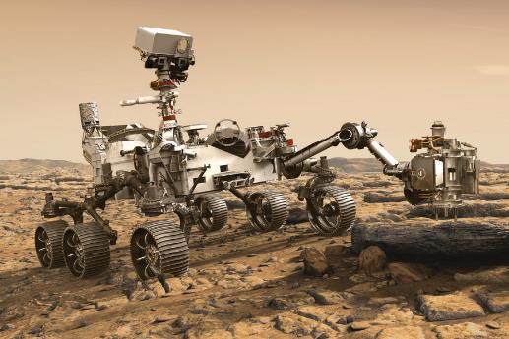
The Mars Rover will do most of the work. Let’s learn about it.
https://www.youtube-nocookie.com/embed/GeqtDRl5o74?autoplay=1&iv_load_policy=3&loop=1&modestbranding=1&playlist=GeqtDRl5o74
This is a picture of the Perseverance Rover.

Slide 18
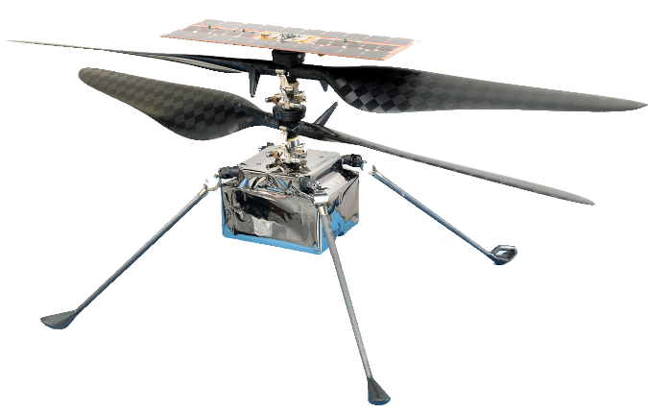
The helicopter Ingenuity will be doing a lot of the work.
Let’s learn about it!
Testing the Mars Helicopter Delivery System on NASA's Perseverance Rover - YouTube (youtube-nocookie.com)

Slide 20
Rover Landing on Mars
These are very long videos that you can watch later.
https://www.youtube.com/watch?v=6A_j8X2Wgoo
https://www.nytimes.com/live/2021/02/18/science/nasa-mars-landing

