Slide 1
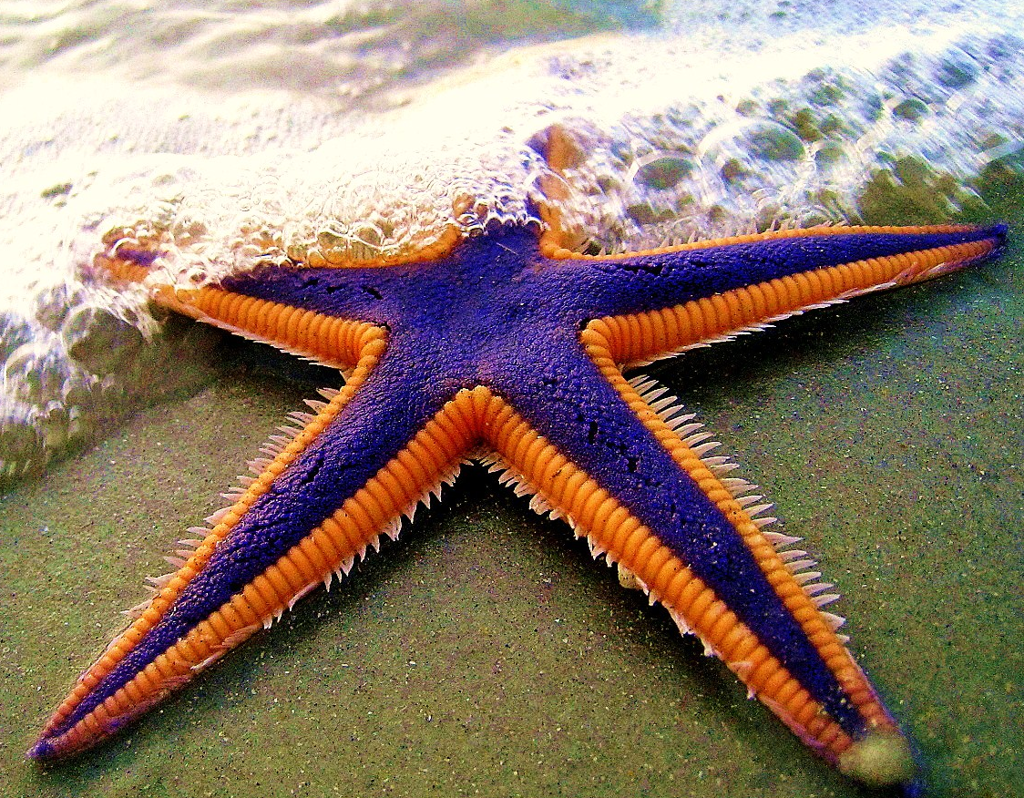
Starfish Characteristic: Purple skin - P
What is the phenotype for
this starfish?
Purple phenotype is what you see!

Slide 2
Starfish Characteristic: Purple skin - P
What is the genotype for
this starfish?
pp non-dominant recessive

Slide 3
Starfish Characteristic: Purple skin - P
What is the genotype for
this starfish?
PP or Pp genotype is the letters – if a big P exists the starfish will be Purple

Slide 4
Starfish Characteristic: Purple skin - P
What is the genotype for this starfish if it is heterozygous?
Pp

Slide 5
Starfish Characteristic: Purple skin - P
What is the genotype for this starfish if it is a hybrid?
Pp

Slide 6
Starfish Characteristic: Purple skin - P
What is the phenotype for
this starfish?
Yellow phenotype is what you see!

Slide 7
Starfish Characteristic: Purple skin - P
What is the genotype for this starfish if it is a purebred?
PP

Slide 8
Starfish Characteristic: Purple skin - P
What is the genotype for this starfish if it is homozygous?
PP

Slide 9
Starfish Characteristic: Purple skin - P
What is the phenotype for this starfish if it is a purebred?
Purple

Slide 10
Starfish Characteristic: Purple skin - P
What is the phenotype for this starfish if it is a hybrid?
Purple

Slide 11
Starfish Characteristic: Purple skin - P
Let’s make babies!
This picture shows the hybrid father. What is it’s genotype?
Pp

Slide 12
Dad
P p

Slide 13
Starfish Characteristic: Purple skin - P
Let’s make babies!
This picture shows the purebred mother. What is her genotype?
PP

Slide 14
Dad
P p
P p
P p
P
P
P
P
P
P
mom

Slide 15
Starfish Characteristic: Purple skin - P
Let’s make babies!
This picture shows the purebred mother. What is it’s genotype?
PP

Slide 16
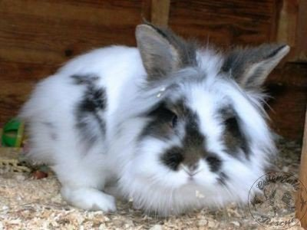
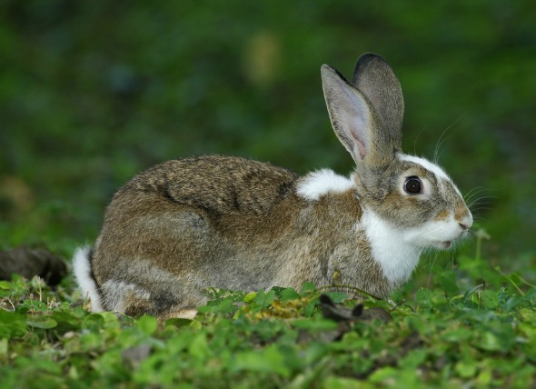
Fuzzy Frieda rabbit has just met short haired Howard.
But what would the babies be like?

Slide 17
OH NO!! Could the babies be bald?

Slide 18
Lets figure out the genotypes:
Frieda
RR
Frieda is dominant for her long hair
Rr
Howard is dominant for his short hair
Howard
rr
these poor babies would be bald!

Slide 19
Howard
r r
r r
Frieda
R
R
R
R
Frieda
Howard
RR long hair
Rr short hair
rr bald!

Slide 20
Should Frieda run?

