Slide 1
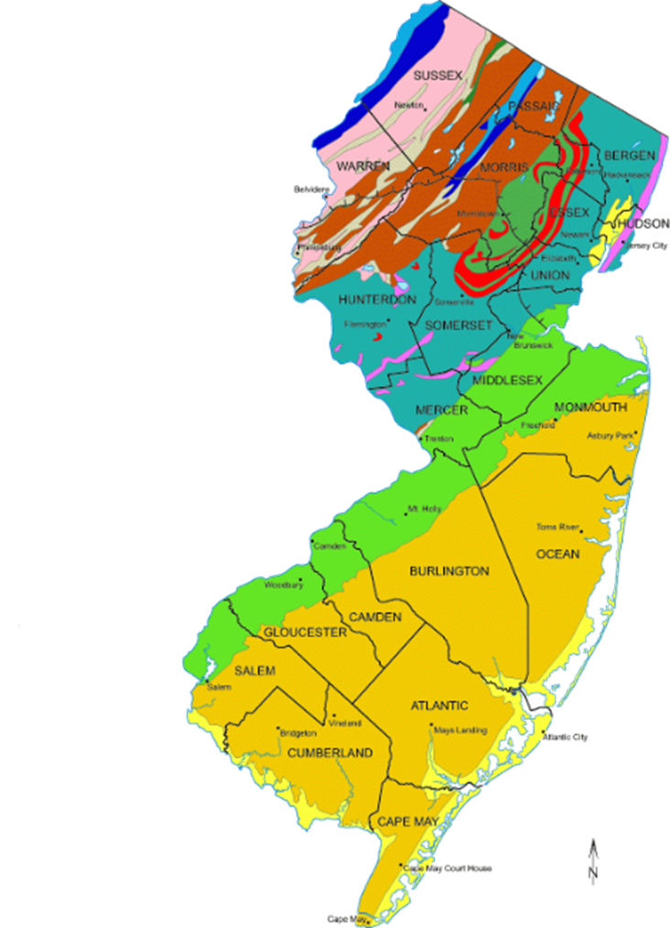
The Rocks of
New Jersey

Slide 2
The Rocks of
New Jersey
These rocks were formed in many different eras in many different ways.

Slide 3
The Rocks of
New Jersey
Our land in South Jersey is made mostly of clay and sand, but at the very top of New Jersey the land is made from slate, shale and other stones. It is part of the Appalachian Mountains. Just like the Poconos

Slide 4
The Rocks of South Jersey are the newest rocks in New Jersey
up to 65 million years old
during the Cenozoic Era – this rock is very new! It is mostly clay, marl, and sand.
more than 65 million years old
during the Mesozoic Era – sand, clay, marl, siltstone, shale (soft rocks) (this rock formed during the Triassic, the Jurassic, and Cretaceous

Slide 5
All of the yellow is land that is mostly clay, marl, and sand.
It is very new land – it is less than 65 million years old!

Slide 6
If you dig in your backyards you will probably find marl or clay.
They are both a light grey or white color and you can actually make things from this clay and fire it in a kiln!

Slide 7
New Jersey is famous for its porcelain plates, bricks and glass – all of which need clay and sand.
Why do you think Glassboro is called that? How about Bricktown?

Slide 8
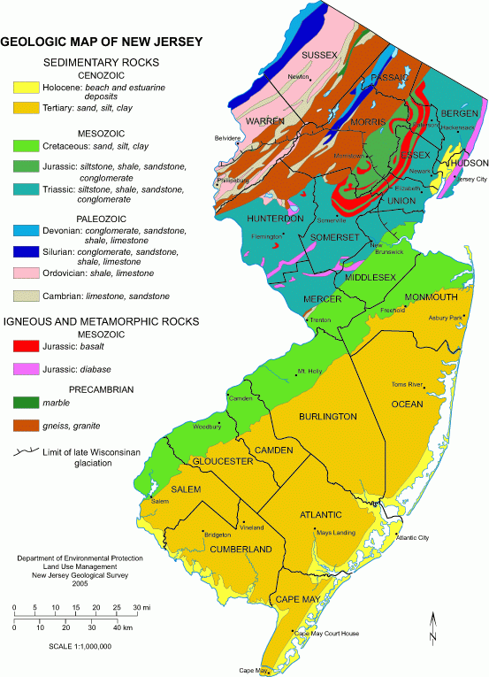

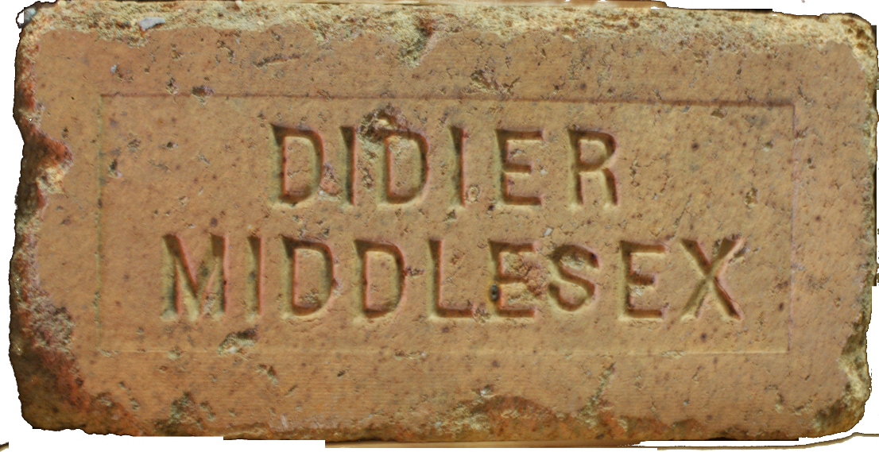



Slide 9
So anyway…
This land was created over the last 65 million years.
up to 65 million years old
during the Cenozoic Era – this rock is very new! It is mostly clay, marl, and sand.
more than 65 million years old
during the Mesozoic Era – sand, clay, marl, siltstone, shale (soft rocks) (this rock formed during the Triassic, the Jurassic, and Cretaceous

Slide 10
It was made from the debris at the bottom of the ocean. After a very long time the extreme weight of the ocean presses the floor of the ocean so much that it becomes rock.
up to 65 million years old
during the Cenozoic Era – this rock is very new! It is mostly clay, marl, and sand.
more than 65 million years old
during the Mesozoic Era – sand, clay, marl, siltstone, shale (soft rocks) (this rock formed during the Triassic, the Jurassic, and Cretaceous

Slide 11
This new land was made during the Cenozoic Era.
That is the time from
65 million years ago until today.
up to 65 million years old
during the Cenozoic Era – this rock is very new! It is mostly clay, marl, and sand.
more than 65 million years old
during the Mesozoic Era – sand, clay, marl, siltstone, shale (soft rocks) (this rock formed during the Triassic, the Jurassic, and Cretaceous

Slide 12
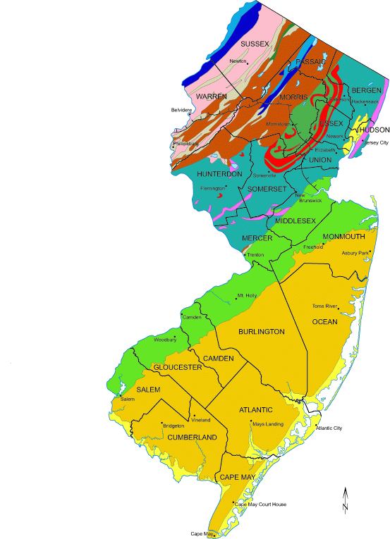
This new land was made during the Cenozoic Era.
That is the time from
65 million years ago until today.
up to 65 million years old
during the Cenozoic Era – this rock is very new! It is mostly clay, marl, and sand.
more than 65 million years old
during the Mesozoic Era – sand, clay, marl, siltstone, shale (soft rocks) (this rock formed during the Triassic, the Jurassic, and Cretaceous

Slide 13
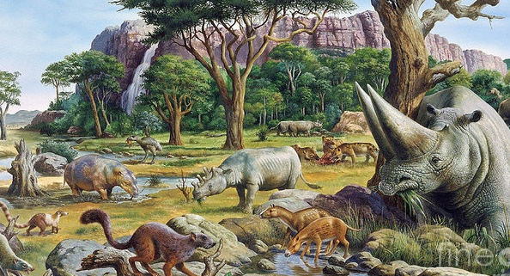
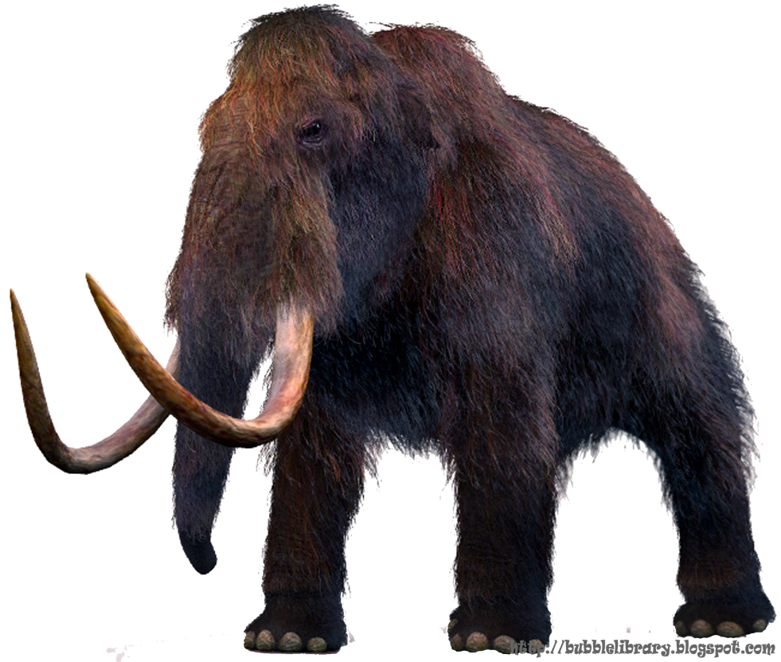
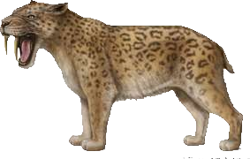
Cenozoic

Slide 14
Cenozoic
The Cenozoic era included animals like the sabre tooth tiger and
the wooly mammoth, and the mammoth lived nearby!

Slide 15
The Rocks of
New Jersey
up to 65 million years old
during the Cenozoic Era – this rock is very new! It is mostly clay, marl, and sand.
more than 65 million years old
during the Mesozoic Era – sand, clay, marl, siltstone, shale (soft rocks) (this rock formed during the Triassic, the Jurassic, and Cretaceous
More than to 250 million years old
during the Paleozoic Era – this rock is very old! It is mostly sandstone, shale, limestone

Slide 16
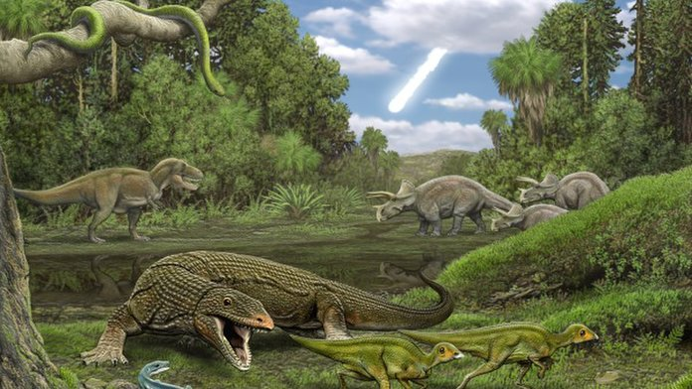
Mesozoic
The Mesozoic Era is also called the age of the dinosaurs. It began when there was a mass extinction of other types of animals and ended with the mass extinction of the dinosaurs themselves.

Slide 17
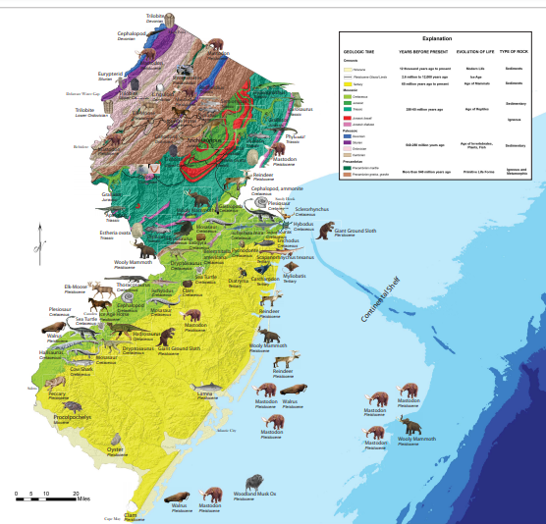
Dinosaurs in NJ
Dinosaurs have been found all over NJ, but one of the earliest was found in Haddonfield which is a town only about ten miles away.
https://www.state.nj.us/dep/njgs/enviroed/freedwn/prehistoriclife.pdf
Mesozoic

Slide 18
The Rocks of
New Jersey
up to 65 million years old
during the Cenozoic Era – this rock is very new! It is mostly clay, marl, and sand.
more than 65 million years old
during the Mesozoic Era – sand, clay, marl, siltstone, shale (soft rocks) (this rock formed during the Triassic, the Jurassic, and Cretaceous
More than to 250 million years old
during the Paleozoic Era – this rock is very old! It is mostly sandstone, shale, limestone

Slide 19

Paleozoic
The Paleozoic Era began with the breakup of Pangaea. The first true animals (vertebrates) began crawling out of the sea and life on earth exploded. Think about it – some of New Jersey was part of Pangaea!!

Slide 20
The Rocks of
New Jersey
up to 65 million years old
during the Cenozoic Era – this rock is very new! It is mostly clay, marl, and sand.
more than 65 million years old
during the Mesozoic Era – sand, clay, marl, siltstone, shale (soft rocks) (this rock formed during the Triassic, the Jurassic, and Cretaceos
More than to 250 million years old
during the Paleozoic Era – this rock is very old! It is mostly sandstone, shale, limestone

Slide 21


NJ State Tree

Slide 22
The Rocks of
New Jersey
Highlands
Appalachian
Ridge
and Valley
Central Corridor / Piedmont Region
Inner
Coastal
Plain
Atlantic
Coastal
Plain
Outer
Coastal Plain

Slide 23

The
New Jersey
State Seal

Slide 24


A raised seal and the machine that makes it.

Slide 25

The
New Jersey
State Bird
Eastern Goldfinch

Slide 26

NJ State Animal
Horse

Slide 27

NJ State Flag

Slide 28

NJ State Animal
Honey Bee

Slide 29

NJ State Animal
Bee

