Slide 1
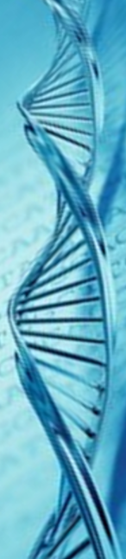
Genetics
How to make a spotted chicken – and other fancy stuff

Slide 2
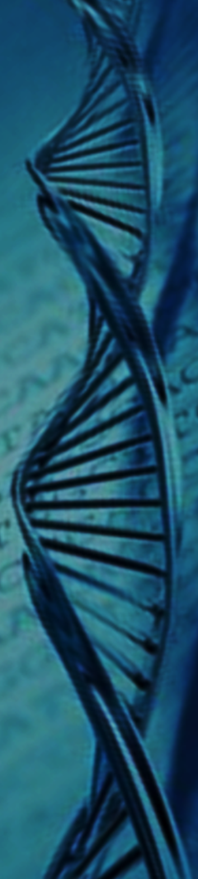
Mendel
The father of genetics figured out how complete dominance worked. But we now know that complete dominance is not the complete story.

Slide 3
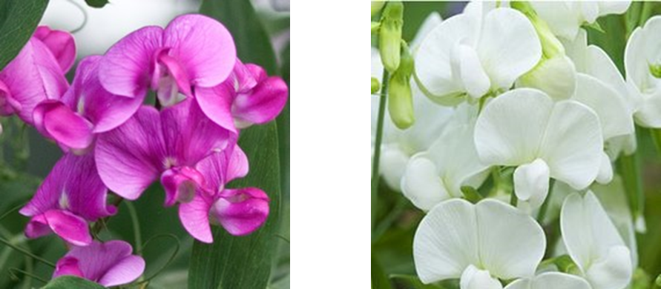
Mendel
In complete dominance there are two possible phenotypes from three genotypes
Genotype | Phenotype
PP | Purple
Pp | Purple
pp | White
The hybrid takes the dominant trait

Slide 4
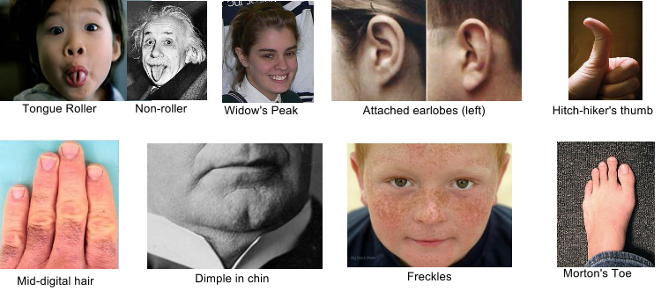
Complete dominance two phenotypes
either freckles or not – either a widows peak or not

Slide 5
Non-Mendelian
Beyond Mendel there are three additional types of reproduction – incomplete dominance – codominance and sex linked dominance

Slide 6
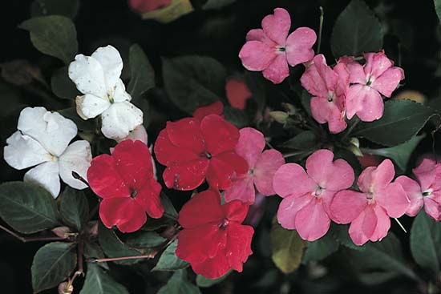
Incomplete Dominance
Neither gene is strong enough to fully take the trait. Each gene shows at the same time and you end up with three phenotypes
Genotype | Phenotype
RR | Red
Rr | Pink
rr | White
The hybrid mixes the traits

Slide 7
Incomplete Dominance
R
R
R
R
R
R
Genotype | Phenotype
RR | Red
Rr | Pink
rr | White
The hybrid mixes the traits
r
r
r
r
r
r

Slide 8


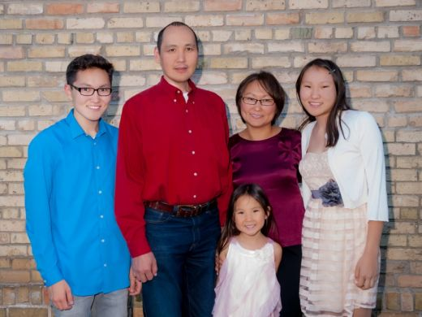
Incomplete dominance three phenotypes
skin color hair - curly straight wavy height – tall short medium

Slide 9
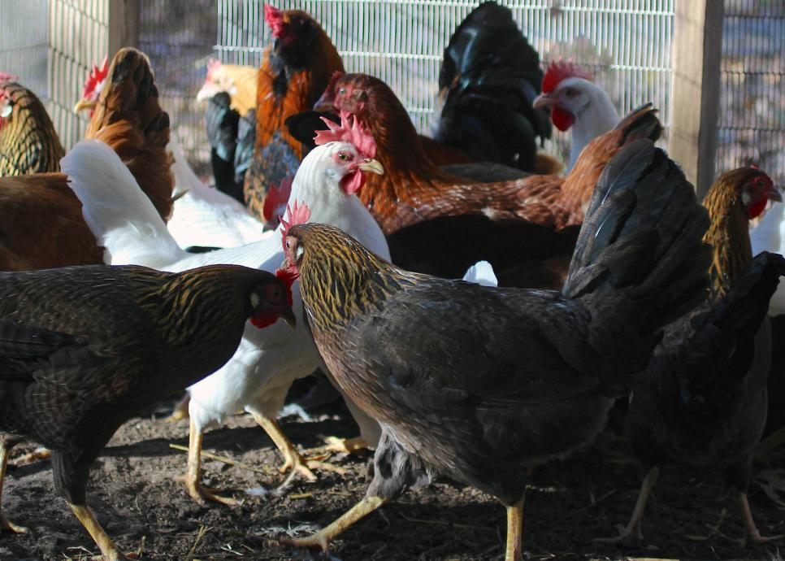
Codominance
Both genes are very strong and show in a hybrid – so you end up with four phenotypes – two fully dominants, one combination and one recessive

Slide 10
Codominance
I^{B}
I^{B}
i
I^{B}
i
i
I^{W}
I^{W}
I^{W}
i
i
i

Slide 11
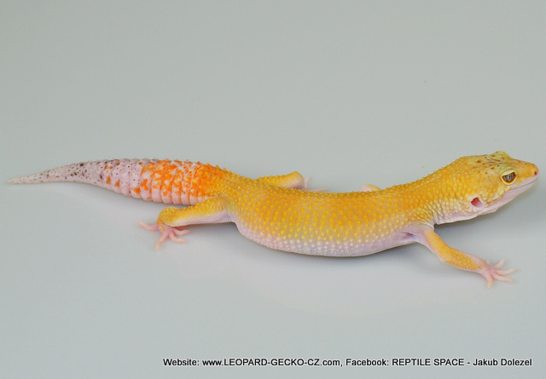
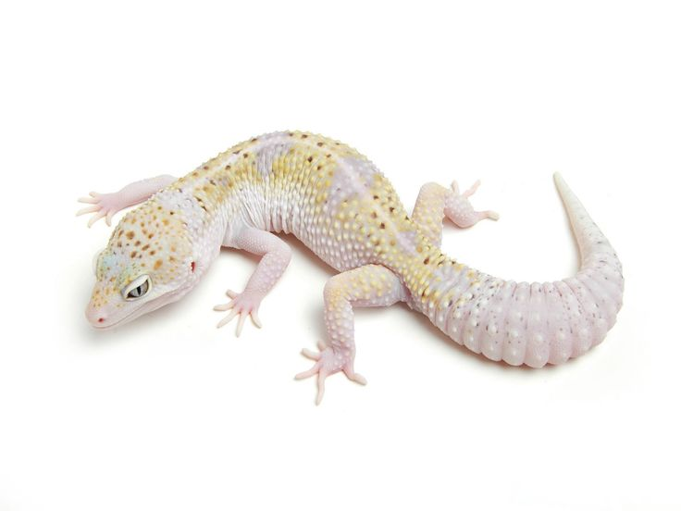
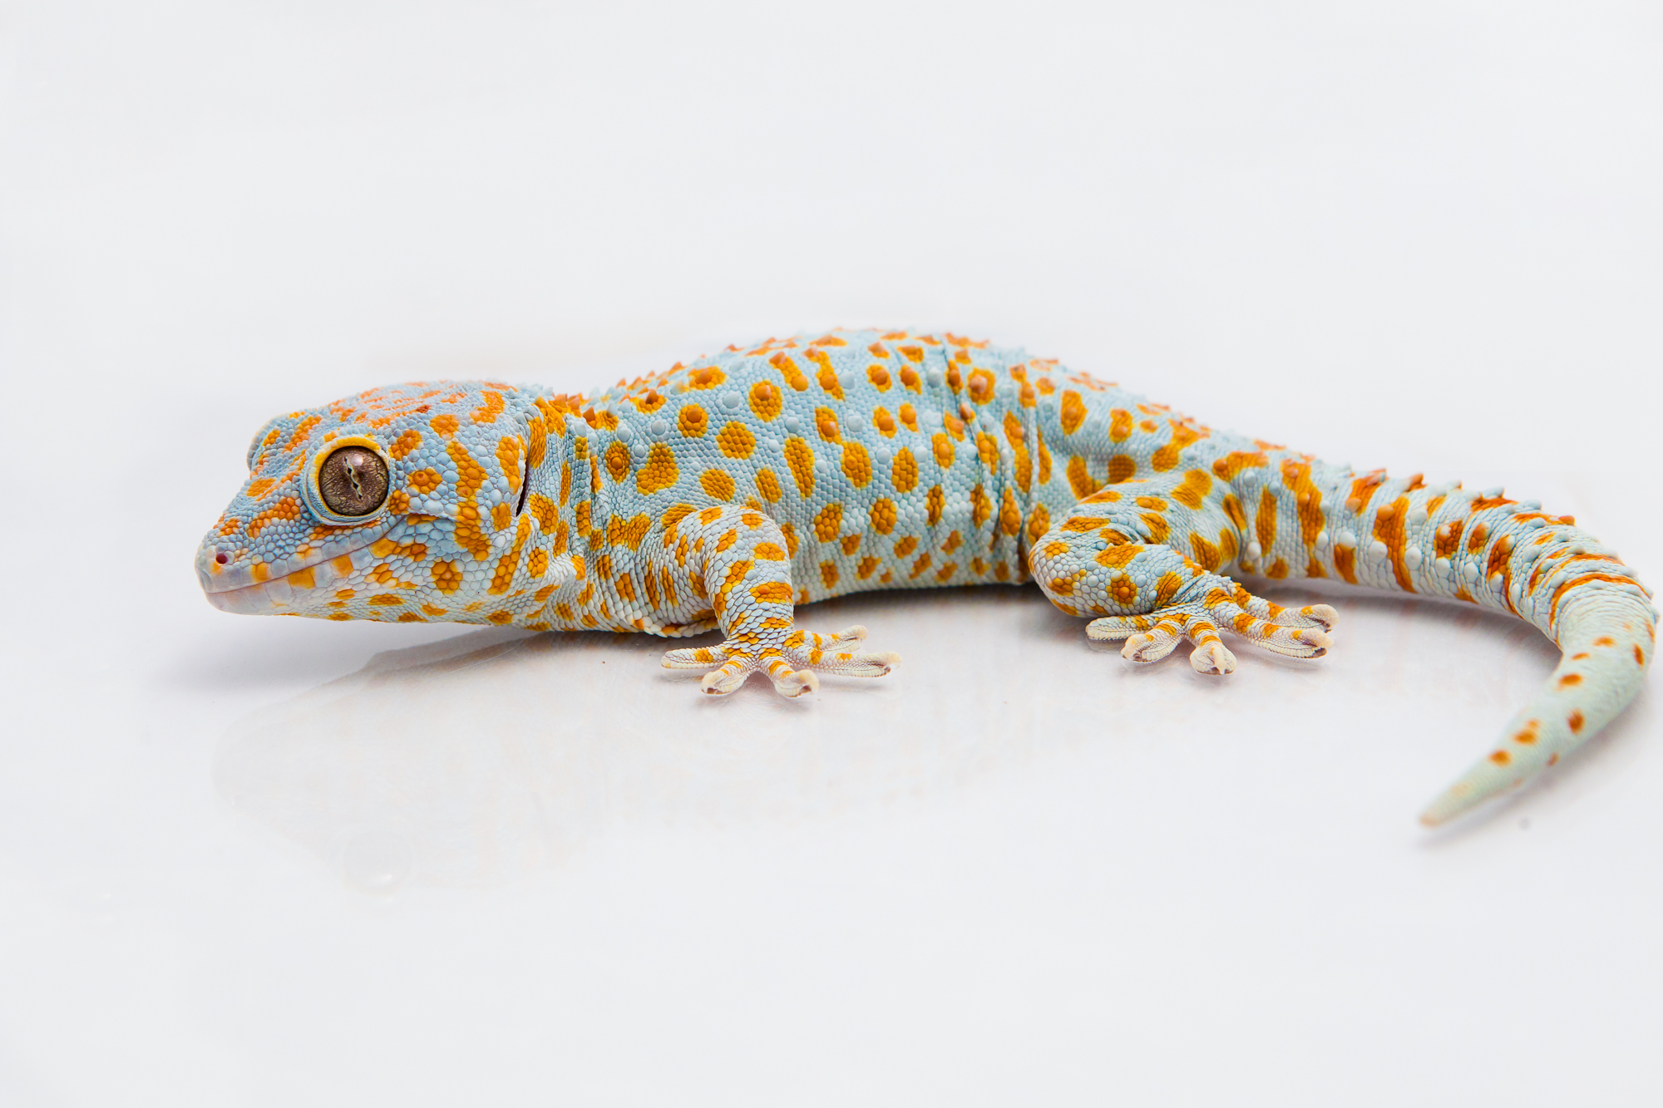
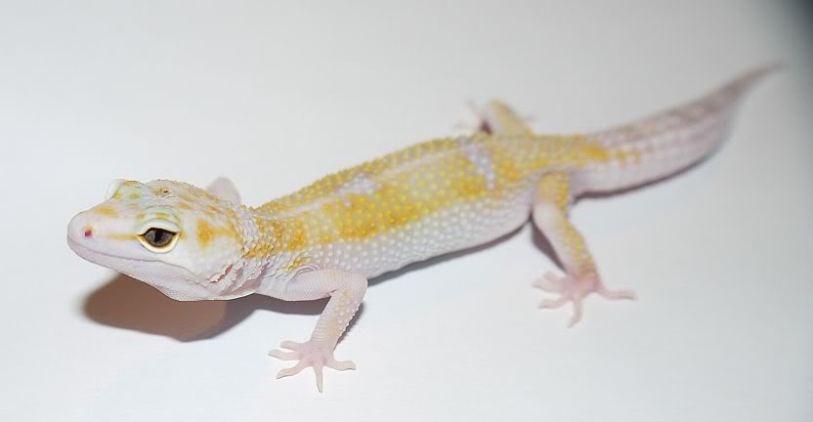
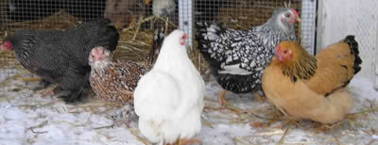
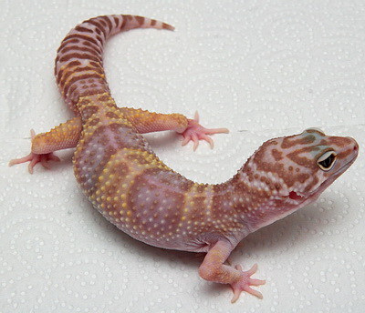
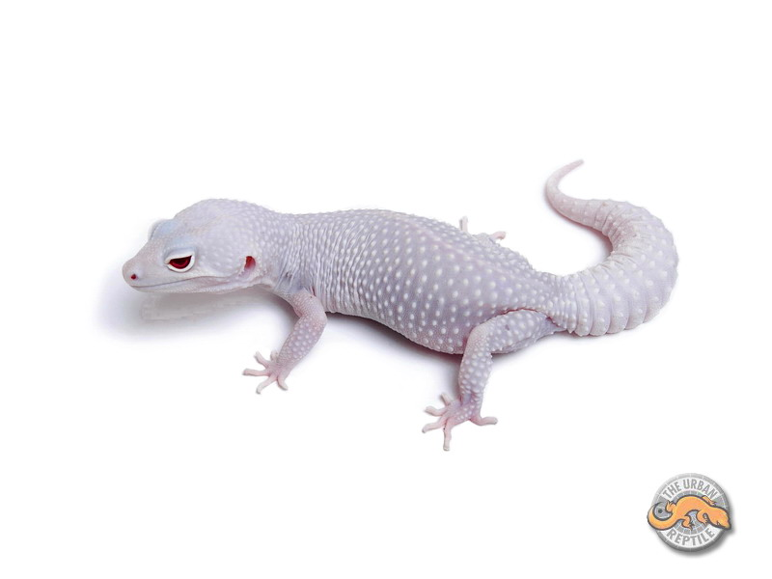
codominance four phenotypes
Black, White, spotted and Tan

Slide 12
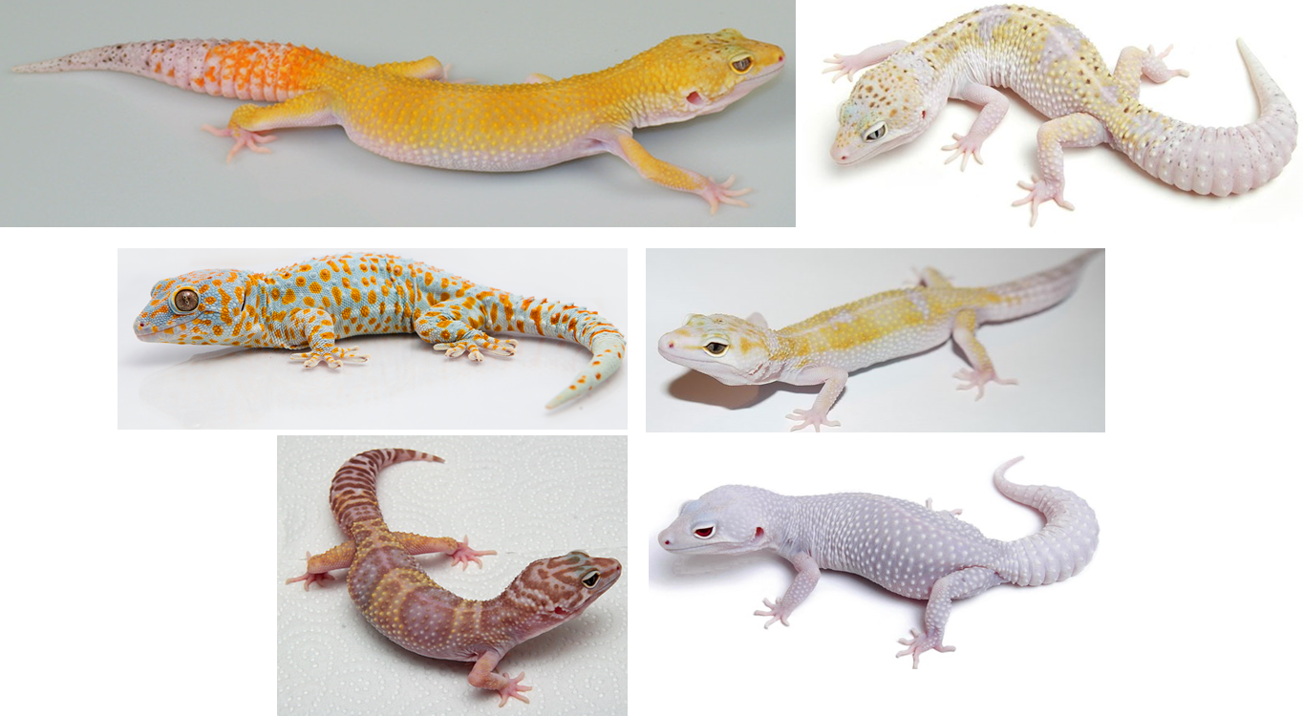
codominance four phenotypes
Mom Dad
four phenotypes
White
Yellow
Spotted
brown

Slide 13
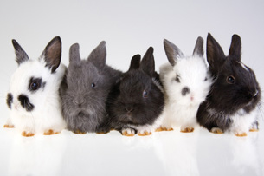
Which type?
Mommy is white with black spots
Daddy is black
Incomplete the babies are white black & grey (3 phenotypes)

Slide 14
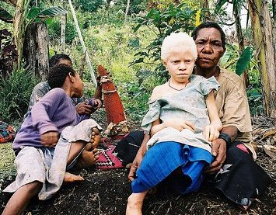
Which type?
Mommy and Daddy have brown skin – the child is an albino
All of the other children are brown
complete there are only two phenotypes – brown or albino

Slide 15
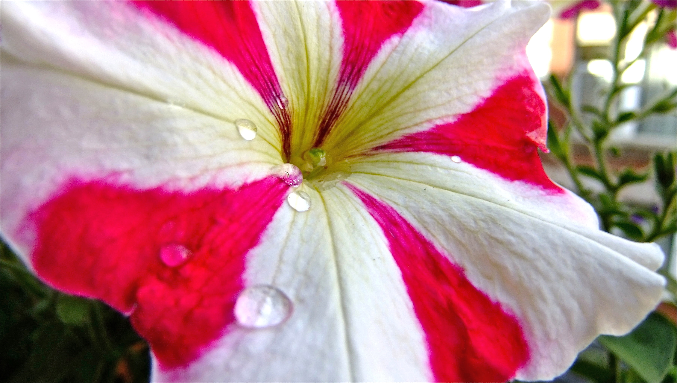
Which type?
Mommy is red
Daddy is white
Some of the babies are yellow!
Codominance four phenotypes

Slide 16
Complete dominance two phenotypes
Incomplete dominance three phenotypes
Codominance four phenotypes

Slide 17
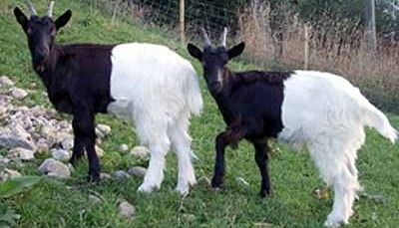
What happened here?

