Slide 1
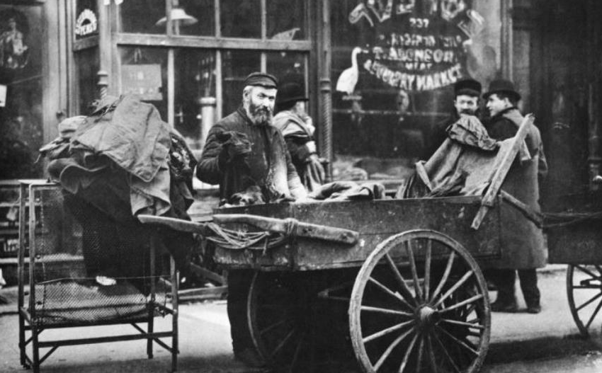
The Immigrant experience – New York City

Slide 2
1880s – 1930s
New York City

Slide 3
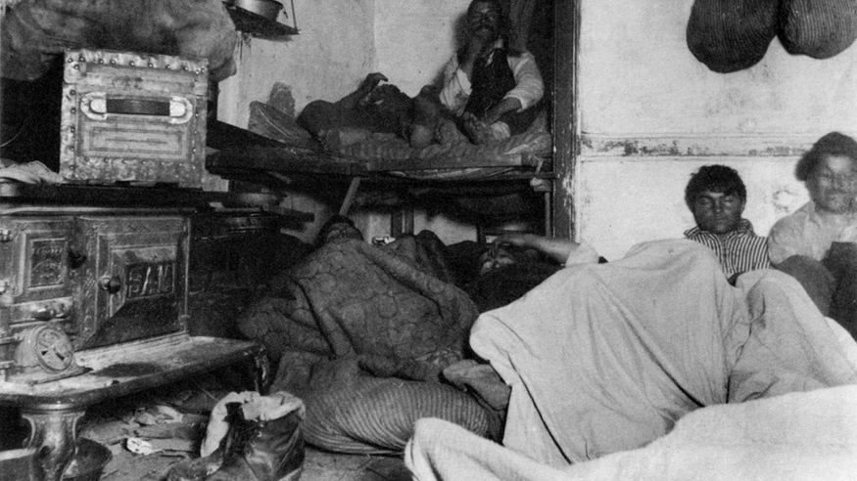
1880s
New York City

Slide 4
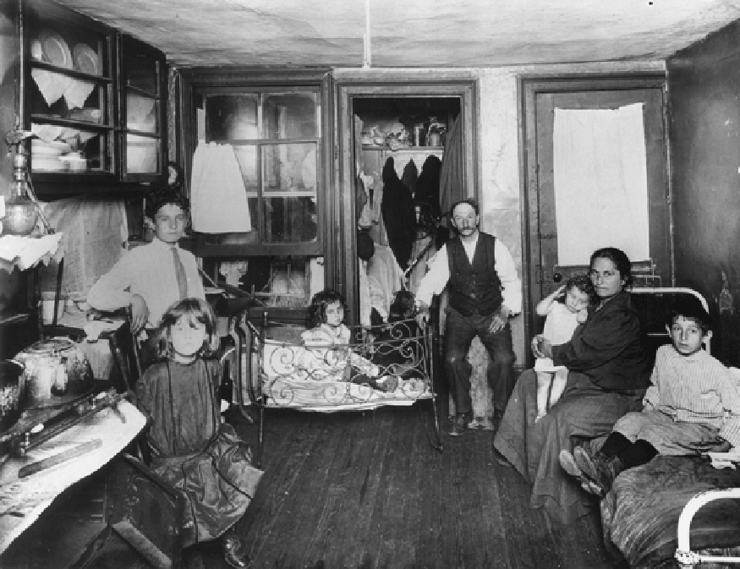
1890s
New York City

Slide 5
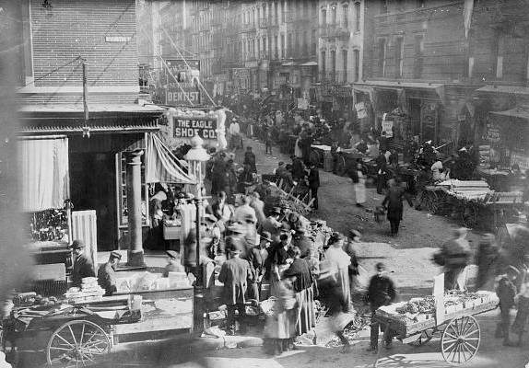
1880s
New York City

Slide 6
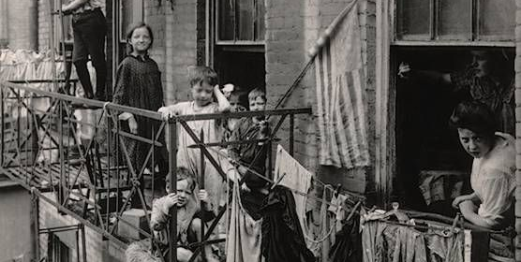
1908
New York City

Slide 7
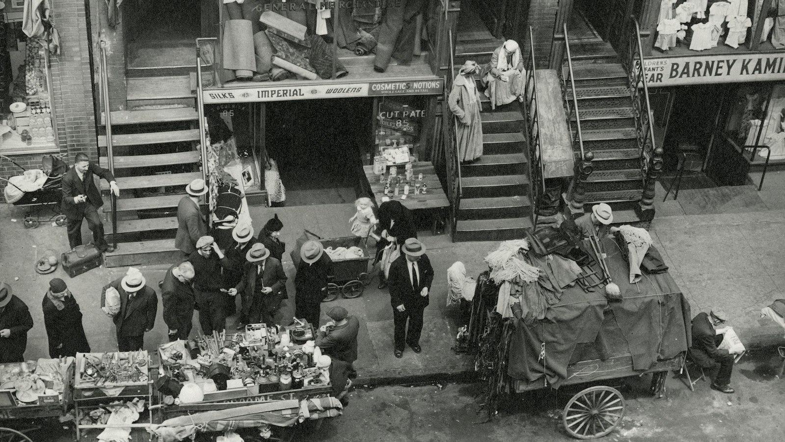
1930
New York City

Slide 8
1920s
Berlin Germany

Slide 9
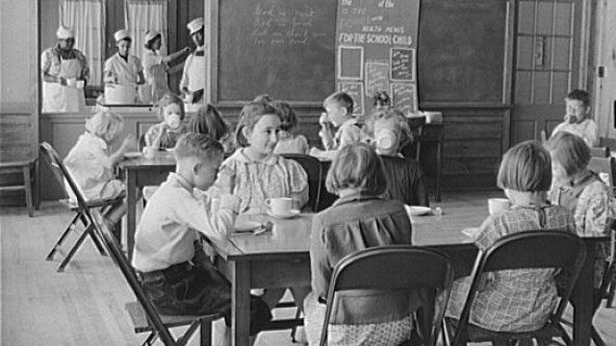
School Lunch
Berlin Germany 1920s

Slide 10
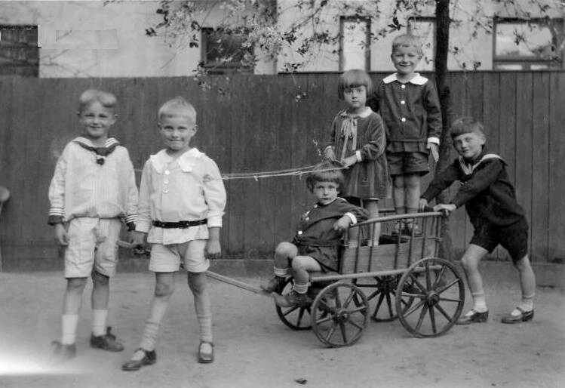
Playing
Berlin Germany 1920s

Slide 11
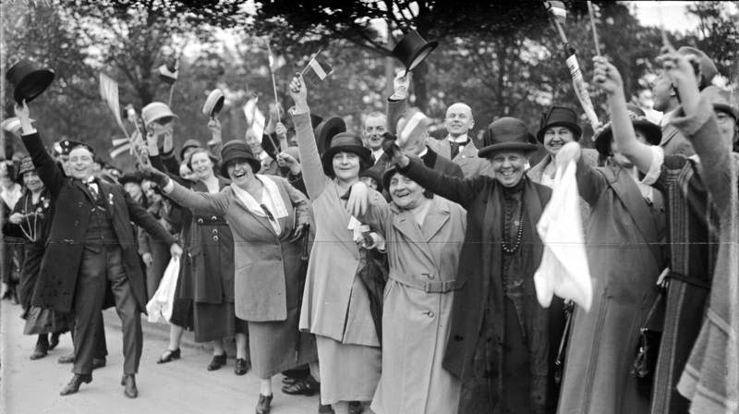
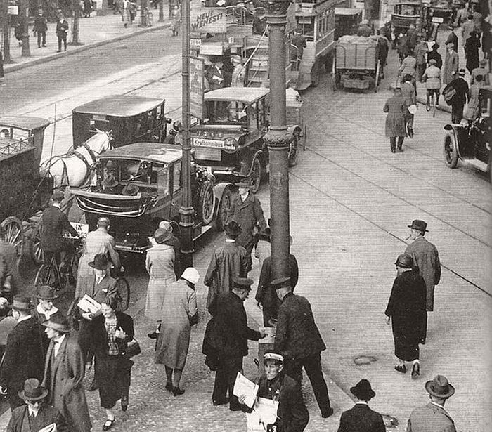
Parade
Berlin Germany 1920s

Slide 12
Berlin Germany 1920s

Slide 13
Berlin Germany 1920s

Slide 14
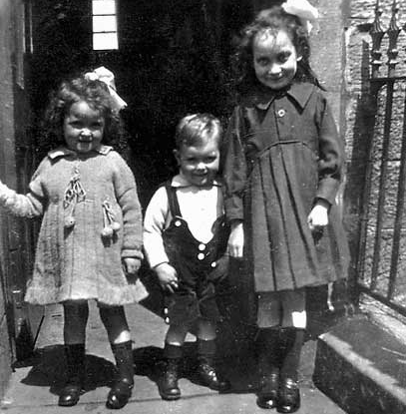
Cute
Berlin Germany 1920s
Berlin Germany 1920s

Slide 15
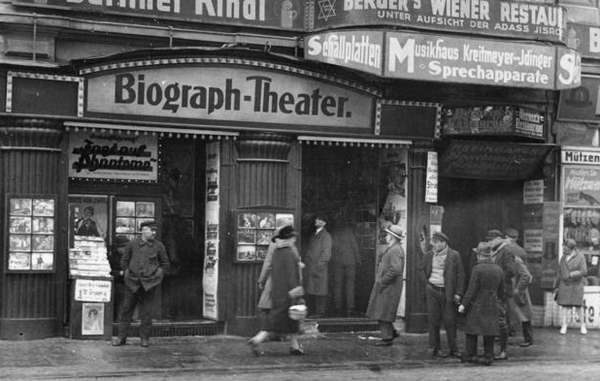
The Jewish Neighborhood
Berlin Germany 1920s

