Slide 1
Excerpt from The Colossus by Emma Lazarus
“Give me your tired, your poor,
Your huddled masses yearning to breathe free,
The wretched refuse of your teeming shore.
Send these, the homeless, tempest-tost to me,
I lift my lamp beside the golden door!”

Slide 2
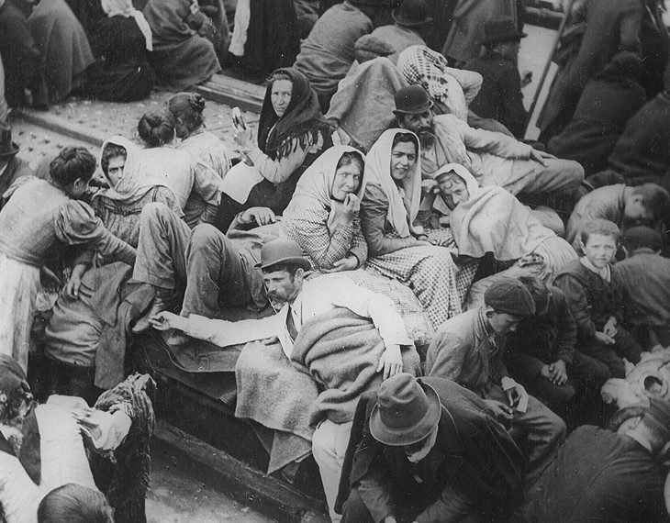
huddled masses
(very poor people in a large crowd)

Slide 3
wretched refuse
wretched
(extremely poor or miserable)
refuse
(trash or garbage)

Slide 4
yearning
(longing, wanting desperately to…)

Slide 5
teeming
(full of or swarming with)

Slide 6
tempest-tost (tempest-tossed)
(pounded or hit repeatedly by storms)

Slide 7
what do you think the Golden Door is?
?

