Slide 1
Ghana
Where is Ghana? What is it like?

Slide 2
Ghana is here

Slide 3
Ghana is warm all year round

Slide 4
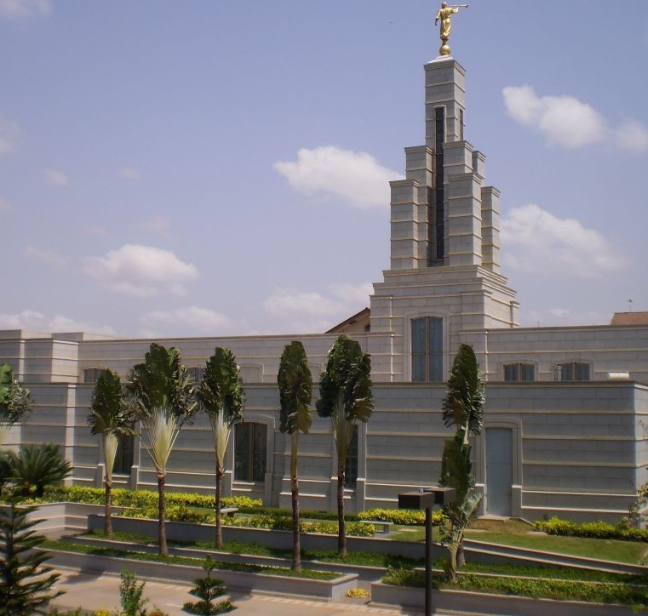
it has modern cities

Slide 5
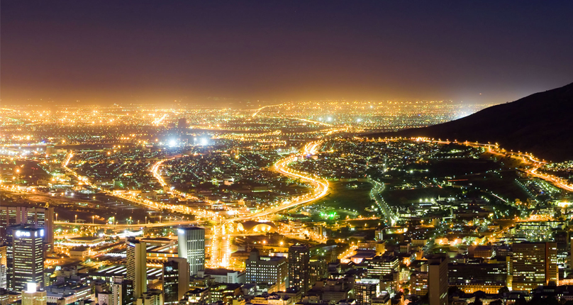
Accara
Accra

Slide 6
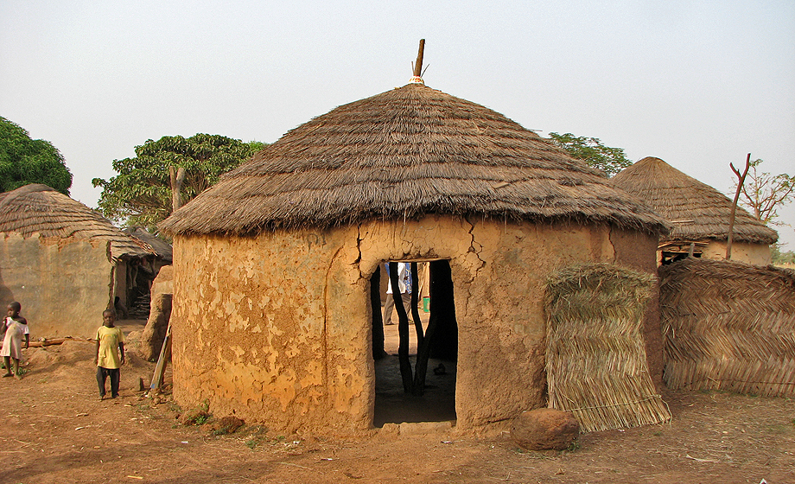
but a lot of the citizens of Ghana live the way their ancestors did.

Slide 7
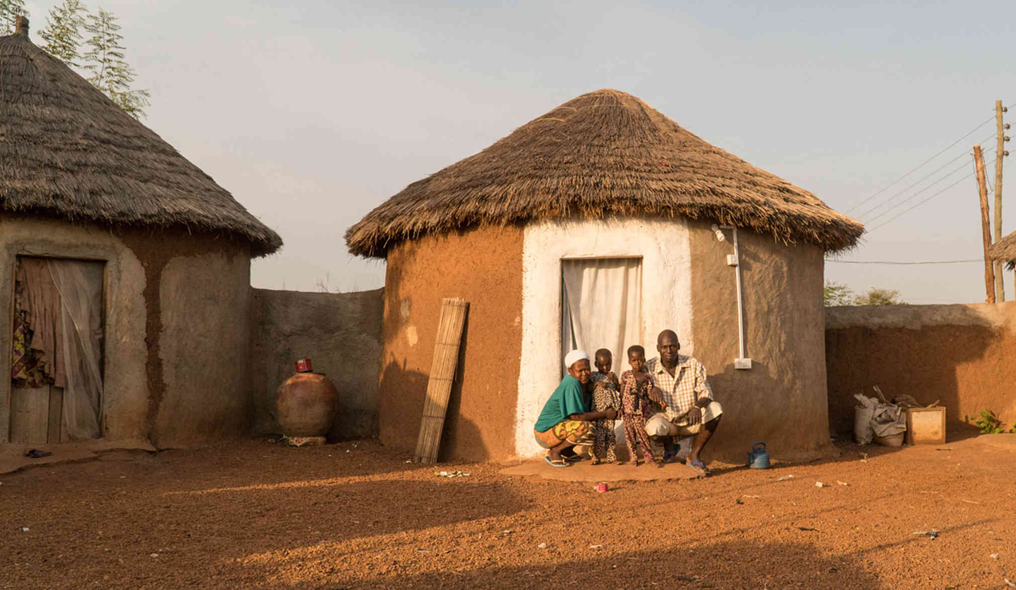
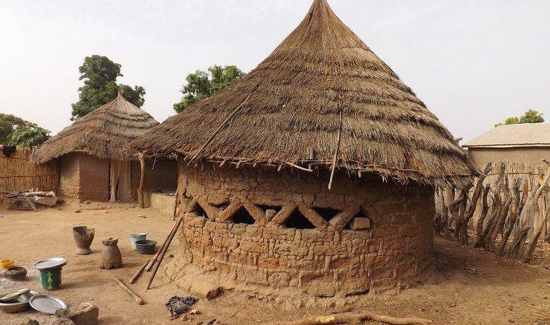
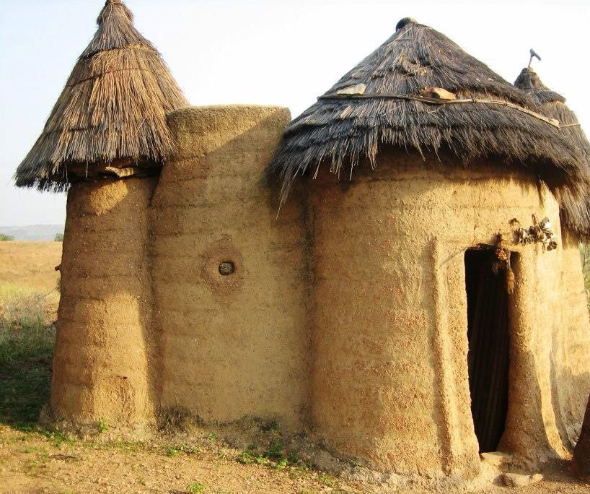
these are mud huts.

Slide 8
air conditioner
solar panel

Slide 9
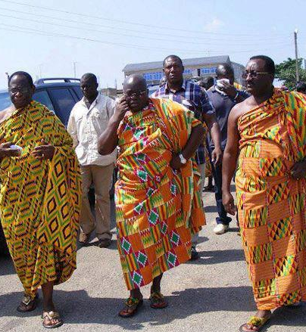
these men are wearing their dresses

Slide 10
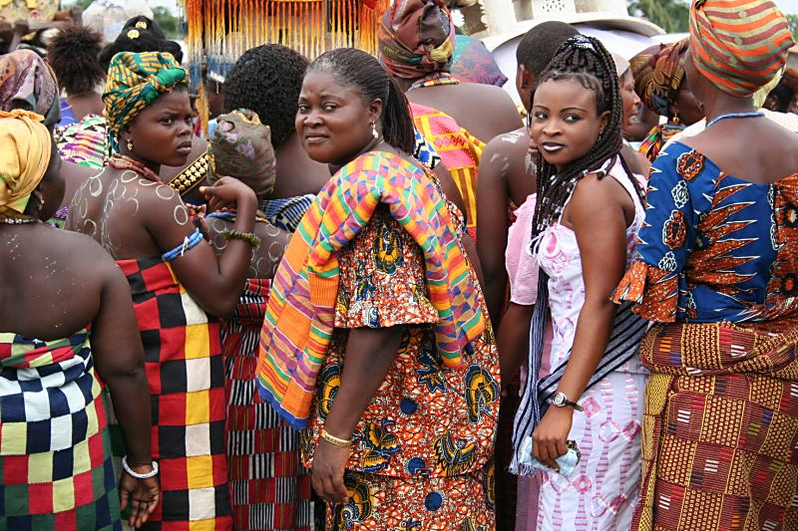
they are known for their fabrics

Slide 11
this cloth has gold and black on it.

Slide 12
what does that mean?

Slide 13
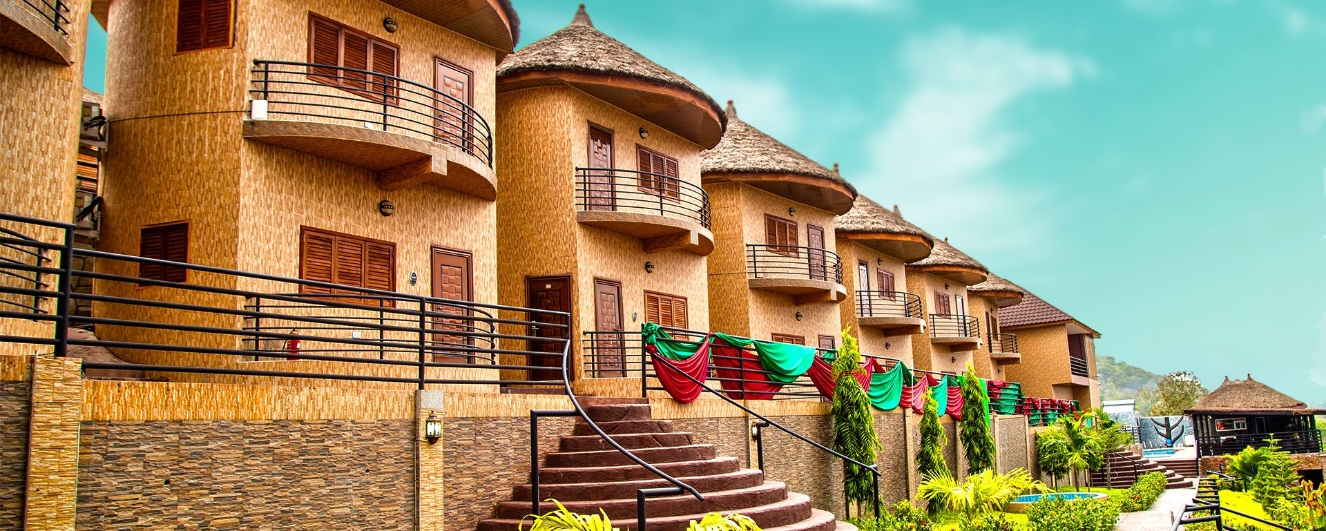
this is a new hotel in Accra

Slide 14
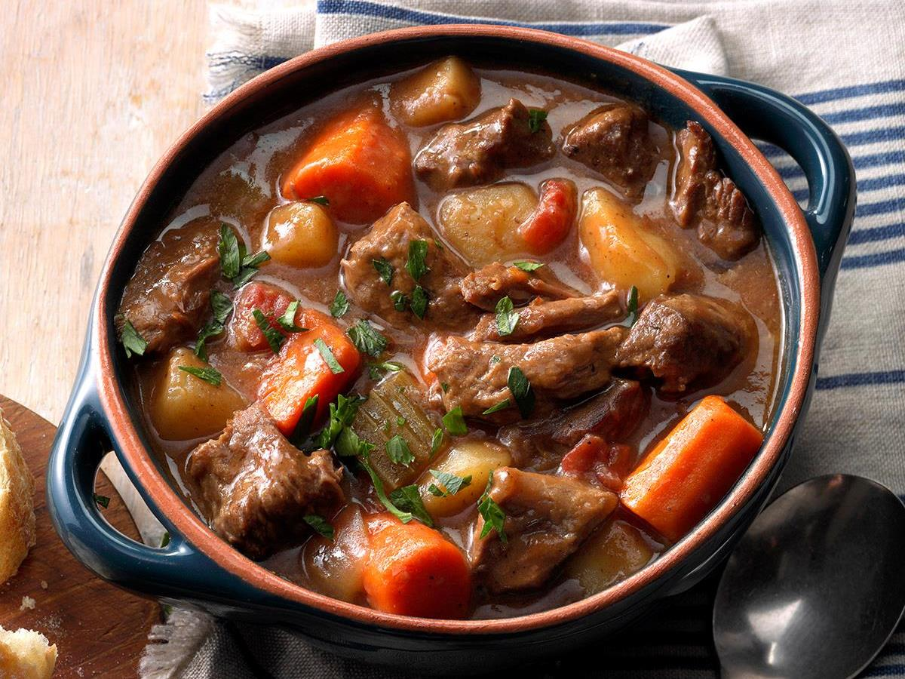
this is stew. it is not goat stew

