Slide 1

Edited by Lynn Cronin
Mid-Unit between 2 & 3 for catch-up

Slide 2
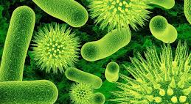
Pre-Cambrian Era
In the Pre-Cambrian Era life began as
simple, single celled organisms in the ocean.

Slide 3
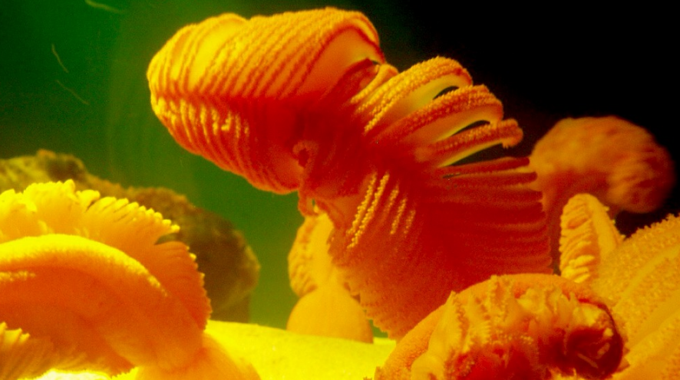
Pre-Cambrian Era
Plants and animals began to appear.

Slide 4
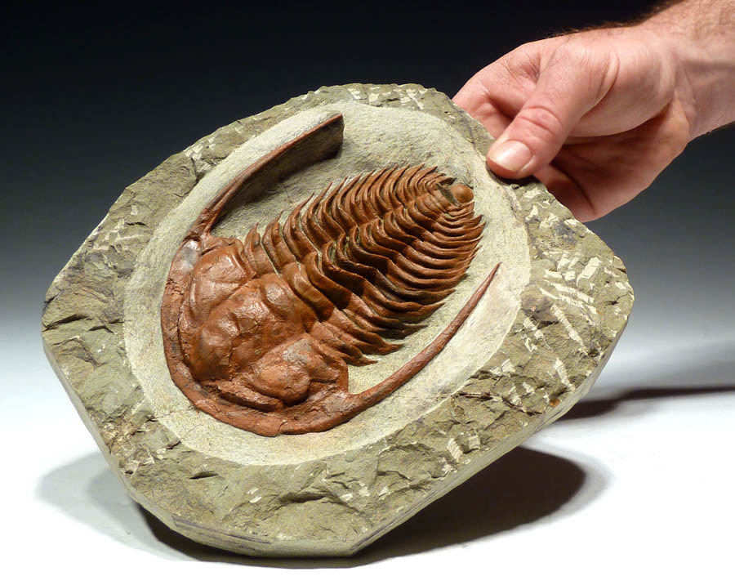
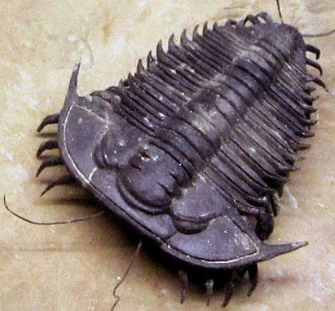
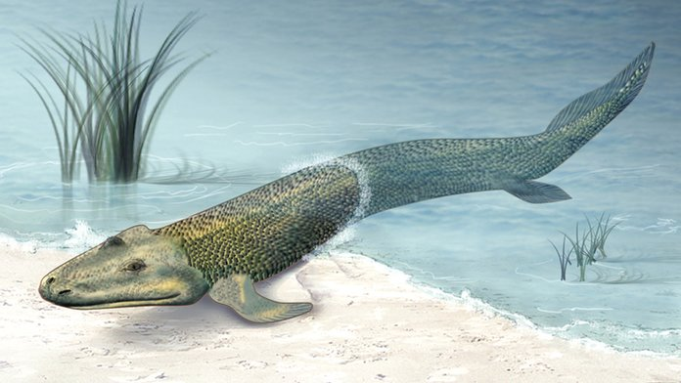
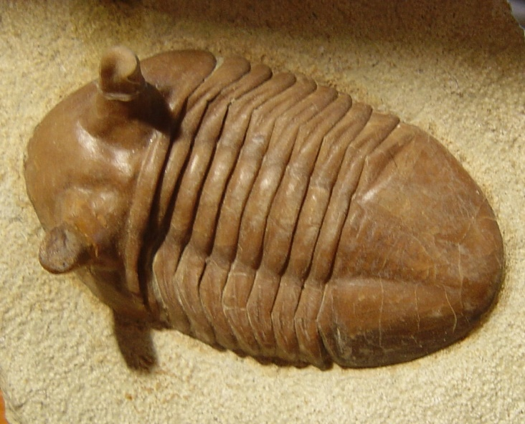
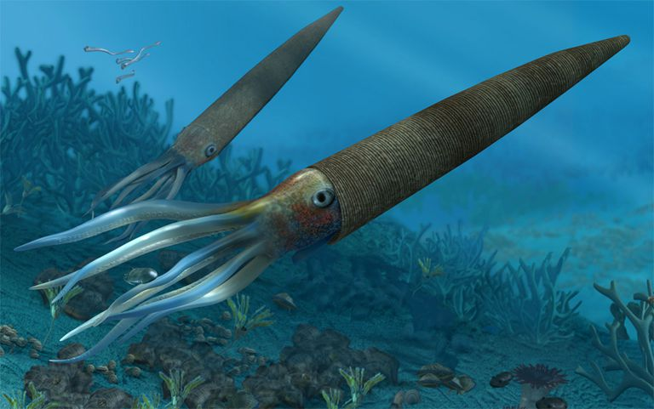
The Paleozoic Era began in the oceans.
These Trilobites are ancient ancestors of horse shoe crabs.
Paleozoic Era

Slide 5
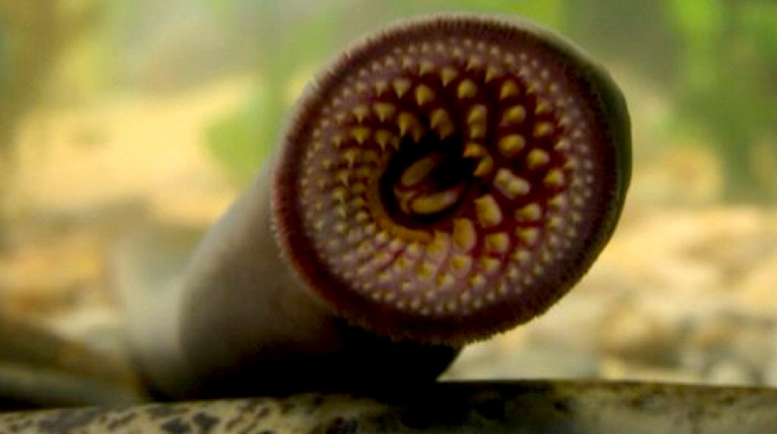
Life became more and more complicated .
Paleozoic Era

Slide 6
Animals and plants finally crawled out of the oceans!
Paleozoic Era

Slide 7
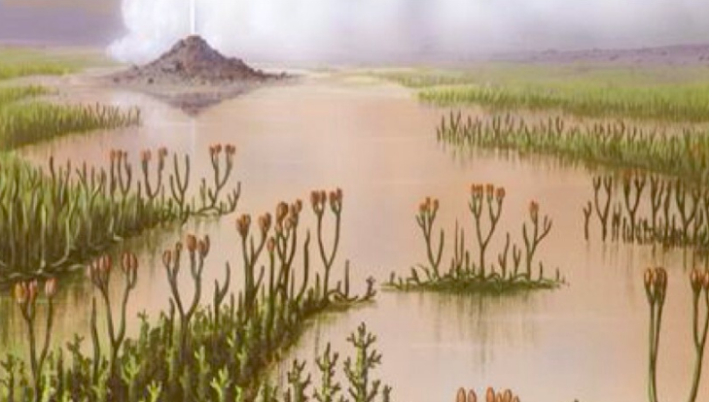
Paleozoic Era
By the end of this era plants were everywhere!

Slide 8
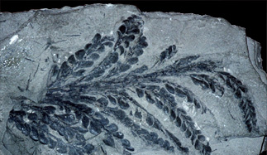
Paleozoic Era
The first ferns grew.

Slide 9
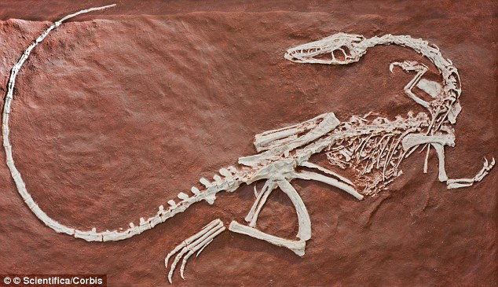
Mesozoic Era
Dinosaurs finally arrived in the Mesozoic Era

Slide 10
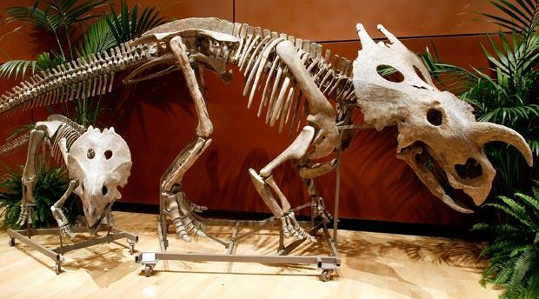
Mesozoic Era
The Age of the Dinosaurs

Slide 11
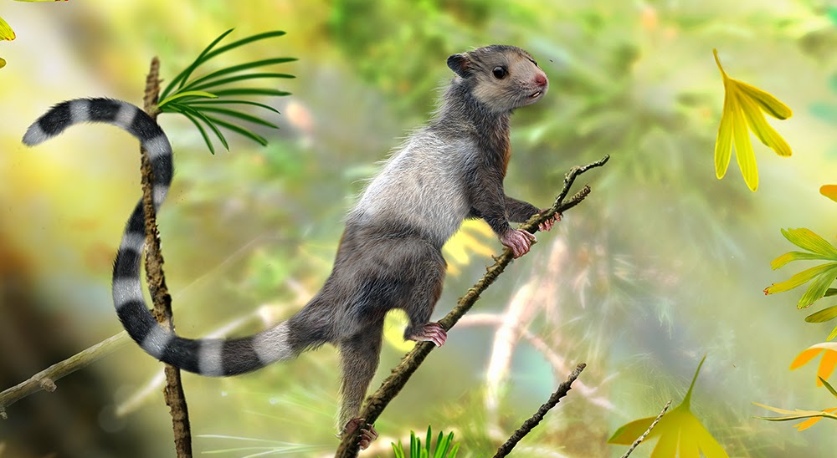
Mesozoic Era
Early mammals appeared. This matters because we are mammals.

Slide 12
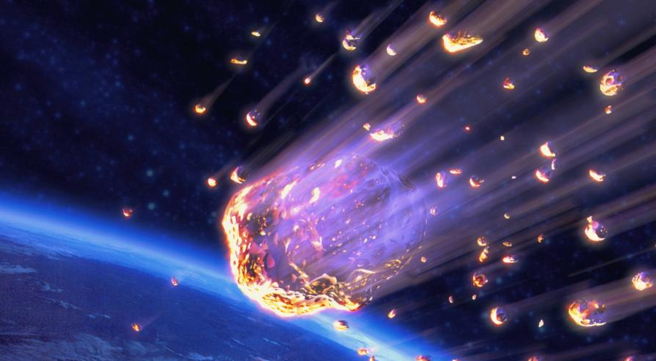
Mesozoic Era
The Mesozoic Era ended when a meteor fell to earth
and killed all of the large animals.

Slide 13
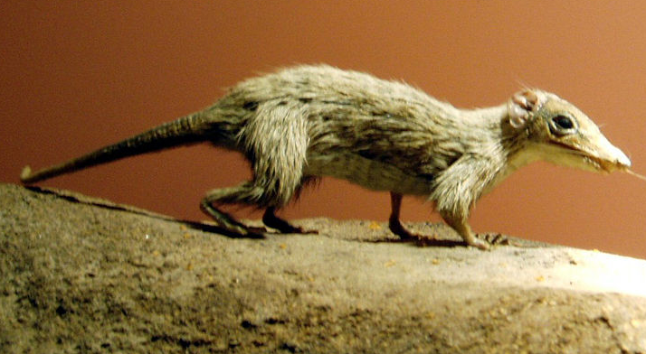
Cenozoic Era
Luckily mammals were small animals and they (we) survived!!

Slide 14
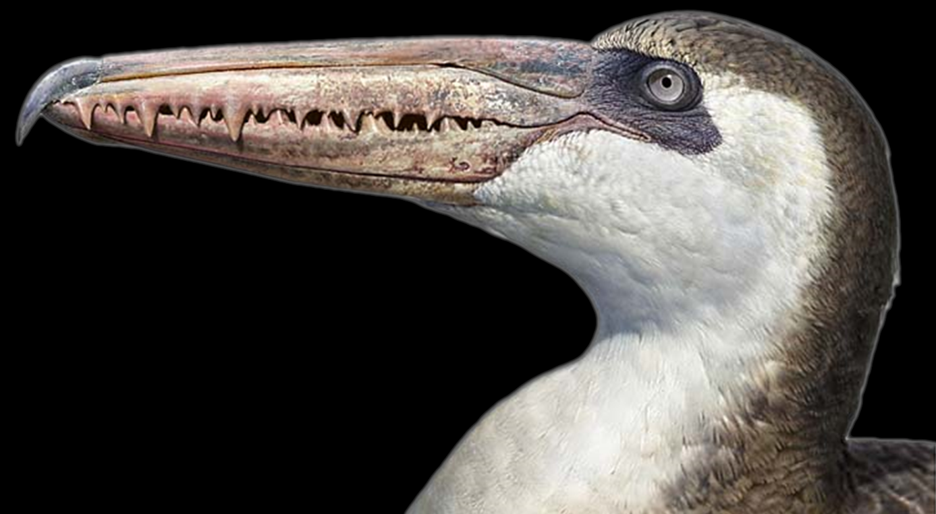
Did you see his teeth?
Cenozoic Era
Birds survived too!

Slide 15
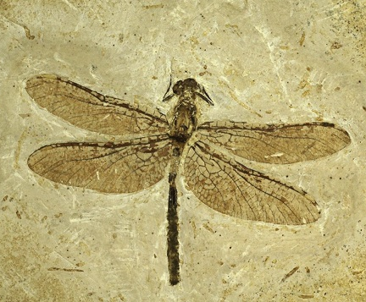
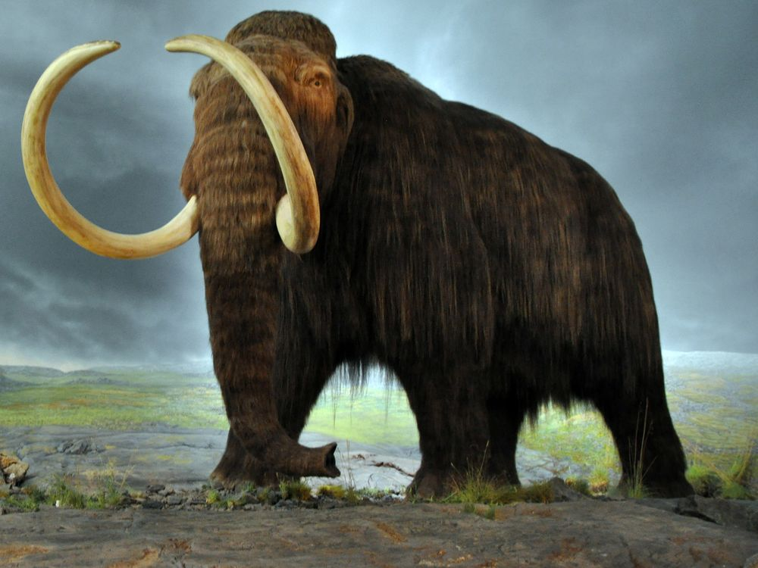
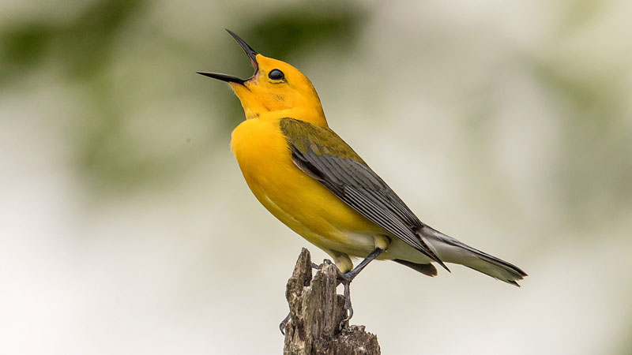
Cenozoic Era
This is our era! From 65 million years ago until today.

Slide 16
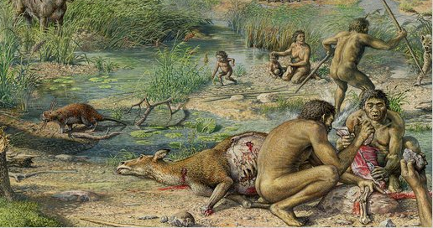
Cenozoic Era
Human beings arrived about 6 million years ago.

Slide 17
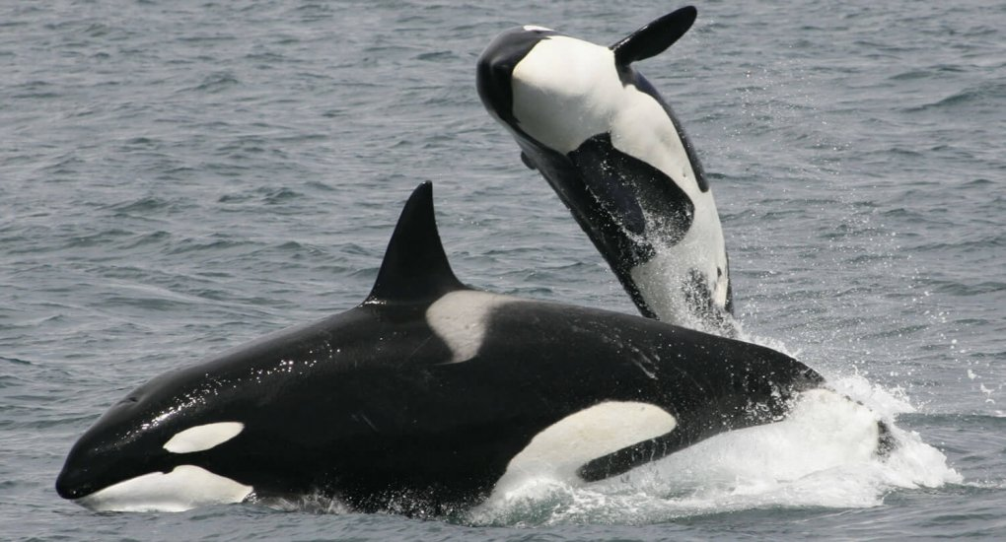
Cenozoic Era
Whales and dolphins evolved.

Slide 18
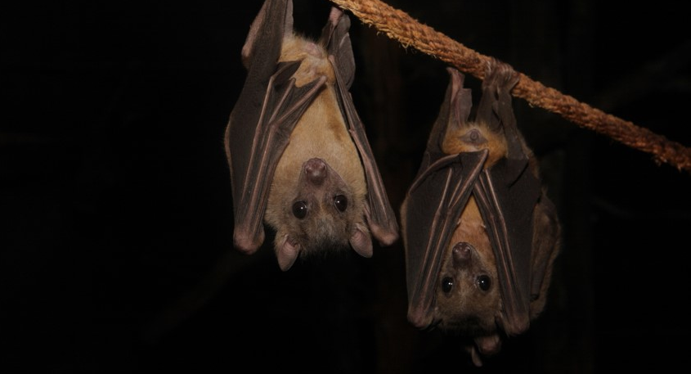
Cenozoic Era
Bats, cats, dogs, cattle, and humans became common.

Slide 19
