Slide 1
Wednesday March 31
Today we will be working on the coordinate plane again.
But first we will look at some division facts and try to connect that with our divisibility rules.

Slide 2
Take out your coordinate plane grids.

Slide 4
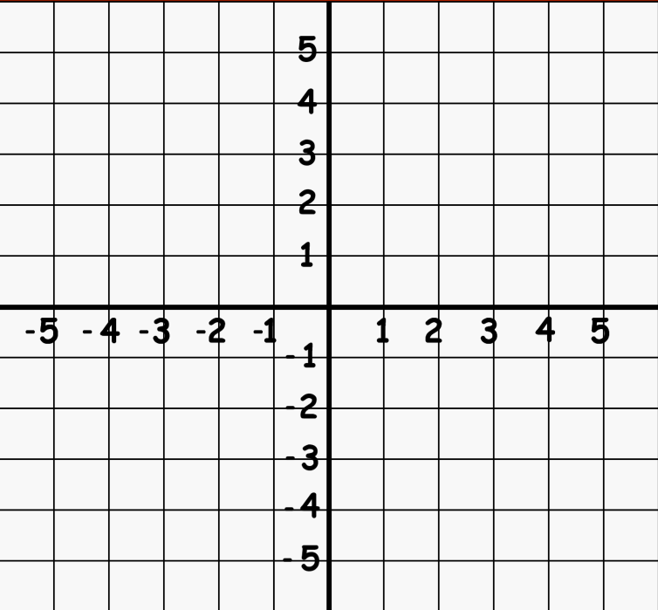
The coordinate plane
To find
the point.
Run your finger along the x-axis until you find your first number.
Then think about the line and find the second number.
(2,5)

Slide 6
I will name a point.
You mark it and then show me.

Slide 7
Do not erase anything until I tell you to.

Slide 8
(1,5)
Mark it and show me.

Slide 9
The coordinate plane
Don’t erase anything.
Run your finger along the x-axis until you find your first number.
Then think about the line and find the second number.
(1,5)

Slide 10
(3,1)
Mark it and show me.

Slide 11
The coordinate plane
Don’t erase anything.
Run your finger along the x-axis until you find your first number.
Then think about the line and find the second number.
(3,1)

Slide 12
(5,5)
Mark it and show me.

Slide 13
The coordinate plane
Don’t erase anything.
(5,5)

Slide 14
Connect all of your points.

Slide 15
The coordinate plane
Is that symmetrical?
Erase.

Slide 17
I will name a point.
You mark it and then show me.

Slide 18
Do not erase anything until I tell you to.

Slide 19
(1,5)
Mark it and show me.

Slide 20
The coordinate plane
Don’t erase anything.
(1,5)

Slide 21
(2,0)
Mark it and show me.

Slide 22
The coordinate plane
Don’t erase anything.
(2,0)

Slide 23
(4,5)
Mark it and show me.

Slide 24
The coordinate plane
Don’t erase anything.
(4,5)

Slide 25
(5,0)
Mark it and show me.

Slide 26
The coordinate plane
Don’t erase anything.
(5,0)

Slide 27
Connect all of your points.

Slide 28
The coordinate plane
Is that symmetrical?
Erase.

Slide 30
I will name a point.
You mark it and then show me.

Slide 31
Do not erase anything until I tell you to.

Slide 32
(3,5)
Mark it and show me.

Slide 33
The coordinate plane
Label it #1
1
Don’t erase anything.
(3,5)

Slide 34
(1,0)
Mark it and show me.

Slide 35
The coordinate plane
1
Label it #2
2
Don’t erase anything.
(1,0)

Slide 36
(6,3)
Mark it and show me.

Slide 37
The coordinate plane
1
3
Label it #3
2
Don’t erase anything.
(6,3)

Slide 38
(0,3)
Mark it and show me.

Slide 39
The coordinate plane
1
4
3
Label it #4
2
Don’t erase anything.
(0,3)

Slide 40
(0,5)
Mark it and show me.

Slide 41
The coordinate plane
1
4
3
2
5
Label it #5
Don’t erase anything.
(0,5)

Slide 42
Connect all of your points in number order.

Slide 43
The coordinate plane
1
4
3
2
5
Is that symmetrical?
Erase.

Slide 44
Puzzle piece today.
Division practice.

Slide 46
Divisibility rules!
Do you remember your divisibility rules?
If it’s
Even
You can divide by
2

Slide 47
Divisibility rules!
Do you remember your divisibility rules?
If it ends in
0 ^{or} 5
You can divide by
5

Slide 48
Start with 2.
Is it even?
Try 5
28
÷ 7
Ends in?
2 too low
Skip count in 5s
5 is too high
7x2=
14
7x3=
21
4
(add 7)
7x4=
28
(add 7)

Slide 49
Start with 2.
Is it even?
Try 5
24
÷ 4
Ends in?
2 too low
Skip count in 5s
5 close
4x5=
20
4x6=
24
6
(add 4)

Slide 50
Start with 2.
Is it even?
Try 5
56
÷ 7
Ends in?
2 too low
5 also too low
But I can skip count in 5s…
7x5=
35
7x6=
42
(add 7)
8
7x7=
49
(add 7)
7x8=
56
(add 7)

Slide 51
Start with 2.
20
÷ 4
Is it even?
Try 5
Ends in?
5
4x5=
20

Slide 53
Sometimes you get lucky and you can simply skip count an answer.
2s are very skip countable.
16
÷ 2
8

Slide 54
Sometimes you get lucky and you can simply skip count an answer.
2s are very skip countable.
12
÷ 2
6

Slide 55
Sometimes you get lucky and you can simply skip count an answer.
2s are very skip countable.
18
÷ 2
9

Slide 56
Sometimes you get lucky, and you can simply skip count an answer.
5s are very skip countable.
35
÷ 5
7

Slide 57
Sometimes you get lucky, and you can simply skip count an answer.
5s are very skip countable.
25
÷ 5
5

Slide 58
Sometimes you get lucky, and you can simply skip count an answer.
5s are very skip countable.
40
÷ 5
8

Slide 59
We have tried a few things.
See if you remember a multiplication problem that fits.
Check your divisibility. Even or ends in 0,5
Start low and move up until you find it.
Remember that you can skip count in 5s!
Better yet – memorize these facts!

Slide 60
About the future…
We need to learn how to do long division.
It is actually easier than the stuff you have already learned, but..
Not if you don’t know your division facts.
So, we will finish up with coordinate plane work start memorizing.

Slide 61
Helper facts
If you can think of a multiplication problem that is close – but low – you can write way less dots in an array.

Slide 62
Helper facts
9x7=
I could draw 7 rows of 9

Slide 63
Helper facts
9x7=
Forget that!
Skip count skip count up to 9x5 then count on.
45
63
Or just memorize your facts.

Slide 64
Helper facts
There is something else you can do with this idea.
What we really just did is change the fact into two facts that were easier to deal with.
Instead of 9x7, we just solved 9x5 and added 9x2

Slide 65
Helper facts
9x7=
(9x5)
+
(9x2)
(45)
+
(18)
63

Slide 66
Helper facts
And you can use that idea to multiply large numbers!

Slide 67
Helper facts
9x150=
(9x100)
+
(9x50)
9
0
0
+
45
0
1350

Slide 68
Helper facts
4x120=
(4x100)
+
(4x20)
4
0
0
+
8
0
480

Slide 69
Helper facts
3x130=
(3x100)
+
(3x30)
3
0
0
+
9
0
390

Slide 71
Friends of 10
Friends of 10 are number pairs that add to 10.
6
+
4

Slide 72
Friends of 10
What is the 10 pair for…
7
+
3

Slide 73
Friends of 10
What is the 10 pair for…
2
+
8

Slide 74
Friends of 10
What is the 10 pair for…
5
+
5

Slide 75
Friends of 10
What is the 10 pair for…
3
+
7

Slide 76
Friends of 10
What is the 10 pair for…
8
+
2

Slide 77
Friends of 10
What is the 10 pair for…
1
+
9

Slide 78
Friends of 10
Friends of 10 are the most commonly added pairs of numbers.
If you need to add up a string of numbers, finding friends makes it a lot easier!
6+4+7+3+5=
Find your 10 pairs first.
10+
10
+5
=25

Slide 79
Friends of 10
Try it!
8+9+3+1+2=
Find your 10 pairs first.
10+
10
+3
=23

Slide 80
Friends of 10
Try it!
7+2+3+8+4
Find your 10 pairs first.
10+
10
+4
=24

Slide 81
Friends of 10
Try it!
8+6+5+5+3+2+1
Find your 10 pairs first.
10+
10
+10
=30

Slide 82
Friends of 10
Try it!
2+3+7+9+1+4+3
Find your 10 pairs first.
10+
10
+2+4+3
=29

Slide 83
Friends of 10
Try it!
3+4+8+6+7+1+1
Find your 10 pairs first.
10+
10
+10
=30

Slide 84
When you have addition and subtraction problems, I want you to think about the + and – as belonging to the number behind it.

Slide 85
For example.
6+8-5+4-2
+
belongs to 8
You can shift numbers around that way.
6-5+4-2
+8

Slide 86
Re-write the equation so that + is first and - is second.
6+8-5+4-2
First find the pluses
6
+8
+4
-5
-2
=11
Now find the minuses
Use your calculator to make sure you get the same answer.

Slide 88
Re-write the equation so that + is first and - is second.
3+7-5-8+6-1
First find the pluses
3
+7
+6
-5
-8
-1
=2
Now find the minuses
Use your calculator to make sure you get the same answer.

Slide 90
Re-write the equation so that + is first and - is second.
3+4+9-8+2-7
First find the pluses
3
+4
+9
+2
-8
-7
=3
Now find the minuses
Use your calculator to make sure you get the same answer.

Slide 93
Symmetry on the coordinate plane
This is the coordinate plane.

Slide 96
Symmetry on the coordinate plane
THIS IS THE X-AXIS
THIS IS THE Y-AXIS
This is the coordinate plane.

Slide 97
Symmetry on the coordinate plane
Translational symmetry works best on the coordinate plane.

Slide 98
Symmetry on the coordinate plane
We will look at only this section of our coordinate plane for now.

Slide 99
Symmetry on the coordinate plane
And we will blow it up.

Slide 100
Symmetry on the coordinate plane
(
)
1
,
2
This rhombus is at point (1,2)

Slide 101
Symmetry on the coordinate plane
(
)
1
,
2
If we translate this shape by +2 on both axis, it moves here.

Slide 102
Symmetry on the coordinate plane
(
)
3
,
1
This shape is at point (3,1)

Slide 103
Symmetry on the coordinate plane
(
3
,
1
)
If we translate this shape by +2 on both axis, it moves here.

Slide 105
Symmetry on the coordinate plane
(
)
5
,
4
This shape is at point (5,4)

Slide 106
Symmetry on the coordinate plane
(
3
,
1
)
If we translate this shape by -3 on both axis, it moves here.

Slide 107
Symmetry on the coordinate plane
reflection
Rotation
translation
(
3
,
2
)
(
3
,
3
)
Which type of symmetry?

Slide 108
Symmetry on the coordinate plane
reflection
Rotation
translation
(
1
,
3
)
(
3
,
5
)
Which type of symmetry?

Slide 109
Symmetry on the coordinate plane
(
)
1
,
2
(
)
3
,
5
If we translate this shape by +2 on both axis, it moves here.

Slide 113
Today’s puzzle piece 7s multiplication

Slide 114
Quiz tomorrow.

Slide 116
It’s time for…
Gee I’m a tree
Get it? Geometry!

Slide 117
What angle am I?
I have many names.
90⁰
square
perpendicular
right

Slide 118
What angle am I?
I have 2 names
180⁰
line

Slide 119
What angle am I?
I started at 0⁰ then went all the way around
360⁰
Degrees in a circle

Slide 120
What angle am I?
I am chunky
Obtuse
What is the rule for obtuse angles?
They are larger than 90⁰

Slide 121
Acute or Obtuse?
Obtuse
What is the rule for obtuse angles?
They are larger than 90⁰

Slide 122
Acute or Obtuse?
Acute
What is the rule for acute angles?
They are smaller than 90⁰

Slide 124
Symmetry
Rotation
Point of symmetry
Shapes rotate around a single point
Almost like they are stuck to clock hands.

Slide 125
Symmetry
Rotation
Point of symmetry

Slide 127
Symmetry
Draw a flower with rotational symmetry.
Point of symmetry
Then mark your Point of symmetry

Slide 128
Symmetry
Not rotational.
No Point of symmetry

Slide 129
Symmetry
Rotational.
Imaginary lines.
Point of symmetry

