Slide 1
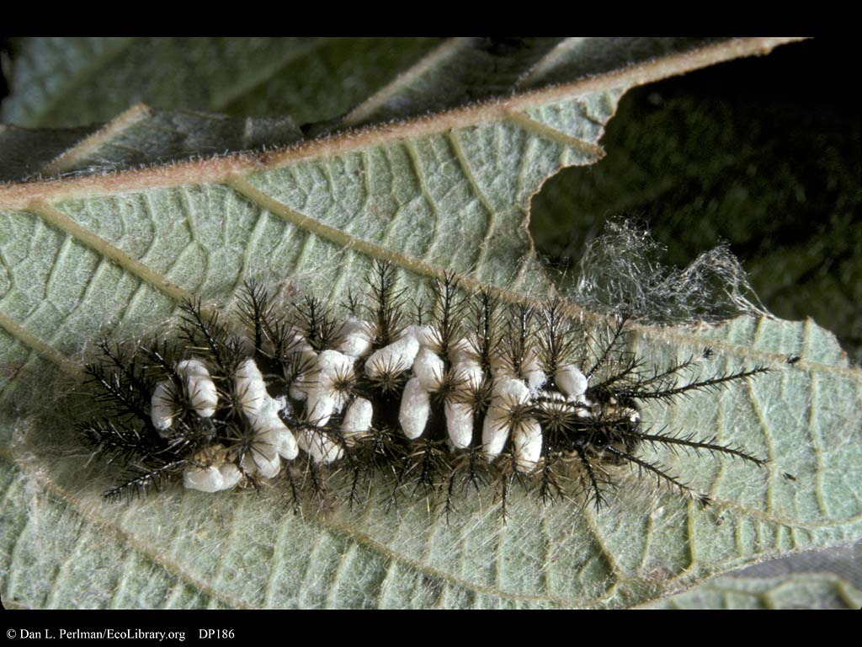
A wasp lays eggs into a cockroach. The eggs hatch and eat the cockroach

Slide 2
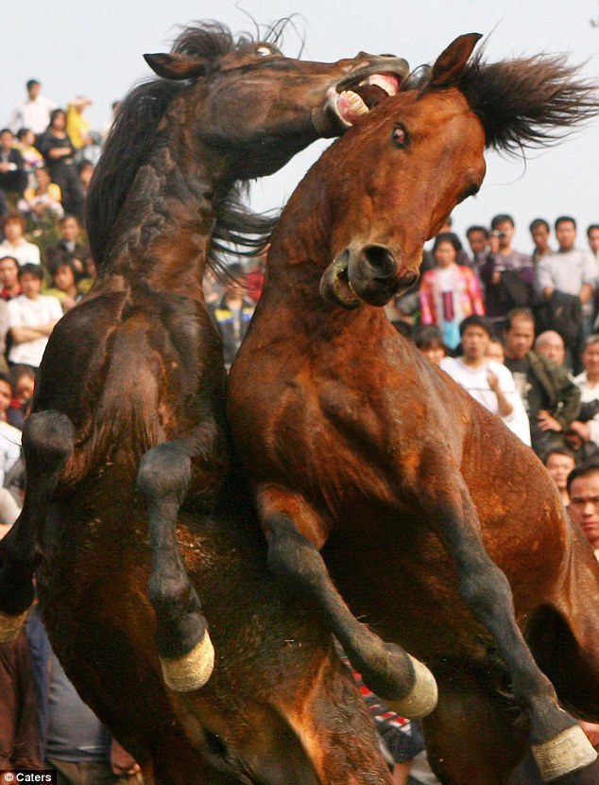
Two stallions fight over the right to mate with the female horses.

Slide 3
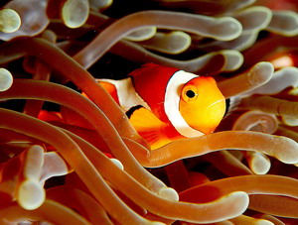
A clownfish lives in a sea anemone for protection and also brings pieces of food over to the anemone to eat.

Slide 4
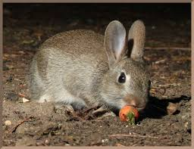
A rabbit grazes on some wild carrots.

Slide 5
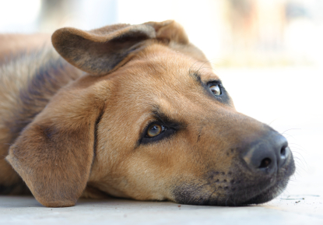
Your dog has a tapeworm that makes him sick while the tapeworm stays happy and healthy inside the intestinal tract.

Slide 6
Barnacles attach to whales to get access to more food without hurting or helping the whale.

Slide 7
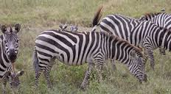
A certain bird stays near zebras. The bird eats bugs and ticks off the zebra’s skin, keeping the zebra clean from parasites.

Slide 8
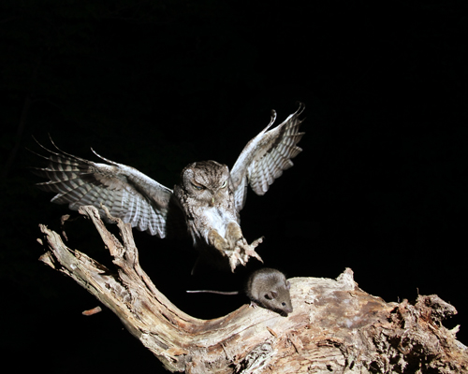
An owl swoops down from the sky and catches a mouse.

Slide 9
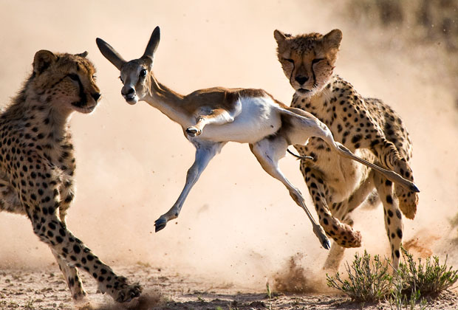
Both lions and cheetahs hunt antelopes.

Slide 10
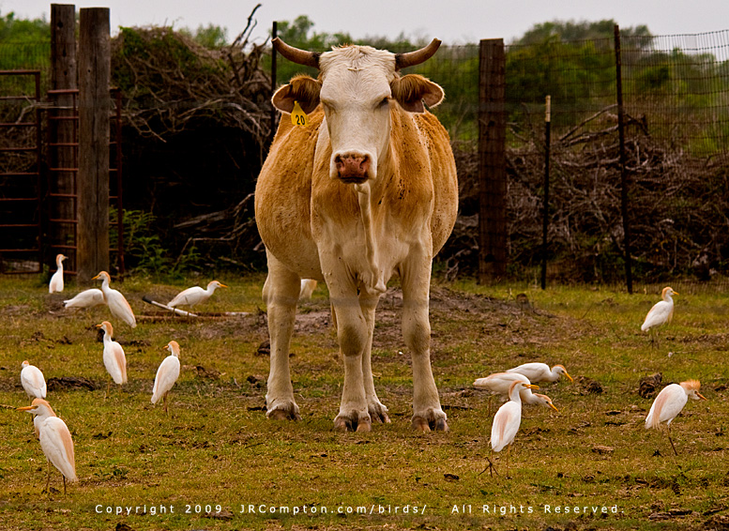
Cattle egrets (bird) follow cattle around to eat the bugs they stir up from walking.

