Slide 1
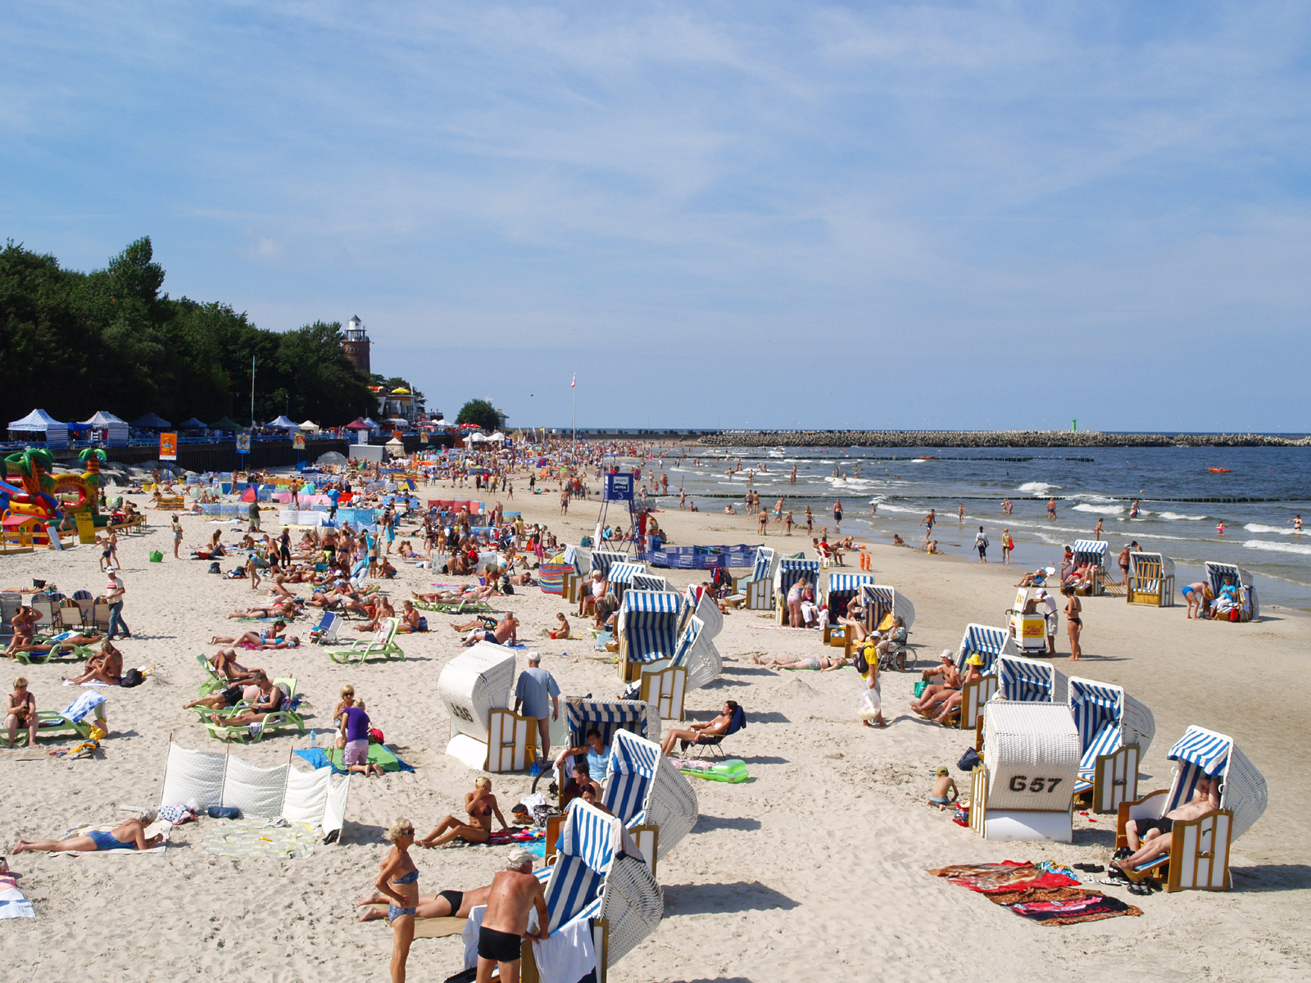
What is climate?
ESSENTIAL QUESTION
UNIT 5 WEATHER

Slide 2
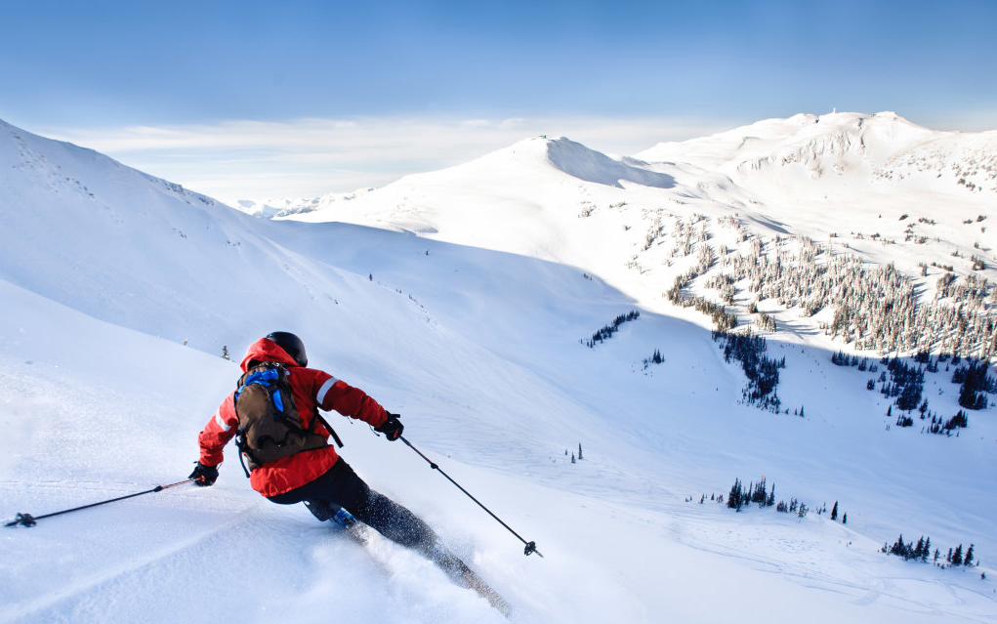
You are visiting three friends in December.
ESSENTIAL QUESTION
UNIT 5 WEATHER

Slide 3
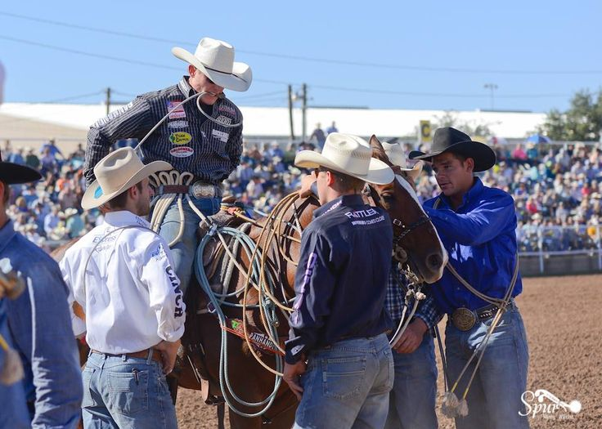
One lives in Vermont, one in South Florida and one in Ohio.
ESSENTIAL QUESTION
UNIT 5 WEATHER

Slide 4
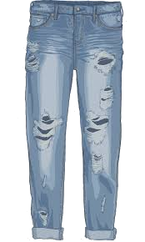
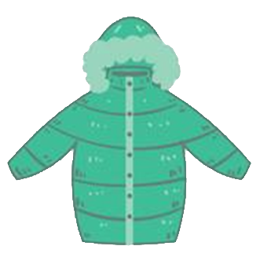
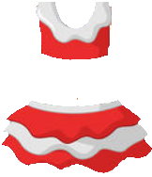
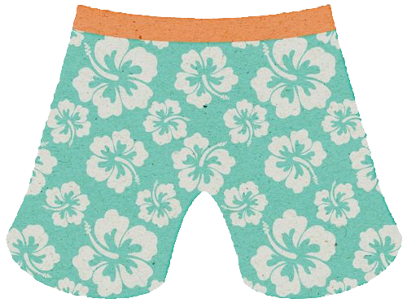
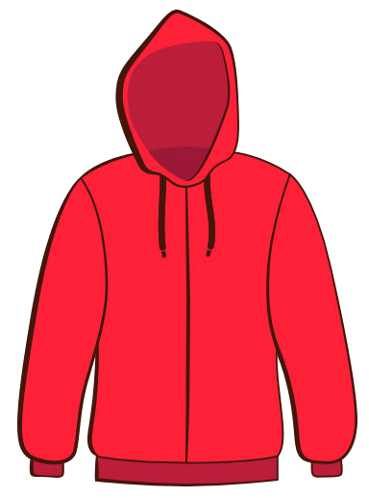
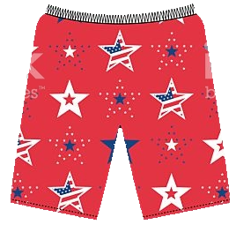
What should you pack?
ESSENTIAL QUESTION
What should you pack?
ESSENTIAL QUESTION
UNIT 5 WEATHER

Slide 5
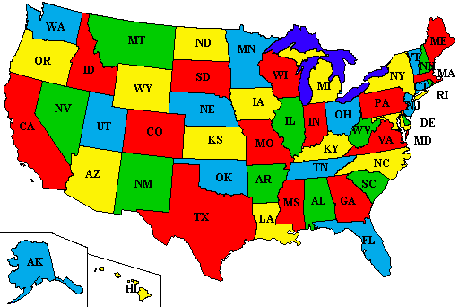
Vermont
First, where are Vermont, Florida and Ohio?
ESSENTIAL QUESTION
Ohio
Florida
UNIT 5 WEATHER

Slide 6
In Vermont December is Ski Season!
Pack your snowboard and mittens!
UNIT 5 WEATHER

Slide 7
South Florida is always hot!
Pack your snorkel and bathing suit!
UNIT 5 WEATHER

Slide 8
Ohio in December is a lot like it is here
Pack your snowboard and mittens – but it might not snow!
UNIT 5 WEATHER

Slide 9
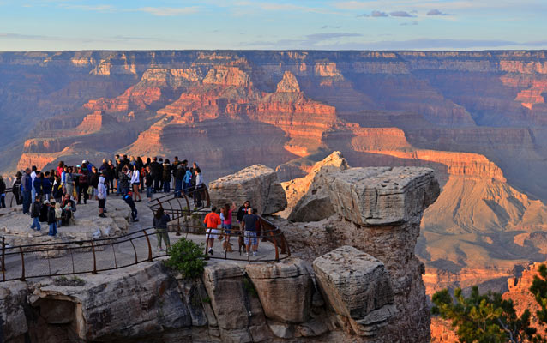
So why is it so different in different places?
ESSENTIAL QUESTION
UNIT 5 WEATHER

Slide 10
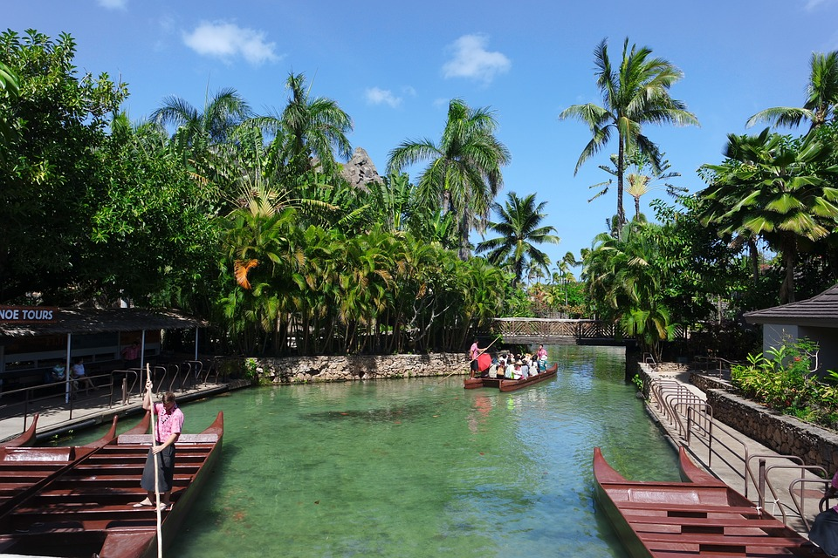
Climate!
ESSENTIAL QUESTION
UNIT 5 WEATHER

Slide 11
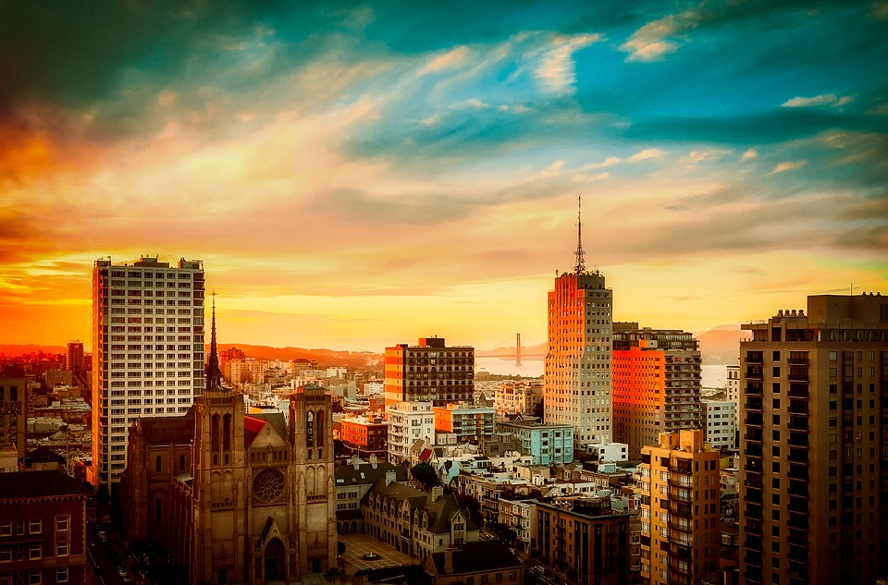
So what is Climate?
ESSENTIAL QUESTION
UNIT 5 WEATHER

Slide 12
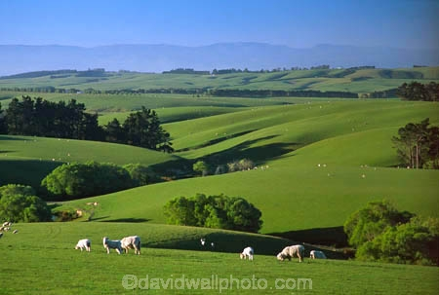
Climate is the general weather pattern in an area over a long period of time.
ESSENTIAL QUESTION
UNIT 5 WEATHER

Slide 13
This winter it snowed in Southern Georgia.
ESSENTIAL QUESTION
Georgia
UNIT 5 WEATHER

Slide 14
Does that mean we should expect snow in Georgia every winter?
ESSENTIAL QUESTION
Georgia
UNIT 5 WEATHER

Slide 15
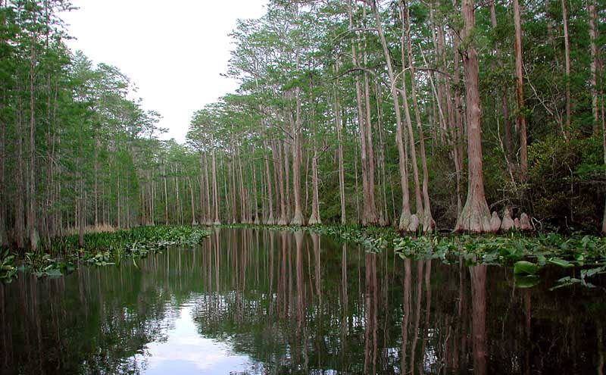
No!
That would be silly.
The climate in Georgia is usually warm.
ESSENTIAL QUESTION
UNIT 5 WEATHER

Slide 16
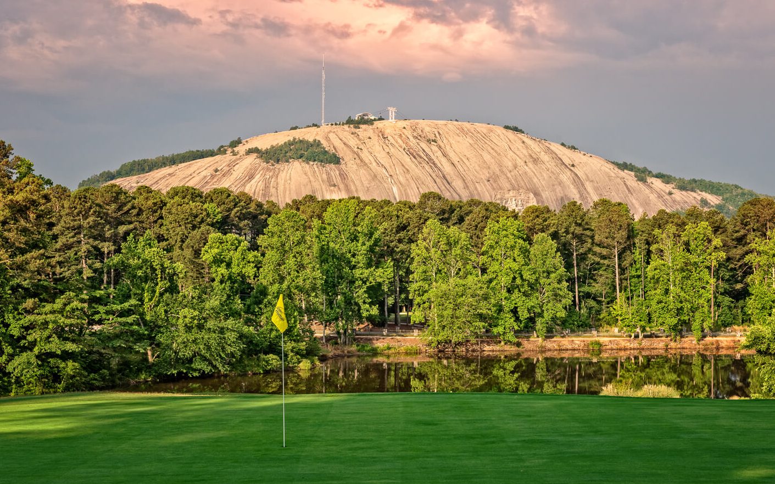
So why is the climate different in different places?
ESSENTIAL QUESTION
UNIT 5 WEATHER

Slide 17
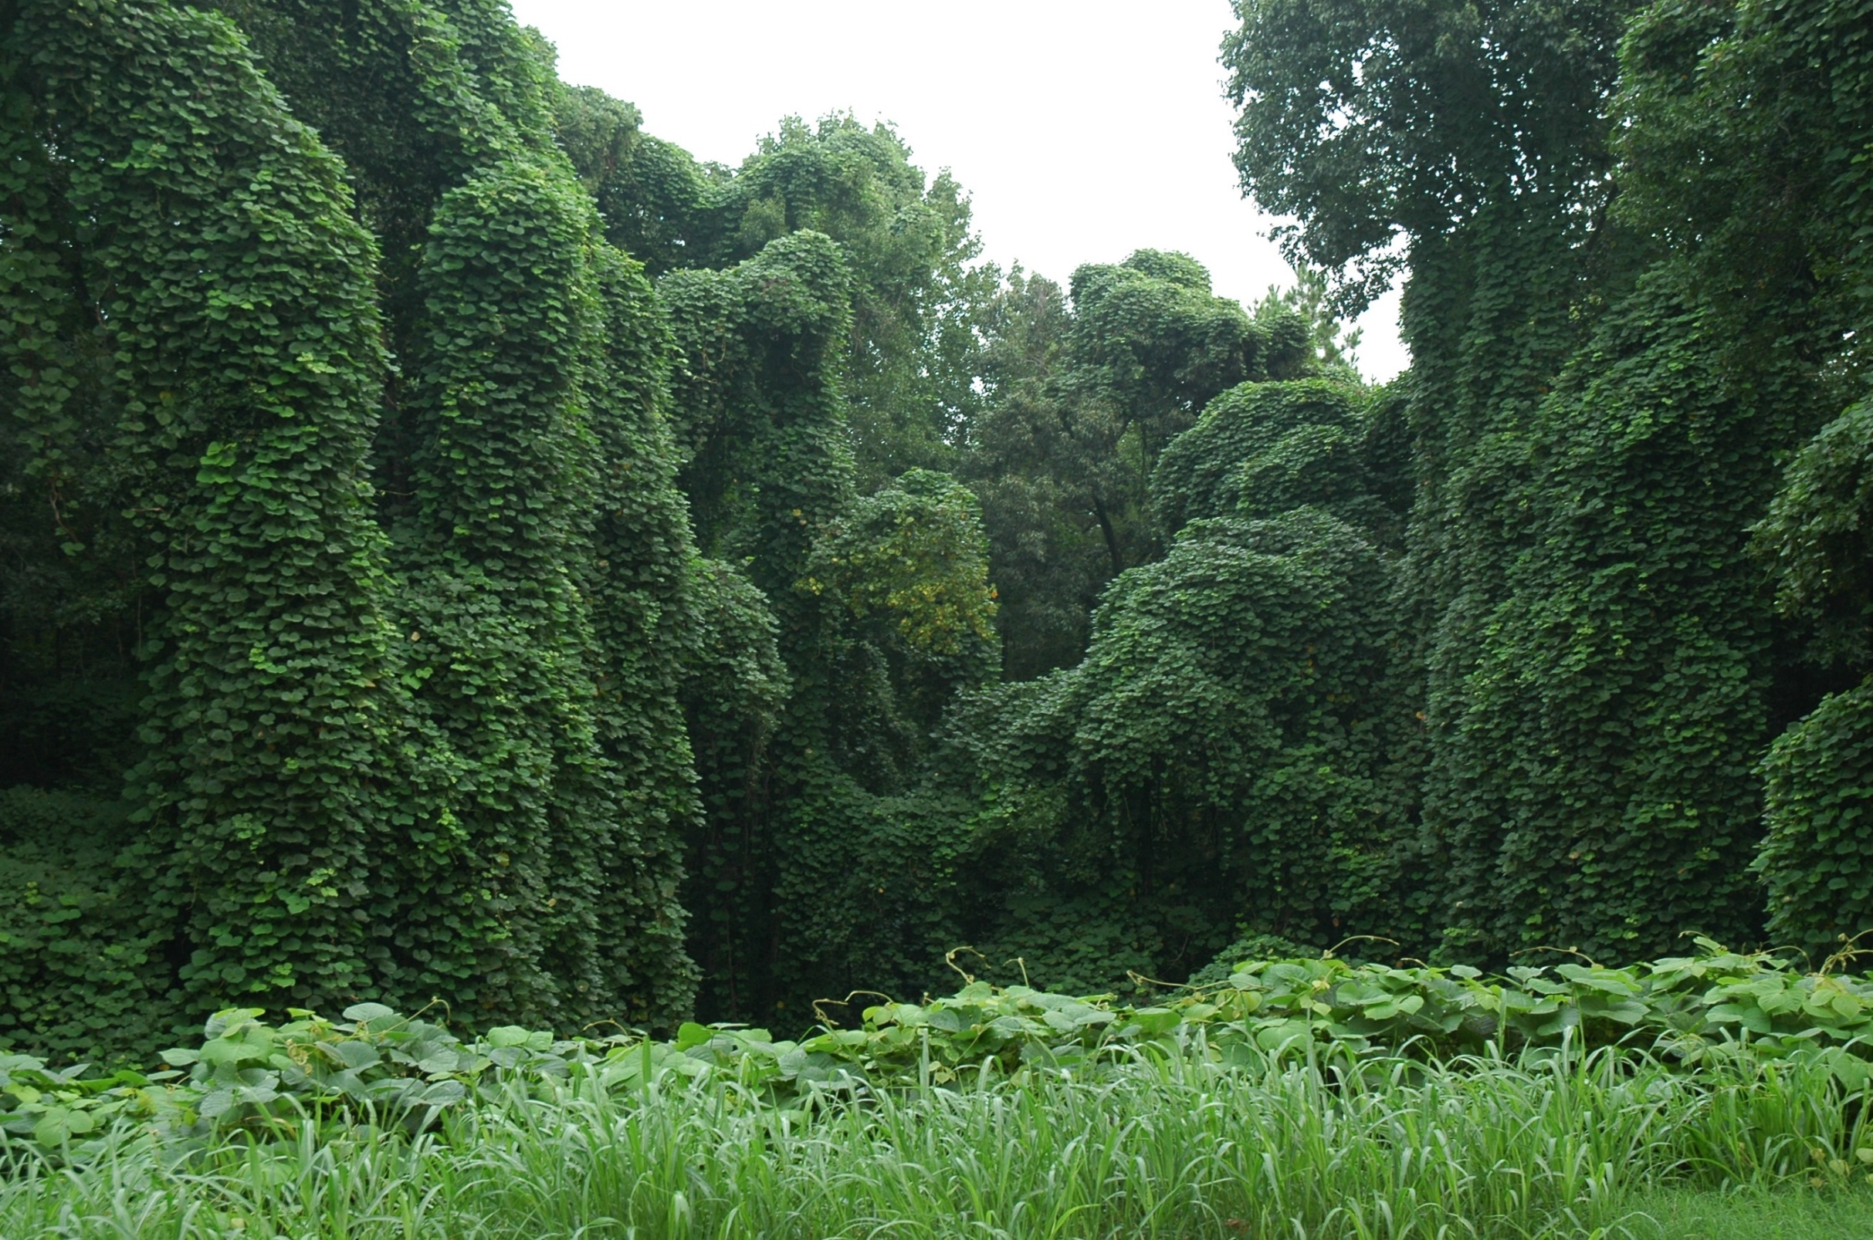
Read pages 132 -133
As a group
UNIT 5 WEATHER

Slide 18
90˚ N
North Pole
Latitude lines go around the Earth
parallel to the equator.
60˚ N
60˚ N
45˚ N
45˚ N
1 Latitude how close is it to the equator or the North or South Poles?
Elevation is it on a mountain? At sea level?
3 Water if it is close to an ocean or a large lake the water evens the temperature out.
3 Main Reasons for Climate
30˚ N
30˚ N
15˚ N
15˚ N
Equator
Equator
15˚ S
15˚ S
30˚ S
30˚ S
45˚ S
45˚ S
60˚ S
60˚ S
UNIT 5 WEATHER
90˚ S
South Pole

Slide 19
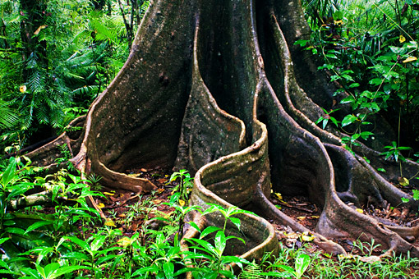
Latitude how close is it to the equator or the North or South Poles?
The closer a place is to the equator the warmer it is.
3 Main Reasons for Climate
UNIT 5 WEATHER

Slide 20
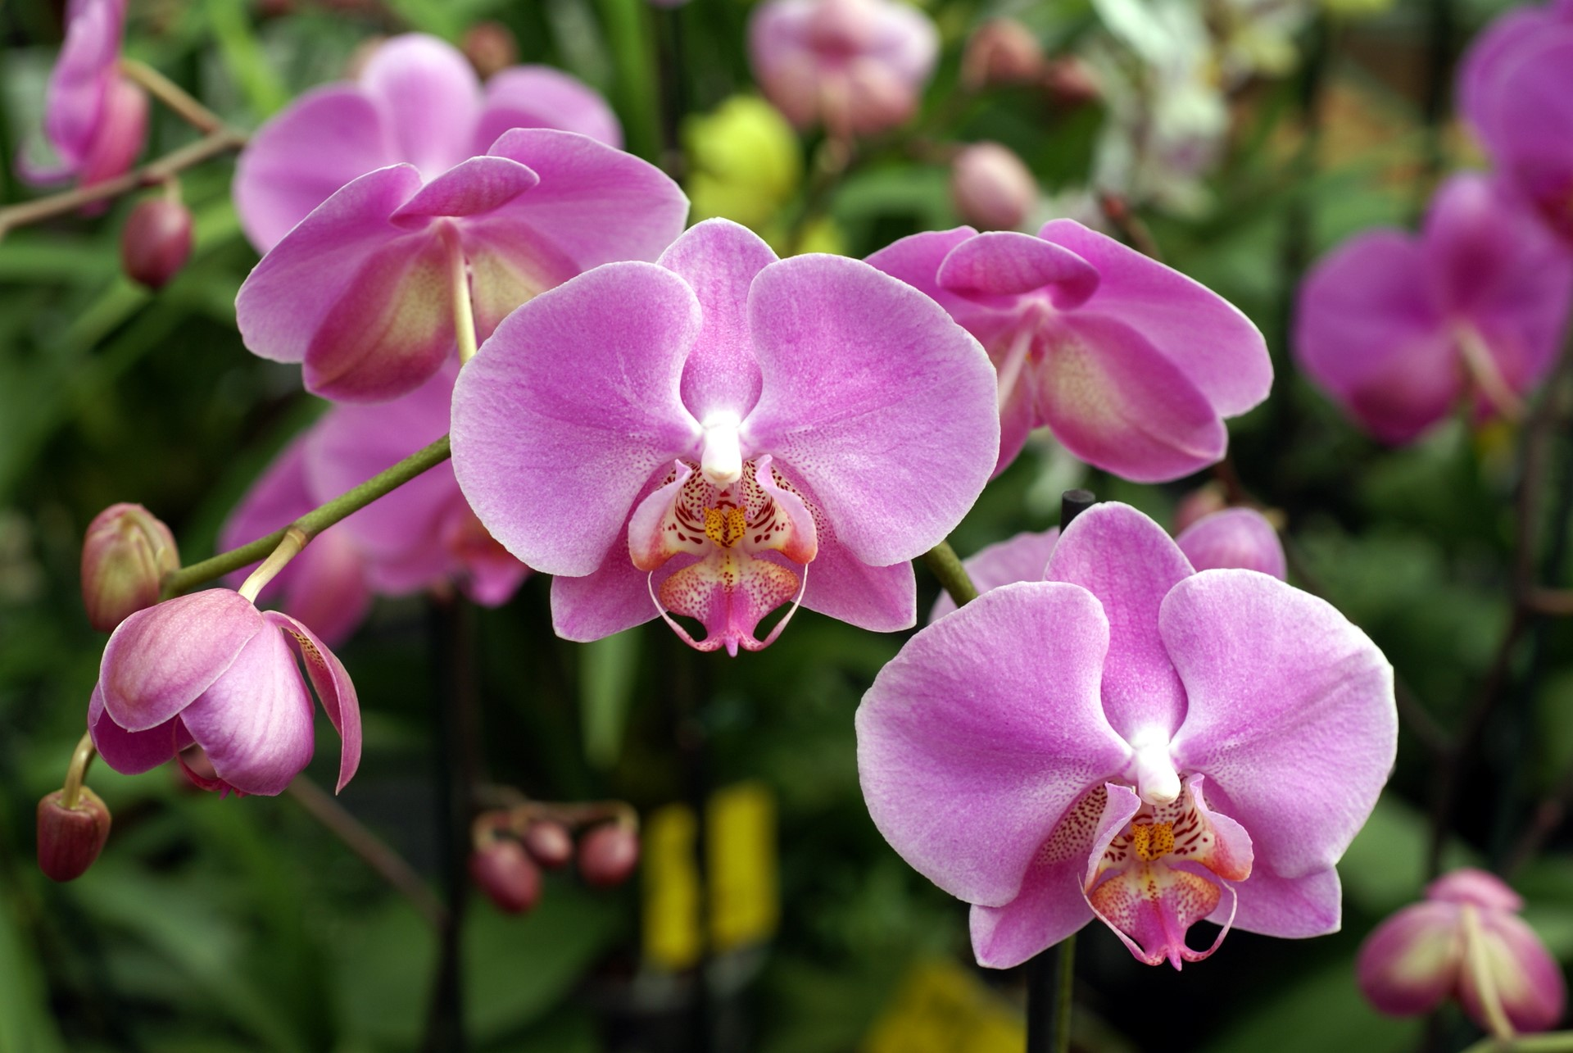
Elevation is it on a mountain? At sea level?
As you go up a mountain the temperature goes down. So if you are at sea level (like at the beach) it will be warmer than if you are at the top of a mountain.
3 Main Reasons for Climate
UNIT 5 WEATHER

Slide 21
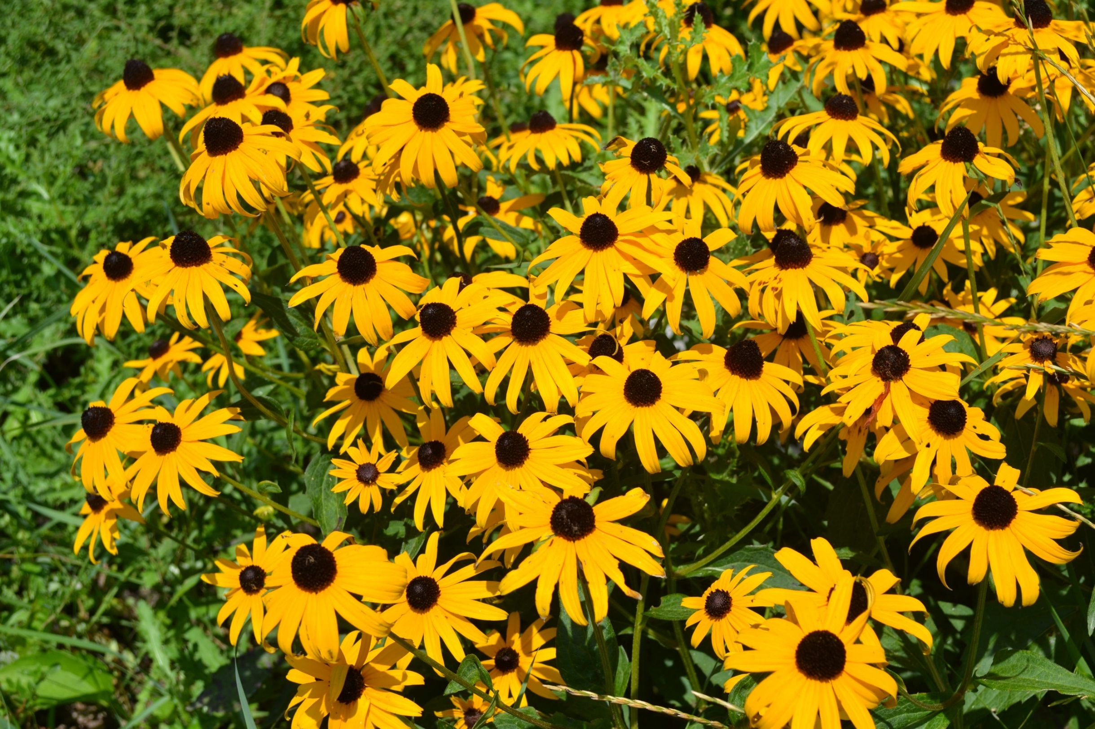
Water if it is close to an ocean or a large lake the water evens the temperature out.
Washington State is as far north as Maine – but it never gets as cold as Maine because the Pacific Ocean keeps the weather warmer. This happens when a large body of water is to your west, so England is way warmer than Northern Canada.
3 Main Reasons for Climate
UNIT 5 WEATHER

Slide 22
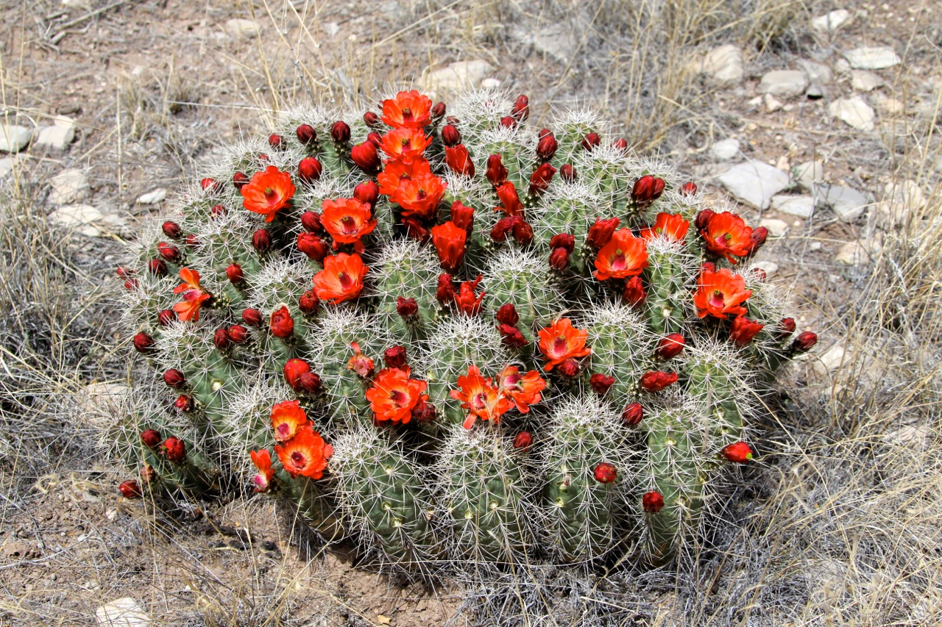
Look back at pages 132 -133
In order to answer the questions on the next two pages.
As a group
UNIT 5 WEATHER

Slide 23
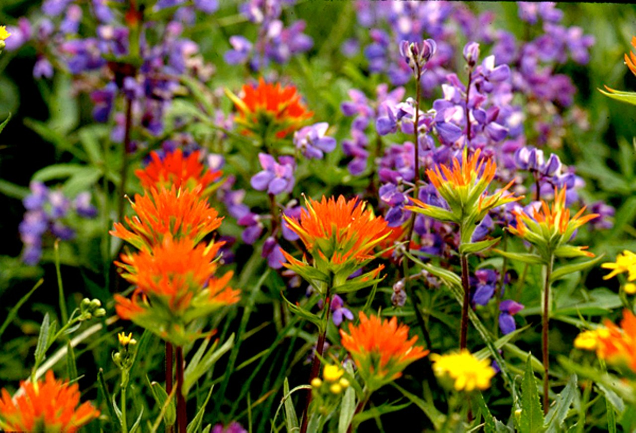
How does the climate in Yuma, Arizona compare to the climate in Portland Oregon?
Why do you think they are so different?
As a group
UNIT 5 WEATHER

Slide 24
How does the climate in Syracuse New York compare to the climate in St. Petersburg, Florida?
Why do you think they are so different?
As a group
UNIT 5 WEATHER

Slide 25
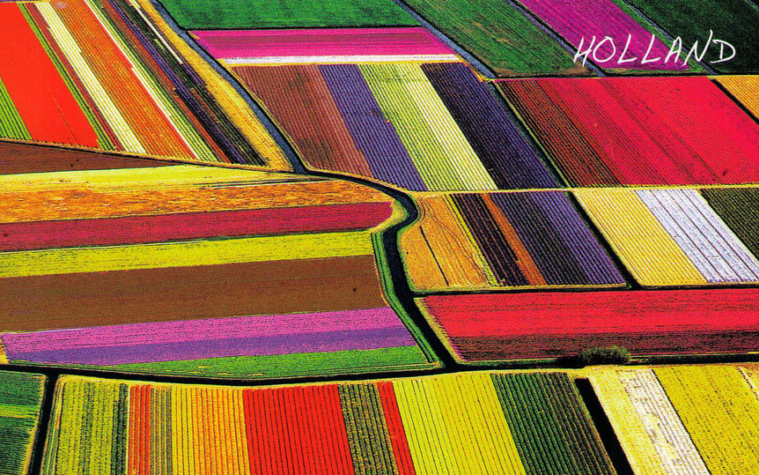
Use the worldwide climate map on the next page.
Can you find a country in Europe
that has similar weather to South Carolina?
As a group
By the way – all of these pictures of flowers are from places that we have talked about. This one, however, is just cool. It is a photograph of tulip fields in Holland (which is in the Netherlands and is above and to the left of Germany)
UNIT 5 WEATHER

Slide 26
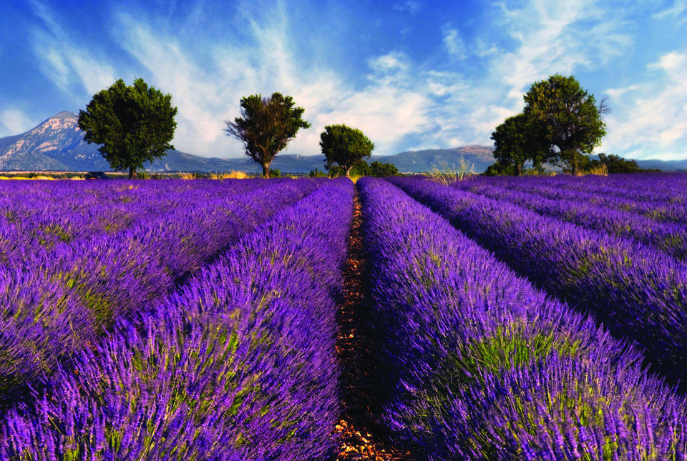
Use the worldwide climate map on the next page.
Can you find a country in Europe with a climate similar to California?
As a group
These are French violets – they are grown for their color and they smell great!
UNIT 5 WEATHER

Slide 27
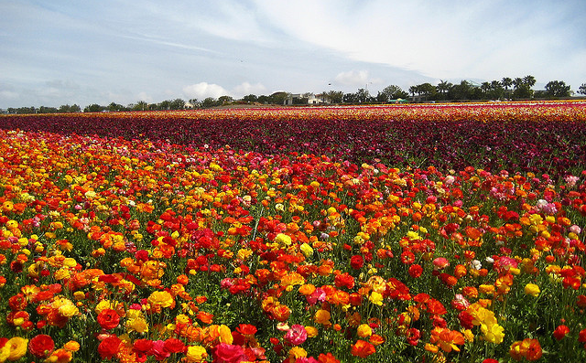
Use the worldwide climate map on the next page.
Sweden is very far north of Maine, but they have a very similar climate.
How could you explain that??
As a group
Flower fields in Carlsbad California. These are grown for sale and tourists!
UNIT 5 WEATHER

Slide 28
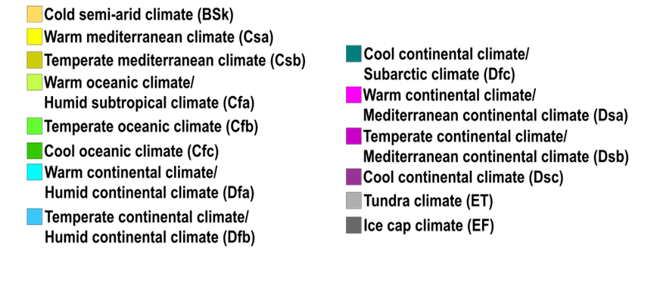
Iceland
Norway
Sweden
55° N
Ireland
England
Poland
Germany
France
45° N
Maine
Italy
Portugal
Spain
NJ
35° N
Greece
California
South Carolina

