Slide 1
Cells, Heredity
& Classification
Chapter 4 notes

Slide 2
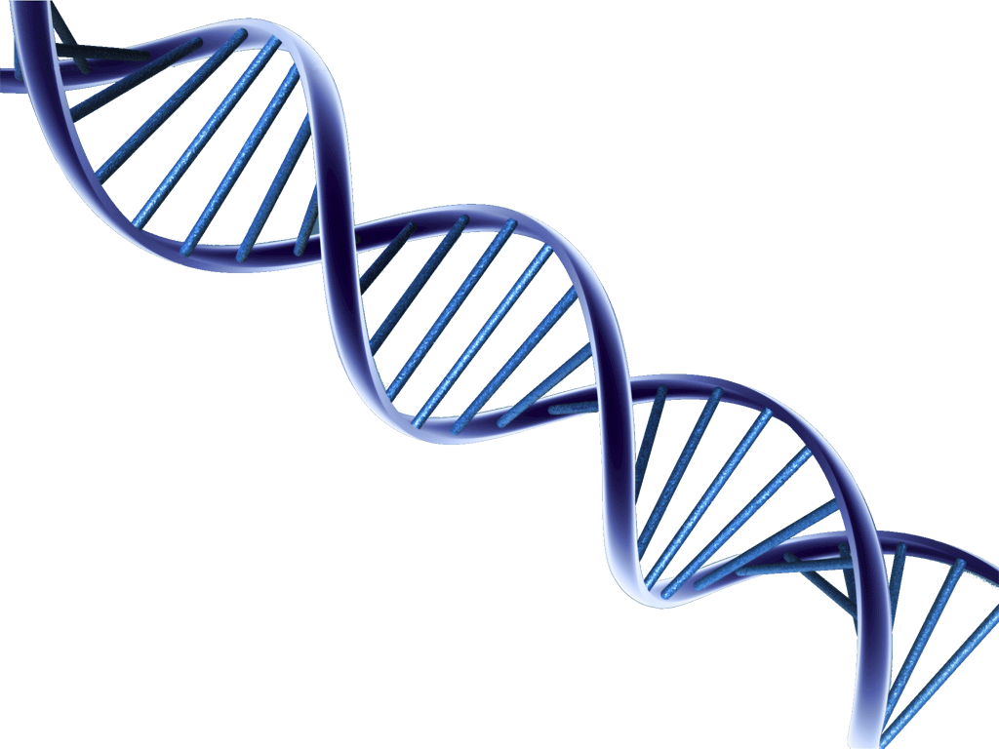
Section 1:
What Does DNA Look Like?

Slide 3
What is DNA?
(Deoxyribonucleic Acid)
    Carries the instructions for inherited traits
    Carry genes - a string of nucleotides that carry the information for inherited traits

Slide 4
    What is DNA made of?
    Made up of smaller units called nucleotides
        Three parts - sugar, phosphate and a base
        Four different bases - adenine, cytosine, guanine, thymine
        Referred to by their first letter

Slide 5
        What does DNA look like?
    DNA is a twisted ladder
        Sides are made of sugar and phosphate
        The rungs (part of the ladder you put your feet on) are made of bases

Slide 6
Scientist who discovered DNA’s shape
    Erwin Chargaff (Chargaff’s Rules) -
        The amount of adenine always equals the amount of thymine
        The amount of cytosine always equals the amount of guanine

Slide 7
Rosalind Franklin
    Took x-rays of DNA
        Found that DNA has a spiral shape
        Did not get credit for her findings while she was still alive – because she was a woman

Slide 8
James Watson & Francis Crick
    Made a model of DNA
    Model looked like a twisted ladder
    Won the Nobel Prize for science!

Slide 9
Adenine always pairs with (or is complimentary) to thymine
Adenine
Thymine

Slide 10
Cytosine always pairs with (or is complimentary) to guanine
Guanine
Cytosine

Slide 11
How Does DNA Copy Itself?
    Paired bases allow the cell to replicate, or make copies, of DNA
    DNA splits down the middle and the old bases are used as a template, or guide, for the new bases.
    DNA is copied every time the cell divides

