Slide 1
Which succession begins with bare rock?
PRIMARY SUCCESSION

Slide 2
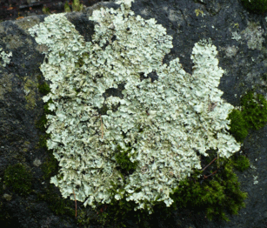
What is the pioneer species in primary succession?
LICHEN

Slide 3
Lichen produces acid that breaks the rock down.
When it dies it leaves behind a little bit of dirt and a little bit of broken rock that looks like sand.

Slide 4
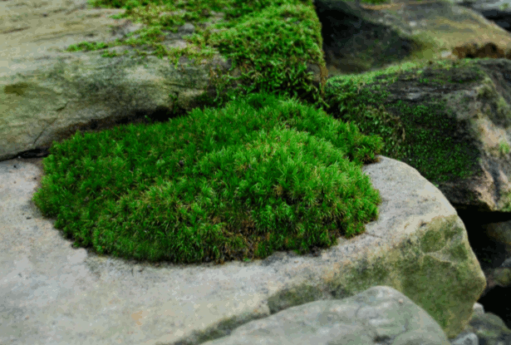
After the lichen have lived for many generations,
moss moves
in and begins
to grow.

Slide 5
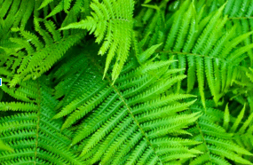
Finally ferns and
other, larger
plants move in
and eventually
the area
becomes a
forest.

Slide 6
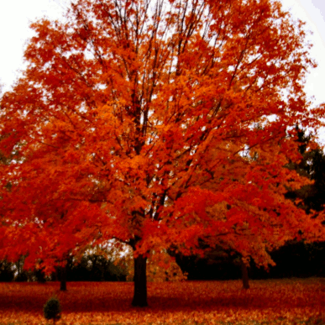
The Climax Species in primary succession are Oak and
Maple Trees

Slide 7
Lichen Moss Ferns Shrubs and finally Oak and Maple

Slide 8
What is the Pioneer Species in Primary Succession?
Lichen

Slide 9
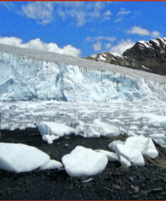
How do we end up with an area of bare rock?
Moving glaciers scrape all life and all dirt from the rock below.

Slide 10
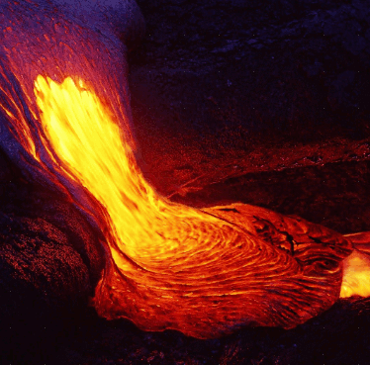
Volcanic magma covers an area and cools to bare rock

Slide 11
What are the climax species in primary succession?
OAK AND MAPLE TREES

Slide 12
Name two ways to end up with bare rock.
Glaciers and Volcanoes

Slide 13
What happens if an area gets destroyed, but there is still dirt?
That is called Secondary Succession - and life regrows quickly in secondary succession

Slide 14
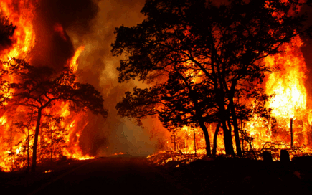
The area could be destroyed by many things...
FIRE
FLOOD
TSUNAMI
TORNADO
HURRICANE

Slide 15
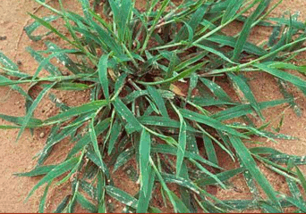
The pioneer
species in
secondary
succession
is usually
crabgrass

Slide 16
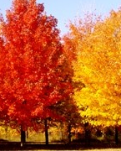
The climax
species in
secondary
succession is…
OAK OR MAPLE TREES (yup – the climax species for both primary and secondary succession is the same)

Slide 17
Compare and contrast Primary Succession with Secondary Succession
PRIMARY SUCCESSION | BOTH | SECONDARY SUCCESSION
Starts with bare rock | Replace one species with another species | Starts with soil
Pioneer Species - Lichen | Finish with Oak or Maple trees as the climax species | Pioneer Species – crabgrass
Takes a VERY long time |  | Shorter than Primary
After a glacier melts or a volcano erupts and leaves rock |  | After a farmer abandons his field or after a fire, tornado, hurricane, flood

Slide 18
Let’s review the cycles...
The three cycles we have looked at are the Water Cycle, the Nitrogen Cycle (or Nitrogen Fixation) and the Carbon Cycle.

Slide 19
We need water to...
Keep our blood liquid enough to deliver energy to our cells.

Slide 20
We need nitrogen to...
Build our DNA

Slide 21
Nitrogen is in the air all around us. What must happen before plants can use nitrogen?
Bacteria that grows on plant roots must “fix” the nitrogen
so that the plant can “drink” it in with water.

Slide 22
We need carbon to...
provide energy for our bodies - carbon is the main ingredient in the sugar molecules that give us energy

Slide 23
Explain the two ways that water is cleaned naturally.
Filtration – bad stuff gets stuck in the layers of soil and only pure water reaches the aquifers
Evaporation - Only H₂O molecules evaporate – any dirt or salt in the water is left behind.

Slide 24
How do animals get nitrogen?
Animals (consumers) eat the plant, or they eat another animal that has eaten the plant.

Slide 25
Can you tell me the “story” of the water cycle?
Water vapor evaporates from oceans and rises through the atmosphere. When it gets high enough and cold enough it condenses into water droplets (clouds). When the droplets get too heavy they fall to earth as precipitation. Precipitation either runs-off or filters through the ground into aquifers. Trees add water vapor to the air with transpiration - which is when plants “breathe”.

Slide 26
Can you tell me the “story” of the nitrogen cycle?
Plants live in air that is 78% Nitrogen, but they can’t get Nitrogen from air. Instead they use Nitrogen fixation. When a plant or animal dies and decomposes, all the minerals go into the dirt. Bacteria lives on the roots of plants and “fix” nitrogen it into a form that plants can “drink”. We get nitrogen by eating producers or consumers. We need Nitrogen to make DNA.

Slide 27
Can you tell me the “story” of the carbon cycle?
A little bit of carbon dioxide is in the air around us. Plants use it for photosynthesis - they mix carbon dioxide with water and add sunlight to make sugars and oxygen. Both plants and animals release carbon dioxide through respiration. When plants and animals die they either decompose - and release carbon dioxide into the air or they become fossil fuels and carbon is released into the air when we use them for combustion.

