Slide 1
Where Would You Find These Plants & Why?
Look at the pictures and name the biome where you would find these plants. Why do you think they would be found in that biome?

Slide 2
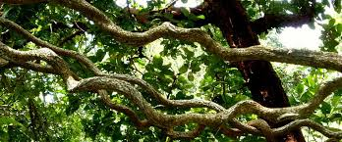
Which Biome & Why?

Slide 3
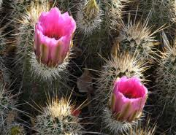
Which Biome & Why?

Slide 4
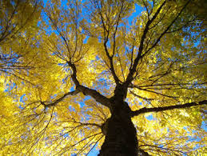
Which Biome & Why?

Slide 5
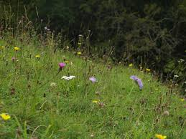
Which Biome & Why?

Slide 6
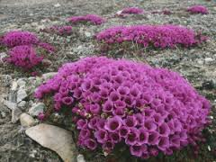
Which Biome & Why?

Slide 7
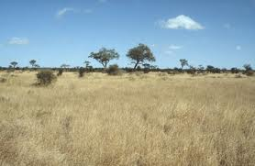
Which Biome & Why?
Savanna – Tall grasses with clumps of trees

Slide 8
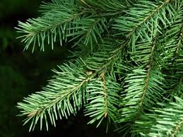
Which Biome & Why?
Coniferous Forest

Slide 9
Which Zone & Why?
Neritic Zone – near the edge of the ocean

Slide 10
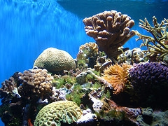
Which Zone & Why?
Neritic Zone – near the edge of the ocean

Slide 11
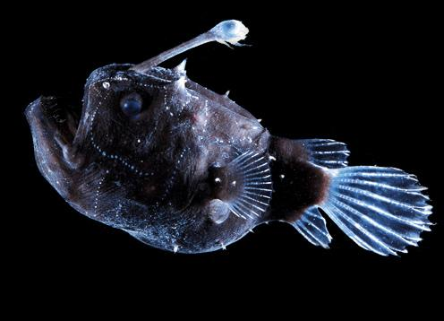
Which Zone & Why?
Benthic Zone – there is no light in the water

Slide 12
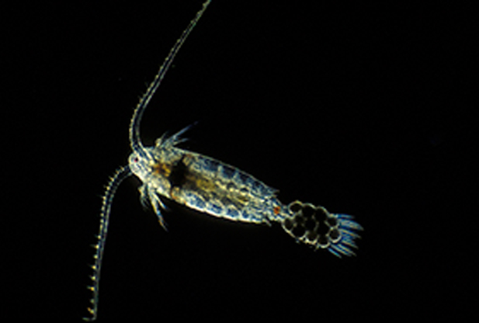
Which Zone & Why?
Oceanic Zone – Plankton are near the surface

Slide 13
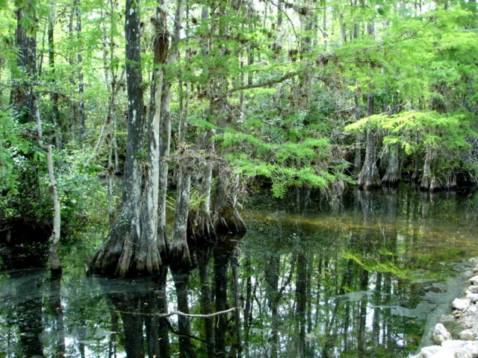
Swamp or Marsh?
Swamp – there are trees!

Slide 14
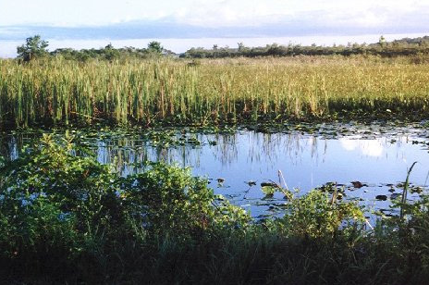
Swamp or Marsh?
Marsh – No Trees

