Slide 1
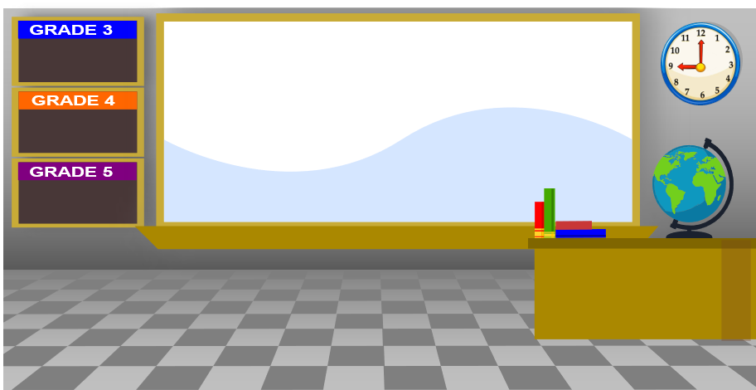
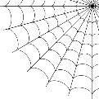
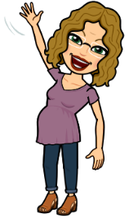
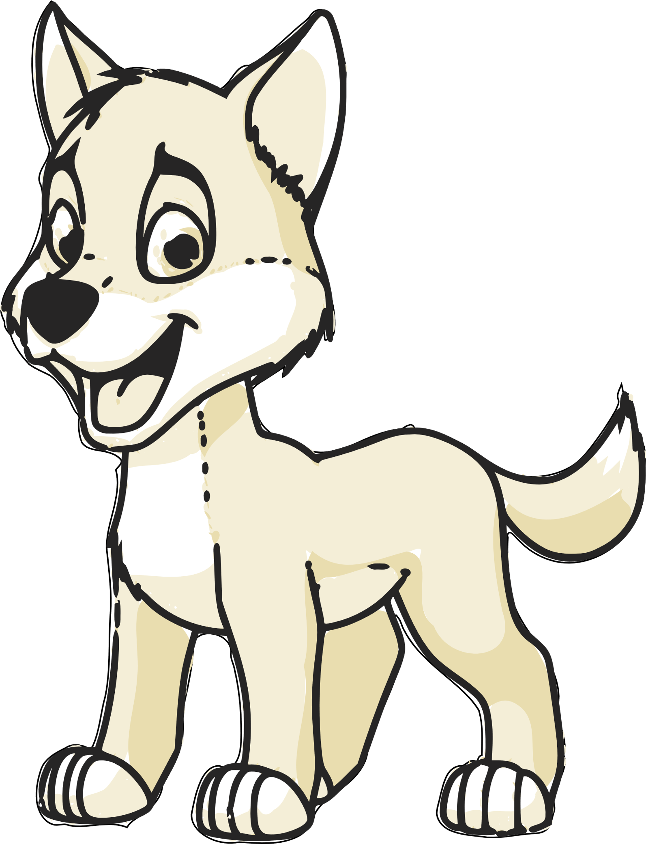
This is our virtual classroom!
I am going to add some of my favorite things to this classroom!
Can you figure out what some of my favorite things are?
Multiplication!
Decimals!
Get ready for Middle School
My Bitmoji is younger than I am!
I like it that way!!!
I am Leo!
Bark!
Your job is going to be to look at pages 3, 4 and 5 of this PowerPoint and choose some of your favorite things to add to your empty classroom. Then I also want a list of 5 additional things that you like!

Slide 2
This is the last thing
That I want you to do.
After you looked at the
next three pages of this
PowerPoint, then I want you
to write a list of at least 5
other things that you like.
When you are finished playing with this document, save it and email it to me at lcronin@wtps.org!
And, definitely delete these words – they get in the way!

Slide 3
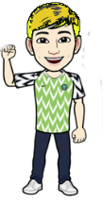
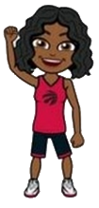
Choose a Bitmoji
(or make your own if you know how!)
Right click to copy it then go back to our empty classroom and right click to paste it in!

Slide 4
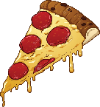
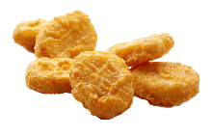
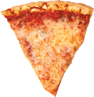
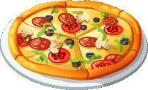
Choose your favorite junk food

Slide 5
Choose your favorite sport or activity

